Slide 1
Internet and Social Media in Agriculture

Slide 2
Shift happen link
http://www.youtube.com/watch?v=jp_oyHY5bug&feature=related

Slide 3
???????????????????????
What role does the internet play in Agriculture
What role does Social Media play in Agriculture

Slide 4
Precision Ag
Who is the Client?
Data and Information.
Immediate.
Period

Slide 5
Information/ Mis-Information

Slide 6
Chat/Blogs
Who is policing Blogs and Chat Rooms??
Do they need policing?
Blogs can lead to innovation and failure.

Slide 7
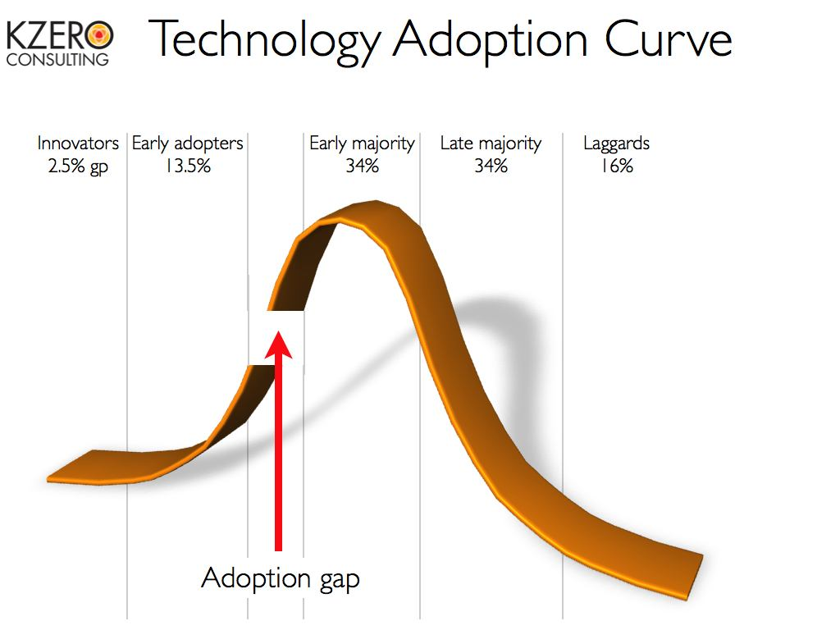
Chat / Blogs
Innovators
What % read Blogs?

Slide 8
Facebook / Google +

Slide 9
Facebook / Google +
Linkage. Social Media is/can be linked

Slide 10
Twitter
First thought people Tweet everything.
Don’t follow those people!!!
Immediate News and Info.

Slide 11
Twitter
10% of Facebook users have Twitter
Specifically Young, Tech Savoy, Educated individuals.

Slide 12
Twitter
Extension Specialist and Agronomist from across the Nation are going to twitter.
What impact could this have?
Ag publishers and Research groups posting old articles and research. Relevant to the current situation.
Universities posting research and meetings.

Slide 13
YouTube

Slide 14
How to Videos and Testimonials

Slide 15
As a Industry Professional
Brand Yourself
Give a Face to the Product.
Give relevant info.
Lots of Pictures
Not what you ate for lunch.

