Slide 1
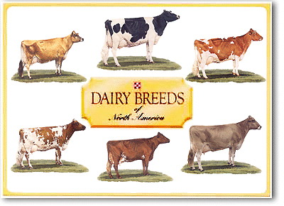
THE DAIRY CATTLE INDUSTRY
Camron Nisly

Slide 2
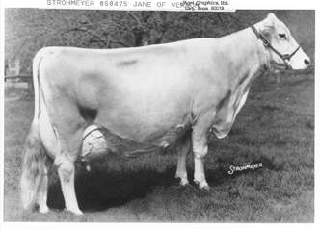
Improving Genetics
Careful breeding to increase yield
Use A. I. to match correct bull with cows to enhance:
Udder, Feet, Calving, Temperament

Slide 3
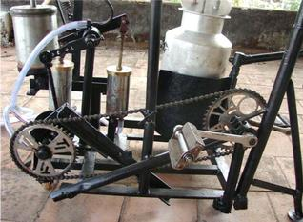
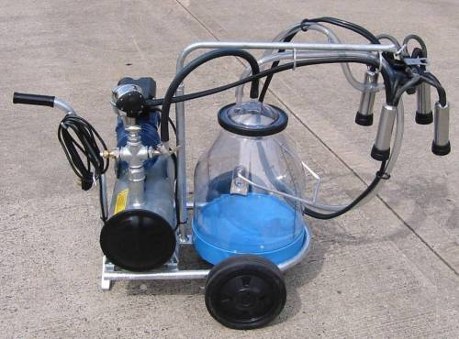
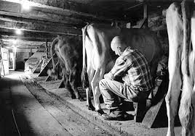
ADVANCES IN MILKING DEVICES AND EQUIPMENT

Slide 4
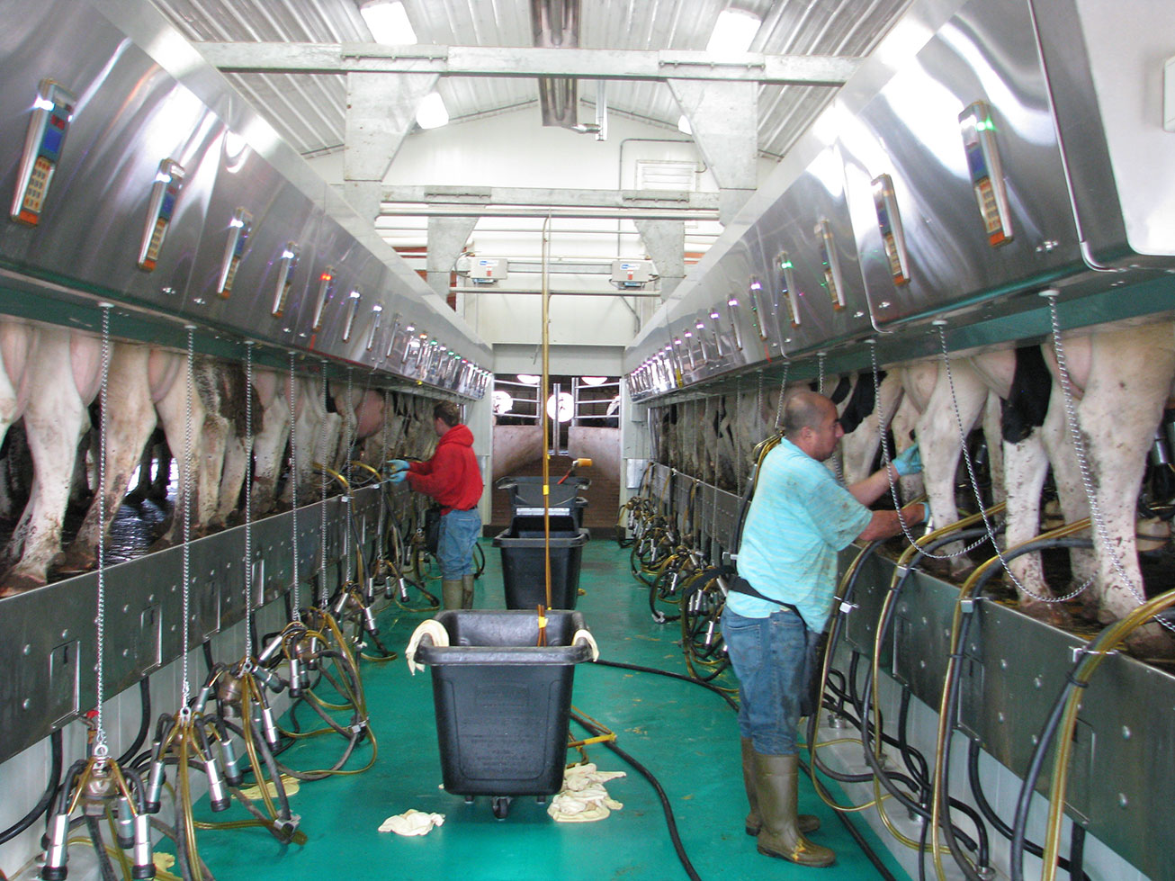
Herringbone Design
Cows enter on one end and stand in a staggered line
Floor is lower for ease
Automatic take off

Slide 5
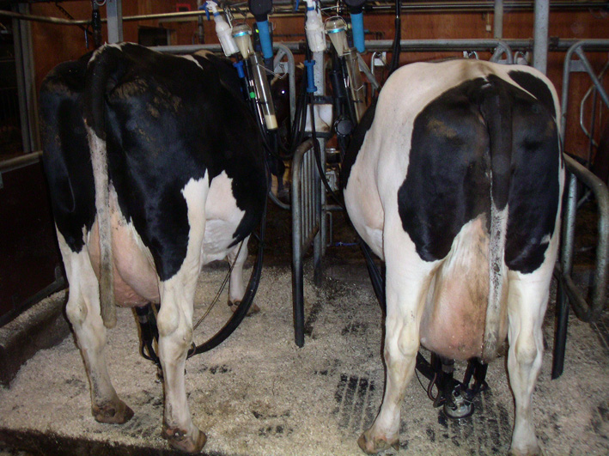
Tie Stall Barn
Cows are tied in stall for the majority of the day
Labor Intensive

Slide 6
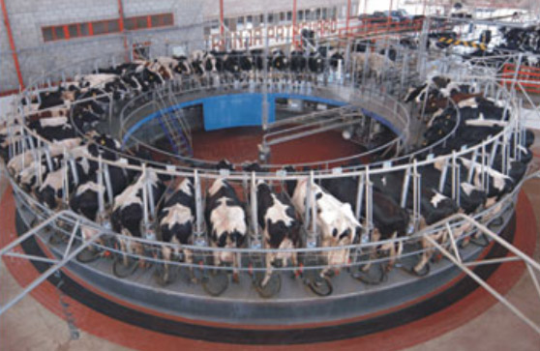
Carousel Milk Parlor
Mostly used with very large dairies

Slide 7
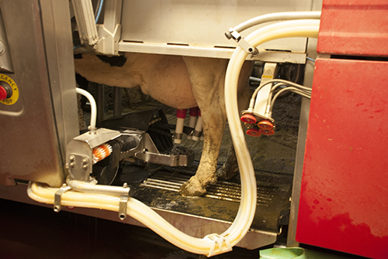
ROBOTIC MILKING MACHINE

Slide 8
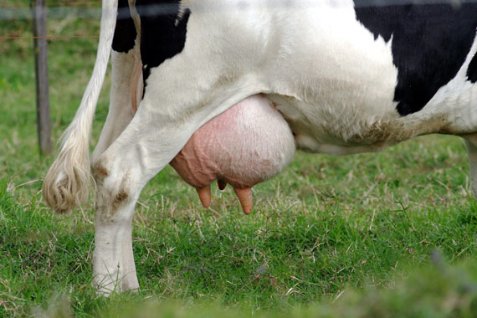
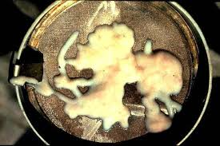
MASTITIS

Slide 9
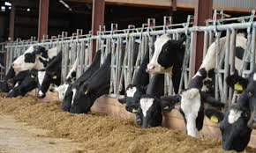
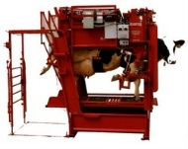
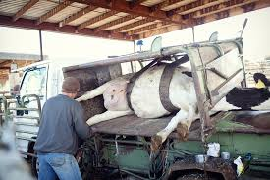
Headlocks
2 Common types of hoof trimmers

Slide 10
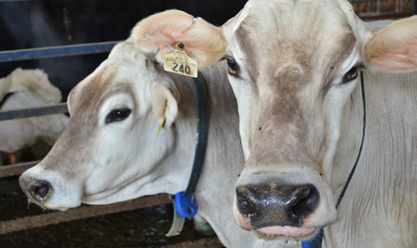
Transponders to regulate feeding at computerized feeders

Slide 11
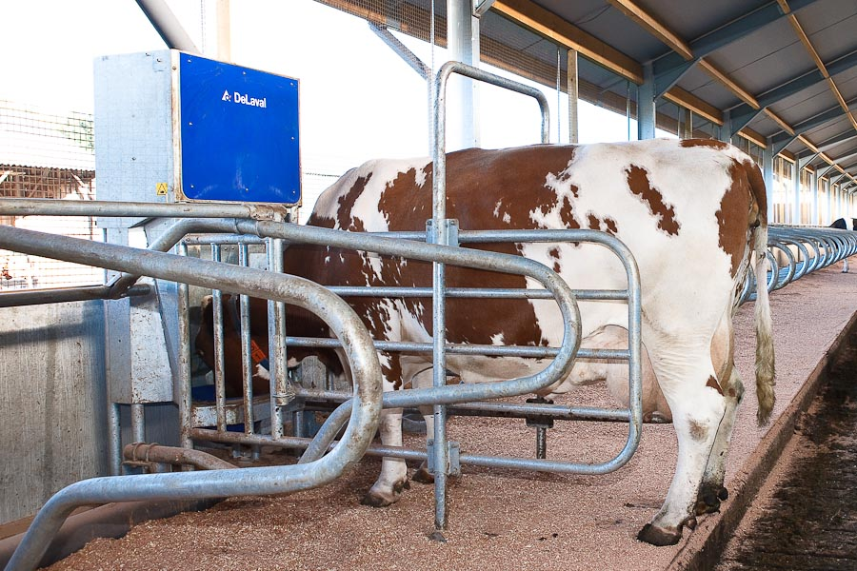

Slide 12
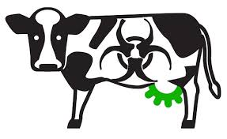
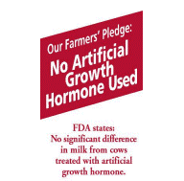
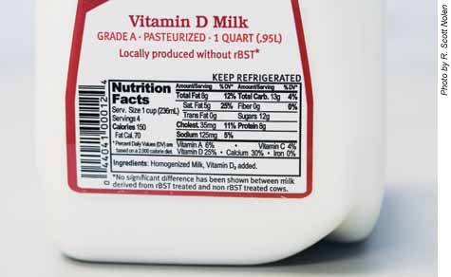

Slide 14
ORGANIC MILK COMES FROM HAPPY COWS

Slide 15
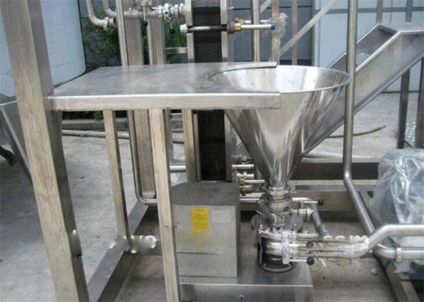
SMALL SCALE CHEESE AND YOGURT PRODUCTION

Slide 16
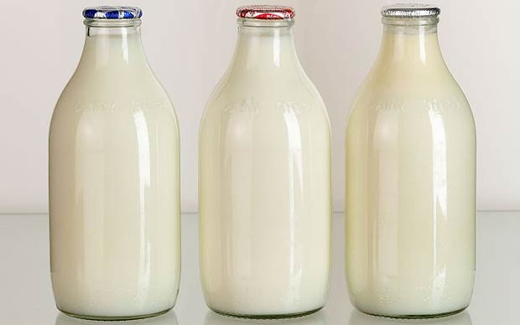
HOME BOTTLING OF CREAM AND MILK

