Slide 1
Using Yield Data to Make Decisions

Slide 2
Reasons for Collecting Yield Data
Document yields
Conduct field experiments
Bottom-line Considerations
Variable Rate Management

Slide 3
Documenting Yield
Yield Levels
Identify good and bad areas
Use agronomics to determine reasons
Yield Stability
Post Harvest Analysis, Adaptive management i.e., analyze experiments

Slide 4
Why?
The goal for properly interpreting yield data is to provide answers to the question; "how can I increase profits on this field?"
However, colorful maps are not knowledge. If these maps are to be of any real value, data generated from them must be incorporated into the decision-making, analysis, and overall planning process of the farm operation
A yield map is of value only when it leads to a management decision or validates management practices.

Slide 5
Yield
What drives yield?
A great deal of research to identify what factor best correlates with yield on a given year.
What drives good and bad yield is often not the same.
Depth to limiting layer: redox, pan, caleche
Soil pH
Texture?

Slide 6
Pattern Description/Explanation
Producer Management Practices Straight Line Patterns
Direction of Application | Against Direction of Application
change in planting date change in hybrid/variety change in chemical application selected rescue treatment chemical skips and misapplications equipment errors poor straw/chaff distribution compaction | drain tile patterns historically different fields old traffic patterns manure applications pipelines/phone lines underground irrigation applications previous compaction
Naturally Occurring Variables Irregular Patterns
Irregular Line | Irregular Area/Patch
topography changes herbicide drift border shading effects insect infestation from bordering lands improper manure applications Waterways | change in soil type drainage patterns weed infestations soil fertility changes previous crop activity disease infestations herbicide carryover historic occurrences insect infestations changes in organic matter animal damage wet areas

Slide 8
Research

Slide 9
Research

Slide 10
Identifying Yield Potential and Yield Stability
What can you do with it?
Identify soil properties….
Variable rate seeding and variable rate N for starters

Slide 11
N rate based on Yield
Year | Zone 1 | Zone 2 | Zone 3
2007 | 120 | 225 | 180
2008 | 140 | 230 | 200
2009 | 130 | 270 | 180
2010 | 150 | 265 | 210
2011 | 90 | 200 | 150
Average | 126 | 238 | 184
Zone 4 | Zone 5
120 | 180
150 | 100
50 | 175
200 | 0
25 | 150
109 | 121
Can you think of a variable, yield characteristic, that could help.

Slide 12
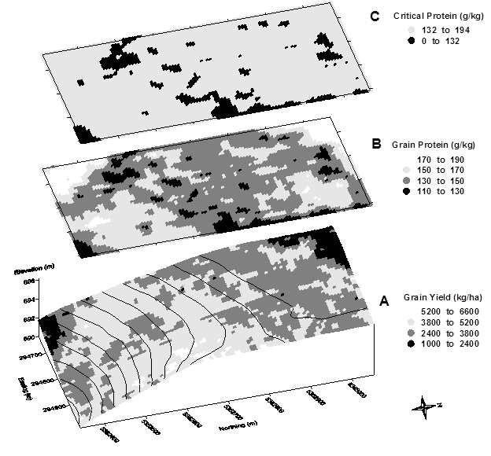
Protein and Yield
Protein measured on the go with NIR
Water stress in corners
FIGURE 19.3. Map of grain yield (A), map of grain protein concentration (B), and map of critically low protein indicating areas where nitrogen could be deficient for yield (C).

Slide 13
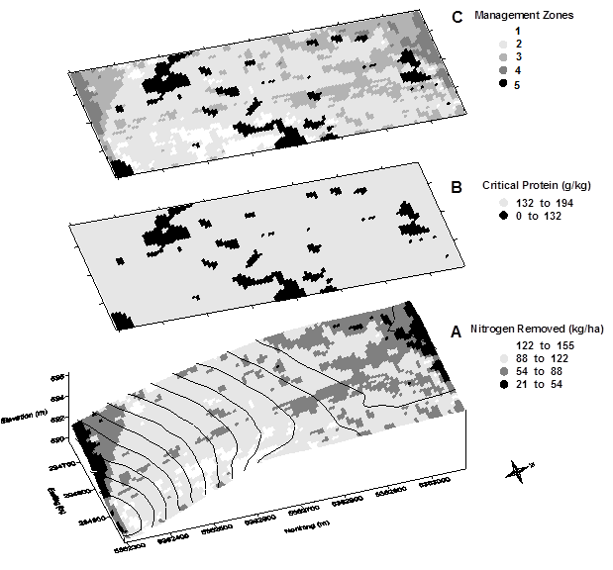
FIGURE 19.5. Maps of nitrogen removed (A), nitrogen deficit (B), and N required (C). The map of N required can be exported from Surfer as an ESRI Shape File for input to a task controller for variable rate application.

Slide 14
Yield Stability
Methods
Created 90’ by 90’ grids and averaged the yield data points within the cell for each year.
Calculated normalized yield for each cell for each year.
Normalized yield = Cell average/entire field average
For example in Field 3 in 2006 the lightest color red cells were less than 90% of the field average.
Then averaged the cells for every year I had yield data to determine a yield stability and classified each cells as:
Low (<90% of field average)
Average-low (90-95% of field average)
Average (95-105% of field average)
Average-high (105-110% of field average)
High (>110% of field average)
Depending on the stability classification I then assigned a seeding rate for example on Field 3 I assigned seeding rate as follows:
Low -27,000
Avg-low – 30,000
Avg – 32,000
Avg-high – 33,000
High – 34,000
Some fields were very consistent so the entire field got 32,000 with the exception of a few cells where populations check strips got placed.

Slide 15
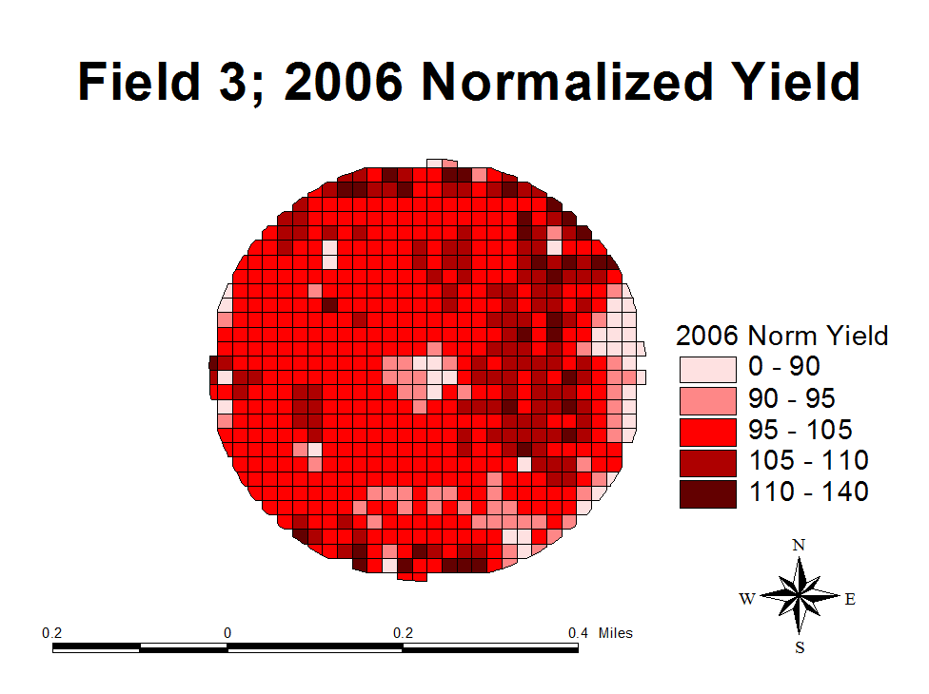

Slide 16
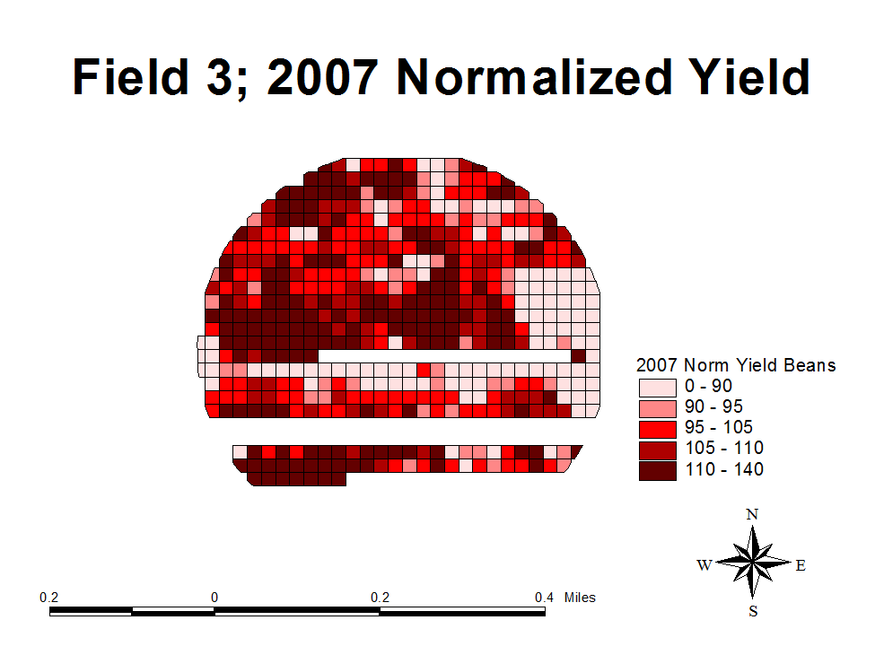

Slide 17
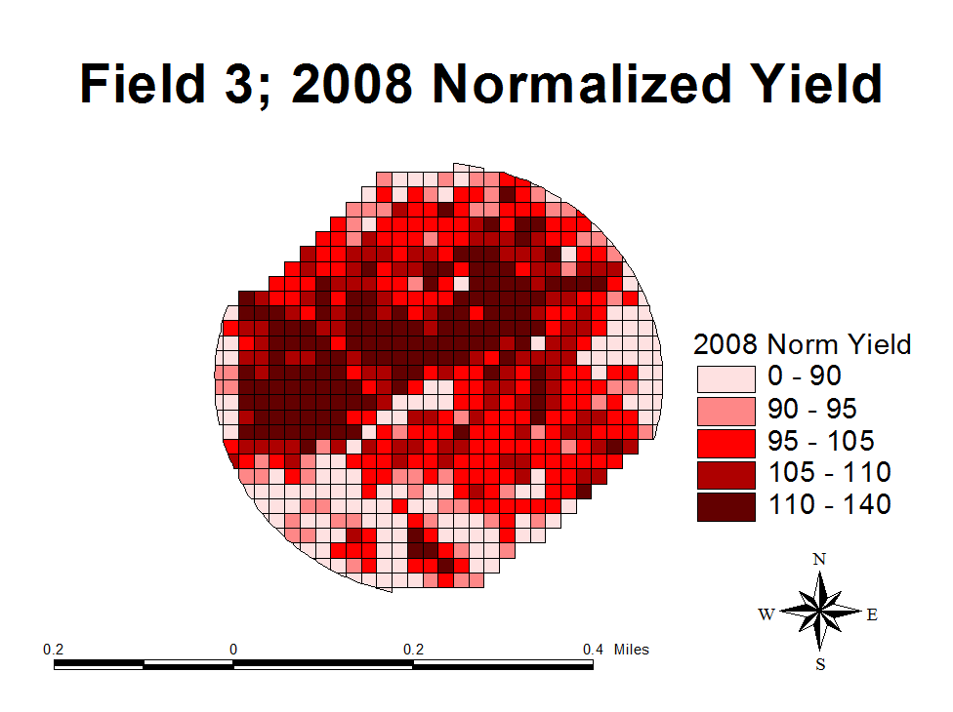

Slide 18
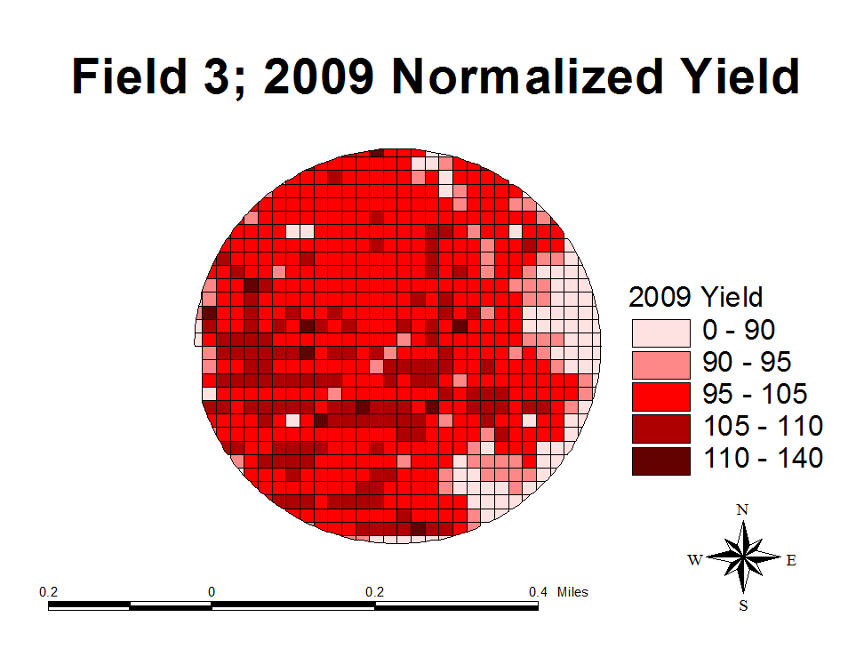

Slide 19
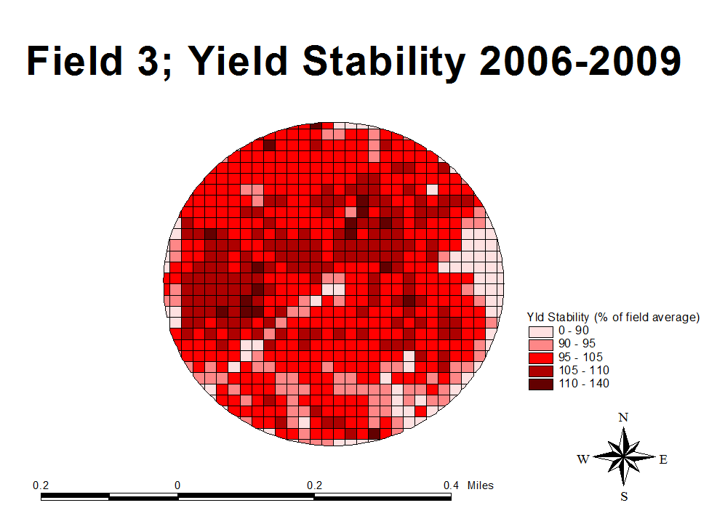

Slide 20
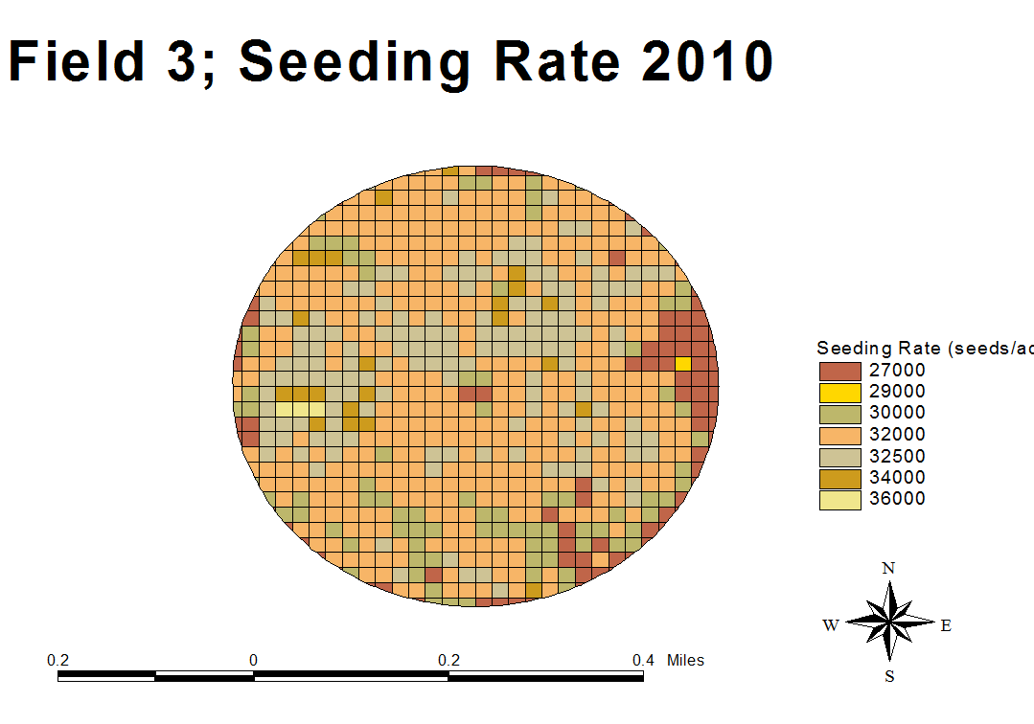
Population Strips. These will be evaluated with yield monitor.

