Slide 1
Variable Rate Nitrogen
Brian Arnall
Oklahoma State University
Precision Nutrient Management

Slide 2
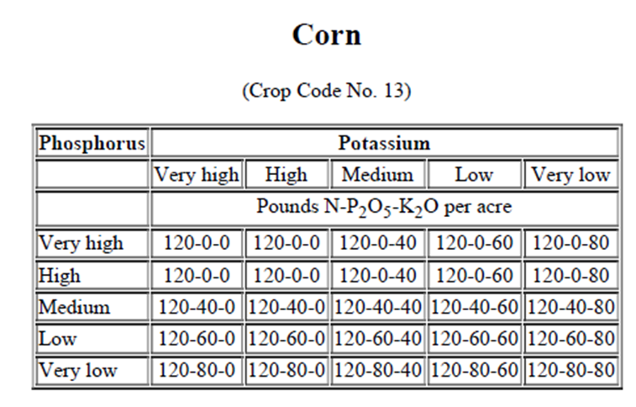
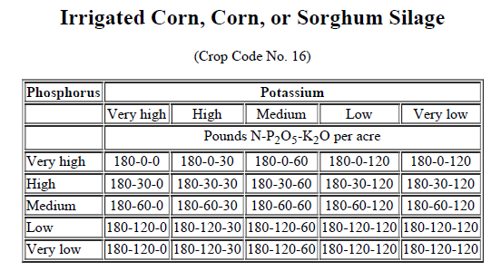
The Why
If yield potential is greater than 120 bushels per acre, apply up to 1.25 pounds of nitrogen per bushel of anticipated yield.

Slide 3
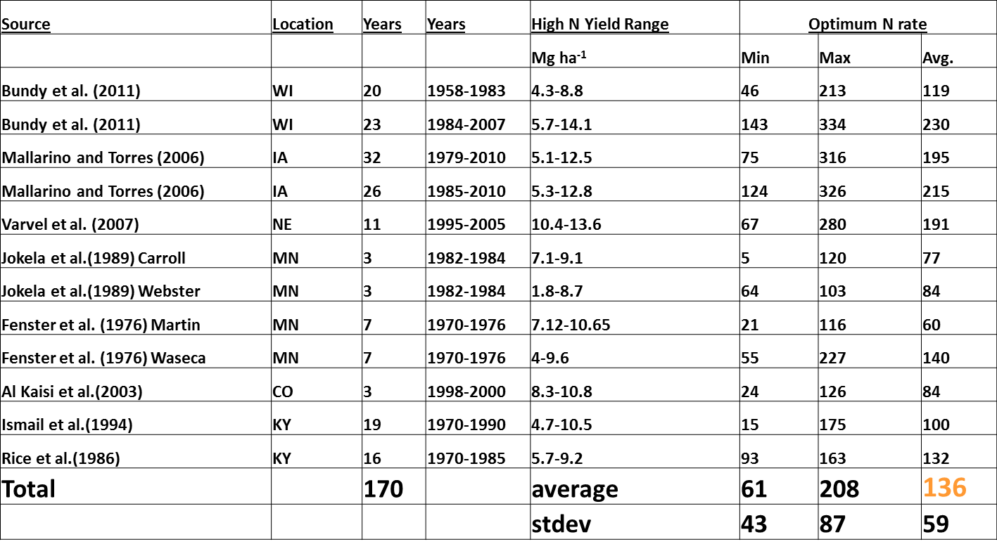
Corn…
1 Mg/ha = 15 bpa, 5 Mg = 75 bpa, 10 Mg=150 bpa, 15 Mg= 225 bpa

Slide 4
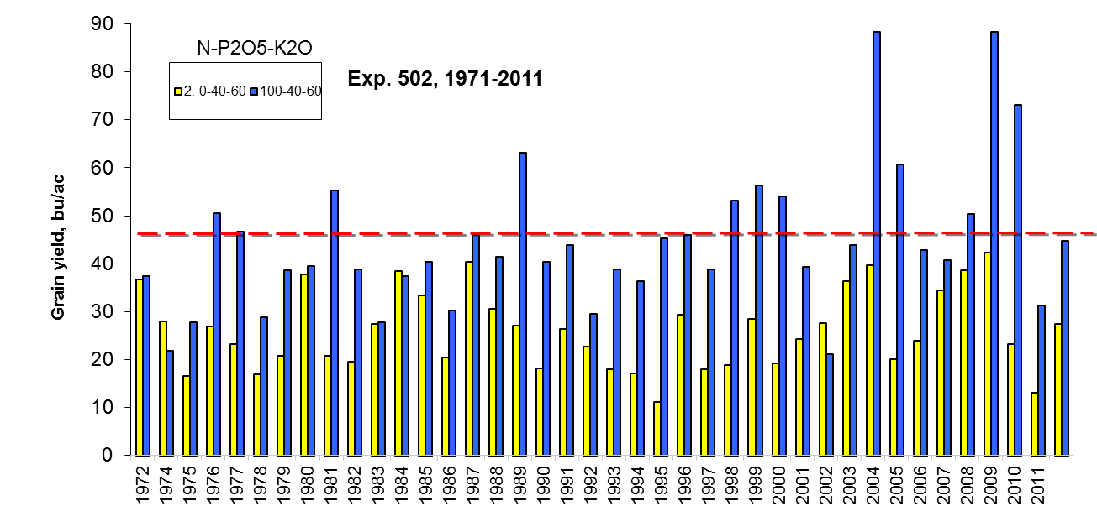
Optimum N rate – Dry land Wheat

Slide 5
Optimum N rate - Dry land Wheat

Slide 6
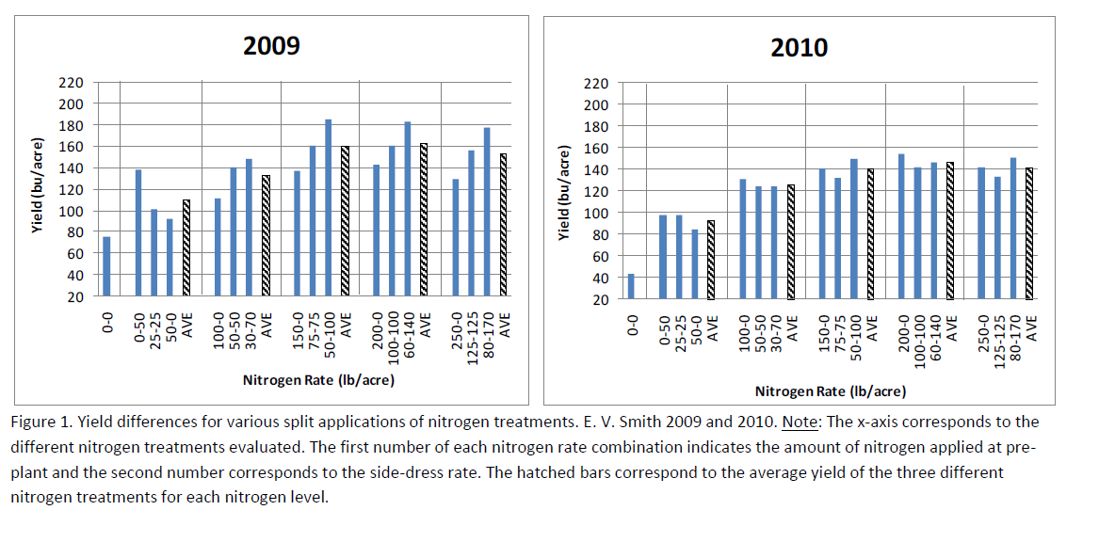
April 2011 Brenda V. Ortiz, Assistant Professor and Extension Specialist, Charles Burmester, Extension Agronomist, and Kip Balkcom, Research Agronomist, USDA-ARS.

Slide 7
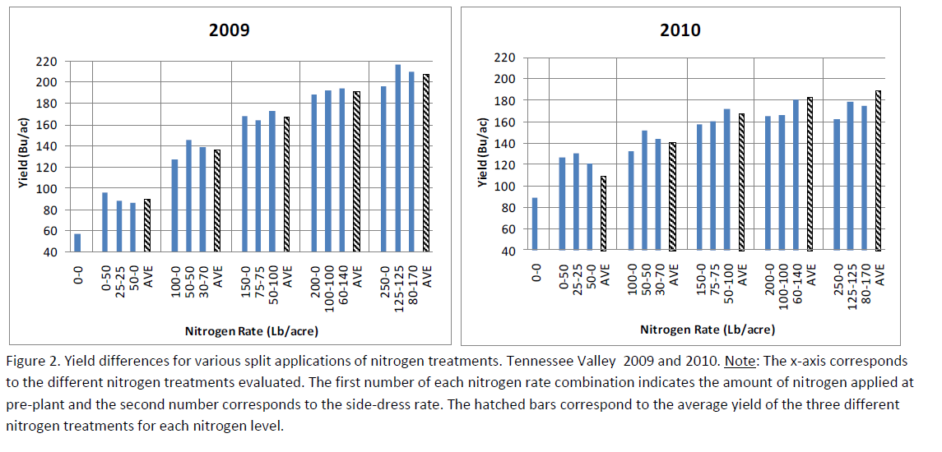

Slide 8
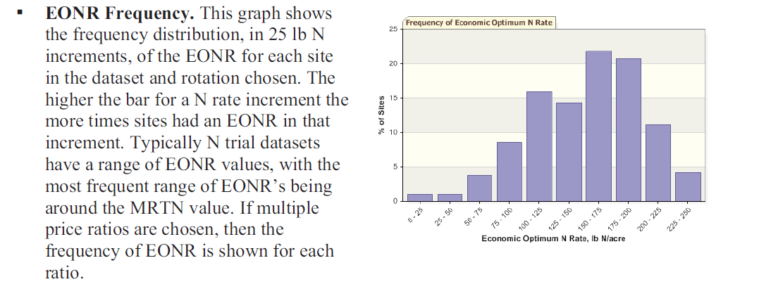

Slide 9
Mobile Nutrients
The Crop Need for these nutrients are driven by uptake i.e. YIELD.
Stanford equation
  Stanford, G. 1973. Rationale for Optimum Nitrogen Fertilization in Corn Production. JEQ 2:159-166
(Plant Uptake – Soil Supply)/ Efficiency
Typical Land-grant rec was
Yield Goal N minus Soil Test N.
In 0-6in of soil 1%OM has 1000 lbs N

Slide 10
Zones

Slide 11
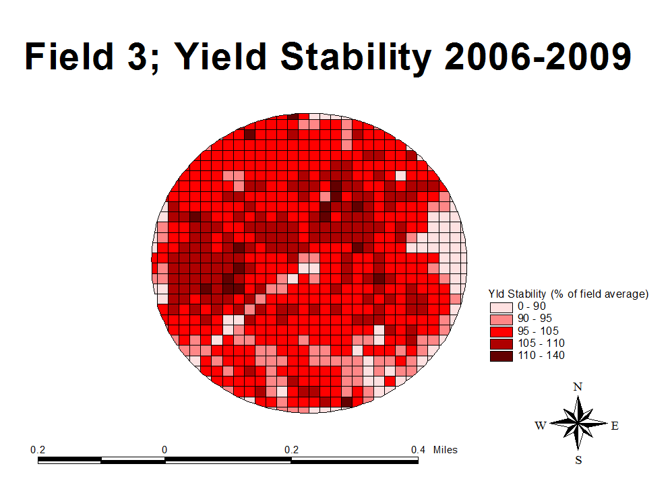

Slide 12
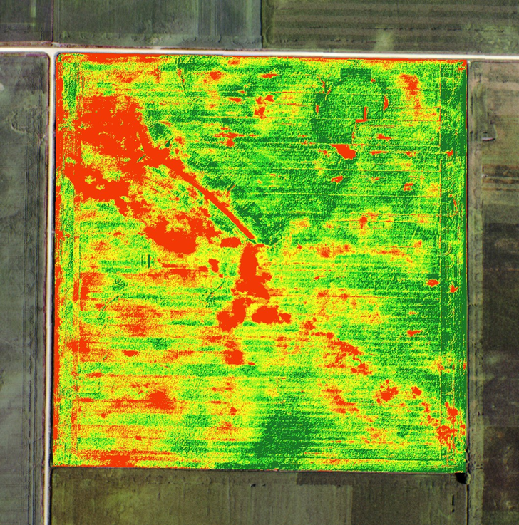
NDVI

Slide 13
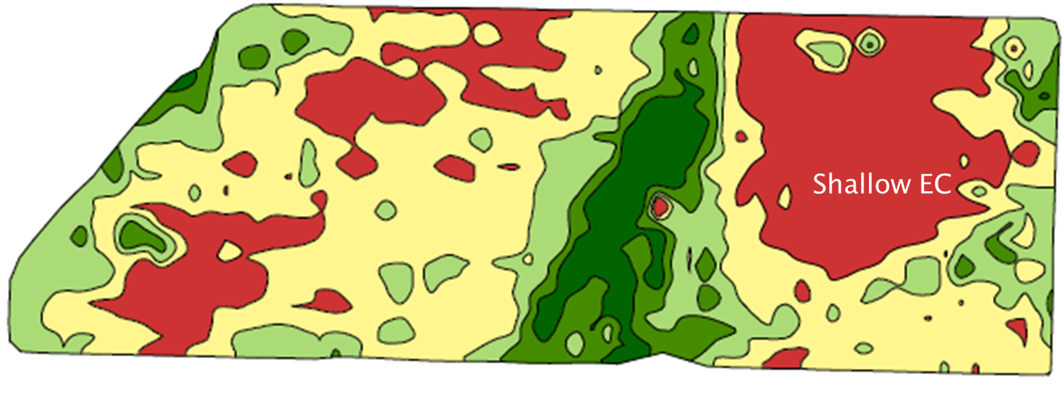
EC

Slide 14
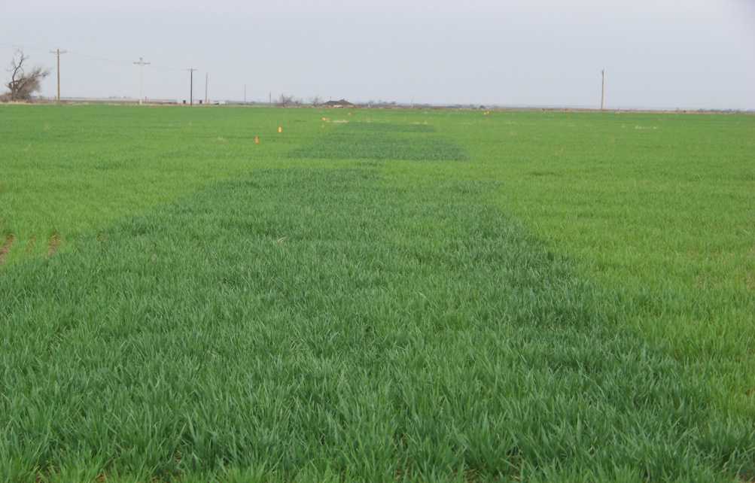
Getting N right for the Year
Mobile Nutrients N
Yield and Environment Driven!!
  Make determinations based off Environment and Plant measured in Season

Slide 15
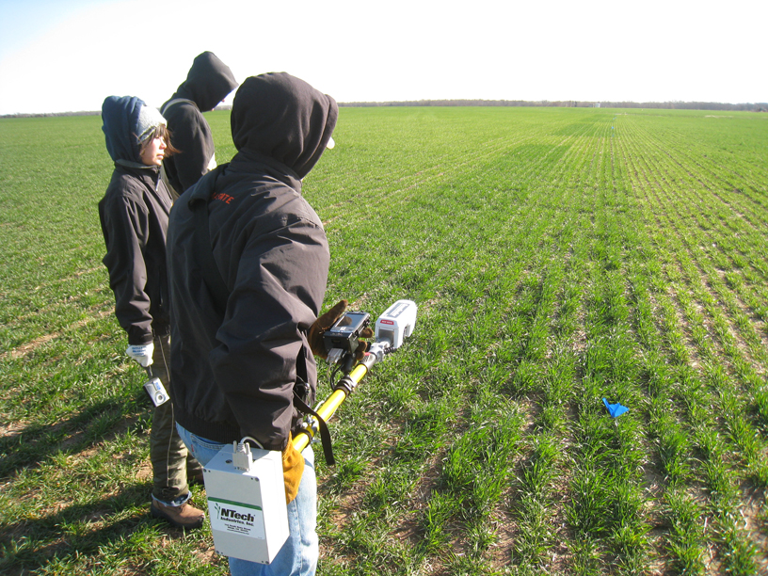

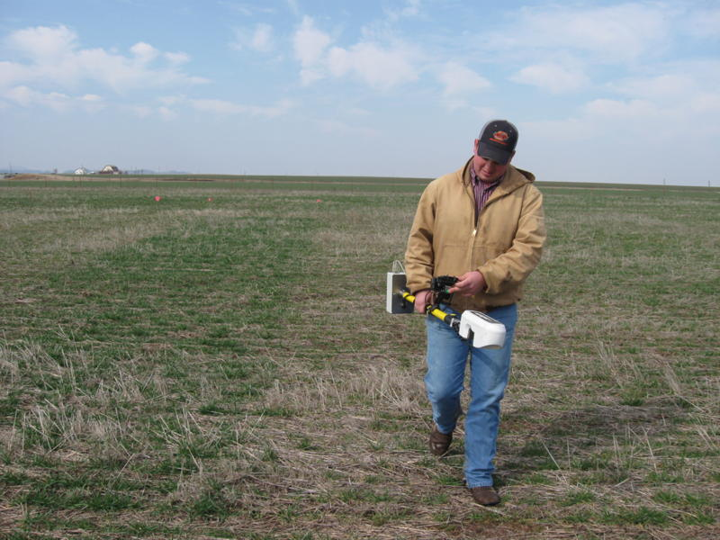
Reference Strips
Are Very Visual..
Consider 0 N

Slide 16
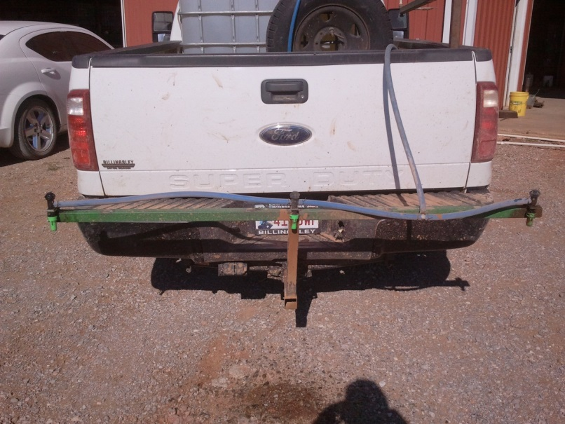
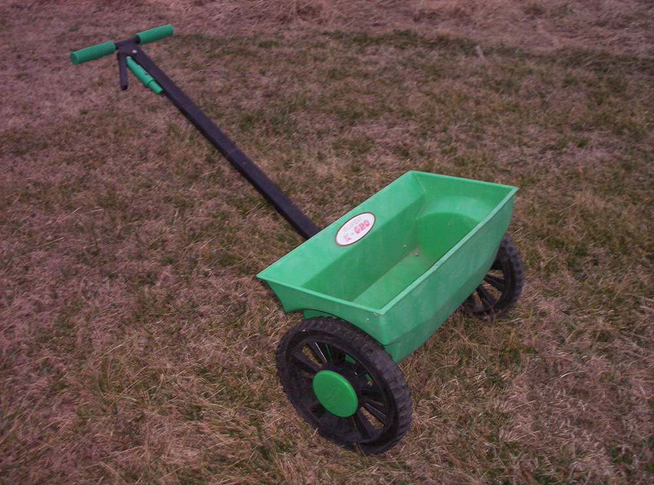
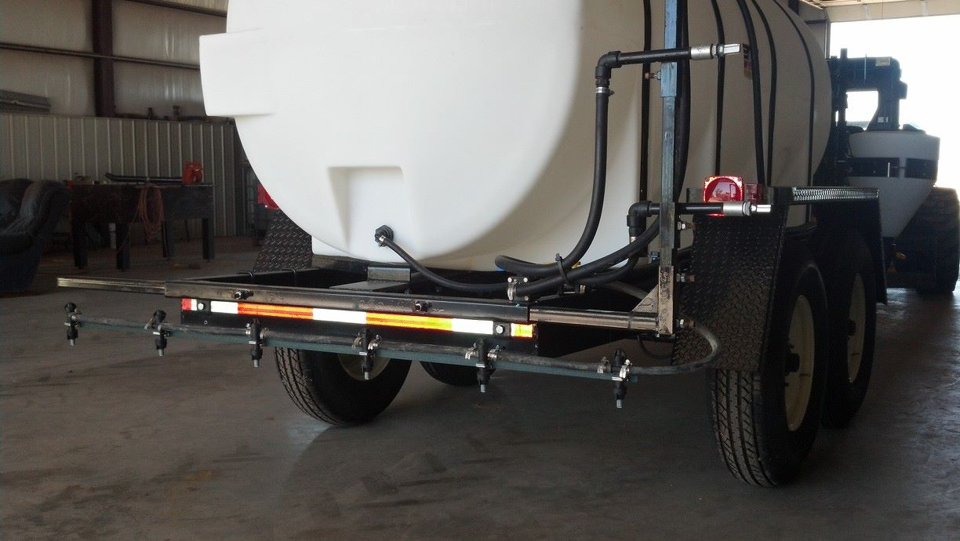
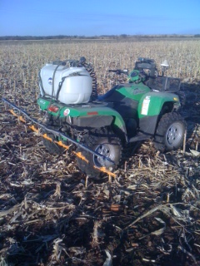
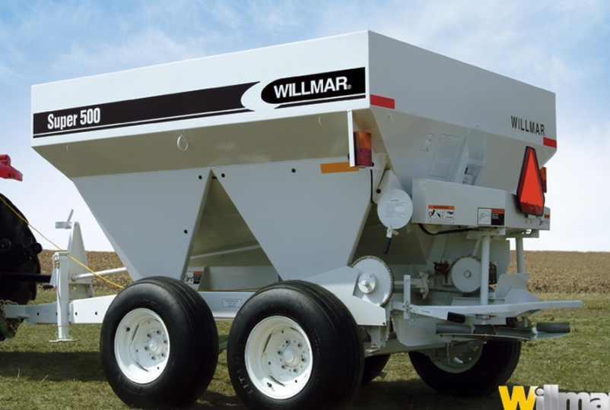
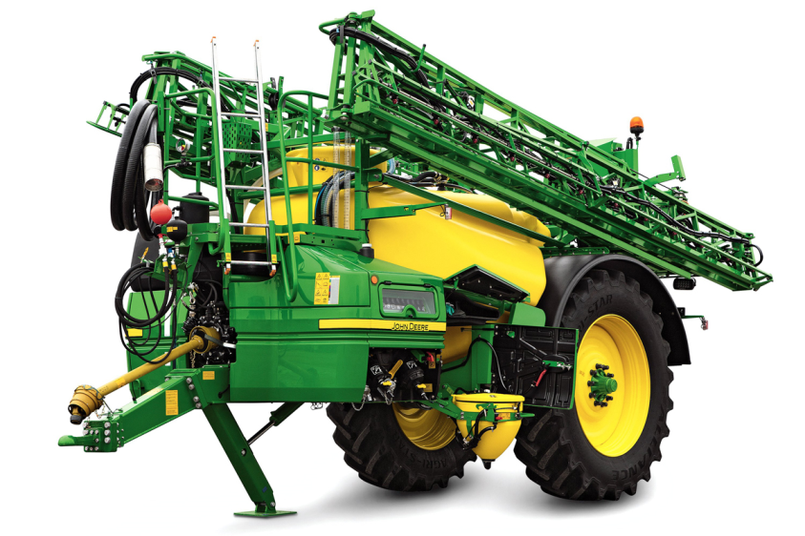
Applicators

Slide 17
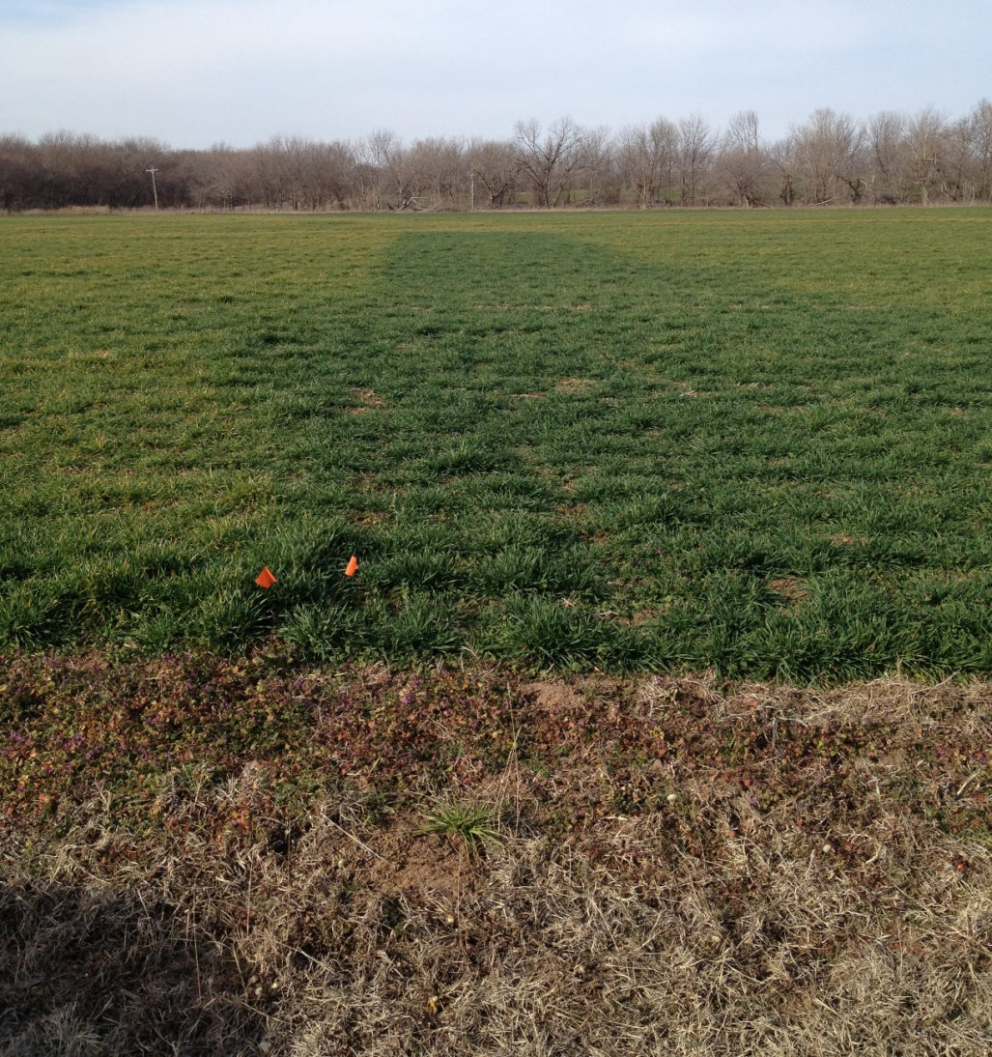

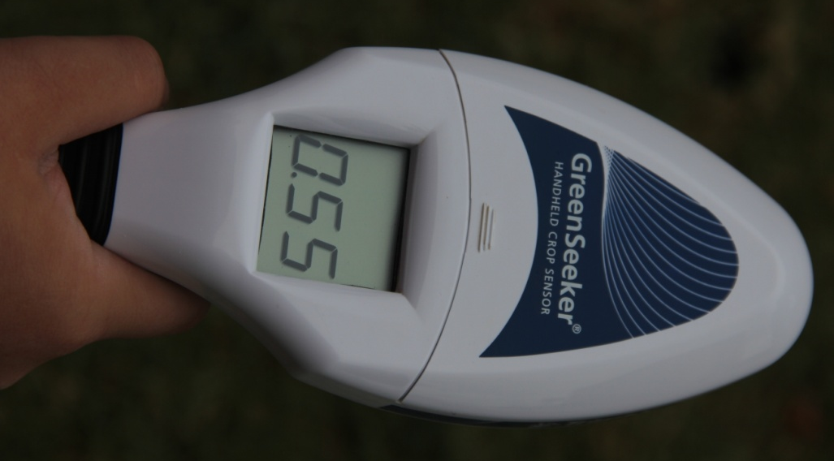

Slide 18
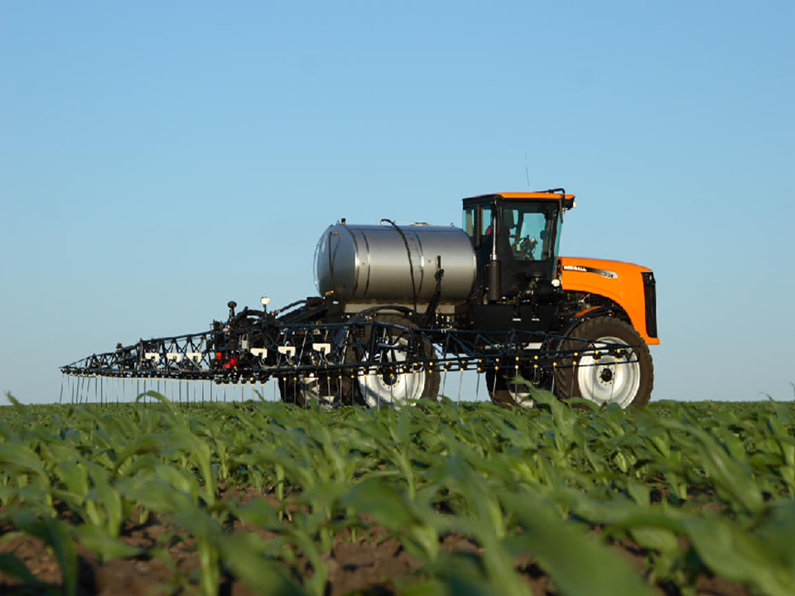
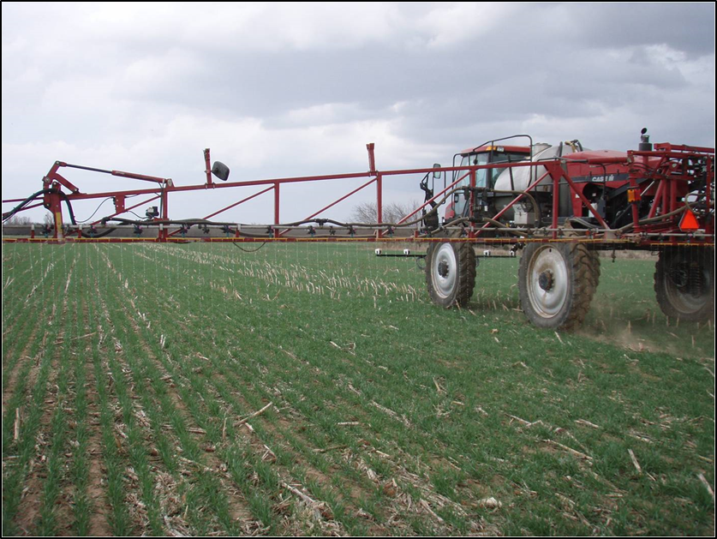
On-the Go

Slide 19

Comparison of Sensor Based N Rec’s to Soil Test Based Rec’s, 2006-2008
Notes:
This is the new summary table when using the table listed in the previous slide and using efficiency factors of .4 for below 60, .5 if it was between 60-100, .55 if it was between 100-120, and .60 for 120-140, and .65 for above. One important thing to remember is if we get within 10 pounds one way or the other is we are really only trading dollars once you get that close due to the nature of the N responsiveness curve. In years where the price of grain is low compared to the price of fertilizer, we want to be 10 pounds on the negative side, and vice versa. A yield goal of 120 was used at Manhattan, and 80 at all other sites.

Slide 20

Regional GreenSeeker Grain Yields - 2005
Notes:
This shows that across several sites, sensor based recommendations yielded as well as farmers current practices.

Slide 21

2006 NE GreenSeeker/Corn Trials
Gross Return ($/A)
75 lbs N – Pre
+
GreenSeeker
175
272
346
367
290
0 N – Pre
+
GreenSeeker
209
280
333
348
293
Farmer Practice
203
259
265
289
254
Treatment
Miami
South Coffeyville
Webbers Falls
Ft. Gibson
All Site Average
Check
228
253
270
375
282
N-Rich
141
171
351
324
247
Notes:
The interesting points in this 2006 trial-
All site average return was greater using sensor based nitrogen management
Consistent with other OSU trials, corn can have periods of N stress early in crop development and still achieve optimum yield as shown here where net profit was as the highest where all N was applied at V8 to V10 according to a sensor based N recommendation.

Slide 22
2006 NE GreenSeeker/Corn Trials
Grain Yield (Bu/A)
75 lbs N – Pre
+
GreenSeeker
87
123
155
167
133
0 N – Pre
+
GreenSeeker
89
120
140
150
125
Farmer Practice
92
122
144
153
128
Treatment
Miami
South Coffeyville
Webbers Falls
Ft. Gibson
All Site Average
Check
91
101
108
150
113
N-Rich
102
114
186
175
144

Slide 23
2006 NE GreenSeeker/Corn Trials
Total N Applied (lbs N/A)
75 lbs N – Pre
+
GreenSeeker
112 (37)
93 (17)
110 (35)
132 (57)
112 (37)
0 N – Pre
+
GreenSeeker
36
52
45
71
51
Farmer Practice
70
120
250
246
172
Treatment
Miami
South Coffeyville
Webbers Falls
Ft. Gibson
All Site Average
Check
0
0
0
0
0
N-Rich
300
300
300
300
300
Notes:
The Ft. Gibson site was fertilized with 2 tons of poultry litter. In the column where 75 was applied preplant, the first number is the total commercial N applied and the n rate recommended by the sensor is shown in the parenthesis.

Slide 24

Average Wheat Performance
100
NS
90
80
Farmer Practice
GS
7% less N with GS
70
60
Farmer Practice
GS
50
40
30
20
10
0
Grain Yield, bu/ac
GS 30 N Rate Applied, lb/ac
Courtesy Wade Thomason VT
Notes:
Numerically, GS was higher at 4 of 16, only 1 of these had GS N rate higher than STD rate

Slide 25

Average Corn Performance
NS
160
140
Farmer
Practice
Sensor
120
21 % less N with GS
100
Farmer
Practice
80
Sensor
60
40
20
0
Grain Yield, bu/ac
Sidedress N, lb/ac
Courtesy Wade Thomason VT

Slide 26

2010 Percent N Reduced
Average Reduction = 25%
N reduction with equal yields.
Notes:
Average was 25%, but you can see a wide variation in results between individual fields.

Slide 27

Clemson
Our work has shown that compared to uniform rate applications the SVNA system has the potential to reduce N usage by 30 to 70% in cotton, corn and wheat productions.

Slide 28
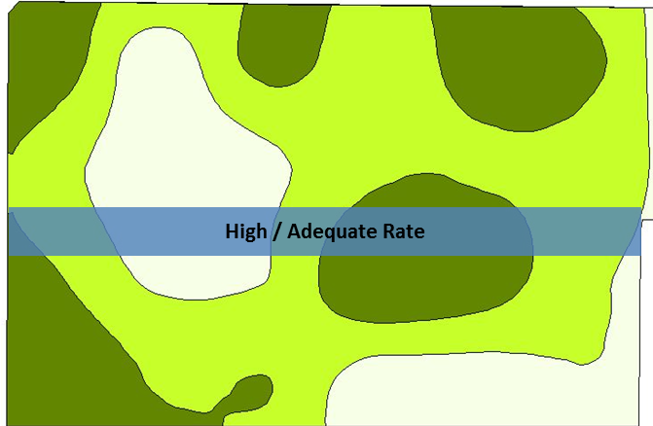
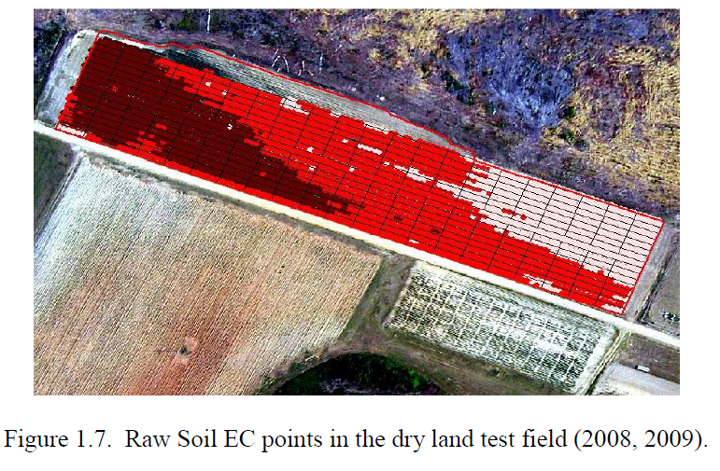
End Game
Zone by Response

Slide 29
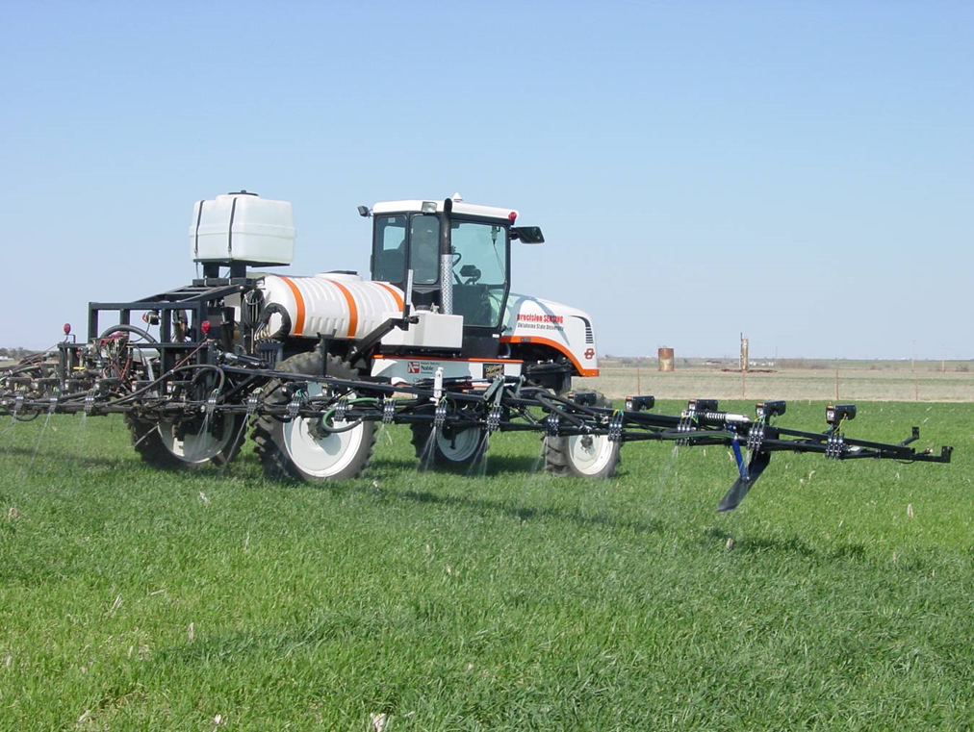
Potential is History
In 2002 we could fertilize ever 2x2 at 10 mph

Slide 30
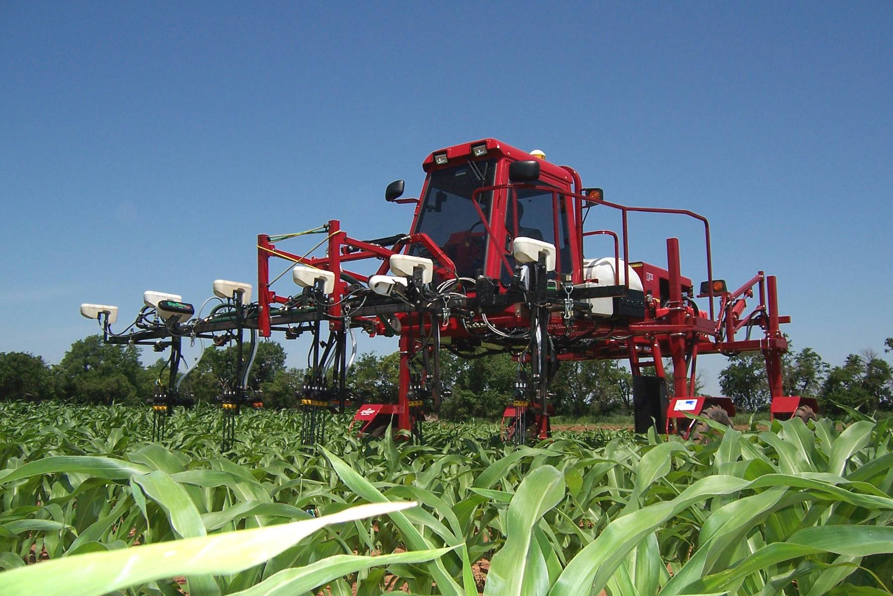
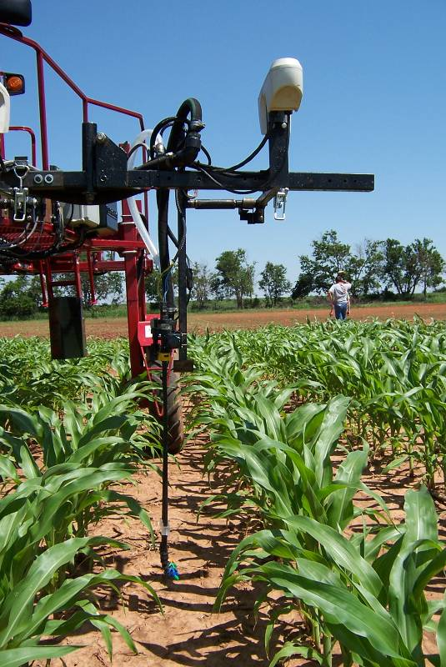
We have been able to fertilize every 2 ft of row since 2003
Notes:
This is a current OSU applicator that can fertilize each individual corn plant.

Slide 31
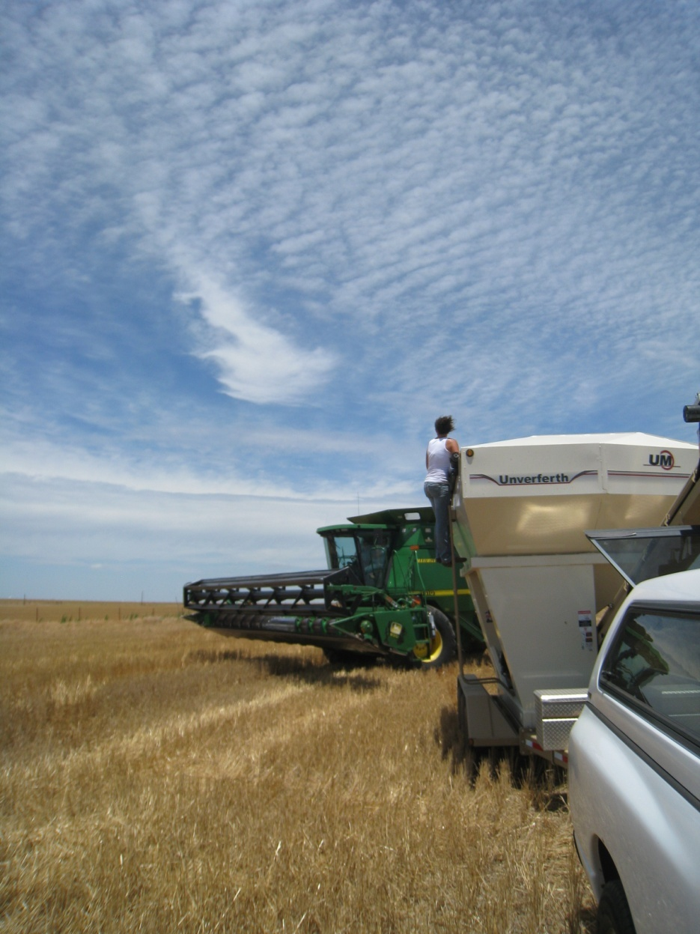
Brian Arnall
373 Ag Hall
405-744-1722
b.arnall@okstate.edu
Presentation available @
www.npk.okstate.edu
Twitter: @OSU_NPK
www.Facebook/OSUNPK
YouTube Channel: OSUNPK
Blog: OSUNPK.com
www.Aglandlease.info

