Slide 1

Components of a Variable Rate Nitrogen Rec
Brian Arnall
Precision Nutrient Management | Oklahoma State University
40 min

Slide 2
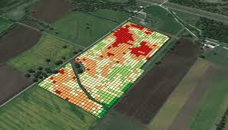
Overview
Share current on goings in US
N Management Concepts
VRT recs How and Why
Hopefully sometime down the road it causes some thought.

Slide 3


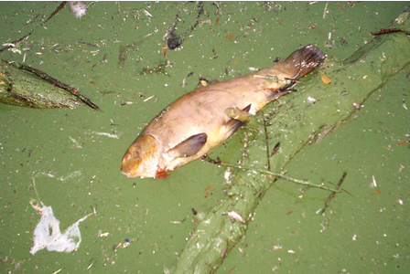
VRN backdrop
In past
  Chesapeake Bay
  Oklahoma Sues Arkansas
News is about Lake Erie
Des Moines
Impact elsewhere

Slide 4
Land-grant N recs
Stanford Equation

Slide 5
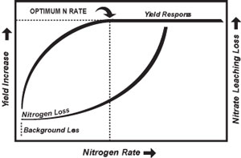
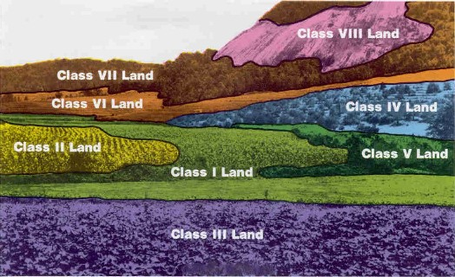
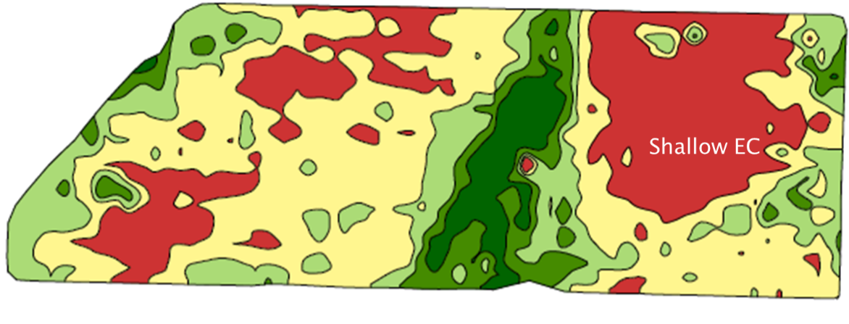
Yield
N_{Crop}
Yield Goal
Soil Class
Yield Map
Biomass Map
Growth | Uptake Model, later.

Slide 6
Yield Goal |Nitrogen Removal Rates
Yield | HRW Wheat | Canola
20 | 30 | 38
30 | 45 | 57
40 | 60 | 76
50 | 75 | 94
60 | 90 | 113
80 | 120 | 152
100 | 150 | 188

Slide 7
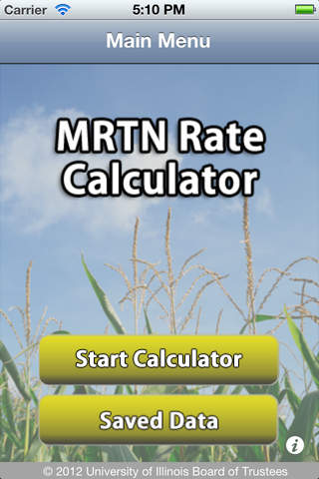
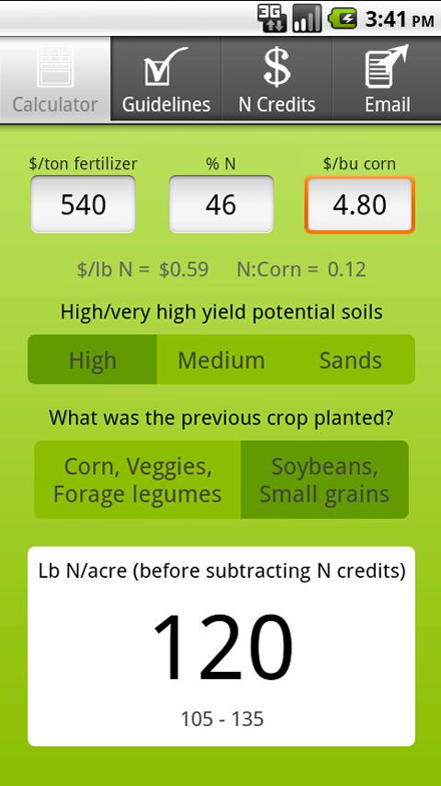
MRNT | EONR
Regionally | Soil Specific
Uses a Large Data Base
Includes Economics

Slide 8
MRNT
It must be recognized that rate guidelines developed from analysis of trials conducted across a wide geography will be general in nature. Those guidelines reflect the research data and provide insight into general fertilizer N needs. However, they cannot predict site-specific N requirements, and they are unlikely to provide an accurate estimate of the optimum N rate needed in each specific environment. It is well documented that optimum N rate varies among sites and years within sites (Figure 5, 6, and 7). Nevertheless, guidelines should provide an N rate that reflects economic value and probability of achieving expected economic return across a range of locations and period of time. The MRTN approach provides both the above-mentioned benefits and allows analysis across a range of N response trials.

Slide 9
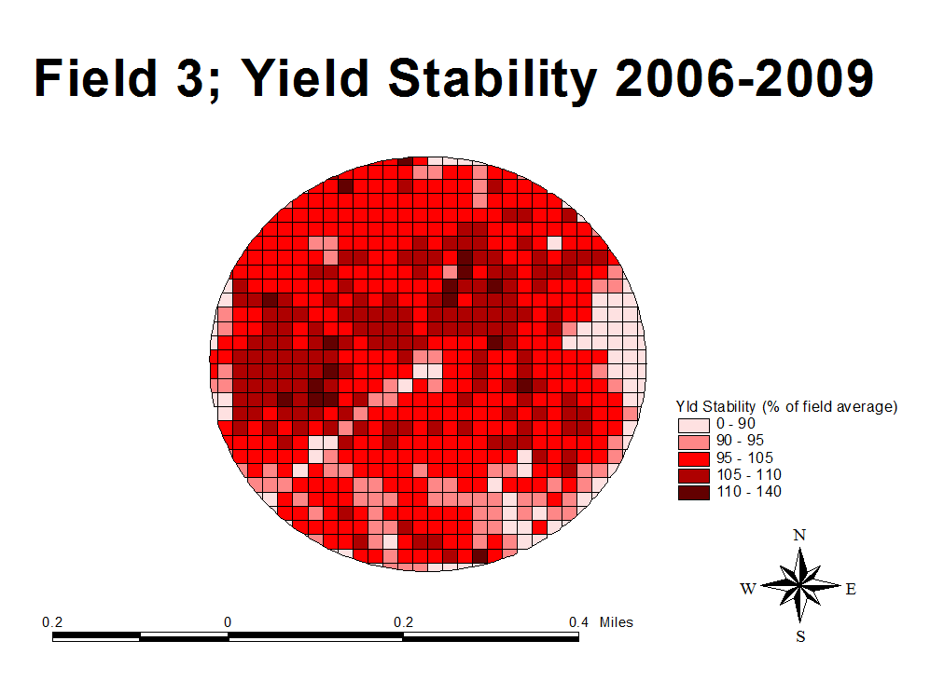
Yield Monitor

Slide 10
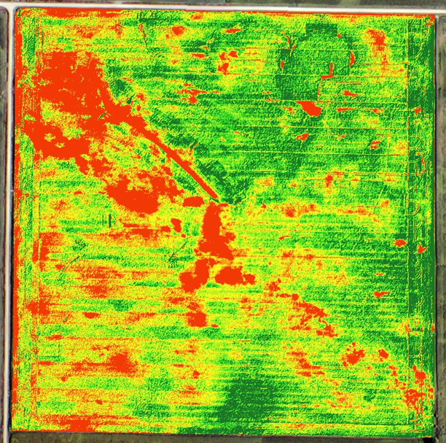
Biomass
Biomass is a Proxy for Yield
NDVI et al. is a Proxy for Biomass
Therefore NDVI is a Proxy for Yield.
  Understanding Bio -> Yield essential.

Slide 11
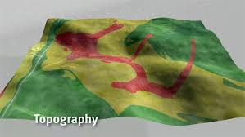
Yield By Soil
Yield Potential determined by
  OM
  Texture
  Soil type

Slide 12
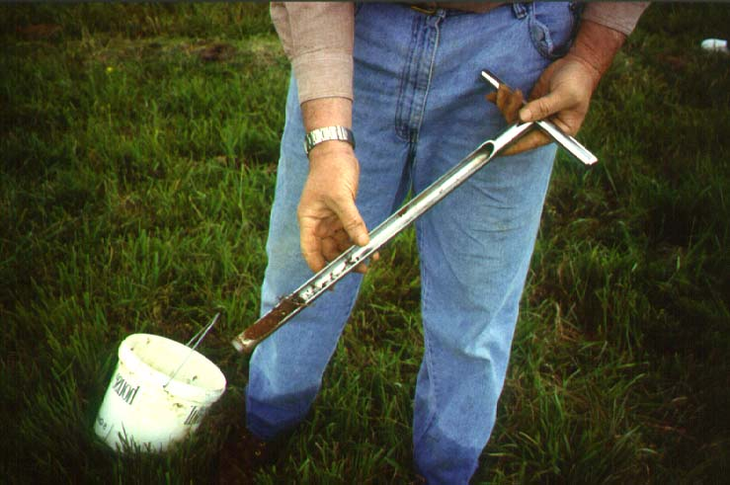
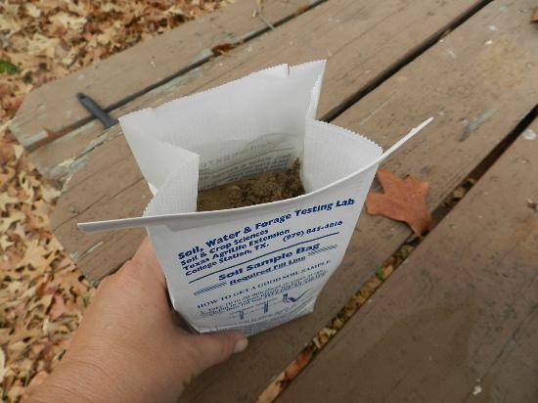
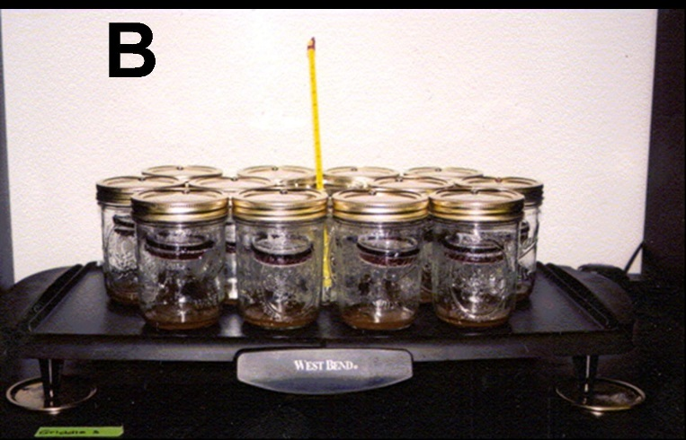
Soil
N_{Soil}
Soil Test
  Pre
  In-Season
Mineralization
Losses
N Addition and N Loss via Weather.

Slide 13
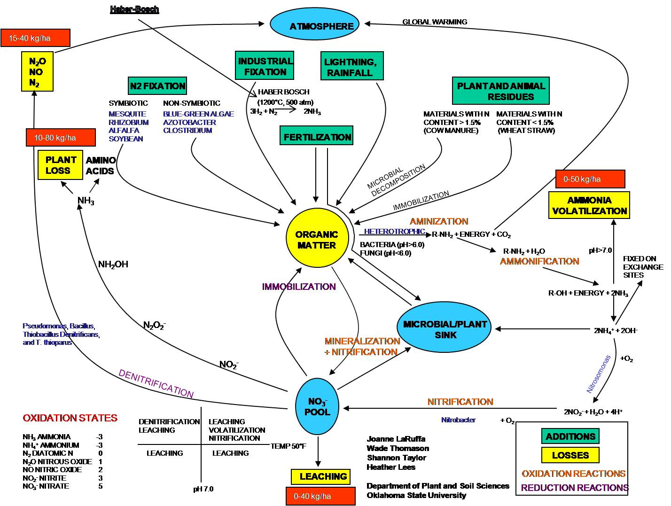
PPSTN|PSNT|ISNT
Accounting for soil N
levels before or after
crop has been planted.
One the first and most regionally successful attempt to conquer the Nitrogen cycle and mineralization.

Slide 14
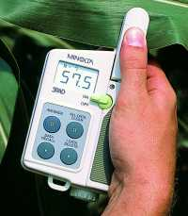
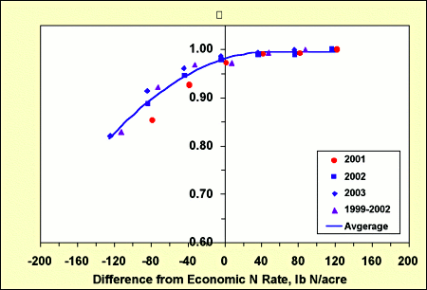
Chlorophyll
Spad Meter
Lets the Plant tell you about the Soil it sees.

Slide 15
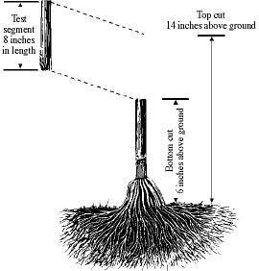
Stalk Nitrate Test
Post Mortem Evaluation. Check up of this year performance.
Which is great, if the optimum N rate is consistent from year to year.
Low = Less than 450 ppm nitrate-N = High probability that nitrogen is deficient
Optimal = 450 - 2000 ppm nitrate-N = Yields are not limited by nitrogen
Excessive = Greater than 2000 ppm nitrate-N = Uptake exceeds requirements

Slide 16




Models
Encirca, Yield 360, AdaptN, FieldView Pro…..
For the most part are looking at two variables.
The deference may be how much priority is given.
Growth Model, Heavily based on GDD.
Soil Model, Heavily based on rainfall and temp.
Most utilizing NOAA data.

Slide 17
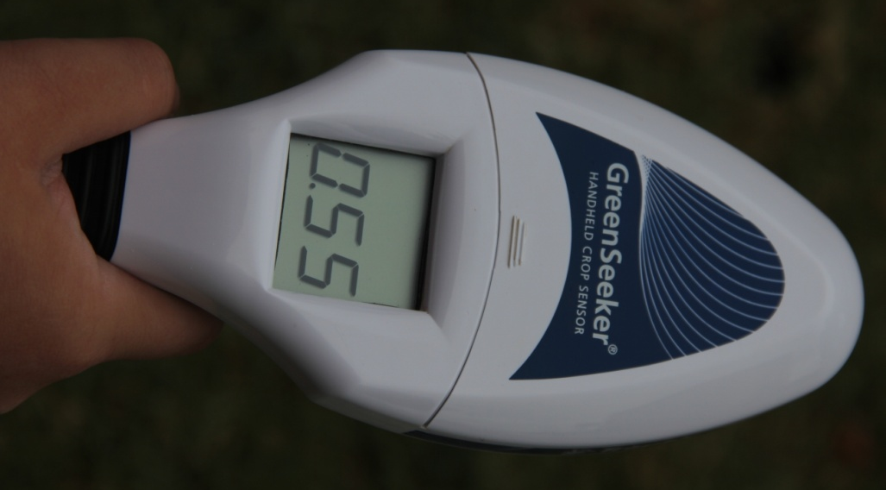
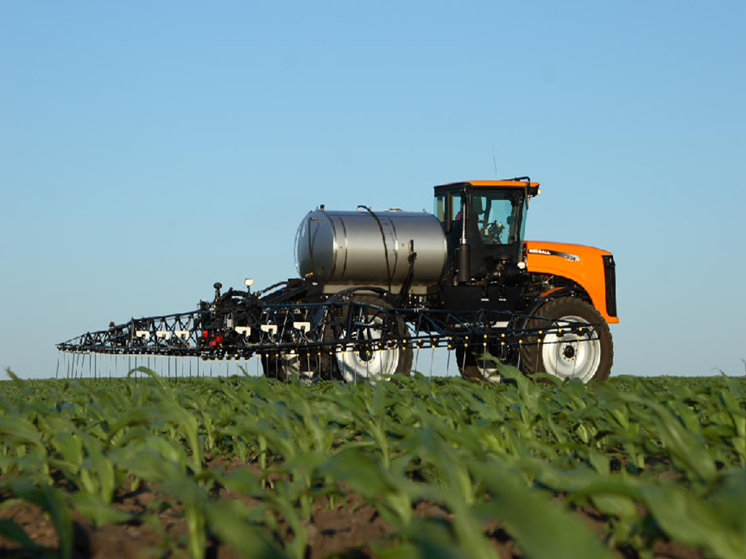
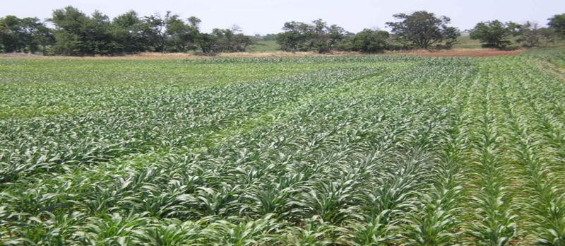
Biomass Plus
NDVI plus a Reference Strip.
Yield + Soil (Environment)

Slide 18
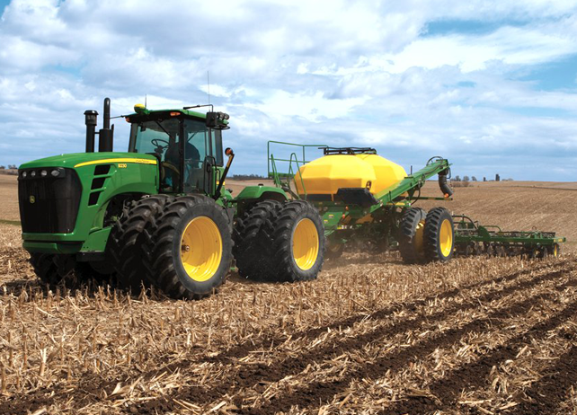
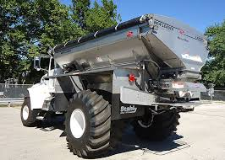
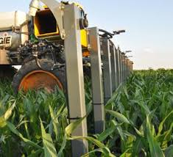
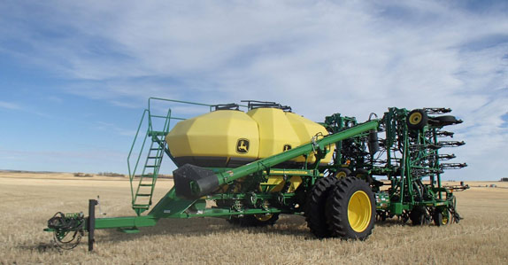
eFert
e_{Fert}
4Rs
  Source
  Placement
  Time
  Rate
NUE –
Lbs of N per Bushel?????
  Consistent low v high?

Slide 19
Integration of Parameters
Stanford Equation

Slide 20
Ncrop and Nsoil

Slide 21
What a theoretical N models look like.

Slide 22
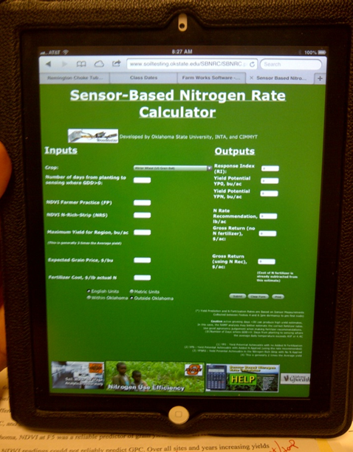
Integration of Approaches
Ok State Optical Sensor.
  YP RI model
Yield by Soil by Weather.

Slide 23
Where is YOUR Opportunity
N-Crop: Is you yield Temporally Variable? Spatially Variable?
N-Soil: Do you have at least .5% OM and inconsistent Weather
E-Fert - is your texture or landscape spatially variable?
Can you adjust based on Management.

Slide 24
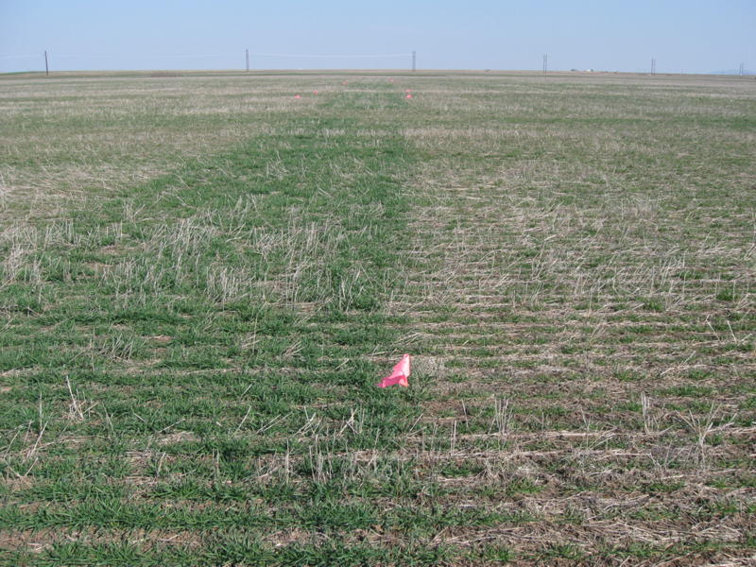
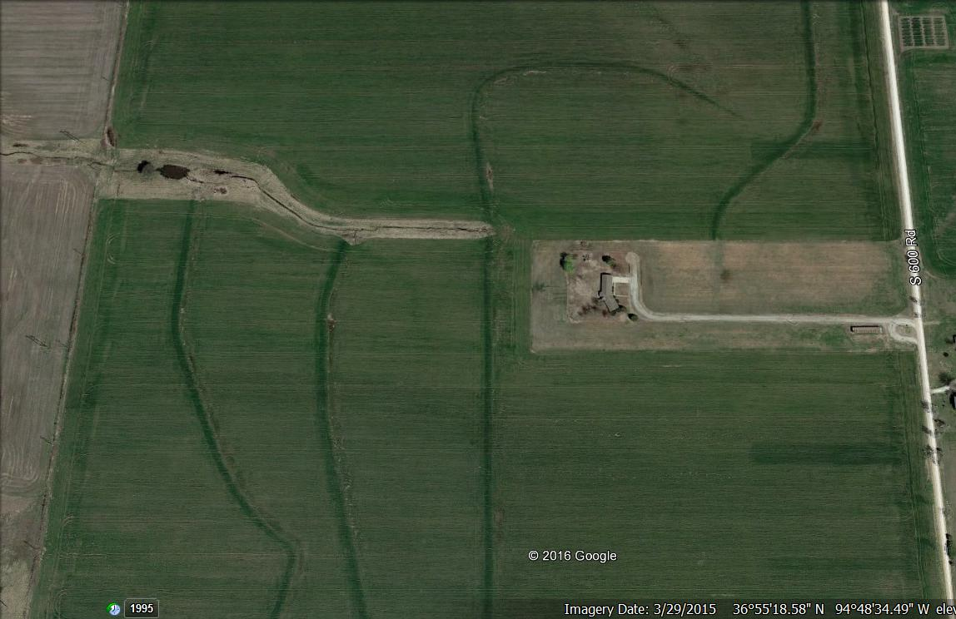
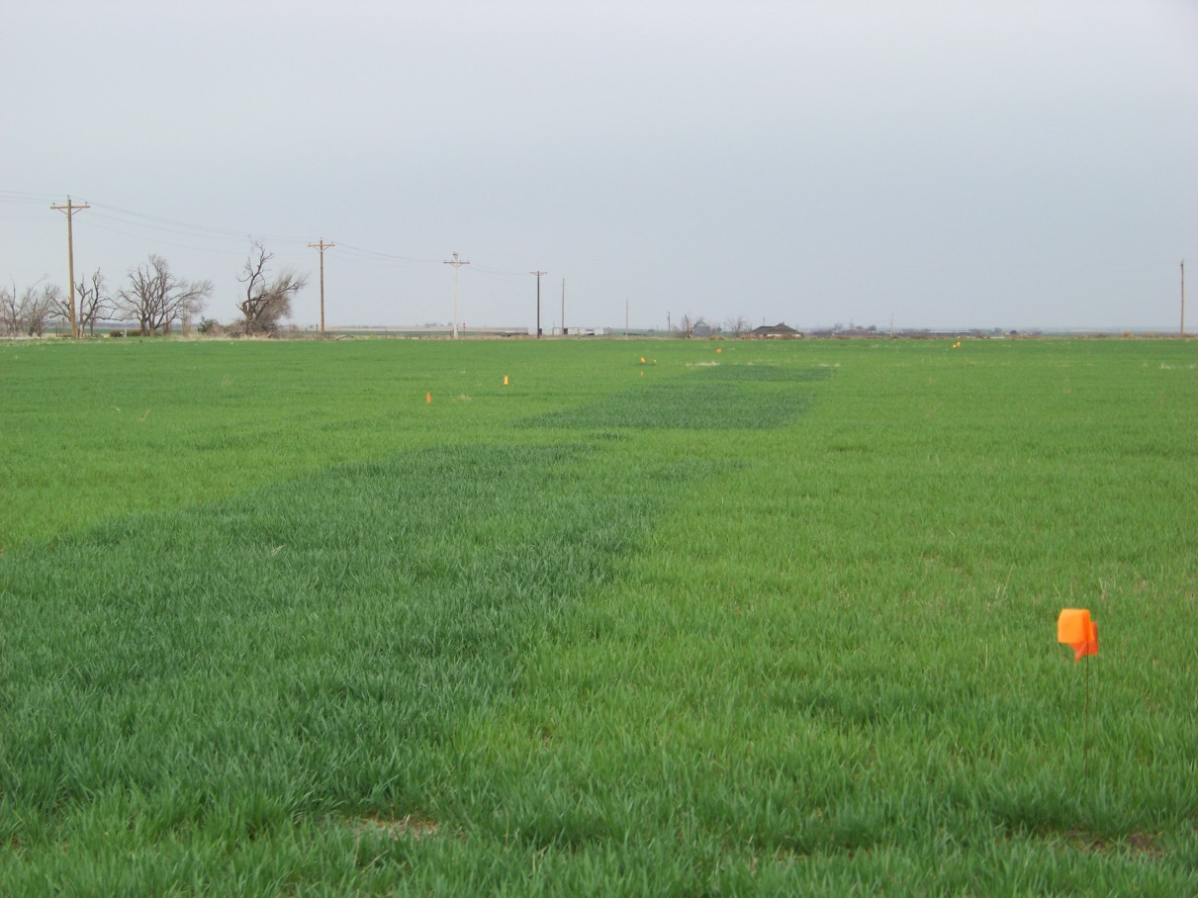
Nutrient Rich | Un-rich Strips

Slide 25
Article
Link for full article at
www.OSUNPK.com

Slide 26
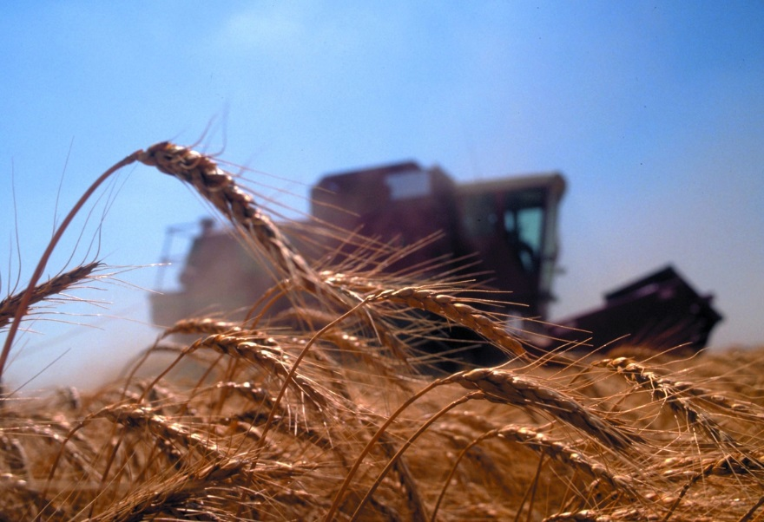
Thank you!!!
Brian Arnall
373 Ag Hall
405-744-1722
b.arnall@okstate.edu
www.npk.okstate.edu
Twitter: @OSU_NPK
www.Facebook/OSUNPK
YouTube Channel: OSUNPK
Blog: OSUNPK.com
www.Aglandlease.info
Projects supported by the International Plant Nutrition Institute and
the Oklahoma Fertilizer Checkoff Program.

