Slide 1
Wesley M. Porter Extension Irrigation Specialist
Irrigation Management

Slide 2
Irrigation
Agriculture accounts for over 80% of freshwater consumption nationwide (Schaible and Aillery, 2006).
Within the past decade the largest growth of farmland and total irrigation water applied occurred in the eastern states (Gollehon and Quinby, 2006).

Slide 3
Why Irrigate?
Increase yield/profit in low rainfall years
Yield stability across years
Safeguard investment (seed, tech fees, fertilizer, etc.)
Risk management
Pest control (pre-emerge and systemics)
Optimize use of applied nutrients

Slide 4
Irrigation: Types
Sub-Irrigation:
Proper maintenance of the water table
Sprinkler Irrigation:
Set sprinklers/Lateral move/Center Pivot etc.
Micro-Irrigation:
Drip/emitters
Surface Irrigation:
Flood Irrigation

Slide 5
Irrigation Scheduling
A technique that involves determining how much water is needed and when to apply it to the field to meet the crop demands.
Main purpose is to increase the profitability of the crop by increasing the efficiency of using water and energy or by increasing crop productivity.
Management of soil water status and the current crop water use, will allow for water to be applied at specific times to meet crop demands and minimize water loss, runoff, and deep percolation.

Slide 6
Irrigation Scheduling
According to the USDA irrigation is scheduled based on:
80% visual observations
6-35% feel the soil, irrigate when “neighbors irrigate”, use a personal calendar schedule, use media daily weather/crop ET reports, irrigate based on scheduled water deliveries
8% or less use irrigation scheduling services, computer simulation models, or plant/soil moisture sensors.

Slide 7
Why Schedule Irrigation?
Well-timed irrigation can:
Eliminate moisture stress during critical plant growth stages
Increase water use efficiency
Help the crop efficiently use fertilizer and other inputs.

Slide 8
Irrigation Scheduling: Methods
Standard Irrigation:
Calendar Scheduling
Water Budget Scheduling (ET)
Crop Coefficients
Tensiometer
Pan Evaporation
ET_{o} from Meteorological Data
Leaf Canopy Temperature
Soil Moisture Sensors
Remote Sensing
VRI:
Tensiometer
Leaf Canopy Temperature
Soil Moisture Sensors
Remote Sensing
Zone Management

Slide 9
What If We Had the Ability To:
Develop Irrigation Management Zones
Apply correct and relevant amounts of irrigation to these zones
Apply no water to non-cropped areas
The Solution is Variable Rate Irrigation

Slide 10
Variable Rate Irrigation
Variable Rate Irrigation also known as VRI or Precision Irrigation
The controlled application of irrigation water over a particular area, based on observed or measured conditions.
Varied rates
On/Off
Scheduling Rates based on perceived or measured water requirements of sub-field zones:
Soil Moisture Sensors
Resistive or Capacitance
Leaf Canopy Sensors
Remote Sensing

Slide 11
Variable Rate Irrigation
In this case the predominate use will be to control the irrigation system on/off over particular areas:
Wet Areas
Overlapping Areas
Non-Crop areas (Roads, Structures, waterways, ditches etc.)
Sensitive Areas
Field Variability

Slide 12
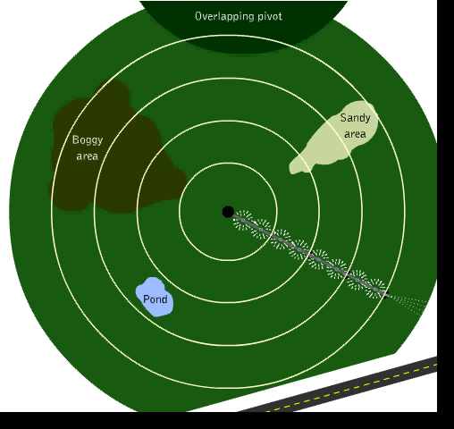
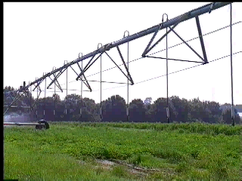


VRI

Slide 13
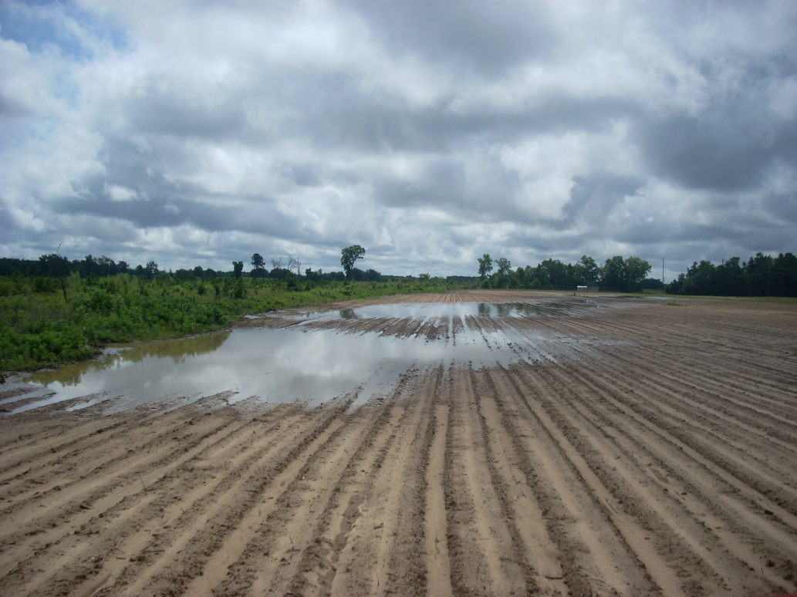
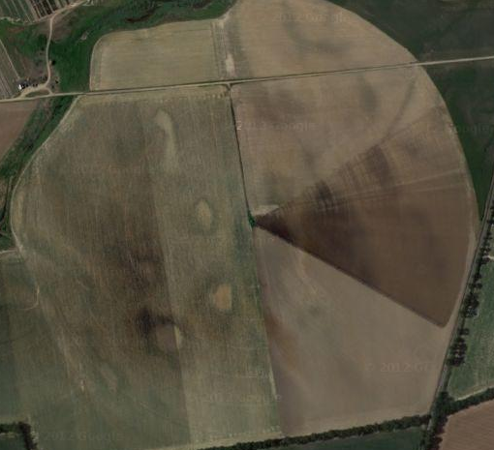
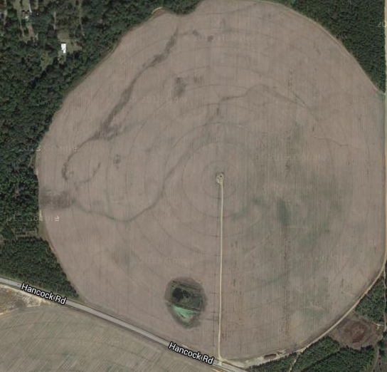
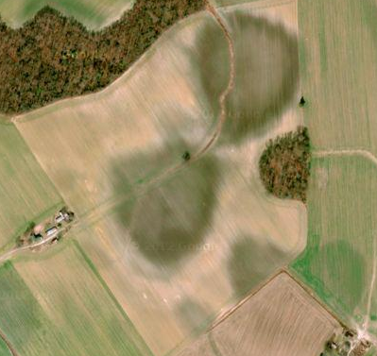
Variable Rate Irrigation: Wet Areas

Slide 14
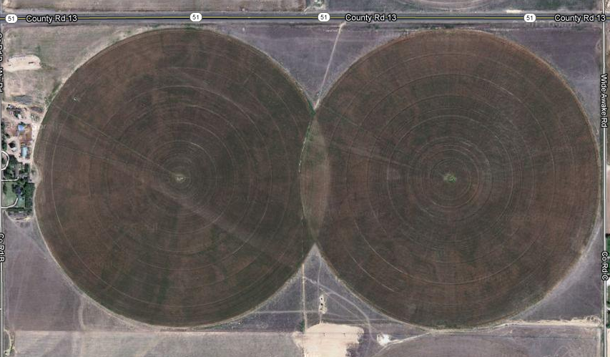
Variable Rate Irrigation: Overlap

Slide 15
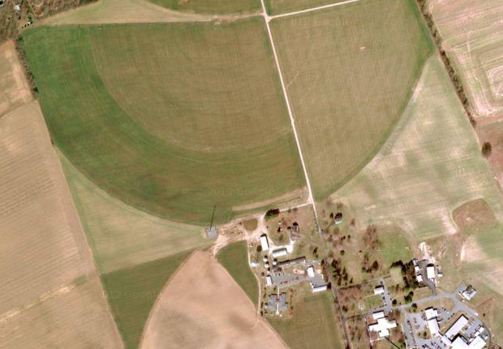
Variable Rate Irrigation: Non-Crop Areas
Non-Crop Area: House or building

Slide 16
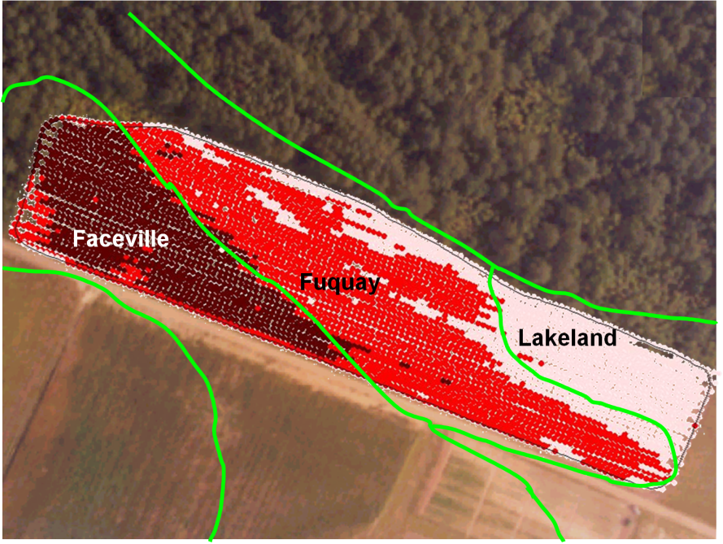
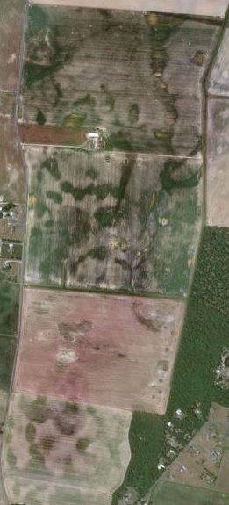
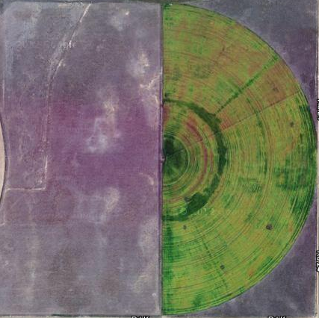
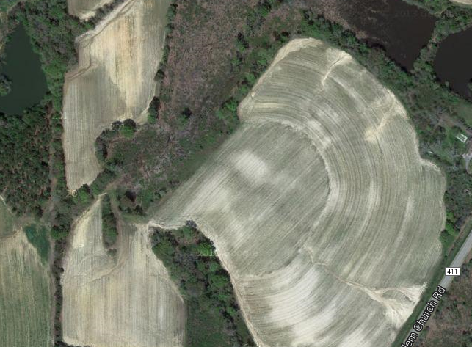
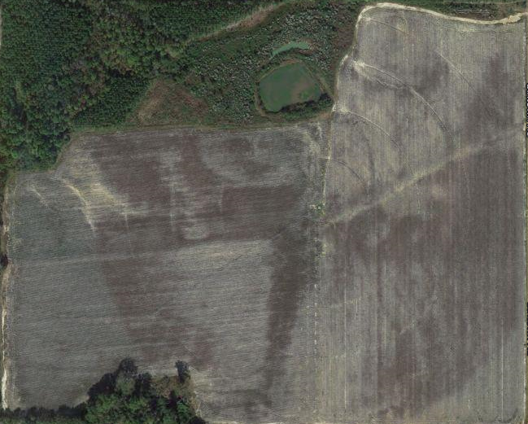
Variable Rate Irrigation: Variability

Slide 17
Is VRI Relevant to My Operation?
Your farm’s irrigation system could benefit from VRI if your field has:
Environmentally sensitive areas under the system coverage area (end gun or nozzles)
Different nutrient management zones
Non-cropped areas under pivot coverage
Varying soil types

Slide 18
Irrigation Cost
Irrigation cost ~ $12/acre-inch applied:
So for 1,000 acres of irrigated land @ 10 inches of irrigation:
$120,000
Using a VRI system for on/off only assuming that ~10% of the “irrigated” land doesn’t require water that translates to a $12,000 saving.
Contact your local NRCS office about EQUIP funds for new and retrofitted systems.

Slide 19
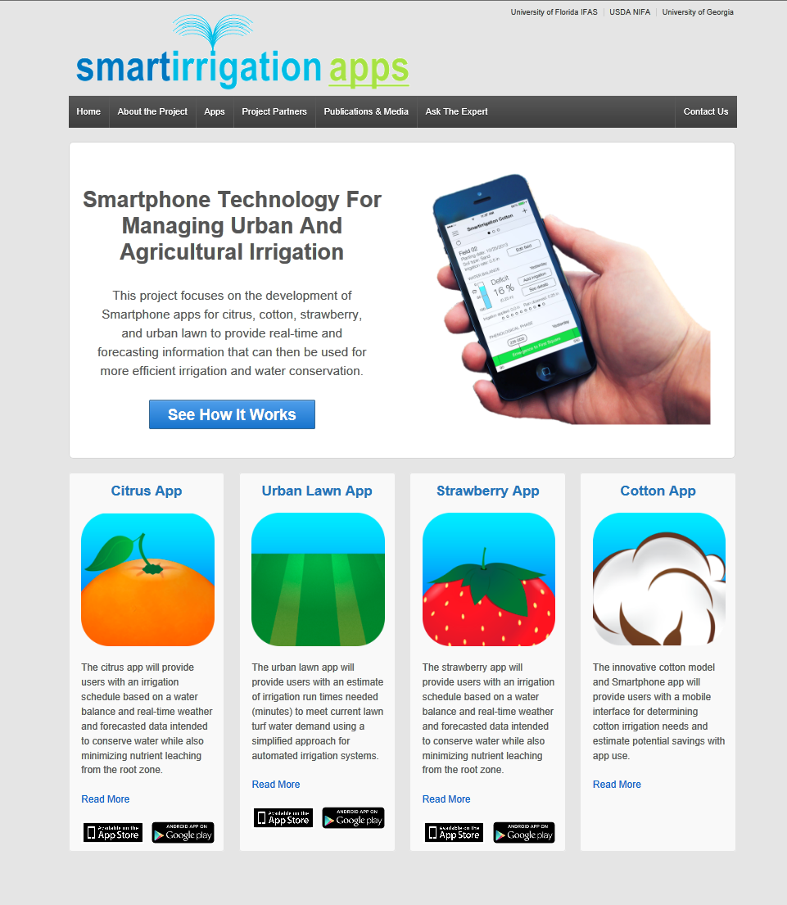
Irrigation Scheduling: Methods
Currently available as of 4/21/2014:
http://smartirrigationapps.org/
Available both at the Google Play Store and Apple App Store for Android and iOS operating systems.

Slide 20
Irrigation Scheduling
Operating Principle of the Scheduling Apps:
Crop Coefficient approach for estimated ET:
Where:
ET_{C} = estimated crop ET
K_{C} = crop coefficient
ET_{O} = Penman-Monteith reference ET (FAO-56)

Slide 21
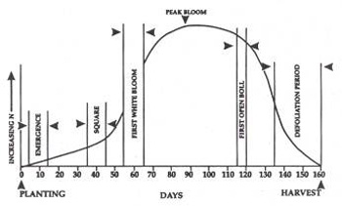
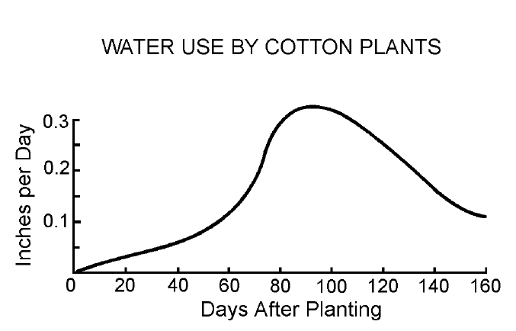
Determining of the K_{C} Curve
Measured crop water use from a cotton field in Louisiana over the growing season.
Water use and crop coefficient function for cotton in Stoneville, Mississippi.
University of Georgia Extension publication.

Slide 22
Determining of the K_{C} Curve
1st
Square
1st
Flower
1st
Open Boll

Slide 23
Cotton App Irrigation Scheduling
Simplified water balance approach:
Soil water holding capacity
Estimated rooting depth
Estimated evapotranspiration (ET_{C})
Minimum allowable soil water depletion (50%)
Irrigation system characteristics (Overhead or drip in this case)
Measured Precipitation and Irrigation

Slide 24
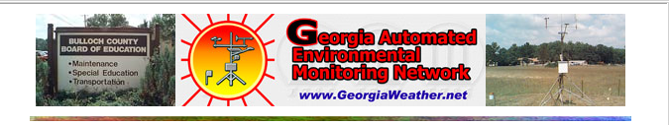
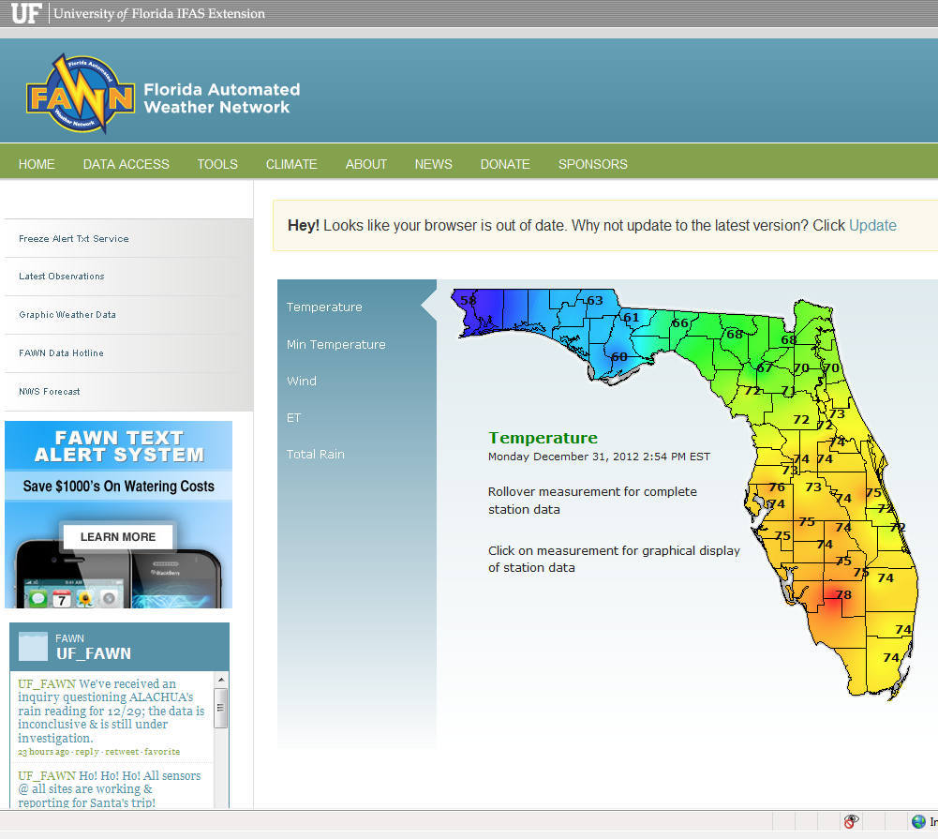
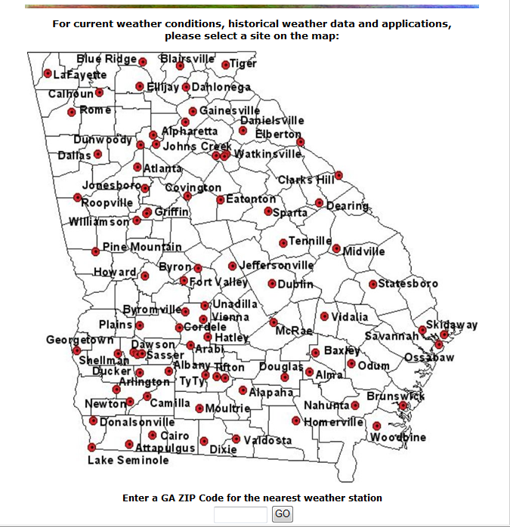
Weather Networks
GAEMN - Georgia Automated Environmental Monitoring Network
FAWN - Florida Automated Weather Network

Slide 25
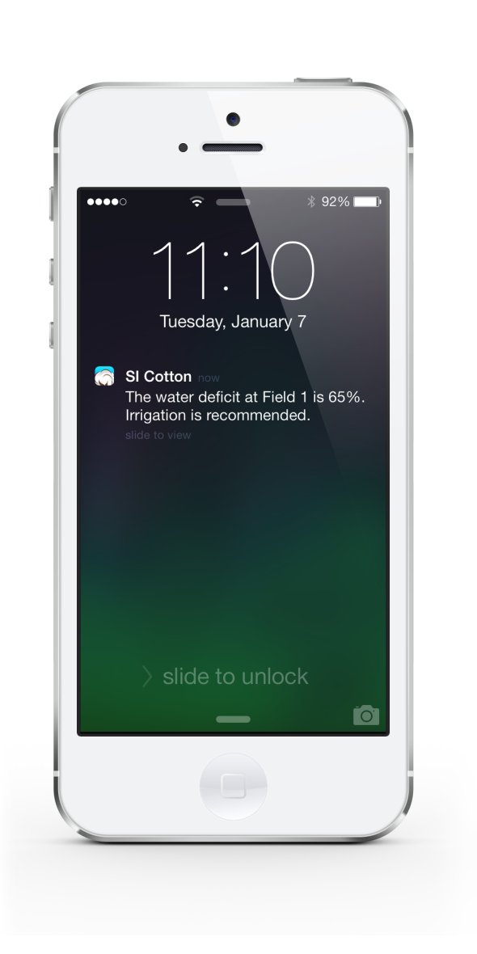
Cotton App
Does not recommend irrigation amounts
Advises user of Root Zone Water Deficient in terms of inches and % total
Maximum Recommended Deficit is 50%
Provides weekly (Monday-Sunday) estimated ET_{C}

Slide 26
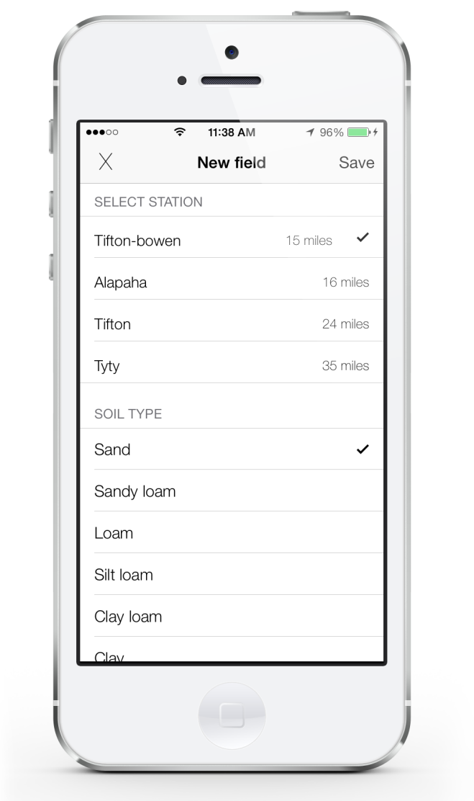
Cotton App: Model Variables
Meteorological data from weather stations
Temperature and Precipitation are used to calculated Penman ET
Soil Type (sand, sandy loam, etc.)
Soil water holding capacity (in/in)
Initial Soil Condition (inches of available water)

Slide 27
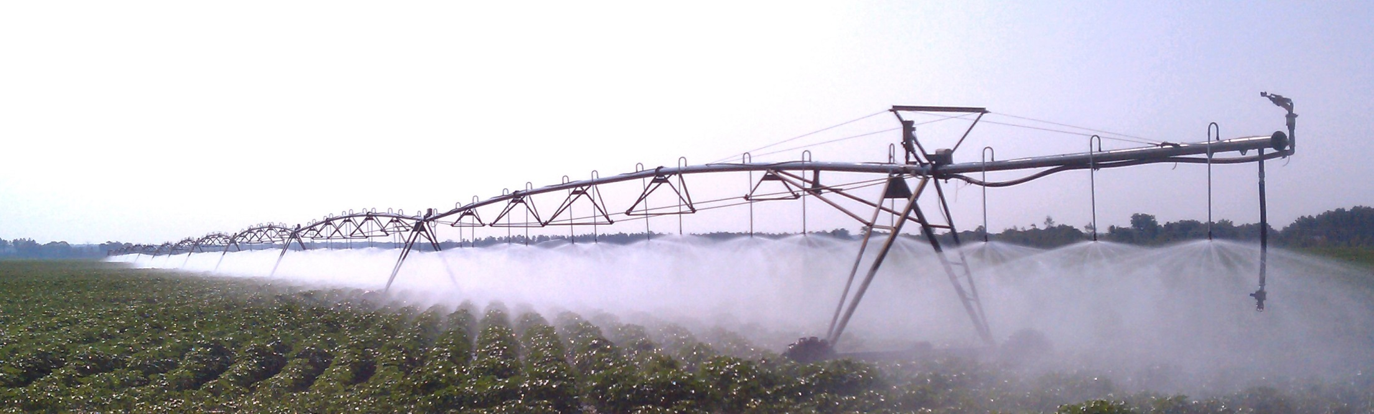
Cotton App: Model Variables
Rooting Depth
Minimum = 6 in; Maximum = 24 in; Increases ~ 0.3 in/day
Irrigation System Type
System Effectiveness (efficiency)- % of applied water which enters soil (85% for pivots)
Default Irrigation Depth (in)

Slide 28
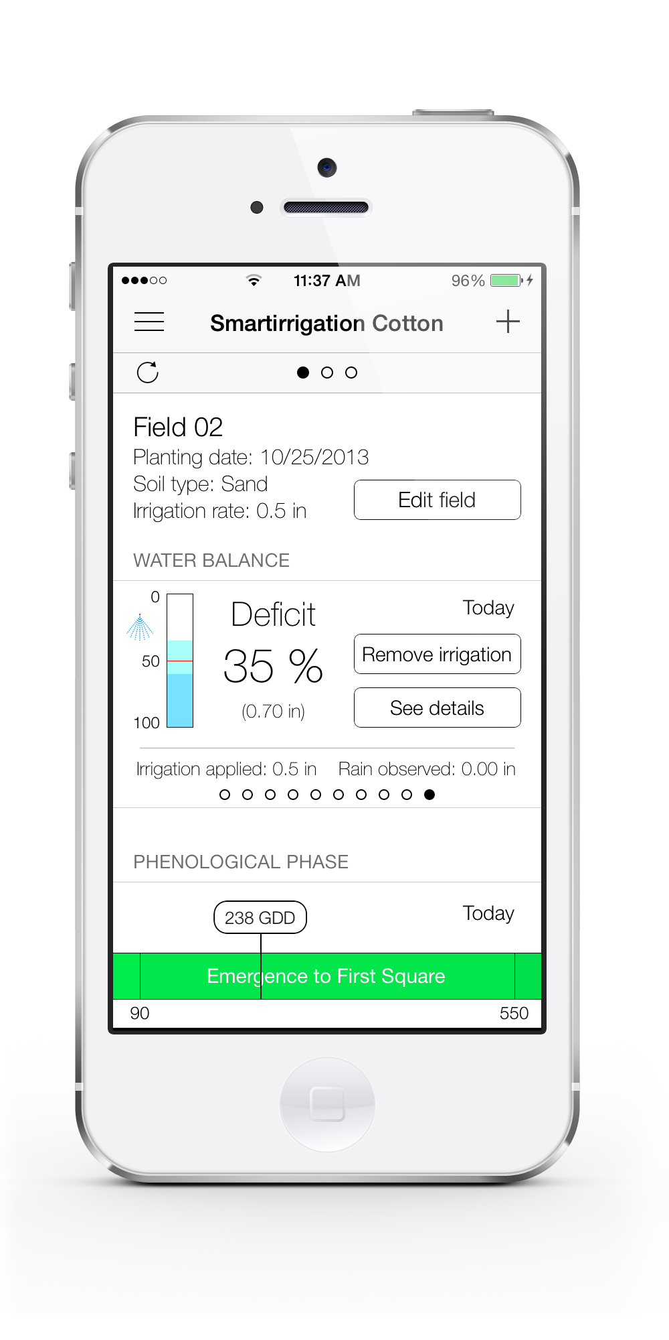
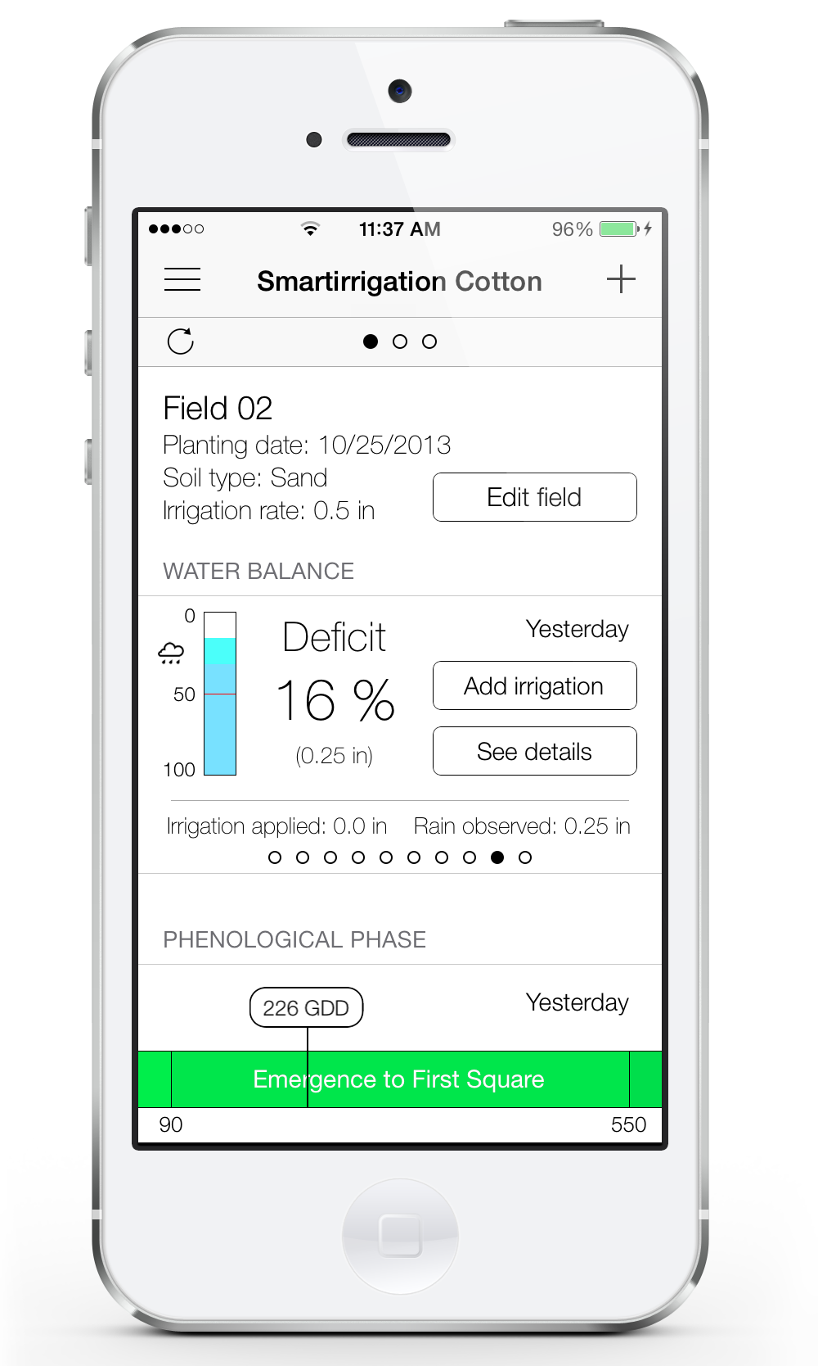
Cotton App

Slide 29
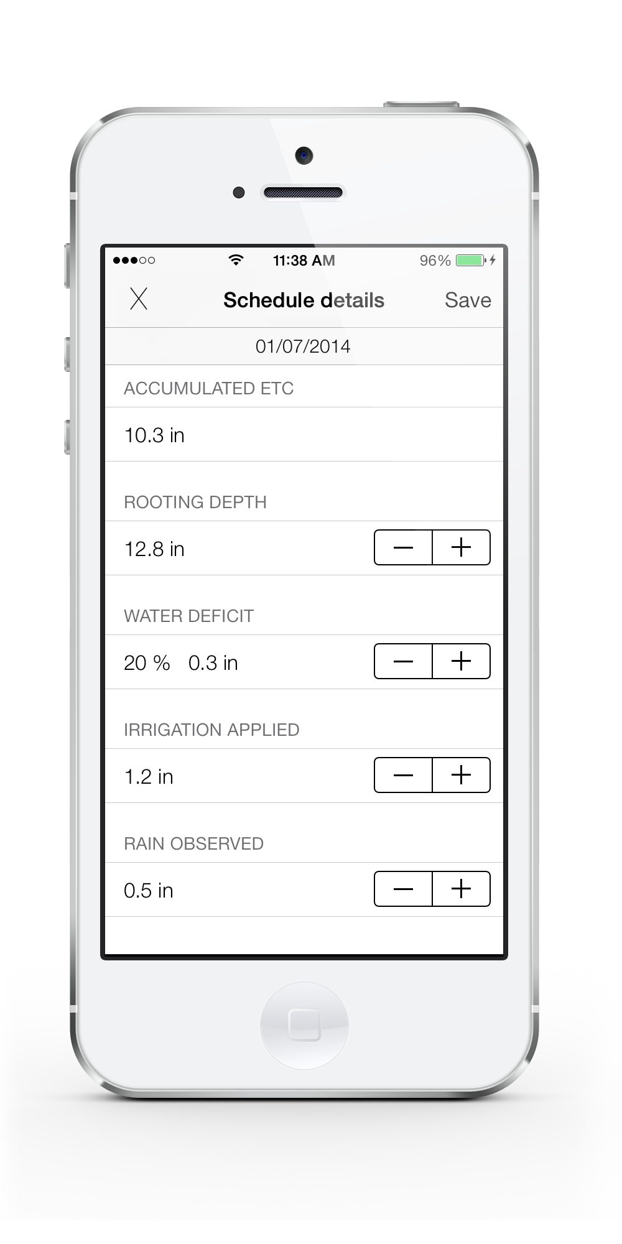
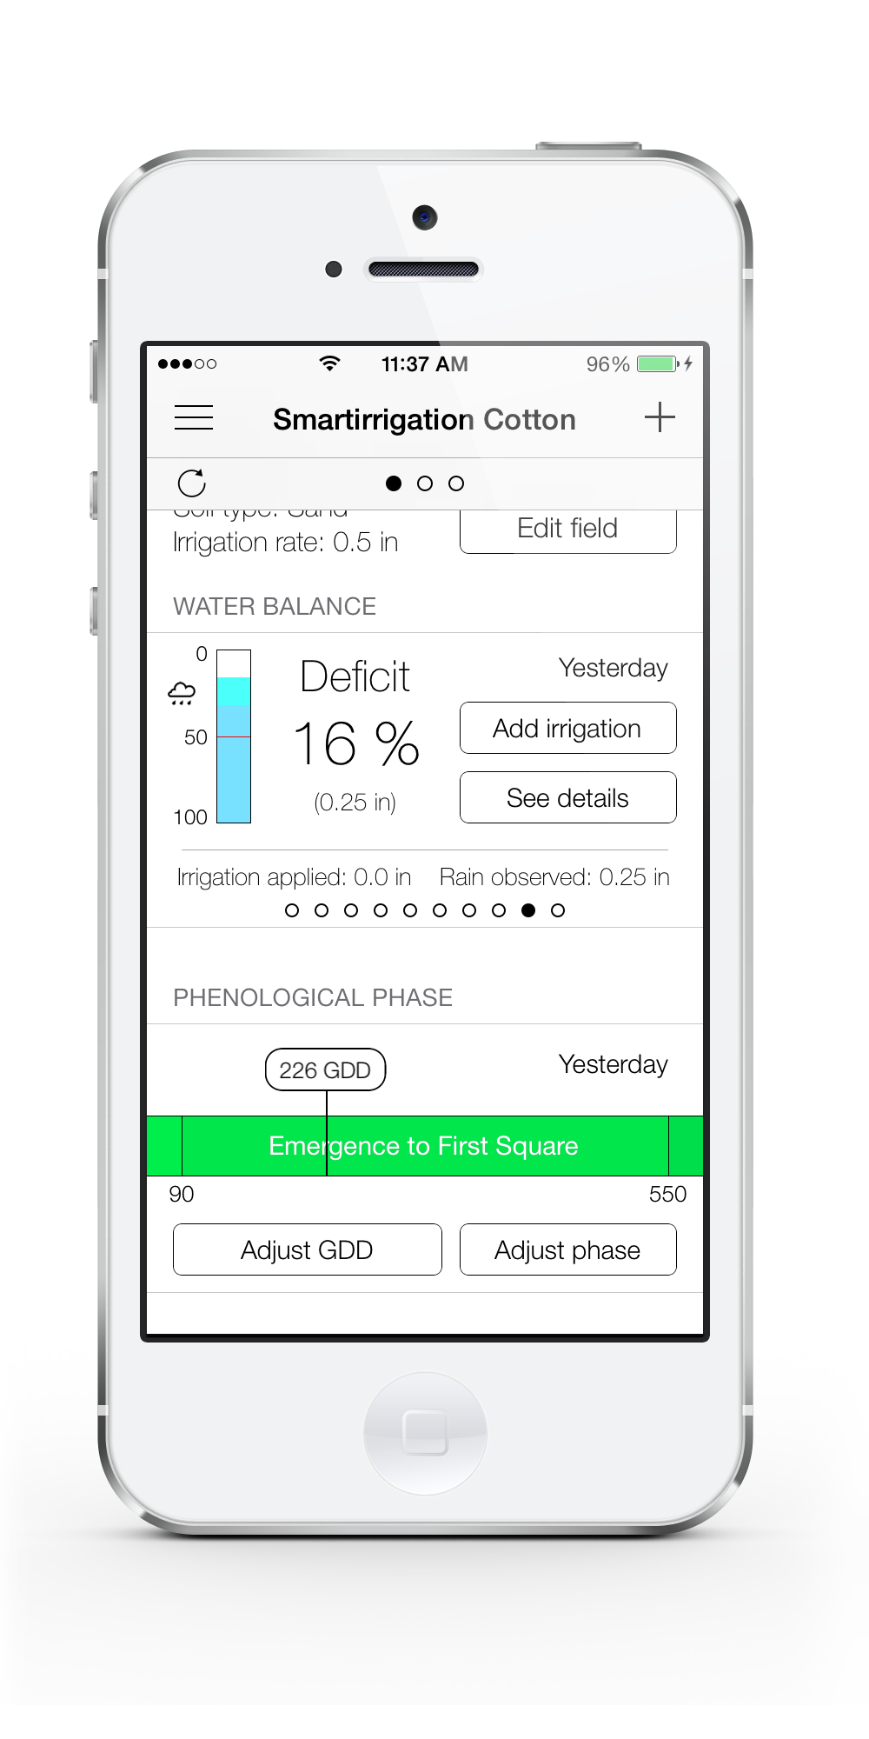
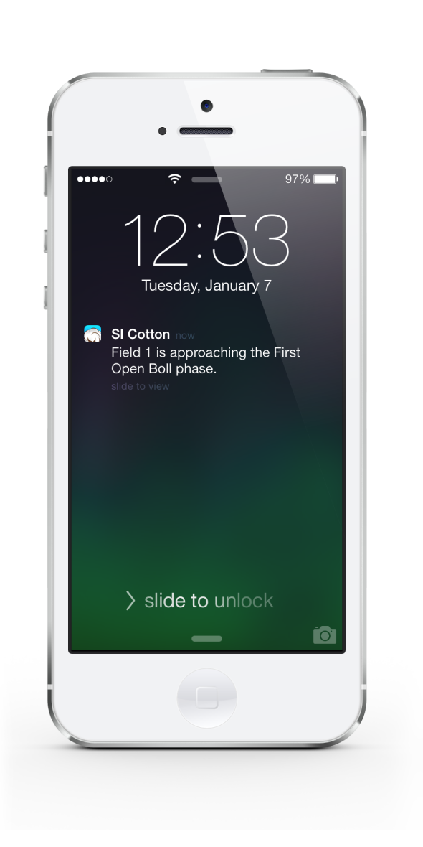
Cotton App

Slide 30

Cotton App
Method | Conservation Tillage |  | Conventional Tillage
 | Lint Yield (lb/ac) | Water Use (in) | Lint Yield (lb/ac) | Water Use (in)
Checkbook | 1350 | 12.7 | 1150 | 12.2
Cotton App | 1485 | 3.0 | 1259 | 3.0
CWSI | 1430 | 5.0 | 1305 | 2.3
Irrigator Pro | 1455 | 2.8 | 1200 | 4.3
Rainfed | 1450 | 1.5 | - | -
Variety = DP 1252 B2RF
Planting Date = 16 May 2013
Harvest Date = 15 Nov 2013
Rainfall = 27.4 inch

Slide 31
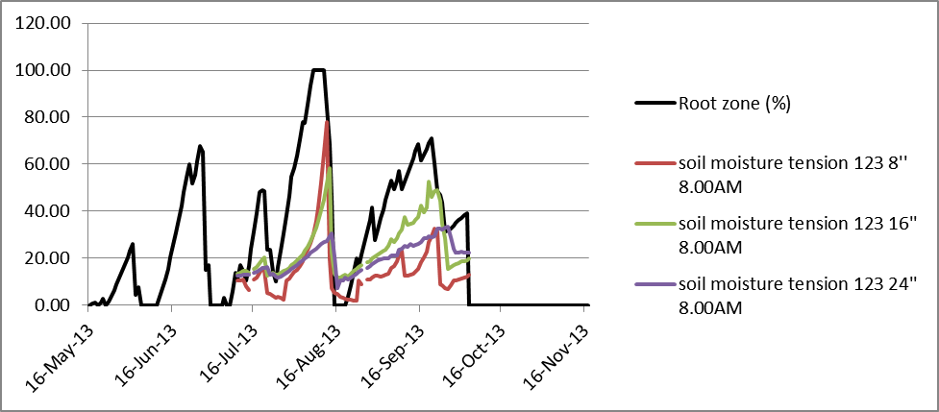
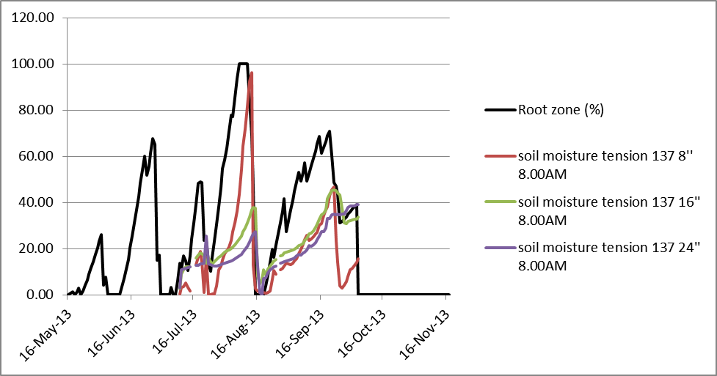
Cotton App
2013 Conservation Tillage
% Root Zone Water Deficit
8 in Soil Water Tension (kPa)
16 in Soil Water Tension (kPa)
24 in Soil Water Tension (kPa)
Soil Water Tension (kPa)
% Root Zone Water Deficit
2013 Conventional Tillage
% Root Zone Water Deficit
8 in Soil Water Tension (kPa)
16 in Soil Water Tension (kPa)
24 in Soil Water Tension (kPa)
Soil Water Tension (kPa)
% Root Zone Water Deficit

Slide 32
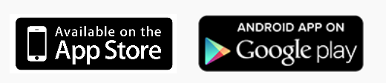
Cotton App: Next Steps
App is currently available
Beta-testing with users in southern Georgia
Continued testing with plots
Regionalize app
Alabama, Florida, Georgia, South Carolina
Add a drought strategy component
Evaluate apps with replicated field trials
Add a peanut app
Add other crops

Slide 33
Cotton App: Partners
Project Team
Funding
University of Florida
Kati Migliaccio, Kelly Morgan, Clyde Fraisse, Diane Rowland, Jose Andreis
University of Georgia
George Vellidis, Guy Collins, Calvin Perry, John Snider
Clemson University
Jose Payero
USDA NIFA NIWQ (2 grants)
USDA NRCS CIG
Cotton Inc.
Georgia Cotton Commission

Slide 34
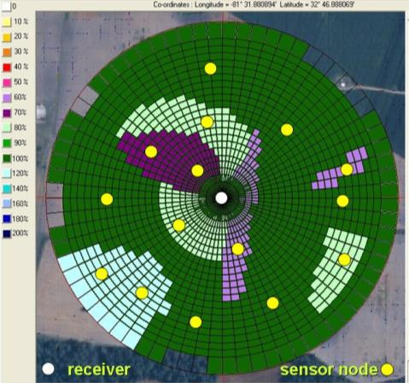
UGA Smart Sensor Array (SSA)
Designed to enable dynamic precision irrigation (VRI)
Dynamic prescription maps based on soil moisture data
High density of sensors to populate irrigation management zones (IMZs)
Design Characteristics:
Truly wireless
Energy efficient
Low Cost
Low profile
Low maintenance
Easy installation/removal

Slide 35
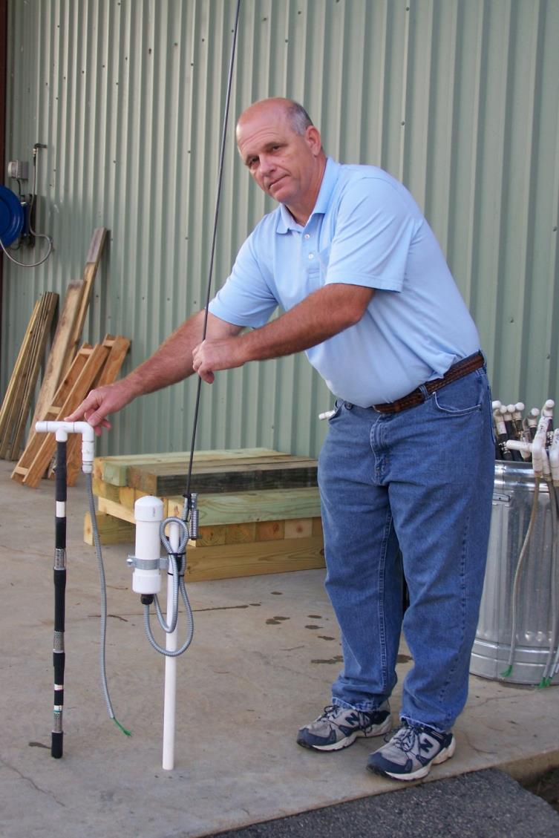
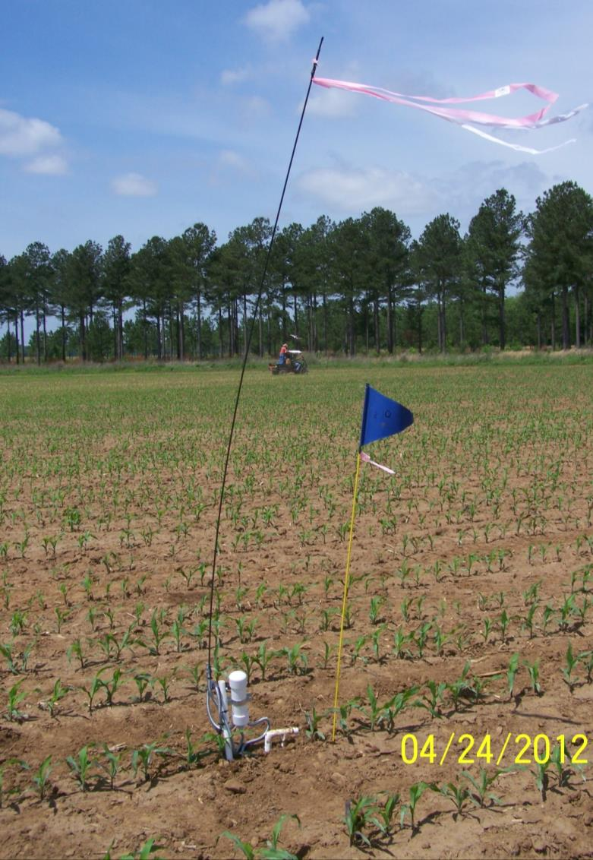
University of Georgia Smart Sensor Array
(UGA SSA)
electronics
04/16/13
3 Watermark® sensors

Slide 36
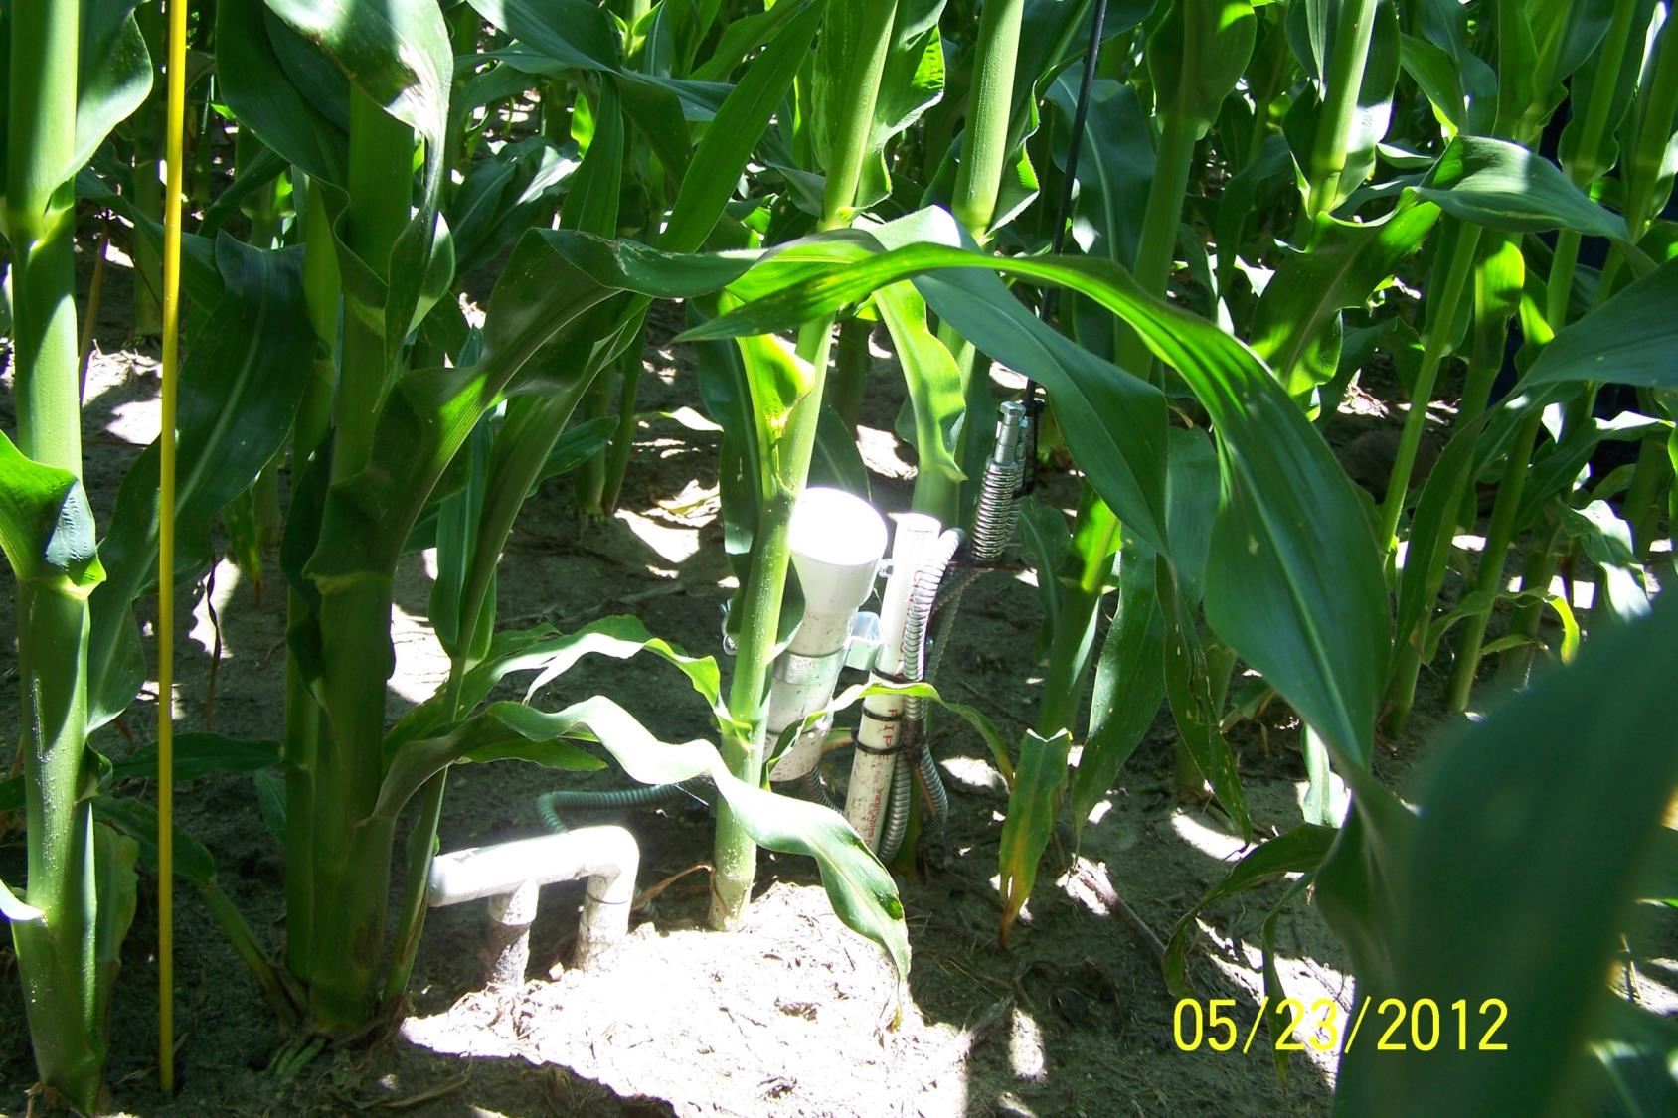
antenna
spring
05/23/13

Slide 37
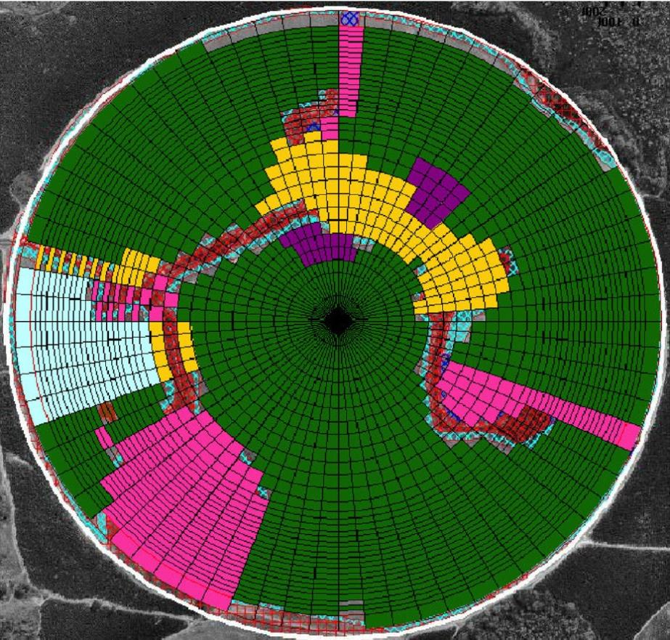
FIST – Flint Irrigation Scheduling Tool
HOME (second page)
select time period : from 7 until
07/12/2013
07/13/2013
farm/field settings
management zone settings
sensor monitoring
data analysis
data export
Crop growth stage
PEANUTS
COTTON
CORN
First Flower
Save
Irrigation Recommendation
inch
inch
inch
inch
inch
18.8 ac
30.2 ac
4.3 ac
191 ac
13.7 ac
0.5
0.3
0.0
1.0
0.7
Approve
Export
Precipitation Forecast
0% chance of rain today
20% chance of rain Tuesday (0.3 in)
50% chance of rain Wednesday (0.9 in)
Legend: push pins:
Blue: Sensor below irrigation threshold
Red: Sensor above irrigation threshold
Flashing Orange: Sensor needs attention

Slide 38
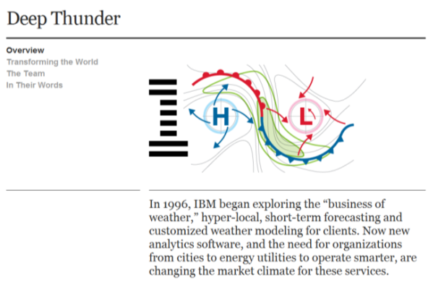
FIST – Flint Irrigation Scheduling Tool
HOME (second page)
select time period : from 7 until
07/12/2013
07/13/2013
farm/field settings
management zone settings
sensor monitoring
data analysis
data export
Crop growth stage
PEANUTS
COTTON
CORN
First Flower
Save
Irrigation Recommendation
inch
inch
inch
inch
inch
18.8 ac
30.2 ac
4.3 ac
191 ac
13.7 ac
0.5
0.3
0.0
1.0
0.7
Approve
Export
Precipitation Forecast
0% chance of rain today
20% chance of rain Tuesday (0.3 in)
50% chance of rain Wednesday (0.9 in)
Legend: push pins:
Blue: Sensor below irrigation threshold
Red: Sensor above irrigation threshold
Flashing Orange: Sensor needs attention

Slide 39
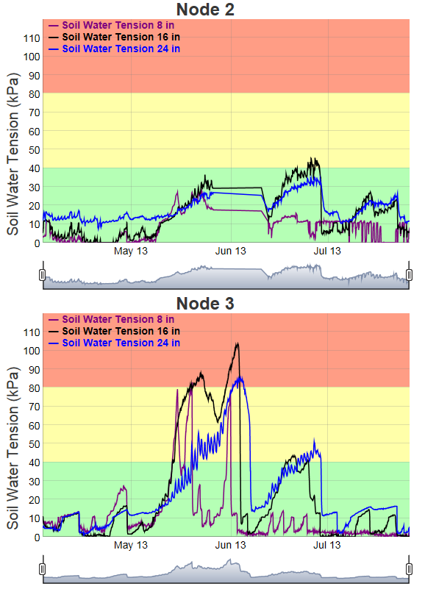
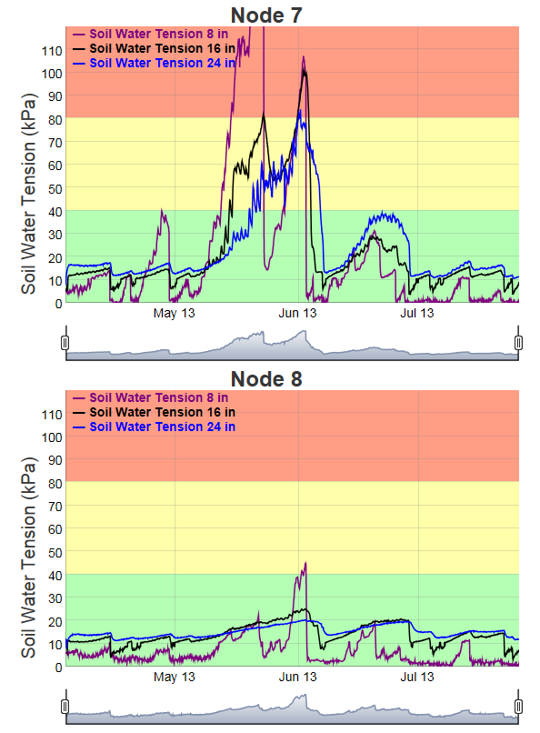
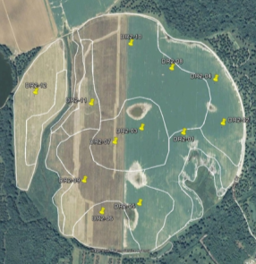
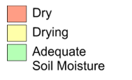
Welcome to the University of Georgia SSA Data Portal
Field 1

Slide 40
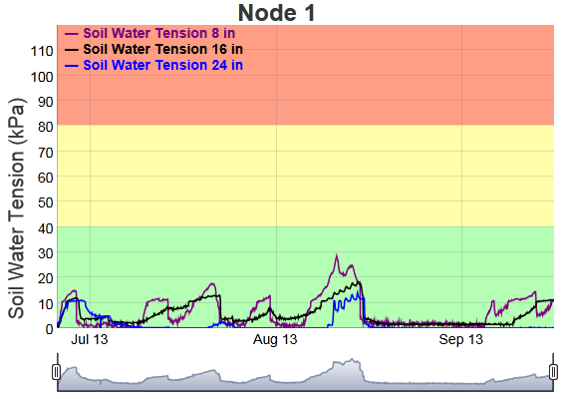
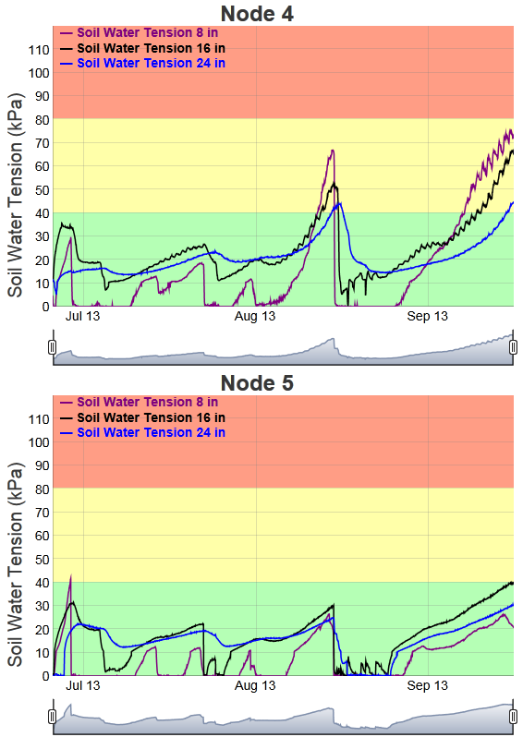
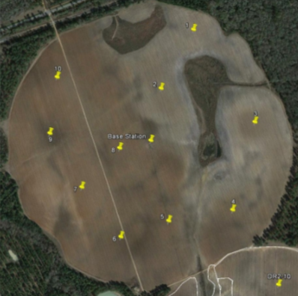
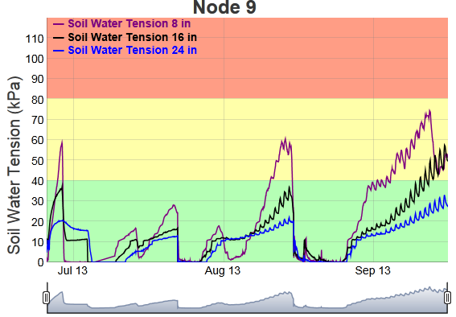
Welcome to the University of Georgia SSA Data Portal
Field 1
1
9
4
5
Peanuts

Slide 41
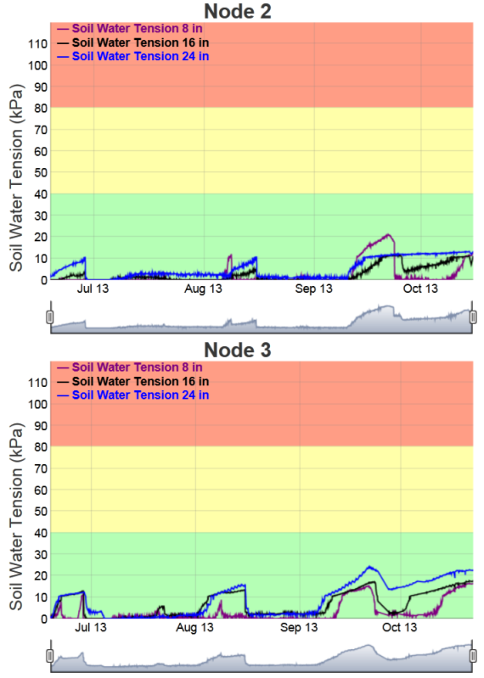
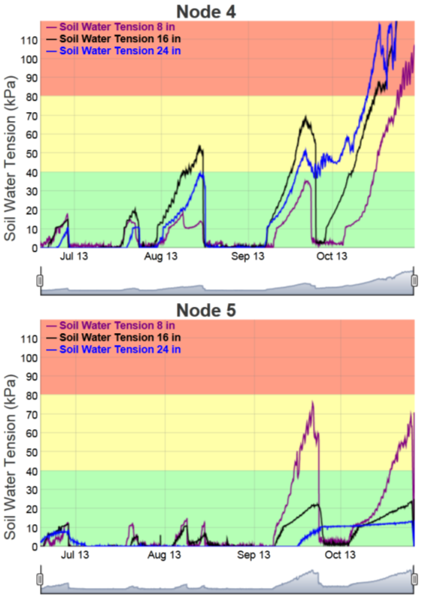
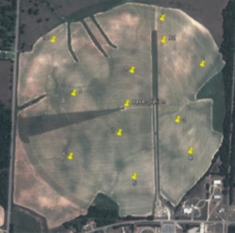
Welcome to the University of Georgia SSA Data Portal
Field 6
Cotton

Slide 42
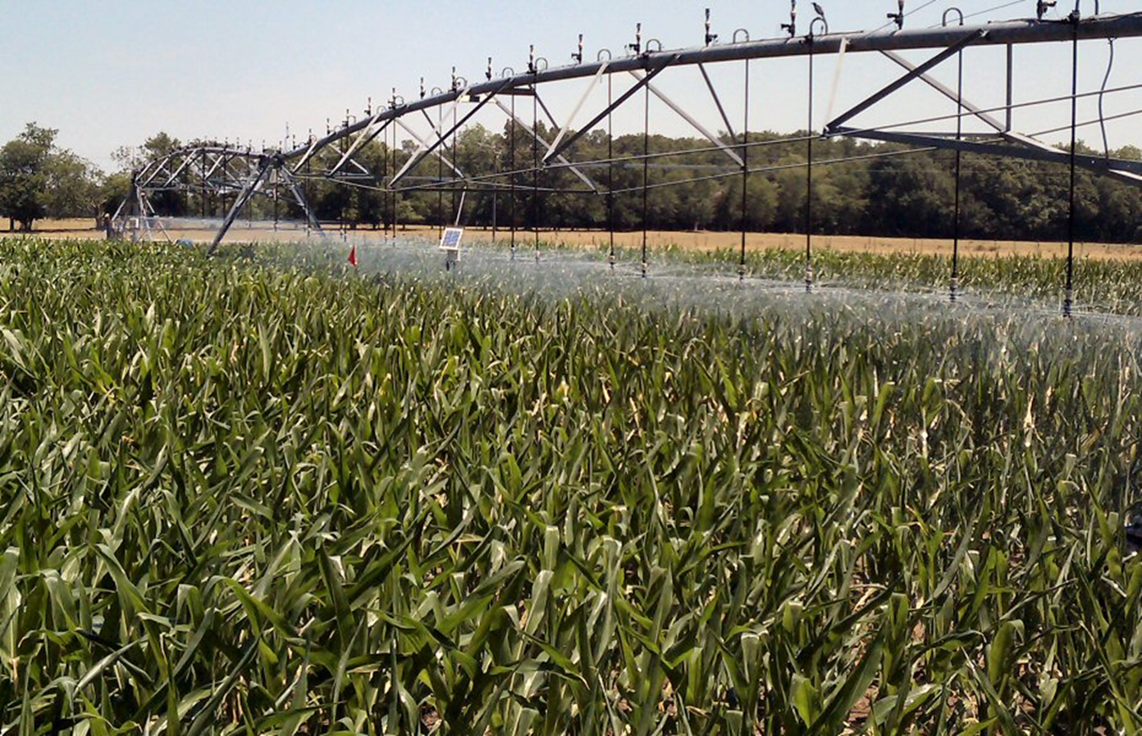
Questions/Comments?

