Slide 1
Sensor Algorithms 101
Brian Arnall
Oklahoma State University
Precision Nutrient Management

Slide 2
Algo 101
Several Sensor Based N Rate Calculations exist.
There are two distinct approaches to N rate calculations.
Use of Yield Prediction and Response
Use of Response only

Slide 3
Algo 101
This Workshop
Will walk through the published Algorithms built by 5 institutions. All are used/available in Commercial systems.
We are not going to compare specific N rates applied.
We are going to look and the Metrics and Agronomics behind each.

Slide 4
Algo 101

Slide 5
Optical Sensor Values
NDVI
  Regardless of sensor is essentially a measure of biomass.
  NDVI = (NIR-VIS)/(NIR+VIS)
Simple Ratio
  SR = NIR/VIS
Red-edge: Chlorophyll measurement

Slide 6
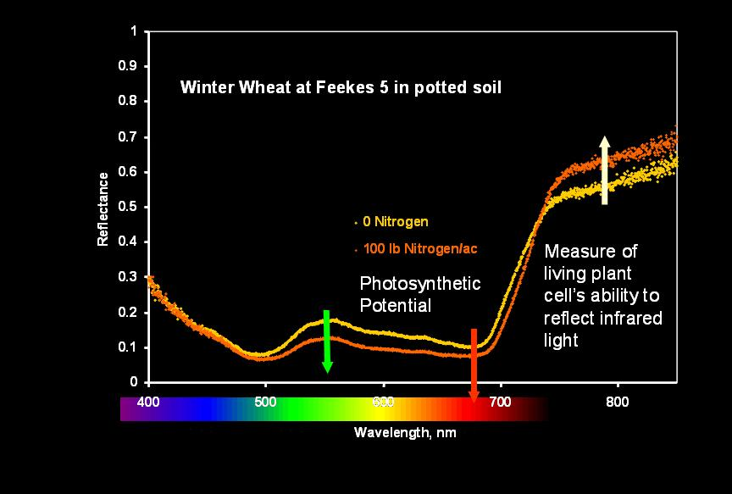
Reflectance

Slide 7
Response
Response is thought of in two ways.
  RI: Increase above standard pre-plant high/low >1
    Increase in yield due to N
    RI 1.2, Expect an increase in yield of 20% w/ N
  SI: Percent of high level low/high <1.0
    Sufficiency of standard practice
    Typically uses a Base N rate
    SI of .75, Expected N need 200 FP = 150
Can be calculated using NDVI or SR

Slide 8
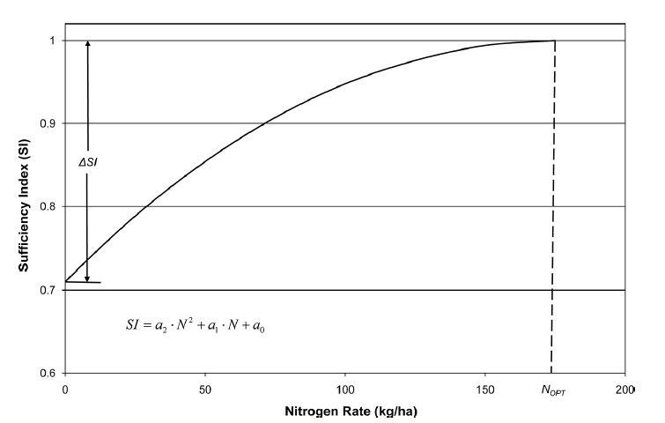
Graph of SI
Figure from Holland and Schepers: 2010 Agronomy Journal.

Slide 9
Response
Correlation between OSURI ndvi and RI Ratio

Slide 10
RI NDVI and RI Harvest
A few of the groups have determined that the relationship RI of NDVI and RI of yield is not a 1 to 1 relationship.
Therefore some algorithms use adjusted RI based on research. Calculation differs across crops and environments (great plains vs east coast).

Slide 11
N-Rich / Reference Strip
What: A high rate of N applied in, across, through, over or under each and every field (NR).
How Much: Rate significantly higher than standard practice (Farmer Practice FP).
How and Where: 10 to 100 ft wide, anywhere representative.
Timing: Crop and Environment specific

Slide 12
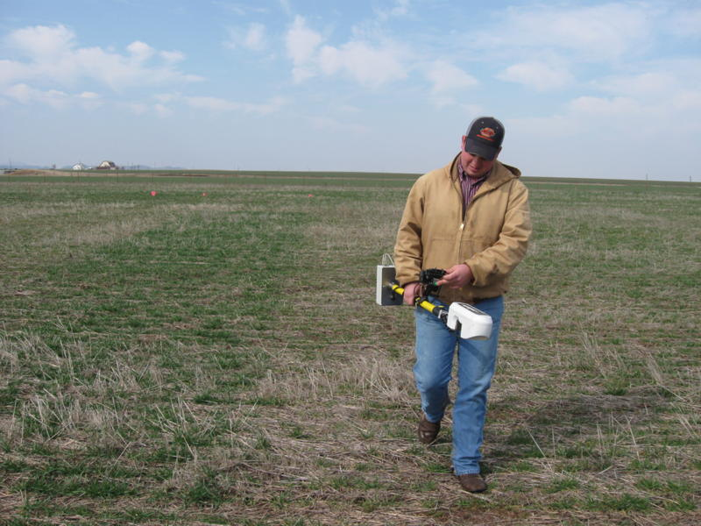
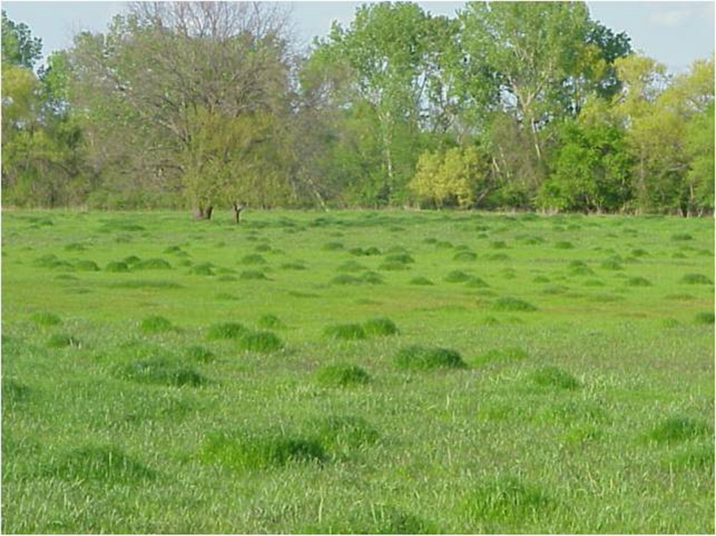
N-Rich / Reference Strip

Slide 13
Zero N Strip Low N
Used in Several areas and algorithms.

Slide 14
RI calcs
OSU 1.64 * (NR/FP) + .5287
tOSU -1.5926*((1-LN)/(1+LN))/(1-NR)/(1+NR))+2.6557
VT NR/LN
Yield with N, YPN
OSU YPN*RI
tOSU 20*exp(-.06 *((1-FP)/(1+FP))*DFP)*
100*2.2/56/2.47*YP0
VT 3500*exp((FP*(NR/LN)/DFP

Slide 15
Virtual RI
Measurements from the greenest area of the field for N-Rich value
Used with SI on On-The-Go sensors.
http://www.agleader.com/products/directcommand/optrx/

Slide 16
Yield with N YPN
OSU YPN*RI
tOSU 20*exp(-.06 *((1-FP)/(1+FP))*DFP)*
100*2.2/56/2.47*YP0
VT 3500*exp((FP*(NR/LN)/DFP

Slide 17
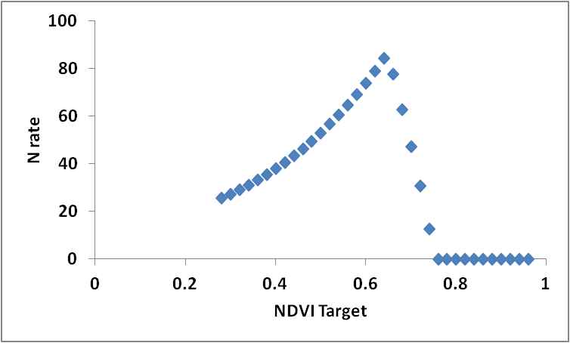
OSU/Canada/KSU/LSU
Uses Yield Prediction and RI (OSU) in ex.
If (YP0*RI<YPNR, YP0*RI, YPNR)-YP0
*56lb/bu *.0125 %N / .60%NUE

Slide 18
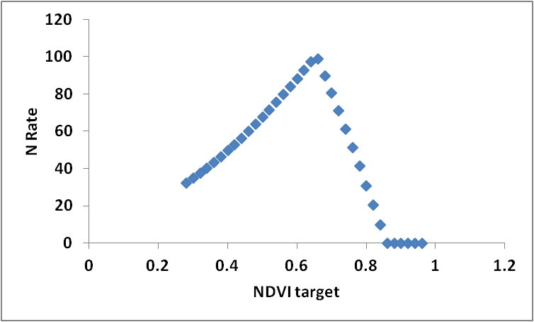
The OHIO State tOSU
Uses Yield Prediction and RI(tOSU) LowN
Min: (YP0*RI, Max Yld) – YP0
*65*.0125/.60

Slide 19
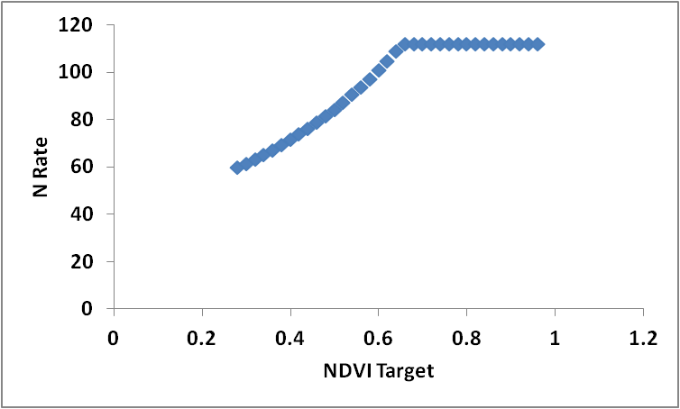
Virginia Tech
Uses Yield Prediction and RI(tOSU) LowN
Min {((.0125/.6)*(YPN-YP0)+100-PreN)), 168-PreN} 100=Sidedress Base Rate 168= Max N.
168-preN

Slide 20
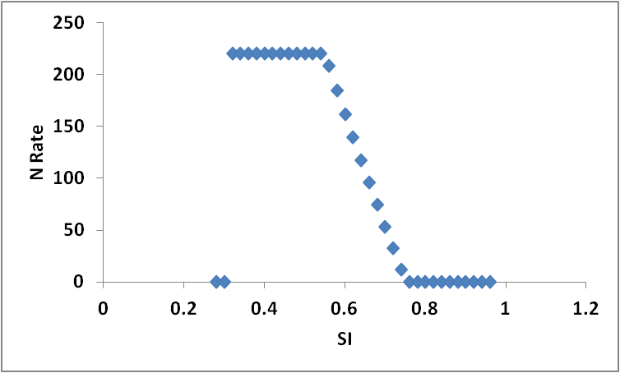
U of Missouri
Sufficiency Index and Max N
Min ((Max N-SI)-Index Ceiling, Max N)
  Max N Changes by stage V6-V7 & V8-V10
  Index Ceiling change by sensor and stage
Min SI used in GS

Slide 21
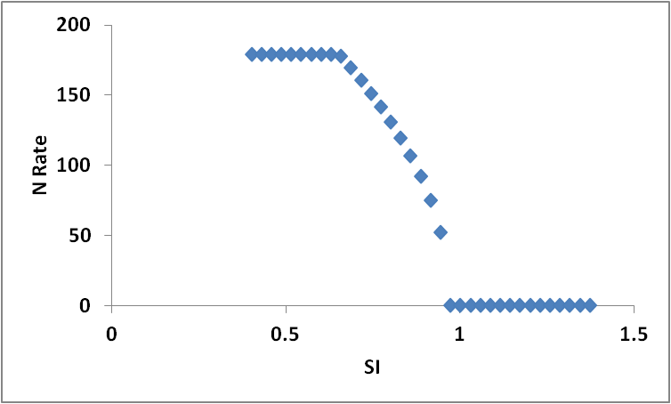
UNL Solari
Uses SI and Optimum N Rate
Based on a Chlorophyll Meter Algo.
Min(317*SQRT(.97-SI), OptN)

Slide 22
Holland Sci
SI, Delta SI, Nopt
(OPTN-Npre-Ncred+Ncomp)*
SQRT (1-SI)/(Delta SI *(1+.1*exp
(backoff* (SIthreshold-SI)
  Delta SI is .3+/-.1 or FP/RI
  Backoff 0,10, 20, 50. controls N dec w/ dec SI
    Adjust based on ability of crop to recover.
  SI theshold .7

Slide 23
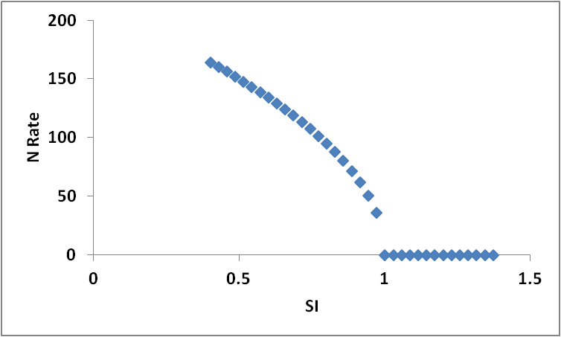
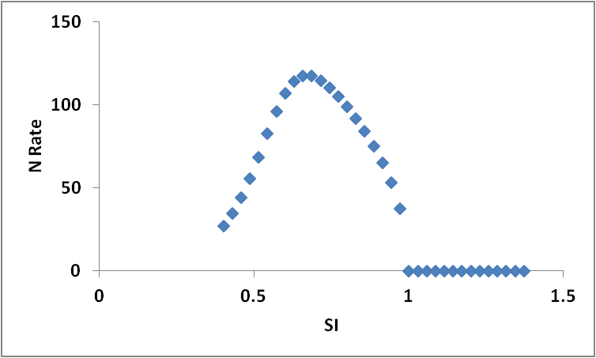
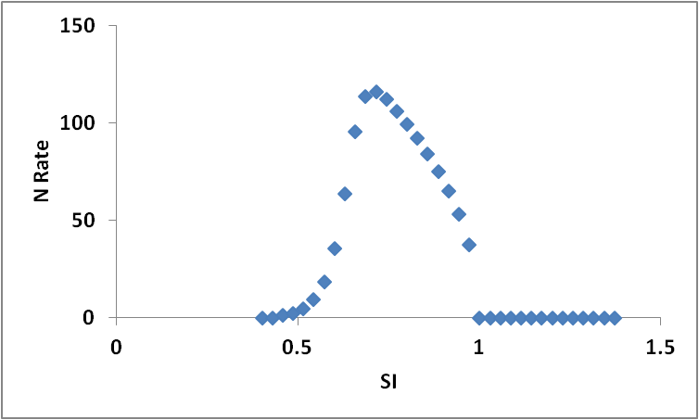
Back off
None
Intermediate
Aggressive

Slide 24
References
www.nue.okstate.edu
http://www.mo.nrcs.usda.gov/technical/technotes_index.html
http://www.grains.cses.vt.edu/corn_algorithm.htm
http://hollandscientific.com/
http://www.agleader.com/
http://ntechindustries.com/
Solari et al. 2010. An active Sensor Algorithm for corn nitrogen reccomendations based on a chlorophyll meter algorithm. Agron. J. V102 4:1090-1098
Holland and Schepers. 2010. Derivation of a variable rate nitrogen application model for in-season fertilization of corn. Agron. J. V102 5:1415-1424

Slide 25

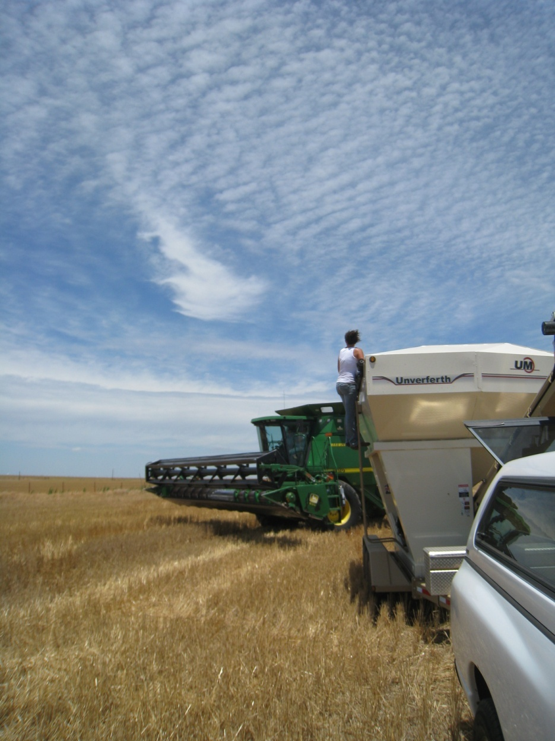
Thank you!!!
Brian Arnall
b.arnall@okstate.edu
Presentation available @
www.npk.okstate.edu
Twitter: @OSU_NPK
Facebook Fan Page
www.facebook.com/osunpk
YouTube Channel: OSUNPK

