Slide 1
Farm Level Data Management
Randy Taylor
Extension Ag Engineer

Slide 2
What is Farm Level Data?
Crop production records
Yield
Field Operations
Input Records
Financial Records
Revenues
Expenses

Slide 3
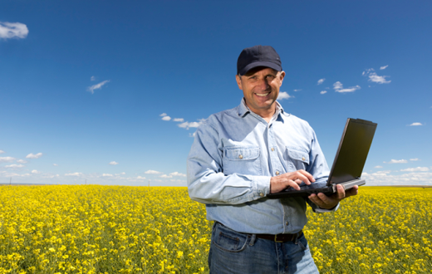
So What’s Changed?
While paper records are still important, we have a streamlined method for getting there.
Technology adoption allows digital records to better manage inputs and equipment.
Data Management can be the driver for agronomic and business decisions…

Slide 4
Farm Level Data Example
No-till corn planted into soybean and wheat stubble
Corn was planted from March 31 to April 22
There were 19 hybrids planted individually on at least 8 acres each. There were another 11 hybrid combinations planted through split planter trials on at least 11 acres each.
The 36 fields used in this study were within a 9-mile radius
Rainfall varied across the area
The cooperators assigned ratings for rainfall (most, intermediate, and least rain) and soil rating (best, good, and poor) to each field

Slide 5
Objective
To determine if the time of day that corn was planted had an effect on yield
It was the cooperator’s observation that they were not getting good stands when they planted early in the day.

Slide 6
Methods
Data were mapped based on time of day that corn was planted
429 points were selected to represent the range of planting times across all 3 farms
Yield, cooperator, hybrid, planting date and time, and rainfall and field ratings were extracted for each location (point)

Slide 7
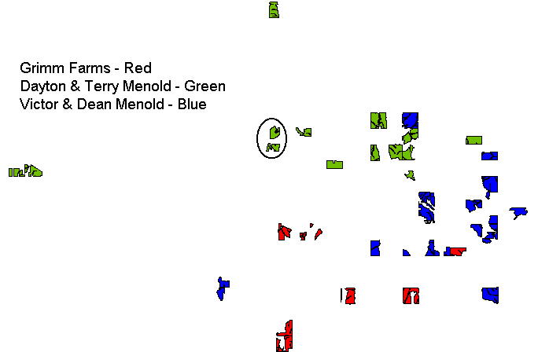
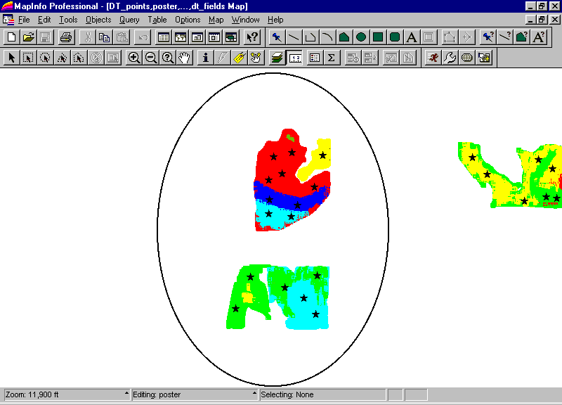
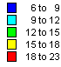
Selecting Observation Points

Slide 8
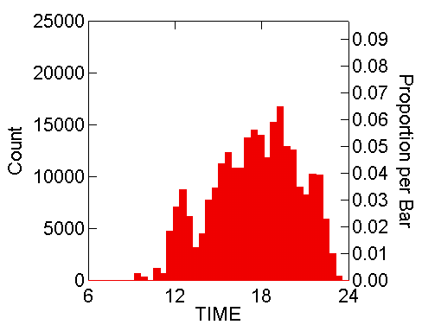
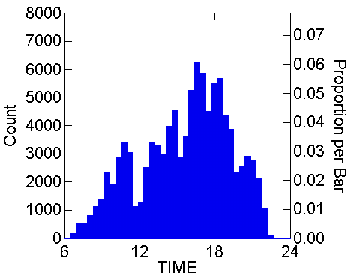
Distribution of Planting Time

Slide 9
Analysis
Multivariate linear regression was used to evaluate the relationship between yield and all the known influencing parameters
Yield was regressed as a function of, planting date, planting date squared, planting time, and planting time squared
Other information was brought into the regression analysis through dummy variables
Hybrids of interest and the rainfall and soil ratings

Slide 10
Regression Results
Dependent Variable: YIELD
N: 429
Multiple R: 0.568
Squared multiple R: 0.322
Adjusted squared multiple R: 0.300
Standard error of estimate: 16.438

Slide 11
Regression Results
Effect
Coefficient
Std Error
Std Coef
Tolerance
t
P(2 Tail)
Constant
723.135
301.127
0.000
.
2.401
0.017
Day
-12.238
5.903
-3.323
0.001
-2.073
0.039
DaySQR
0.059
0.029
3.277
0.001
2.061
0.040
Time
3.430
2.119
0.611
0.012
1.619
0.106
TimeSQR
-0.114
0.064
-0.668
0.012
-1.783
0.075
A12
6.690
4.611
0.065
0.825
1.451
0.148
K77K78
10.240
3.323
0.199
0.391
3.081
0.002
K61
-6.420
3.365
-0.087
0.783
-1.908
0.057
G8366
7.659
3.047
0.115
0.785
2.513
0.012
G26G27
4.623
3.467
0.065
0.681
1.333
0.183
Mixed
-7.335
2.698
-0.128
0.740
-2.719
0.007
GoodRain
19.561
2.774
0.489
0.340
7.051
0.000
MostRain
26.220
2.923
0.665
0.298
8.970
0.000
GoodSoil
5.576
2.732
0.132
0.390
2.041
0.042
BestSoil
4.661
2.527
0.119
0.396
1.844
0.066

Slide 12
Results – Planting Time
Both the time and time-squared variables were significant in the regression
Based on the regression, the cooperators lost about 4 bu/ac in yield when planting at 9 AM as compared to planting at noon.
Though this penalty for planting earlier in the day is not great, it does give the cooperators a real value to use in the decision making process.
Furthermore, if this occurrence is observed in future years, it this analysis could lead to improved machinery management decisions.

Slide 13
Results- Planting Time

Slide 14
Results – Planting Time
Though this penalty for planting earlier in the day is not great, it does give the cooperators a real value to use in the decision making process.
Furthermore, if this occurrence is observed in future years, it this analysis could lead to improved machinery management decisions.

Slide 15
Hybrid Yields
Hybrid | Regression | Farm Average | Acres
31A12 | 6.7 | 4.2 | 79
32K61 | -6.4 | -2.9 | 265
33G26/G27 | 4.6 | 0.5 | 217
34K77/K78 | 10.2 | 17.0 | 488
8366 | 7.7 | 3.5 | 302
Yields are relative to the base hybrid.

Slide 16
Results - Hybrids
Regression analysis showed that 34K77/K78 was 10.2 bu/ac better than 3237, whereas the whole farm average indicated it yielded 17.0 bu/ac more.
However, the whole farm averages do not account for the different planting dates and growing conditions.
3237 was planted in fields that received minimal rain.

Slide 17
Results - Hybrids
Of the 58 observations in the point data for 3237, 23 were associated with the least rainfall condition and no observations for 34K77/K78 were found in the least rainfall category.
More than a third of the low rainfall observations were associated with 3237.

Slide 18
Conclusions
Regression analysis explained over 30% of the yield variability with minimal (?) factors
Regression provided better hybrid analysis than farm averages

Slide 19
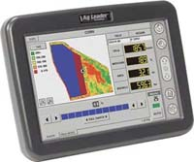
Data Logging
A data logger coupled with a GPS receiver lets us create application maps.
Allows us to record (automatically) what we are doing in the field.
Now we know where the proverbial check strip is located.
Furthermore with wireless technology, data is transferred automatically to the cloud and becomes accessible anywhere.

Slide 20
Grower Needs
Automatic wireless data transfer
Help getting started in data management with local support and training
Simplified Ag software with preference on web-based.
Results from 2012/2013 Alabama Precision Ag Survey of Midwestern and Southern Farmers

Slide 21
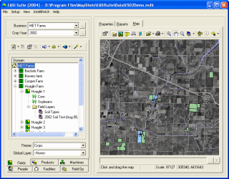
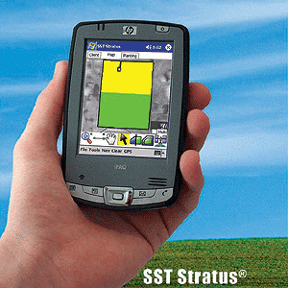
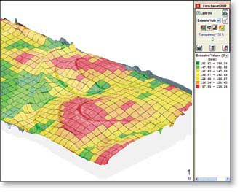
Computer Skills

Slide 22

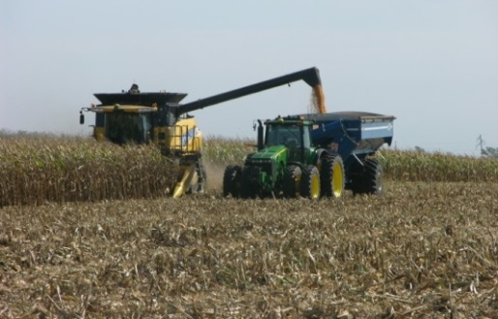



US Trends
Technology…
Ag Data Management
Organizing / Visualization
Analytics
Crop Insurance
Sustainability movement
Images courtesy of the different companies.

Slide 23
Considerations for Ag Data
Farmer / Primary Farm Manager owns the data.
Ownership vs. Licensing
Data streams and connectivity
Machine, agronomy, etc.
Data flowing between company databases / clouds
Remote sensed imagery – who owns?
Policy development – IA and other groups working on policy

Slide 24
Ownership
Ownership is not the concern – the farm or primary farm operator OWNS the data as view by 99.9% out there.
The concern comes with the User License –
What does it mean?
How can it be used?
Is it an exclusive license?
Who can touch access the data?
As data moves between servers, does personal information (name, field ID, GPS points) go with it so it can be linked back to the source?

Slide 25
Remote Sensing and Drones
Who owns remote sensed imagery?
Can someone fly a drone across your field?
Does a drone really matter, it the same information is available from satellites?
New camera technology is being commercialized which may be able to provide the user with more information than might be expected
So as a farmer, companies may not need your data since they can collect through remote imagery and other online intelligence systems.

Slide 26
Seeing Through the Cloud
Industry partnerships
Trusted representative which provides personalized solutions.
Consider the equipment – technology - service you purchase (work together?)
Terms & Conditions related to data (read)
Exclusive license?
If I decide to leave, what happens?
Be engaged (if you want a choice – be engaged)
At least one company is considering a “Growers’ Bill of Rights.”

Slide 27
Data Privacy is the Real Issue
There is talk but little presence by famers in the area of data privacy.
Farm Bureau made their announcement a couple weeks back that may influence Terms and Conditions a little, but more effort is needed now as services are being deployed.
The service sounds great but in the meantime a company may get to see a lot of the business side!
What happens when the real players get involved (i.e. Google, etc.)?

Slide 28
Personal Shopping Data
Companies collect demographics and shopping patterns
Retail discount cards
Credit cards
Some people will gladly share their demographics for a small discount on purchases
Is your individual data valuable (i.e. do they really care what I buy as an individual)?
Probably not without the database

Slide 29
Value of Your Farm Level Data
The data has the most value to you.
A database is only as valuable as the data it contains.
Data integrity is critical
Is your farm level data valuable to someone else?
Probably not without the rest of the database
Large datasets are necessary to make wide scale inferences
Do you get value from the database?

Slide 30
Farm Level Data
Can you make better (i.e. more informed) decisions?
Can you make inferences from one year’s data for future decisions?
Do you have enough data to make good decisions?
Acknowledgements: John Fulton, Auburn University and Jeremy Wilson, Crop IMS provided material for this presentation.

