Slide 1
Delineating Zones for Variable rate Seeding a Fertility Mgt.
Chad Godsey
Godsey Precision Ag

Slide 2
Philosophy
Every producer is at a different point in adoption so cookie cutter approaches do not work in lot of cases. Each plan has to be made individually to accomplish goals.
Development of precision ag technologies like prescriptions should be a continuous dialogue between producers and myself until prescriptions are final.

Slide 3
Basis for Decision Making - Prescriptions
Best case scenario-several years of yield data
Elevation
Soils Maps
Producers knowledge
EC/EM data

Slide 4
Collecting Yield Data
Yield monitor data serves two main purposes:
Enables evaluation of current year’s management
Provides data for future years in regards to how management could be altered to increase yields and/or decrease input costs.
Advantages:
Build a history of yield data to identify management zones
Identify problems that occurred during the current growing season that resulting in yield loss or gain
Evaluating on-farm research trials

Slide 5
Use of Yield Data
The most powerful use of yield data is when multiple years of data are combined in order to determine management practices that will increase yields or decrease input costs.
There is no better method in delineating management zones than through using yield data history. Multiple year yield analysis will define areas that are consistently high, medium, or low averaging.

Slide 6
Multi-year yield analysis
Yield History
Implement variable rate technologies
Incorporate data into next year’s decisions
End of Year Analysis

Slide 7
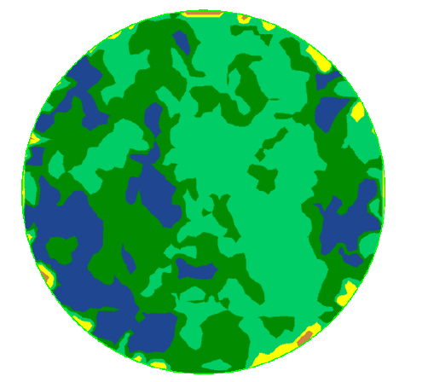
Figure 1. Three years of yield history with basic uniform management. Yields lowest to highest are brown, yellow, light green, dark green, and blue.

Slide 8
Multi-year Yield Map Analysis
Relative grain yield
Year to year stability
Management Zones for seeding
Figure on the left is relative or normalized grain yield over a 4 year period. Yellow area is 95 -105% of the field average for the time period. The middle figure is a measure of the yield stability from year to year. The lightest purple area is very stable. The figure on the right is using the information in the first two figures to generate management zones.

Slide 9
Variable Rate Seeding
The ideal seeding rate no doubt changes within a field for most fields in the Southern Plains.
Several methods can be used like elevation and soil map but yield history is by far the best.

Slide 10
Seeding

Slide 11
Variable Rate Seeding
Typically, save $1-5/acre in seed.
Producers typically have a good idea of what population works best where.
Match hybrid with population
Biggest upside is increase in yield in low yielding area of the field.

Slide 12
Example
Step 1
2.5 acre grid sample
Step 2
Multi-year yield analysis
Step 3
Variable Rate Seeding
Step 4
Variable rate N side-dress application
Step 5
End of year analysis

Slide 13
Nitrogen Management
Based on historic yield potential
Best if utilized with side-dressing
Possibility of variably applying pre-plant depending on what operations are conducted pre-plant

Slide 14
Nitrogen Managment
Example Basic Program
40 lb N/ac as starter
Side-dress: vary rates 15 to 100 lb N/ac
Sprinkler: 100 lb N/ac
Figure 0.8 to 0.9 lb N/bushel of corn
Averaged close to $10/ac savings in N fertilizer
Savings comes from low yielding areas
Yield upside is in high yielding areas of the field

Slide 15
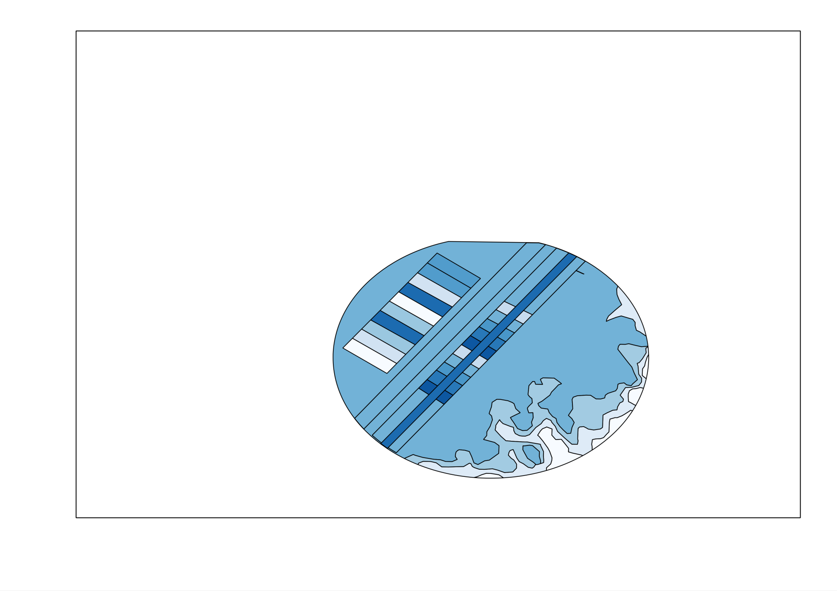
On-farm Trials

Slide 16
Summary
Like I said before, everybody is at a different place in adoption and most individuals have different management strategies.
Develop clear goals and improve and increase use of technology each year.

Slide 17
Thank You
Chad Godsey
Phone: 970-630-7732
Email: chad.godsey@godseyag.com
Fax: 405-896-8420
Web: godseyag.com
Twitter: @godseyag

