Slide 1
Grid Soil Sampling
Brian Arnall

Slide 2

Importance of Proper Fertility
Multi- Nutrient Variable Application
Much like a Ladder
One Step at a Time.
In-Season Cues
Secondary & Micros
In-Season Apps
P & K
Soil Test

Slide 3
Are Fields Variable?
10 fields sampled at 2.5 acre resolution
Average pH variance 2.5
Average P variance 33 ppm
Average K variance 120 ppm

Slide 4
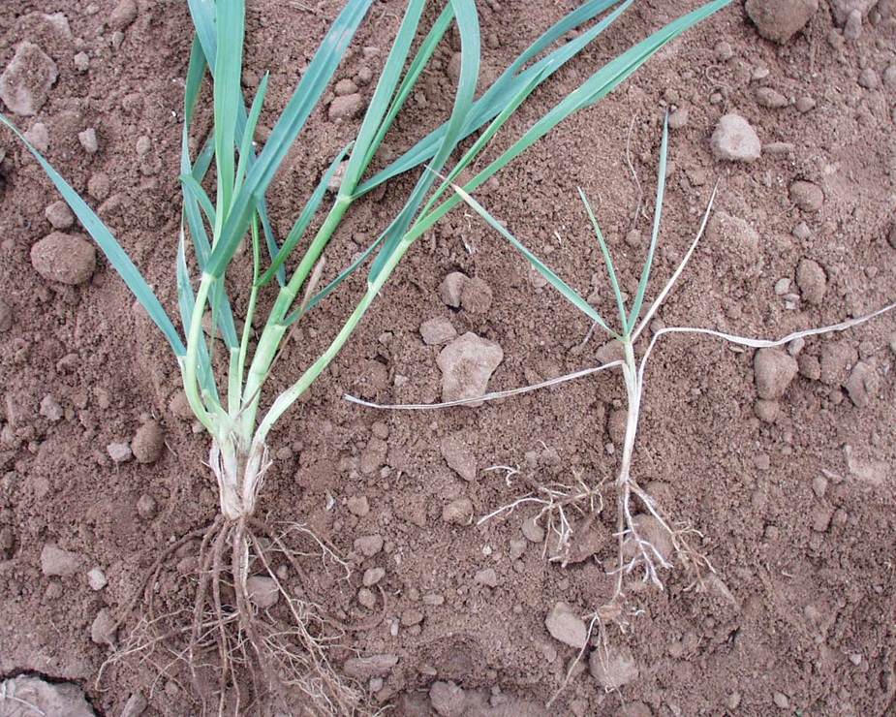
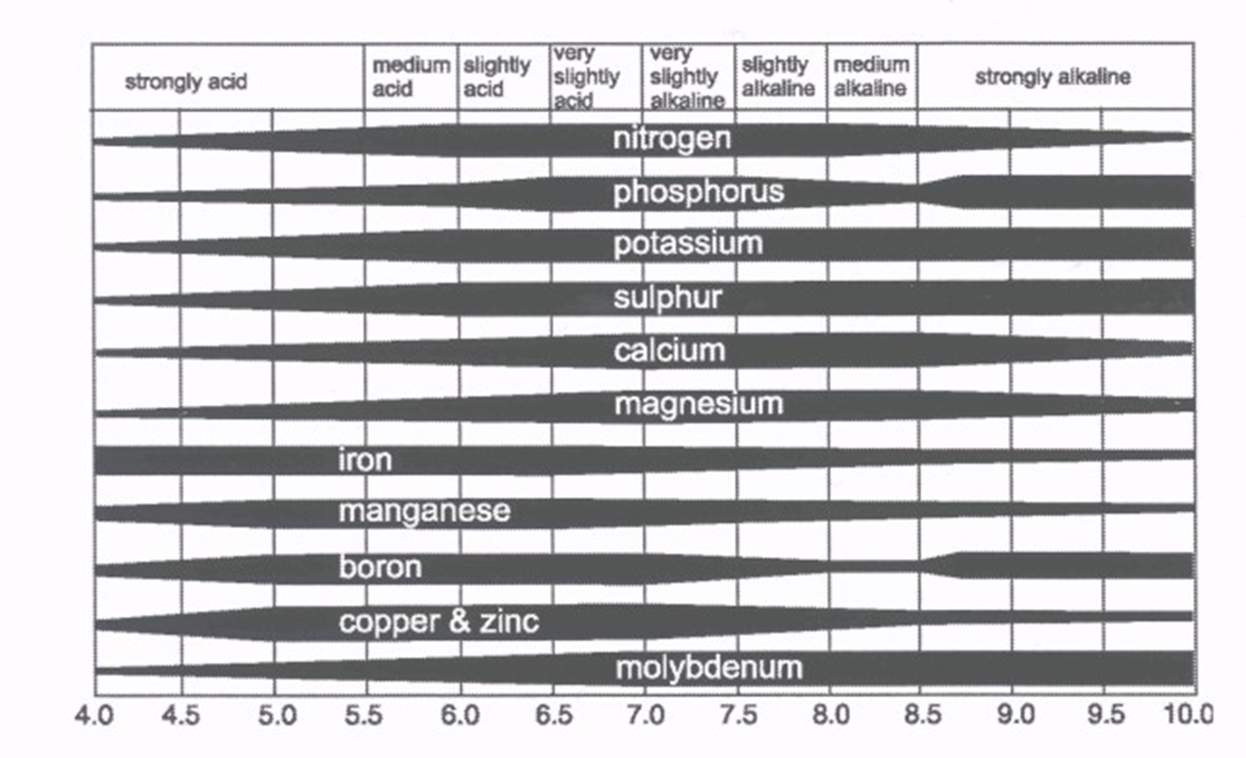
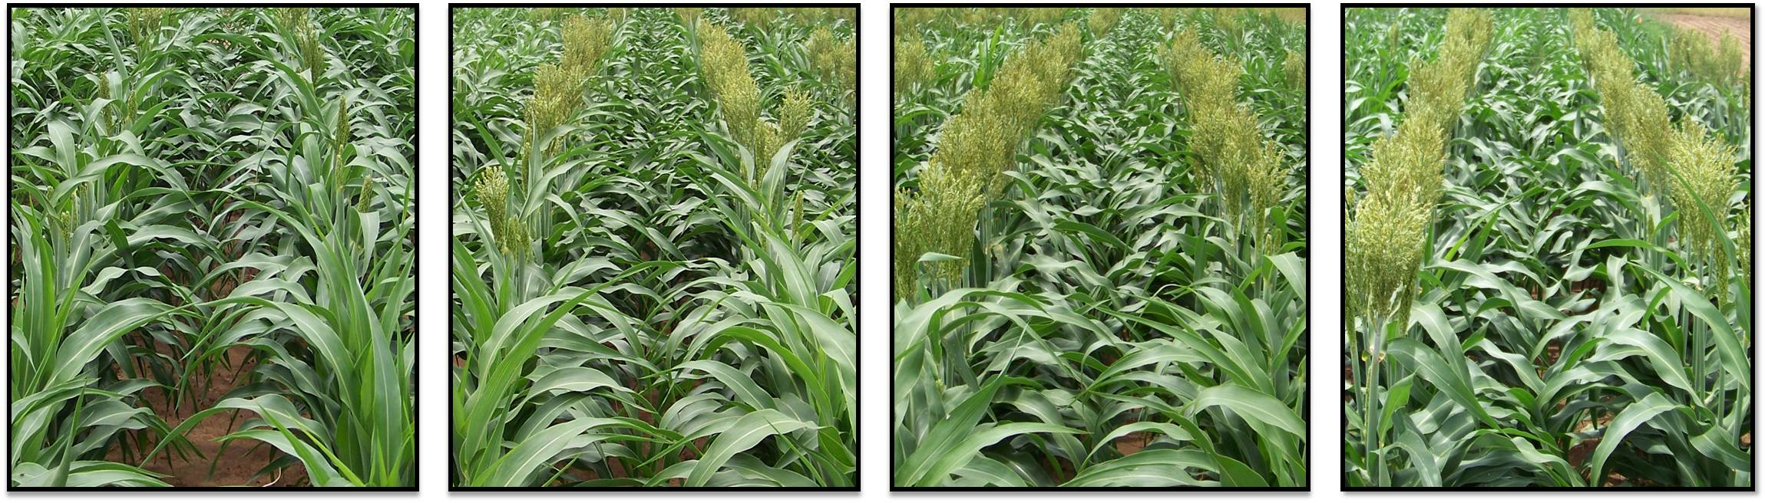
Soil pH
Soil Acidity Impacts
Nutrient Availability
Root Growth
Maturity
Herbicides
Can Be FIXED.
Soil pH 4.2 Soil pH 4.9 Soil pH 5.3 Soil pH 6.1

Slide 5
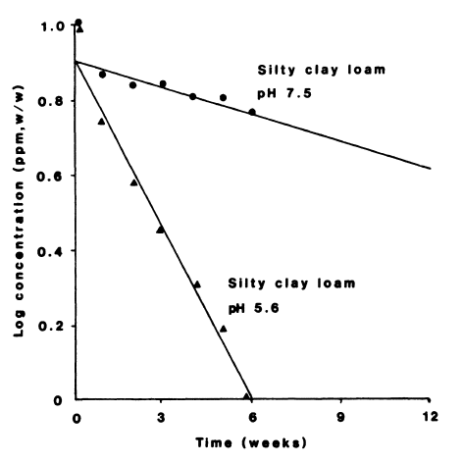
SUs are more persistent at higher soil pH
Glean (chlorsulfuron)
Herbicide concentration
Soil pH 7.5
Half-life ≈ 10 weeks
Soil ph 5.6
Half-life ≈ 2 weeks
Frederickson and Shea, Weed Sci. 34:328-332

Slide 6
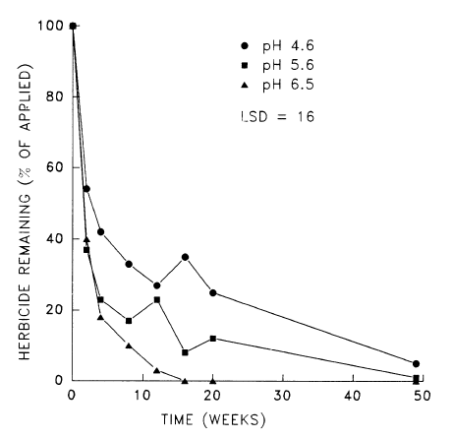
IMIs are more persistent at lower soil pH
Pursuit (imazethapyr)
Soil ph 4.6
Soil ph 5.6
Soil ph 6.5
Loux and Reese, Weed Tech. 7:452-458

Slide 7
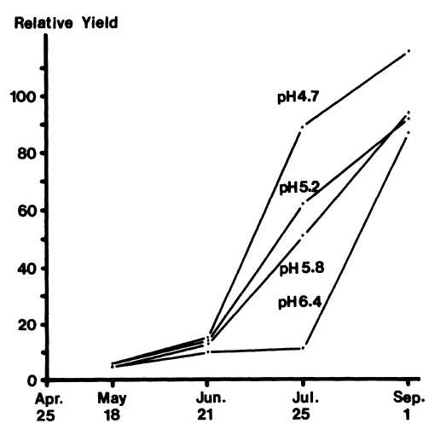
Atrazine is more persistent at higher soil pH
No weed control
10% control after 2 months
Weed growth
90% control after 2 months
Complete weed control
Hiltbold and Buchanan, Weed Sci. 25:515-520

Slide 8
Selecting a Field
Limited resources ….
Interested in Grid Sampling
Which Field????
What will a producer like more
Spending the same $
Spending more $
Spending less $

Slide 9
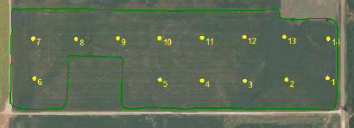
Woods Co
 | pH | BI | Surno3 |  | P | K | SurSo4 |  | Ca | Mg | Fe | Zn | B | Cu
Average | 5.9 | 7.0 | 17.0 |  | 76.3 | 510.1 | 86.9 |  | 3033.9 | 908.3 | 42.3 | 0.3 | 0.3 | 1.1
Min | 5.2 | 6.8 | 10 |  | 28 | 356 | 18.9 |  | 2103.0 | 516.0 | 14.1 | 0.2 | 0.2 | 0.8
Max | 6.8 | 7.1 | 50 |  | 169 | 799 | 269.3 |  | 4518.0 | 1352.0 | 106.1 | 0.7 | 0.4 | 1.9

Slide 10
Composite
pH 5.9
Buffer Index 7.0
Lime Rec .71 ton ac-1
30 tons $900
Soil Test P: 76 STP
Soil Test K: 510 STK
Soil Test S: 87
Soil Test, everything else- good.

Slide 11
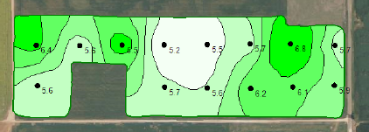

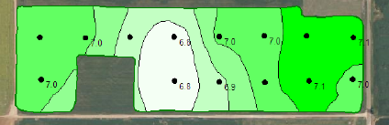

Soil pH and Buffer
VRT Lime BpH Ac Lime total 6.8 – 5.8 ac 1.2 7.0 6.9 – 5.7 ac 1.0 5.7
7.0 – 22 ac 0.7 15.4 7.1 – 8.8 ac 0.5 4.4
VRT Lime Applies 32.5 tons $975

Slide 12
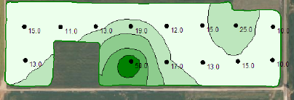

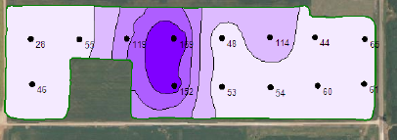

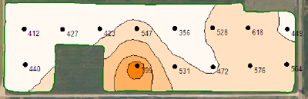

N, P, K

Slide 13

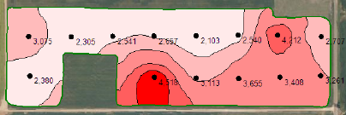

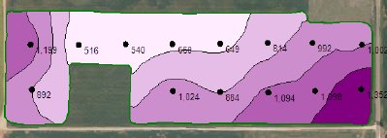

S, Ca, Mg

Slide 14
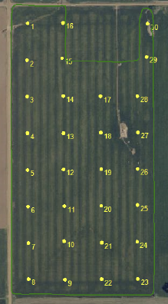
Alfalfa Co Grid
 | pH | BI | Surno3 | P | K | SurSo4 | Ca | Mg | Fe | Zn | B | Cu
Average | 5.9 | 7.1 | 9.4 | 37.5 | 449.2 | 13.1 | 2156.4 | 615.8 | 25.9 | 0.3 | 0.2 | 0.8
Min | 5.4 | 6.9 | 4 | 18 | 355 | 7.3 | 1733.0 | 502.0 | 8.1 | 0.2 | 0.1 | 0.5
Max | 7.2 | 7.2 | 16 | 108 | 579 | 31.9 | 4315.0 | 876.0 | 34.9 | 0.6 | 0.4 | 1.0

Slide 15
Composite
pH 5.9
Buffer Index 7.1
Lime Rec .5 ton ac-1
35 tons $1050
Soil Test P: 38 STP
P2O5 Rec – 60 lbs ac -1
4140 lbs $2070
Soil Test K: 449 STK
Soil Test S: 13
Soil Test, everything else- good.

Slide 16
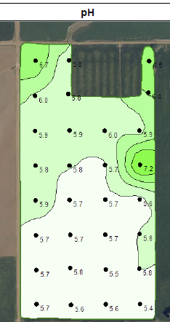
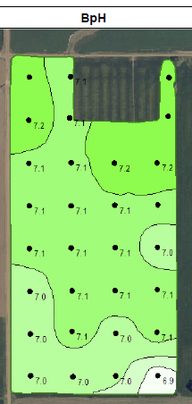


pH and Buffer
85% of the field under a 6.0
VRT Lime BpH Ac Lime Total 6.9 1.2 1.0 1.2 7.0 10 0.7 7.0
7.1 43 0.5 21.5 7.2 14.5 0.0 0
Total Lime applied 30 Tons
Approx $900.

Slide 17
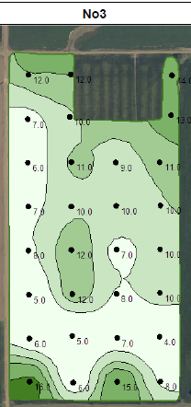
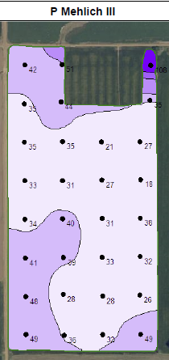
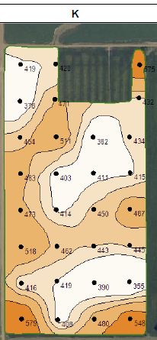



N, P, K

Slide 18
VRT Phosphate
STP P2O5 Ac Total
30 (.8) 80 45.7 3656 44 (.95) 55 21.7 1194 65+ 0 1.4 0 Total P 4889 $2444.5 Under applied on 66% of the acres.

Slide 19
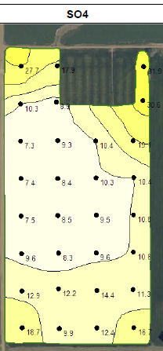
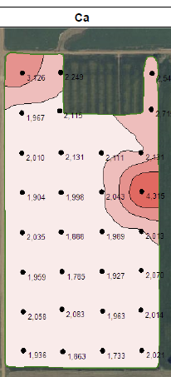
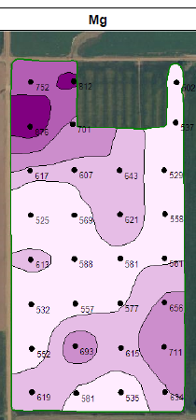



S, Ca, Mg

Slide 20
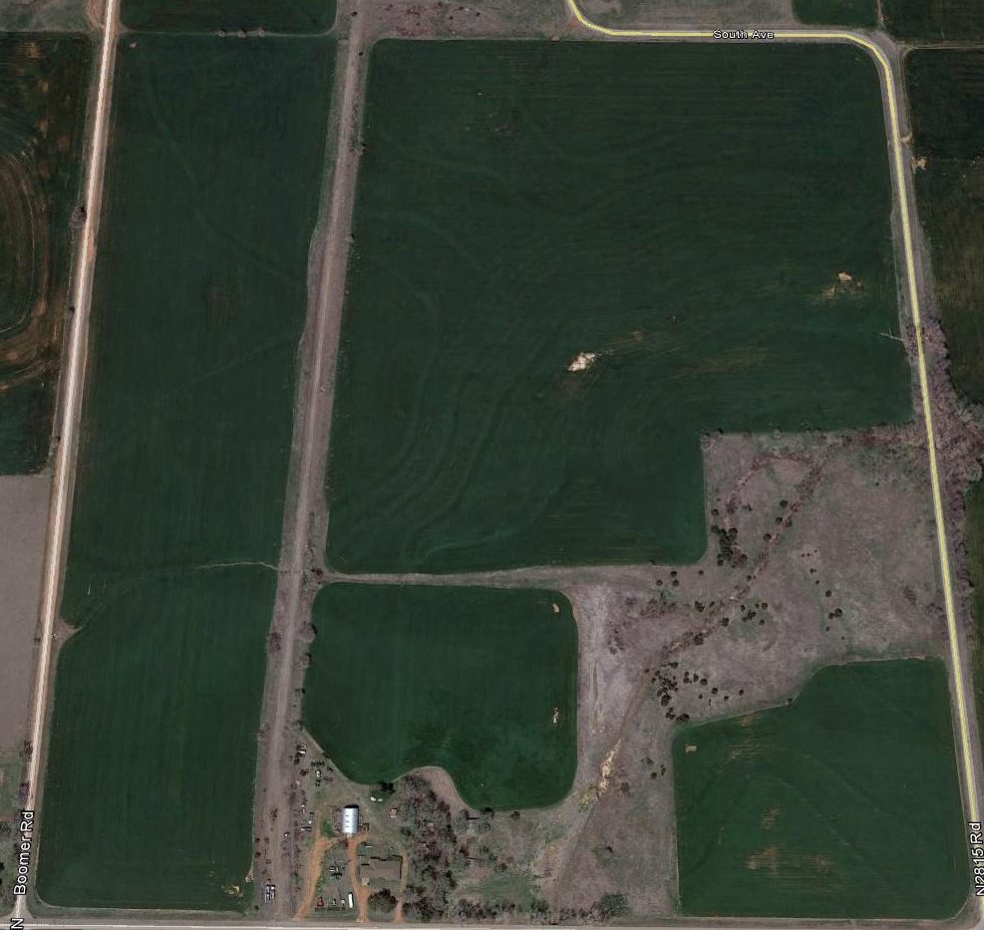
Hillsdale

Slide 21
Composite
pH 5.8
Buffer Index 6.9
Lime Rec 1 ton ac-1
101 tons $3030
Soil Test P: 32 ppm
30 lbs P2O5
3030 lbs $1515
Soil Test K: 411 ppm
Soil Test S: 13
Soil Test, everything else- good.

Slide 22
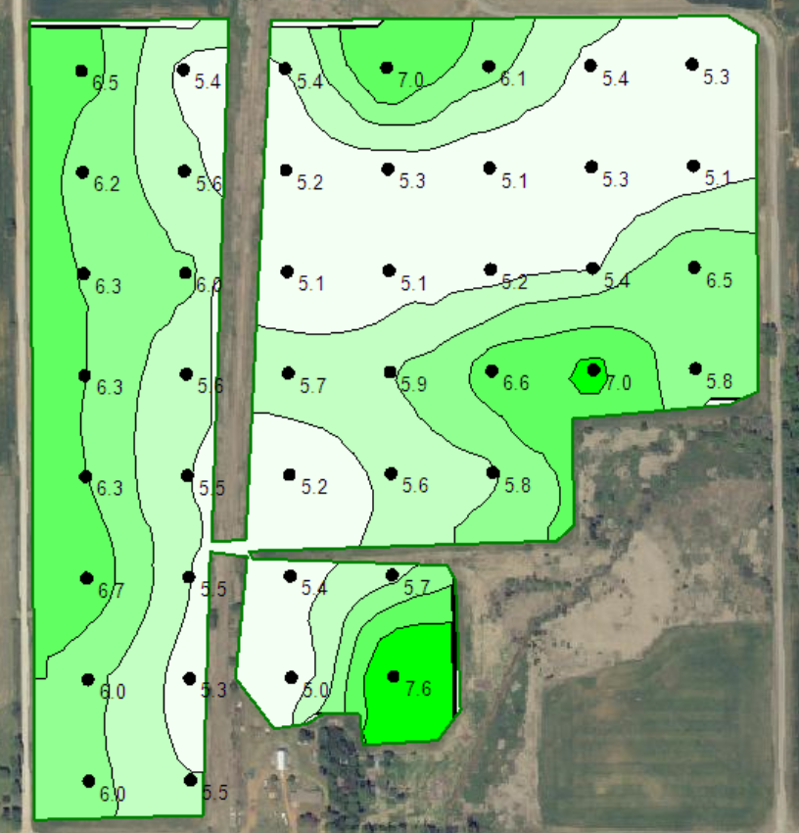
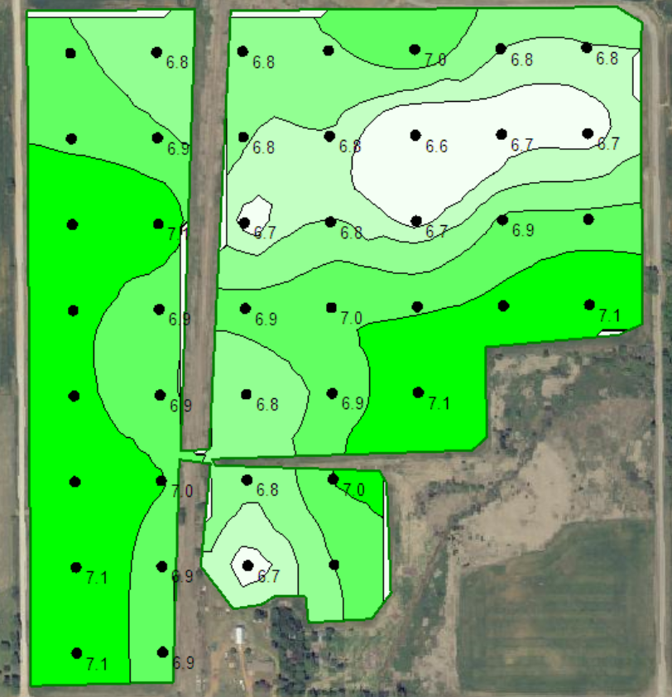
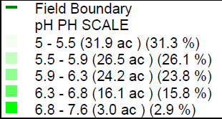
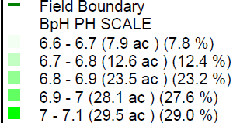
Soil pH Buffer Index

Slide 23
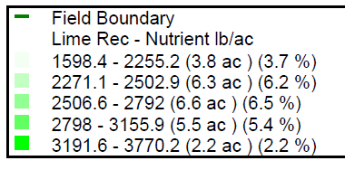
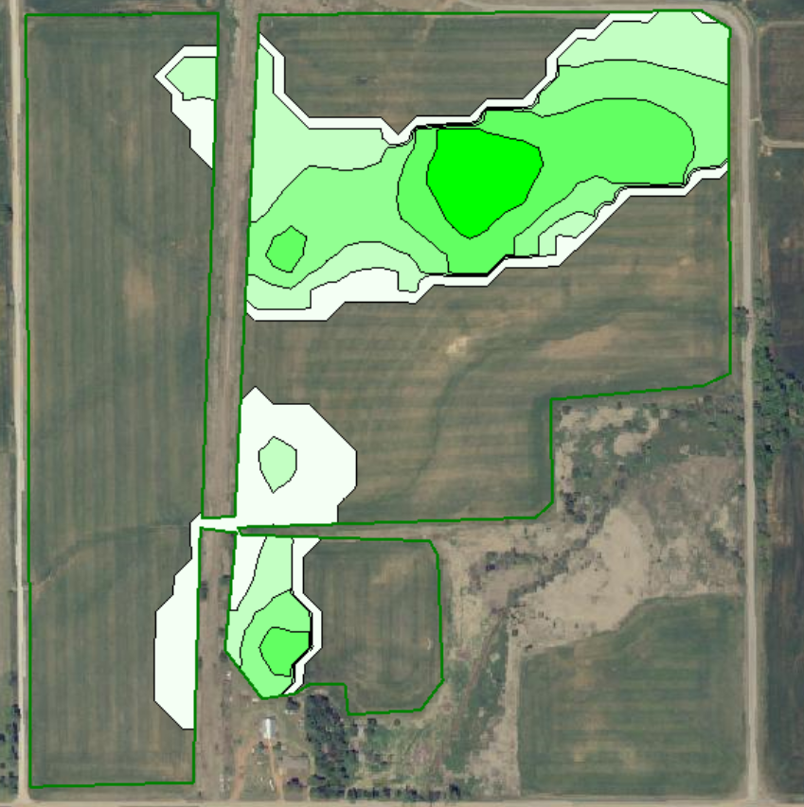
VRT Lime

Slide 24
Lime
VRT lime
32 tons on 24 acs
@ $30/ton 960$
1 ton/ac on 9 ac
1.5 ton/ac on 16
Over applied on 77
Under applied on 16

Slide 25
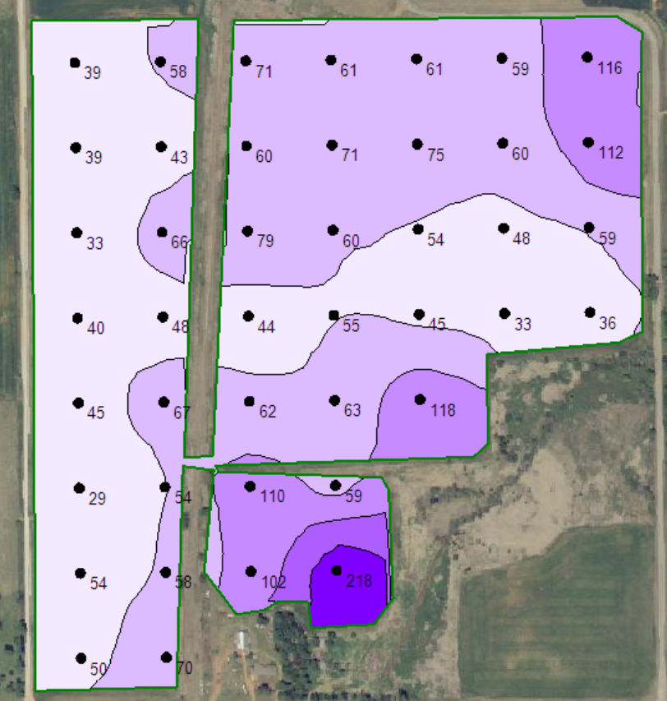
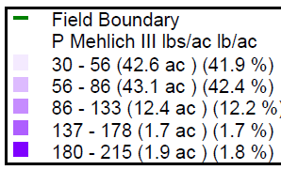
Phosphorus

Slide 26
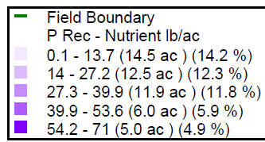
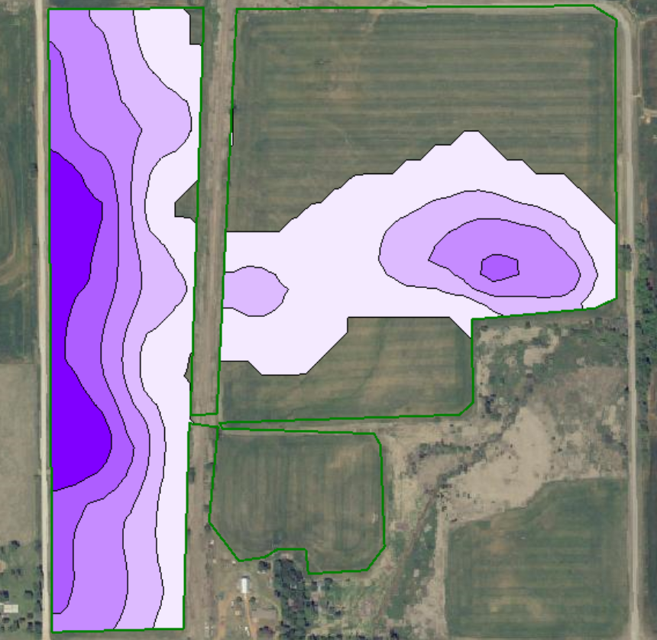
VRT P

Slide 27
Phos
VRT P
50 ac
1,350 lb P205 approx $1040 w/app.
15 ac 95%
13 ac 85%
13 ac 80%
5.5 ac 70%
4 ac 40%
Potential Yield loss at 100bpa
935 bushels

Slide 28
Field in the End
Lime flat
$3030
Lime VRT
$960
Flat P
$0 input
$4675 in loss yield
P VRT
$1040
VRT saved $2070 on Lime, made $3635 on P
Would have cost $1010.
On this 101 ac Field 2.5 grid had a net of $4695.

Slide 29
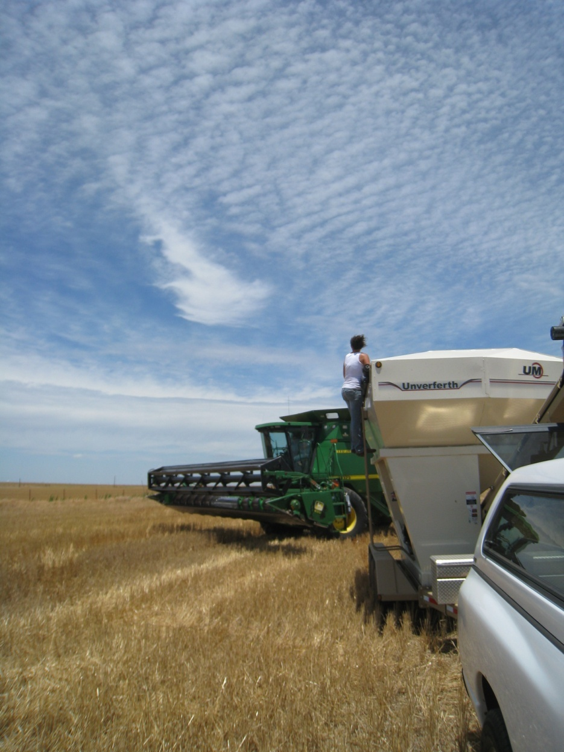

Thank you!!!
www.extensionnews.okstate.edu
Brian Arnall
373 Ag Hall
405-744-1722
b.arnall@okstate.edu
Presentation available @
www.npk.okstate.edu
Twitter: @OSU_NPK
YouTube Channel: OSUNPK

