Slide 1
Use of UAV for Research, Extension, and Production
Brian Arnall
Precision Nutrient Management Dr. Paul Weckler
Biosystems & Agricultural Engineering

Slide 2
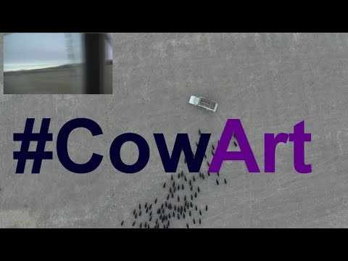
Communication

Slide 3
News
Animal rights group releases video of drone shoot down
http://newsok.com/article/5446992?utm_source=NewsOK.com&utm_medium=Social&utm_campaign=NIC-Twitter
Light aircraft collides with drone in Norway
https://www.flightglobal.com/news/articles/light-aircraft-collides-with-drone-in-norway-416504/?utm_content=bufferfa6f8&utm_medium=social&utm_source=twitter.com&utm_campaign=buffer
11-month old girl injured in Drone crash. http://www.washingtontimes.com/news/2015/sep/18/11-month-old-baby-girl-injured-drone-crash/
Dad shoots down drone hovering over sunbathing daughter
http://www.thedenverchannel.com/news/local-news/dad-shoots-down-drone-hovering-over-sunbathing-daughter

Slide 4
Drone Sightings
http://graphics.wsj.com/faa-drones/
Published 11/26/14; records 2/22-11/11
Significant amount 1000-7000 ft.
Oklahoma City, Okla.
Oct. 12, 2014 CORRECTED INFO FROM FAA OPS: TINKER AFB, OK/UAS INCIDENT/1424C/OKLAHOMA CITY ATCT REPORTED AN ACFT REPORTED TAKING EVASIVE ACTION TO AVOID A SMALL UAS AT 4,800 FEET, 2 FEET WIDE BLACK IN COLOR WITH A CAMERA ATTACHED ON THE BOTTOM. PILOT REPORTED UAS CAME WITHIN 10 - 20 FEET OF ACFT 10 N TINKER. LEOS NOTIFIED
Not ag, but.

Slide 5
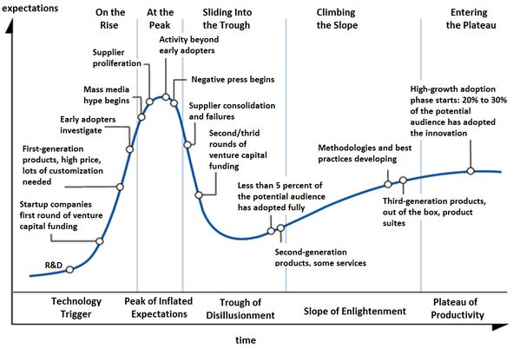

Slide 6
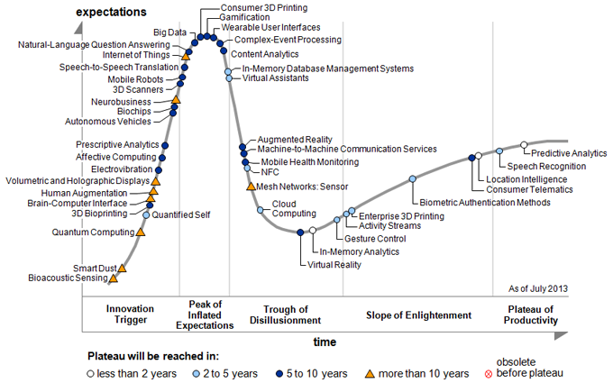
Source: Gartner

Slide 7
The FAA has identified research areas that may evolve over time to adapt to the needs of the NAS and emerging technology. These areas are:
Air Traffic Control Interoperability
Airport Ground Operations
Control and Communication
Detect and Avoid (DAA)
Human Factors
Low Altitude Operations Safety
Noise Reduction & RF Spectrum Management
Unmanned Aircraft (UA) Crew Training & Certification.., Including Pilots
Unmanned Aircraft Systems Traffic Management
UAS Wake Separation Standards for UAV Integration into the NAS

Slide 8
Confusion about FAA Authority
The average person does not routinely interact with the FAA or FAA regulations
– The U.S. has the most complex, but also the safest airspace system in the world
– The public is not aware of the complex set of rules, regulations, laws, and case law associated with aviation
The FAA has broad authority to ensure safety within the national airspace system

Slide 9
FAA Authority
“The FAA is responsible for air safety from the ground up. Under 49 U.S.C. § 40103(b)(2), the FAA has broad authority to prescribe regulations to protect individuals and property on the ground and to prevent collisions between aircraft, between aircraft and land or water vehicles, and between aircraft and airborne objects.
Consistent with its authority, the FAA presently has regulations that apply to the operation of all aircraft, whether manned or unmanned, and irrespective of the altitude at which the aircraft is operating.
For example, 14 C.F.R. § 91.13 prohibits any person from operating an aircraft in a careless or reckless manner so as to endanger the life or property of another.”

Slide 10
Common Myths
Unmanned aircraft are not aircraft
Unmanned aircraft are not subject to FAA regulation
The FAA doesn't control airspace below 400 feet
UAS flights operated for commercial or business purposes are OK if the vehicle is small and operated over private property and below 400 feet

Slide 11
Three Types of Aircraft Operation
Hobby / recreational
– Based on intent
– Covered under Section 336 of the FMRA
“Public use aircraft”
– Public university research (mainly “aeronautical research” as defined by the FAA)
– Government agency use
– Law enforcement
Civil (including commercial)
– Education / training at universities
– Industry
– Anything not hobby or not public use

Slide 12
FAA News Listings
http://www.faa.gov/news/press_releases/
> 600 pending requests for exemptions, the FAA has only approved 53
Press Release Results
2/15/2015 DOT and FAA Propose New Rules for Small Unmanned Aircraft Systems
2/3/2105 FAA Grants Eight More UAS Exemptions
12/10/2014 FAA Grants Five More Commercial UAS Exemptions
11/18/2014 FAA Statement on NTSB Decision in Huerta v. Pirker
10/08/2014 FAA Statement on MITRE's Independent Assessment and Recommendations for NextGen
9/25/2014 U.S. Transportation Secretary Foxx Announces FAA Exemptions for Commercial UAS Movie and TV Production
9/10/2014 FAA Statement
8/13/2014 FAA Announces Virginia Tech UAS Test Site Now Operational
8/07/2014 FAA Announces New York UAS Test Site Now Operational

Slide 13
2/15/2015 FAA Release
Flight and Platform
Line of Sight
< 500 Ft.
First Person view Camera does not satisfy “see-and-avoid”
Operators
Pass FAA- Approved test, Re-test every 2-yrs
Be “Vetted by the Transportation Security Admin”
Make all craft and records available for inspection or testing.
Story From Ag Professional 2/19/15 “Farmers disappointed by restriction in proposed drone rules”
These constraints would limit a drones range and usefulness

Slide 14
3/24/2015 FAA Release
Streamlined COA Process
The new policy allows commercial operators permitted to fly under Section 333 of the FAA Modernization and Reform Act to fly without the current coordination with air traffic control facilities and service centers. Operations will receive a streamlined certificate of authorization to fly if adhering to certain parameters.
The parameters require flights to remain at or below 200 feet above ground level during daylight visual flight rule conditions, at least two nautical miles from airports and five miles from airports with an operational control tower, and the pilot in command must have at least a private pilot license.

Slide 15
FAA requirements are currently strict
– Requires FAA licensed pilot
– Qualified ground observers
– Formal processes for maintenance, training, operations
– Small UAS rules will not take effect until 2016-17
– $10,000 fine per violation
It is unclear how the pending small UAS Proposed Rules will eventually impact universities and public entities
University Legal Counsel & Risk Management offices must be involved with UAV efforts.

Slide 16
Commercial Drone Milestone: 1000 Exemptions Now Approved by FAA August 4, 2015
In an analysis of the first 500, the Association for Unmanned Vehicle Systems International (AUVSI) recently noted that over 20 different industries in 48 states got the OK to fly.
The most exemptions went to the real estate (30.6%), agriculture (21.2%) and construction (14.8%) industries, and the top five states for exemption holders were California (70), Texas (46), Florida (40), Illinois (18) and Arizona (17).
http://www.faa.gov/news/updates/?newsId=83395

Slide 17
NAAA believes that the following safety precautions would significantly reduce the likelihood of UAS collisions
UAS should be equipped with ADS-B Out surveillance technology or an equivalent aircraft ID technology, in which an aircraft determines its position via satellite navigation & periodically broadcasts it, enabling it to be tracked,
UAS and support vehicle should be equipped with strobe lighting
UAS pilots should be required to have a private pilot certificate in order to demonstrate proper knowledge of the National Airspace System (NAS), as well as a Class 3 medical certificate and demonstrate their ability to operate a UAS
UAS pilots should have an equally qualified non-flying observer to ensure the UAS operation remains clear of manned operations

Slide 18
$6.7 Million Settlement Issued for Unmarked Meteorological Evaluation Tower Resulting in Agricultural Aviator's Death
ALEXANDRIA, VA — September 9, 2014 — A settlement was reached last week on the wrongful death action filed by the family of California agricultural aviator Steve Allen in the amount $6.7 million against a group of defendants representing tower manufacturing, wind energy, land-owning and farming interests for not marking or making aware the location of an unmarked meteorological evaluation tower (MET) to protect the pilot.

Slide 20
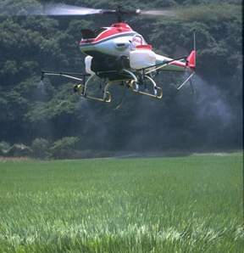
UAS/UAV/The D Word in Ag

Slide 21
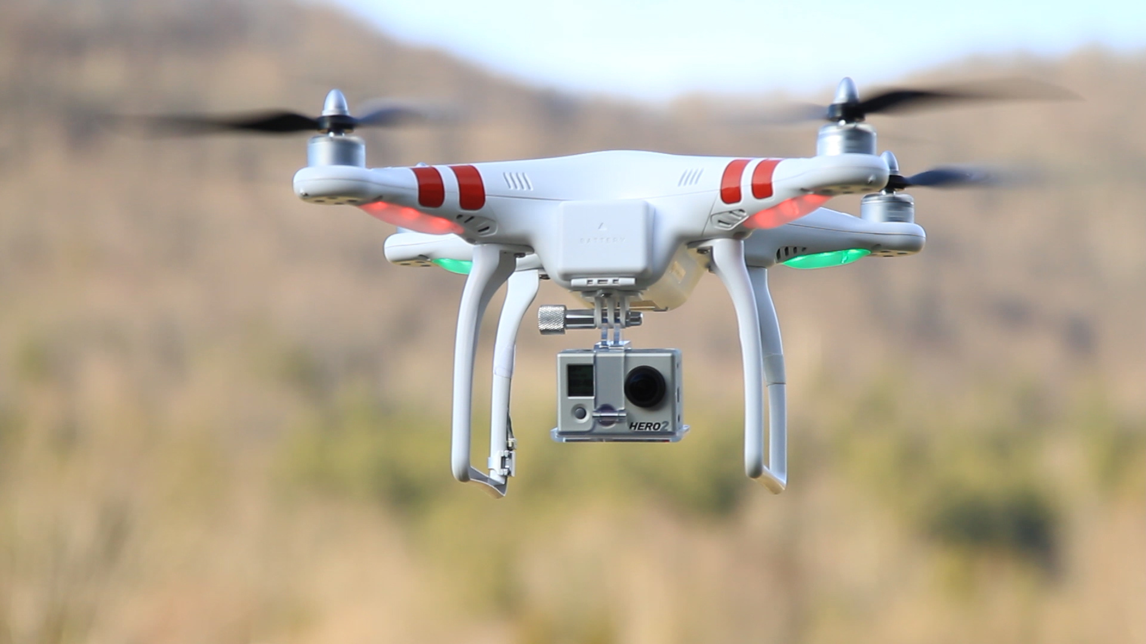
dji.com
DJI has NO FLY ZONE Capability

Slide 22
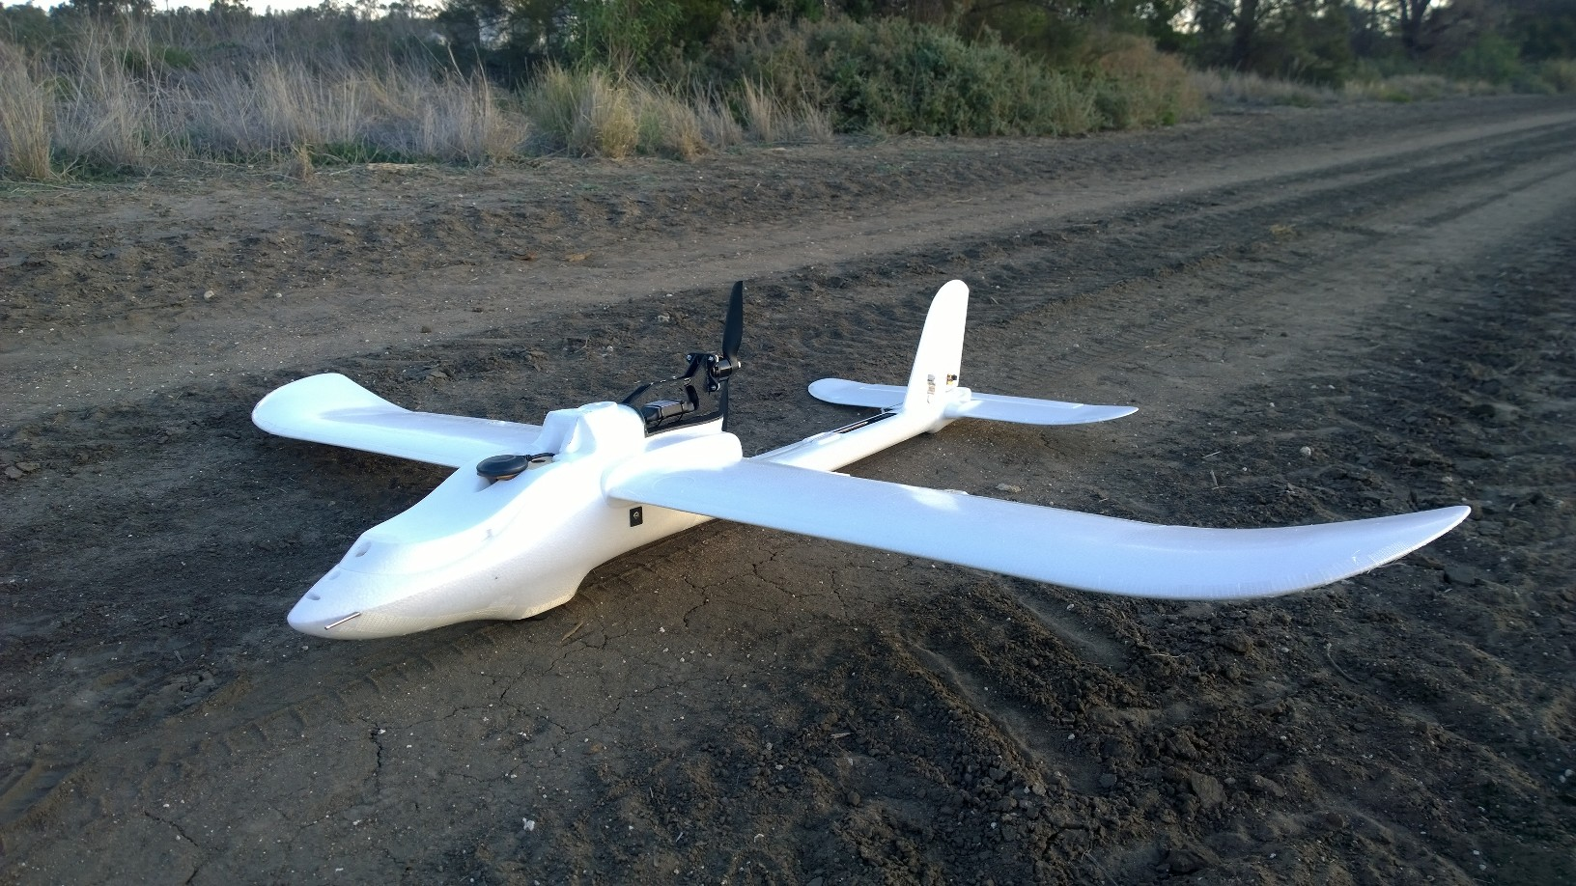
http://agmapsonline.com/

Slide 23
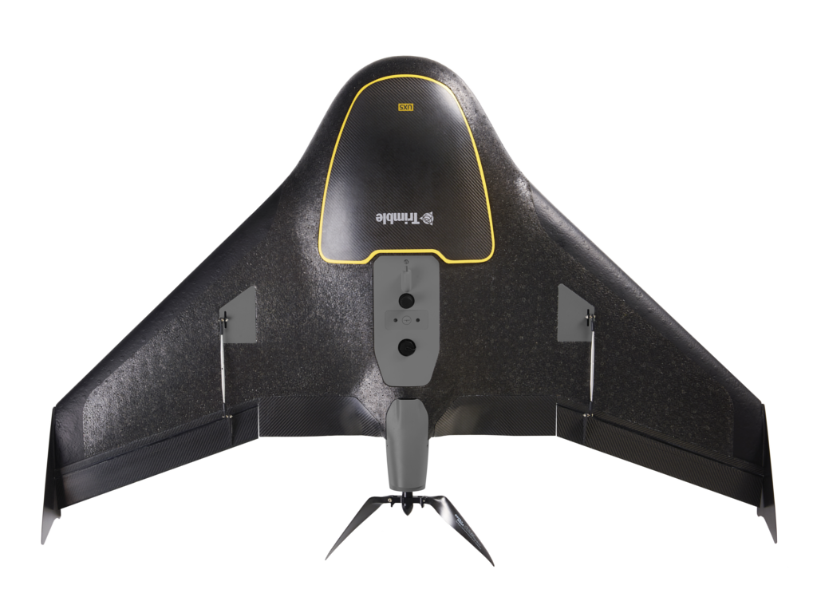
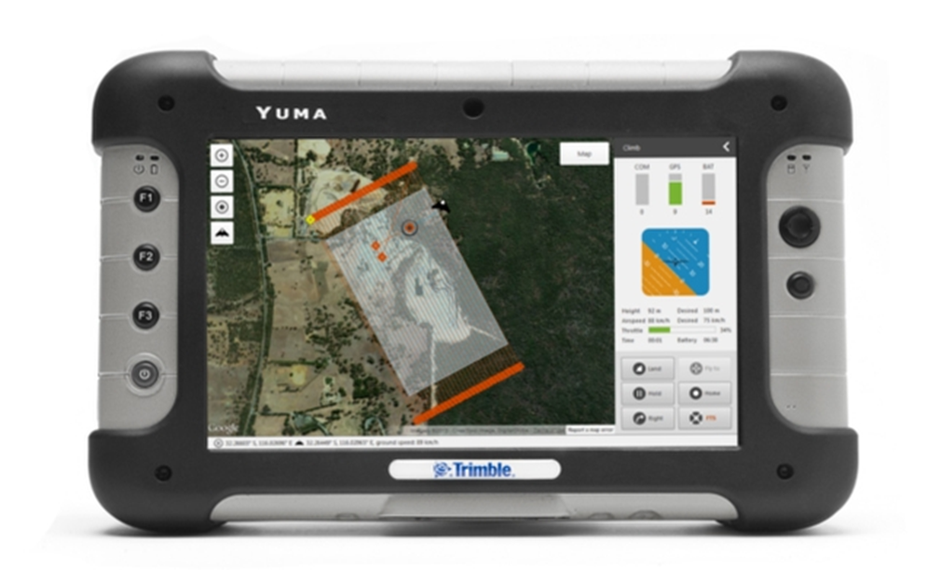
Trimble.com

Slide 24
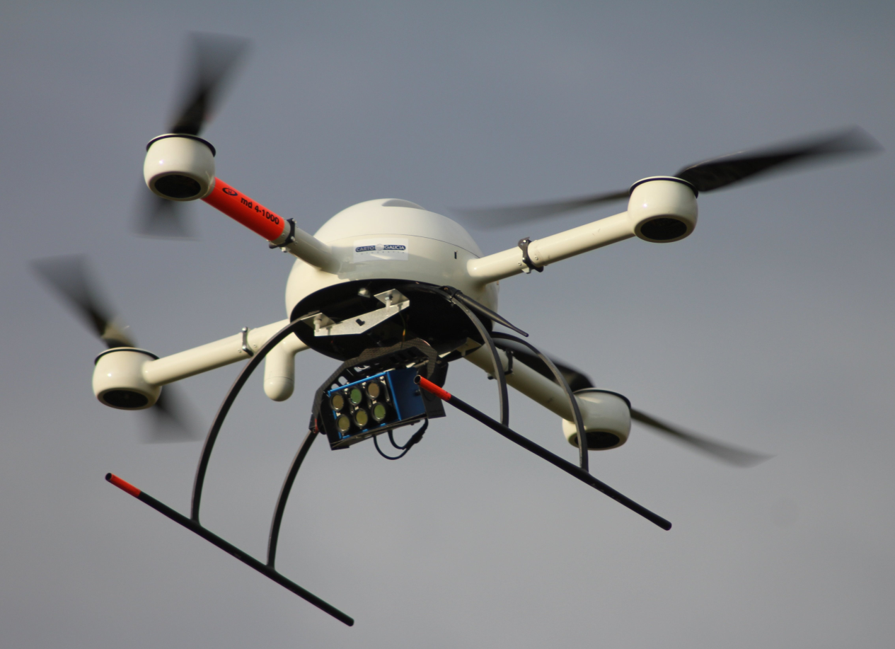
Tetracam.com

Slide 25
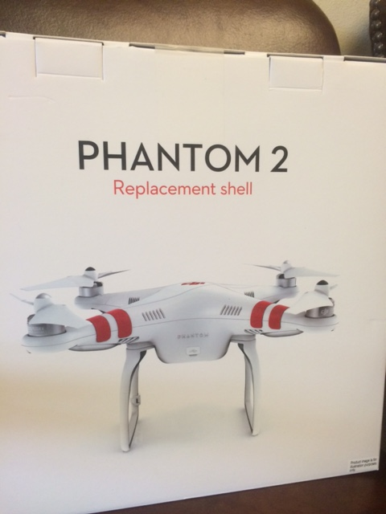
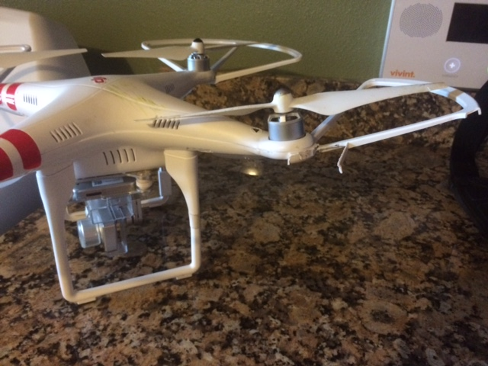
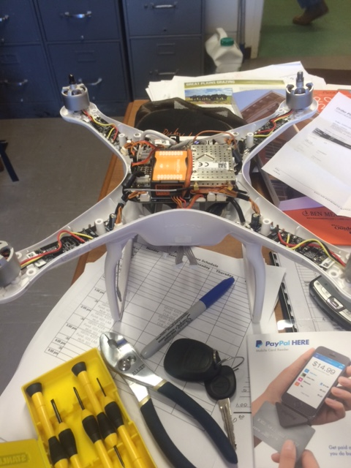
Hints on Platform
They will crash. Period.
Easier to get a replace pieces the better.

Slide 26
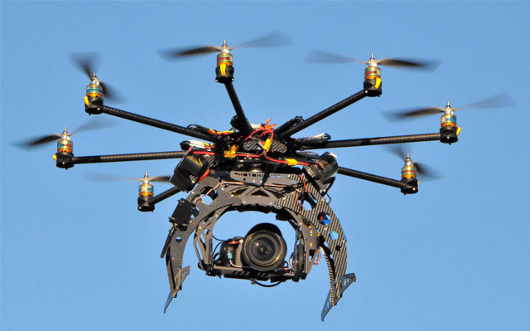
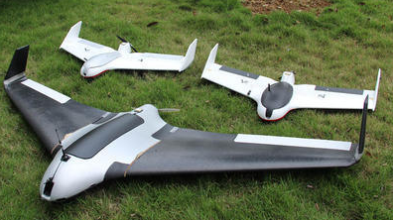
Styles
Copters, Hover and stable
More motors ???
Planes / Fixed Wing, Covers ground

Slide 27
Areas of Research in Ag, NREM, and beyond at OSU
Plant Breeding
High Throughput Phenotyping
Crop Management
Nutrient Management
Zone Delineation
Irrigation
Fire protection
Herd Management
Foundation Seed, Field scouting.
Review of Flyable days
Rural Electric
Energy Sector

Slide 28
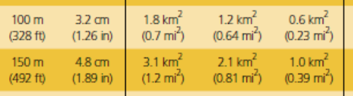
Moving Beyond the GoPro
We can collect data, and potentially a lot of it.
To Get Quality

Slide 29
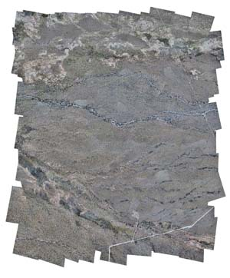
Imagery Stitching
OrthoRectification
http://www.satimagingcorp.com/services/orthorectification/
open sources available
http://conservationdrones.org/post-processing/

Slide 30
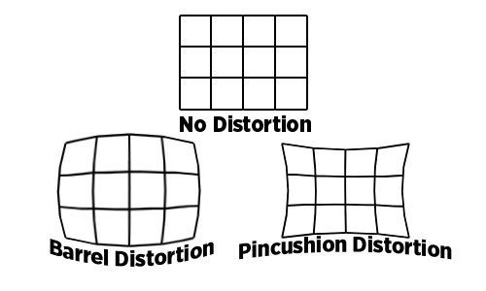
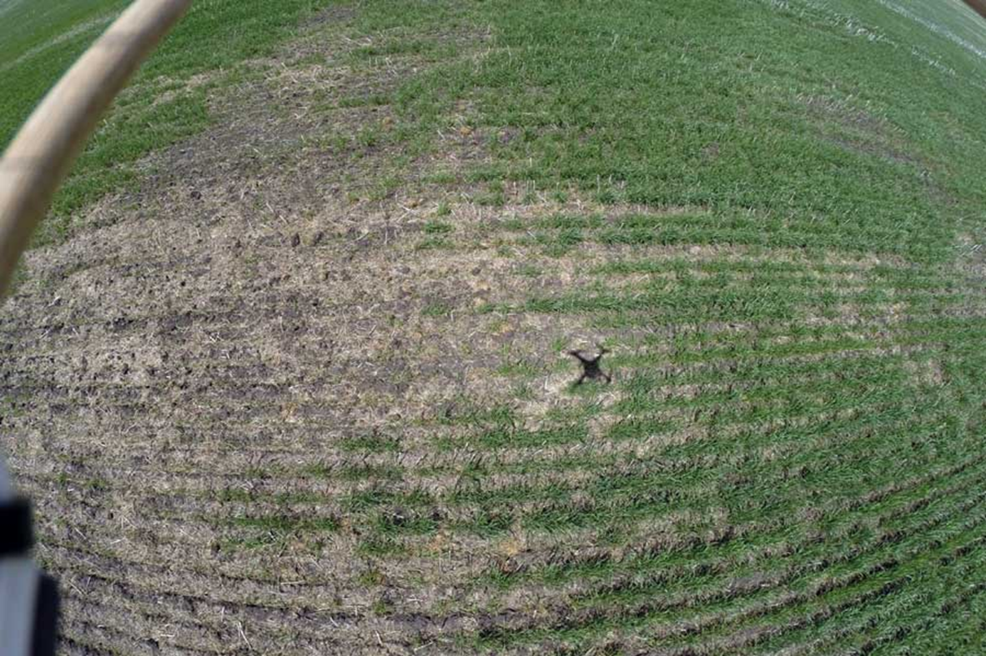
Challenges
Small footprint (Ag)
Image distortion
Locating ground control points
Relatively large errors in exterior orientation parameters (X, Y, Z, roll, pitch, heading)
Wind comes sweeping down the plains……..

Slide 31
Challenges
Payload
Many remote (ground based) High Throughput phenotyper’s have five to ten sensors.
UAVs limited on sensors, many take two passes to get NDVI Visible 1, Near Infrared 2
Calibration of Passive Sensors.
DATA
DATA
DATA
DATA
DATA

Slide 32
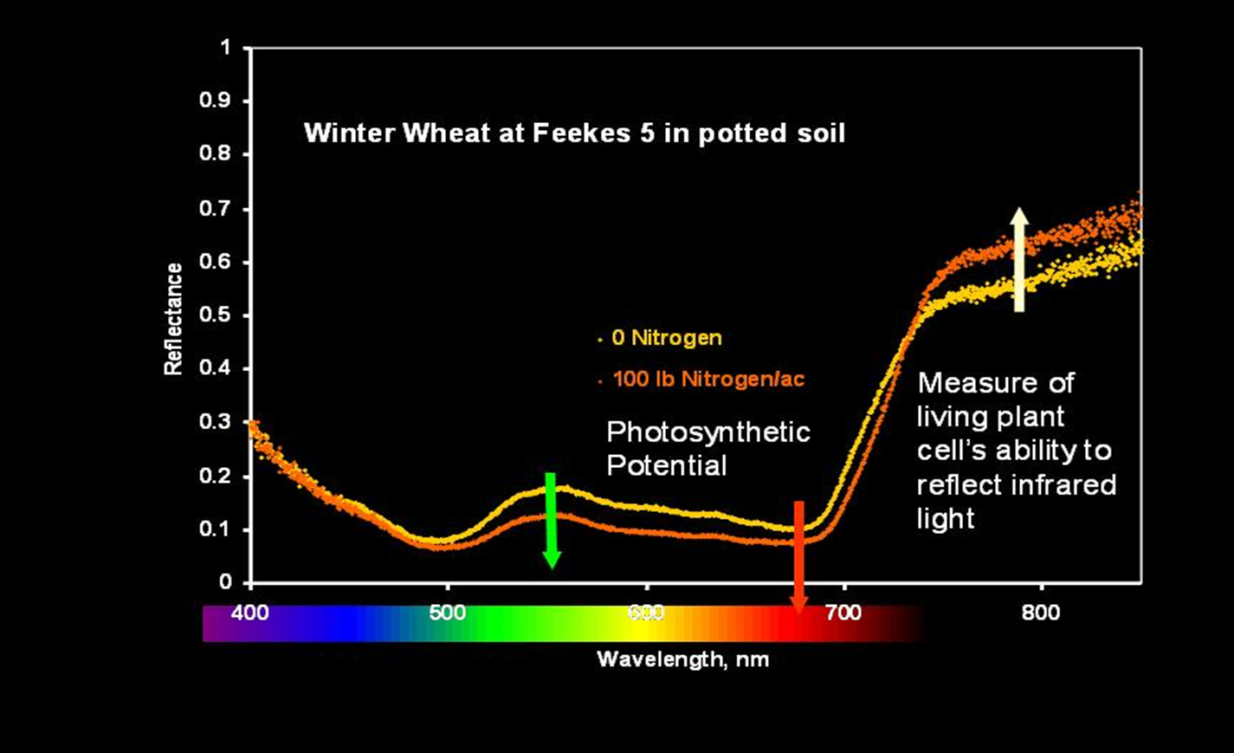
Reflectance

Slide 33
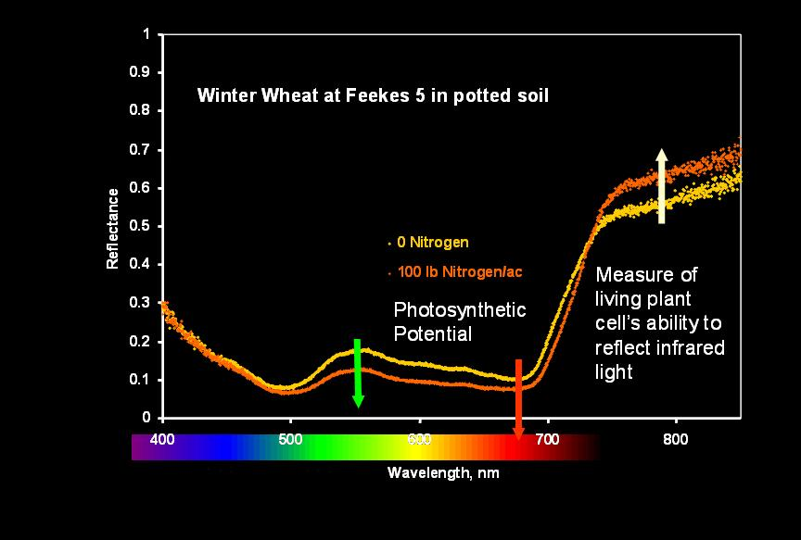
Wavelengths & Indices
NDVI and Simple Ratio
Biomass: Red and NIR (650, 780)
Green or Amber instead of Red (550, 590)
Growth Stage for Amber v Red
Red Edge 680
Chlorophyll
SPAD (650 – 940)
Protein
710 , 810 (Kelly et al 04)

Slide 34
Reflectance Data
Historically satellite and aerial imagery widely used.
Ok State in the mid 90’s started investigating VRT N work.
Evaluated Aerial and Satellite.

Slide 35
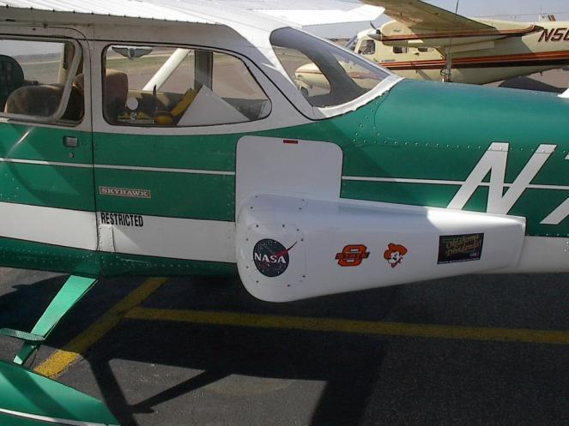
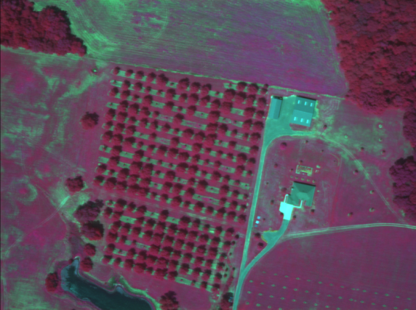
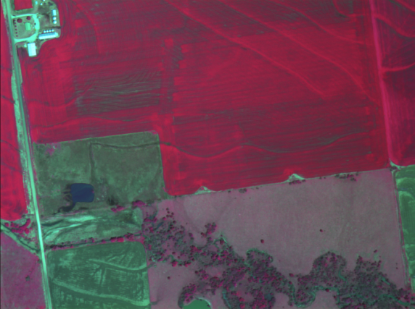
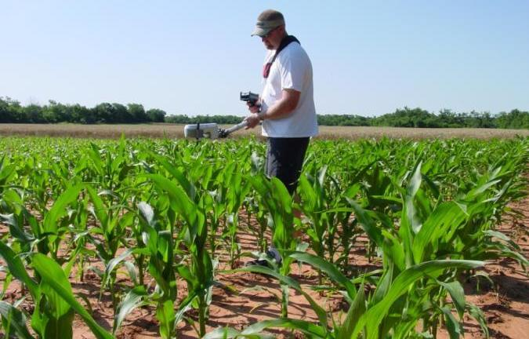
Precision Ag Research at OSU

Slide 36
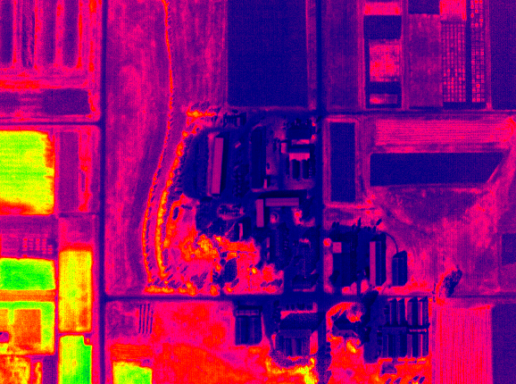
NDVI of OSU Experiment Station 1m Resolution

Slide 37
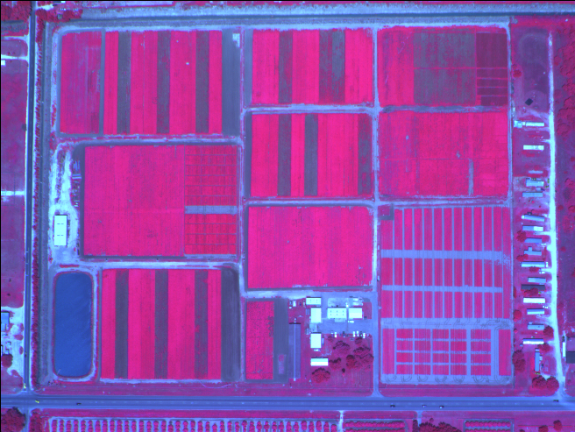
False Color (green, red, NIR) Image < 1 m Resolution - Raw Radiometric Data (Courtesy F. Schiebe, SST Software)

Slide 38
Passive vs Active
Active Sensor emits light, typically via LED.
Passive Sensor records reflectance of natural light.
Sun Angle, impacted by time of day and time of year.
Clouds
Atmospheric interference.

Slide 39
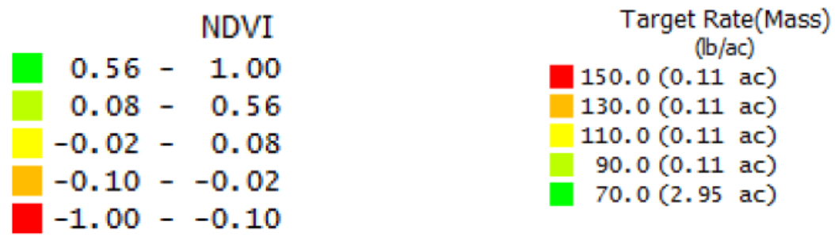
Use of relative values
*From Auto Copter
•Map segmented into NDVI values
•Fertilizer into 150lb, 130lb, 110lb, 90lb, and 70lb
•150lb for the lowest NDVI value
•130lb for the middle-lowest NDVI value
•110lb for the middle NDVI value
•90lb for the middle-highest NDVI value
•70lb for the highest NDVI value
*PGRs and Defoliants in cotton
*Bare Soil imagery for drainage

Slide 40
Aerial Imagery values w/o Cal
Yield Monitor

Slide 41
To Calibrate
With Spectrometer, use white plate.
NUE Wheat project with 330+ plots.
10 to 2
White plate
Incoming and reflectance
Reverse order

Slide 42
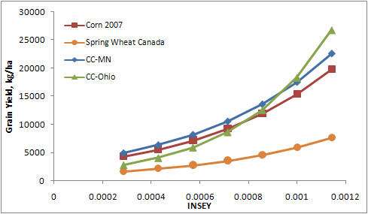
Replicated values
OSU’s use of active sensors
Relate Specific values.
Must have repeatability

Slide 43
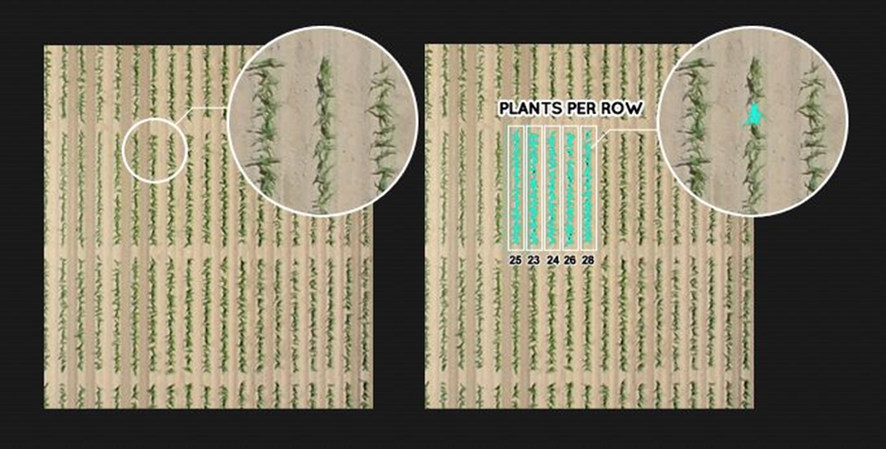
Beyond reflectance
Stand Count
Quite easy
Canopy Temp
Soil Moisture
Soil OM
DOCUMENTATION
http://agloop.com/how-to-produce-more-with-less-the-emergence-of-uav-technology/

Slide 44
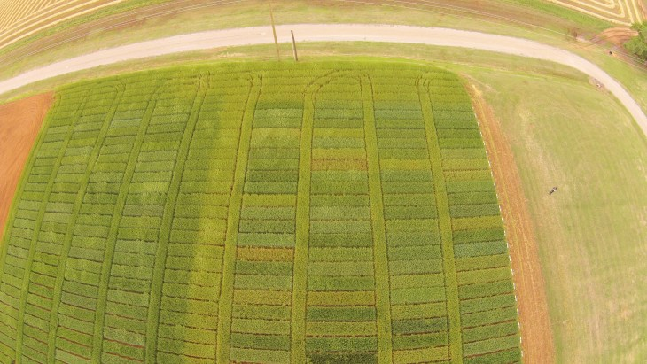
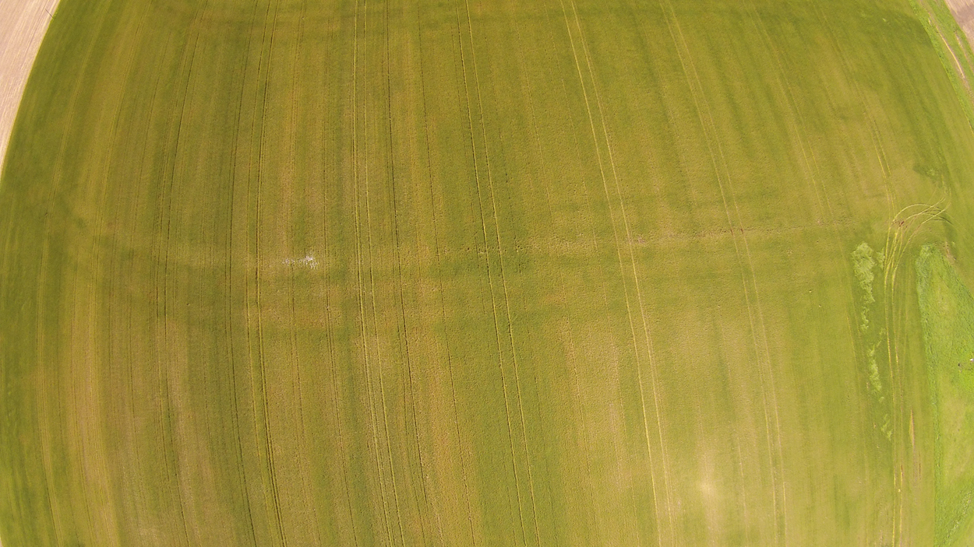
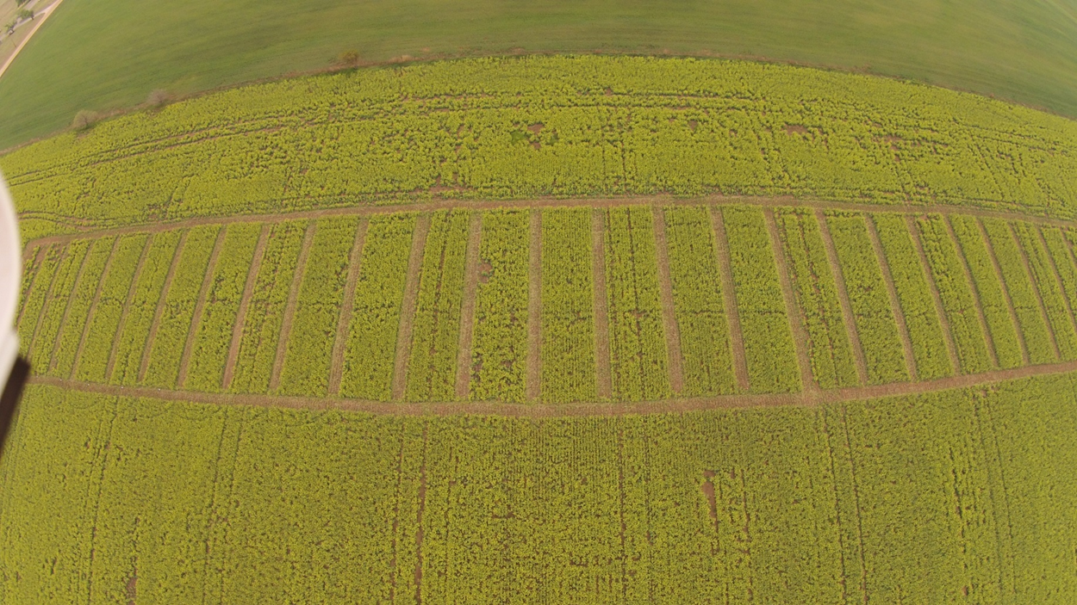
Extension
Visibility..

Slide 45
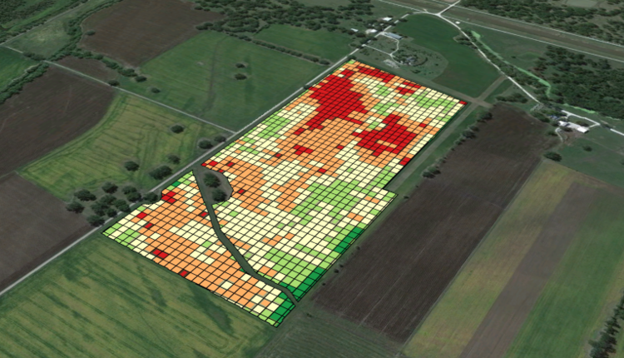
5 Actual Uses For Drones In Precision Agriculture Today
Mid-Season Crop Health Monitoring (aka Scouting)
Irrigation Equipment Monitoring
Mid-Field Weed Identification
Variable-Rate Fertility:
Cattle Herd Monitoring
http://dronelife.com/2014/12/30/5-actual-uses-drones-precision-agriculture-today/

Slide 46

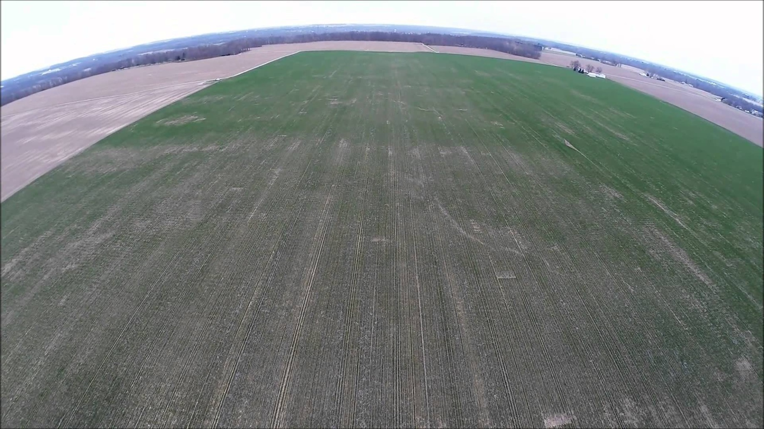
Consulting
https://www.youtube.com/watch?v=Rh7KKO12Mj8

Slide 47
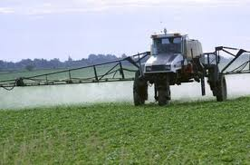
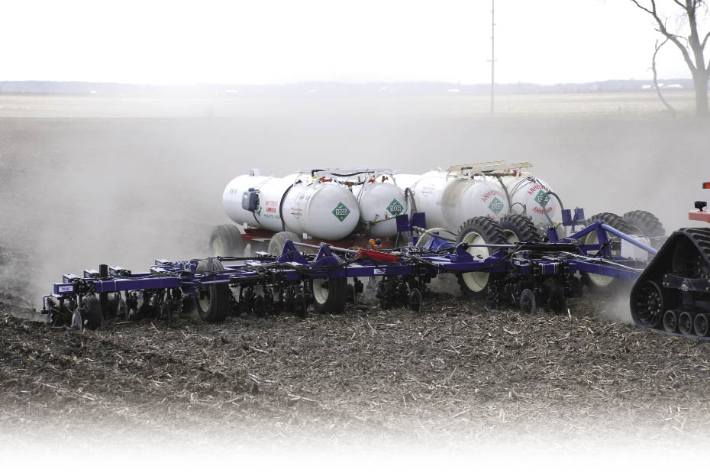
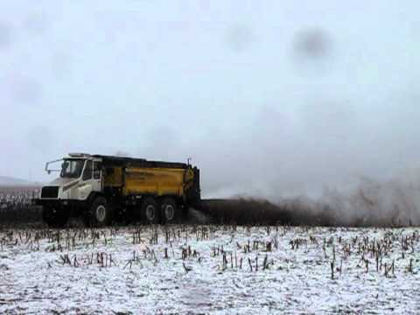
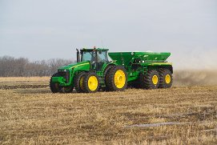
Resolution

Slide 48
Nothing
I mean NOTHING takes the place of Scouting and good Agronomy.
NOTHING..
Get dirty walk the field, take samples.
But there is always a degree of WRONG We are dealing with a living system. More so we are dealing with a Weather Dependent system.
Have a Plan, Have a goal

Slide 49
Today
Consultants can be more efficient and make more money.
With low end UAV’s
Platforms available for high end imagery.
Companies scrambling to find
Increase easy of data processing
Create decision aid tools.

Slide 50
Satellites
June 10-2014 Google Tuesday agreed to buy satellite startup Skybox Imaging Inc. for $500 million in cash, the latest in a number of moves by the world's largest Internet search provider to collect and provide data from the sky. Skybox has designed small, relatively cheap satellites that can collect daily photos and video of the Earth. Skybox satellites weigh roughly 260 pounds, making them much cheaper to build and launch than traditional satellites that can weigh tons. Skybox planned to launch 24 such satellites that could shoot pictures of the Earth more often.
Feb 3 2015 Wilbur-Ellis Co. has reached an agreement with Planet Labs to bring satellite imagery to the AgVerdict software platform, Wilbur-Ellis’ technology in agricultural data usage. This enhancement will significantly improve the delivery of satellite imagery to a grower, making the data available in a matter of minutes rather than days. This new feature will benefit Wilbur-Ellis customers by providing imagery using “ultra-compact” satellites that will soon scan the planet every twenty-four hours.

Slide 51
Planet Labs
3-5 M resolution
RGB & NIR
Mobile App available
Same-day imagery
2 to 3 day fly over
Corn belt…….
www.planet.com
OSU has been given access to the historic Rapid eye data set.

Slide 52
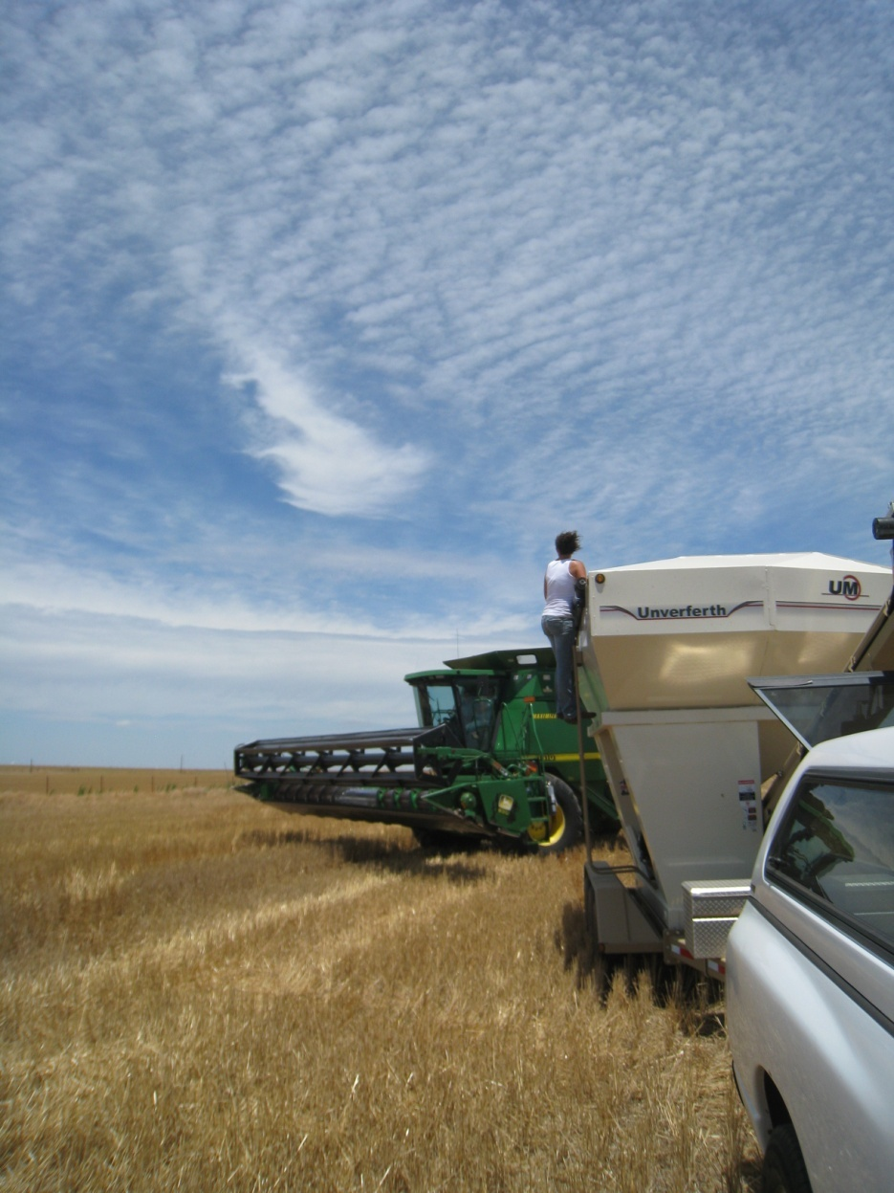
Thank you!!!
Brian Arnall
373 Ag Hall
405-744-1722
b.arnall@okstate.edu
Presentation available @
www.npk.okstate.edu
Twitter: @OSU_NPK www.Facebook/OSUNPK
YouTube Channel: OSUNPK
Blog: OSUNPK.com
www.Aglandlease.info

