Slide 1
The GreenSeeker Technology
Production Advantage Workshop
Brian Arnall
Plant and Soil Sciences OSU

Slide 2
Outline
Nitrogen Fertilization
History
N-Rich Strip
SBNRC
Variable Rate Technology

Slide 3
Farm Bureau and PaSS
Fertilizer Check-off Program
  SBNRC only Possible because of Check-off
  Check-off only possible because of the support of Ok FB
PaSS Youth outreach
  Plant Science Academy
  Land, Range, and Crop Man. Youth Field Day
  Improving Conservation through Experimentation (ICE)

Slide 4
SCIENCE Magazine
Excess nitrogen flowing down the Mississippi each year is estimated to be worth $750,000,000 (Science, Malakoff, 1998)
NUE in cereal production must be improved
Notes:
4

Slide 5
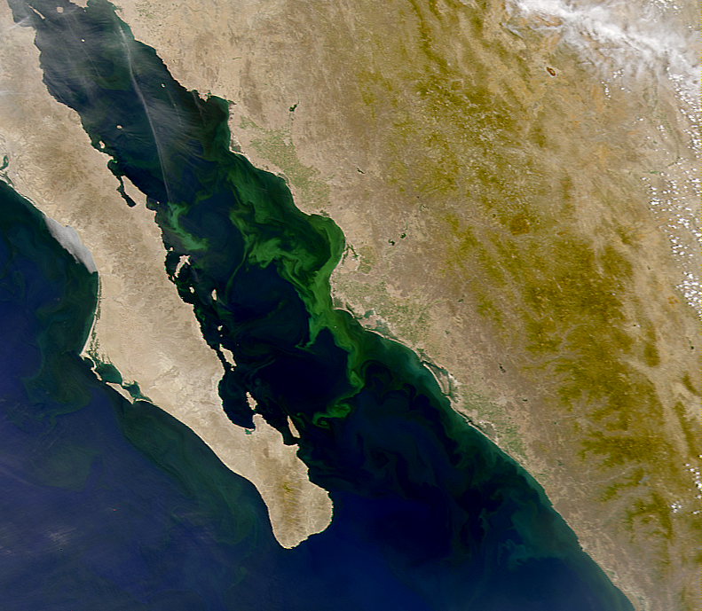
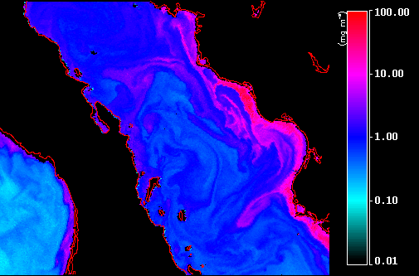
Notes:
Not only Mississippi River Delta problem but also the Gulf of California
5

Slide 6
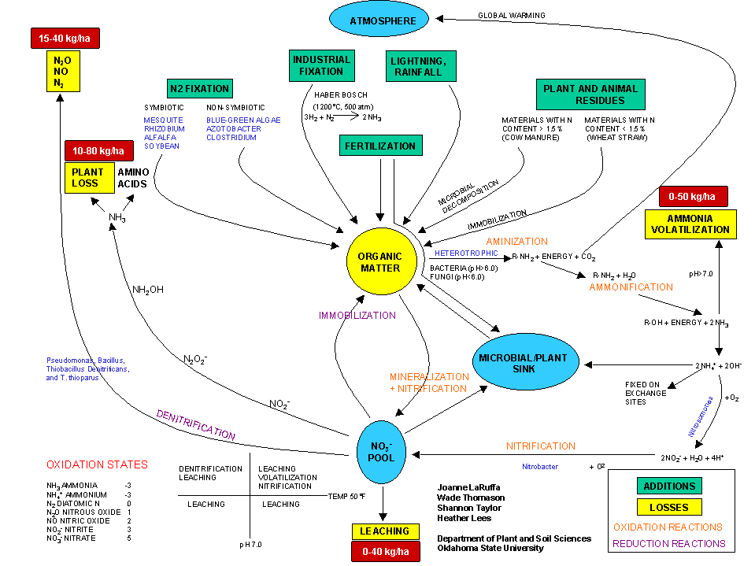
Nitrogen Not Used is Lost
Raun and Johnson, Agron J. 91:357-363
Notes:
The Nitrogen CYCLE LEAKS!!!!!
6

Slide 7
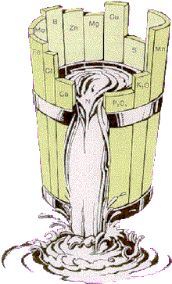
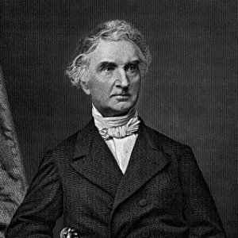
Liebig's Law of the Minimum
Growth is controlled not by the total of resources available, but by the scarcest resource.
  Only by increasing the amount of the limiting nutrient (the one most scarce in relation to "need") was the growth of a plant or crop improved.
Notes:
7
IMPORTANT POINT – Yield is Limited to the MOST deficient Nutrient.

Slide 8
Bray’s Nutrient Mobility Concept
Plants respond to the total
amount of mobile nutrients
present
Plants respond to the
concentration of immobile
nutrients present
Mobile Nutrients Immobile Nutrients
Nutrient limitation directly
related to yield potential,
and dependent on the
environment
Nutrient limitation expressed as a % of potential yield, or “sufficiency”, and independent
of the environment
Notes:
8
IMPORTANT POINTS
MOBILE NUTRIENTS - Plants respond to Total and yield is directly rated to nutrient lbs of nutrient per lb of yield
IMMOBILE NUTRIENTS – Plants respond to Concentration in the Soil, and the yield is affected as a % of total if concentration is below optimum.

Slide 9
Yield Goals
Yield Goals: average of last 3-5 years +30%
Nebraska study showed that farmers overestimated yield by 2 Mg ha⁻¹ (32 bu ac⁻¹), resulting in an excess of 35 kg N ha⁻¹ (Schepers et al., 1986)
Over-optimistic yield goals were the largest contributor to excess N applications with average yield goals exceeding actual yields by over 15%, only about 30% of the fields were within 5% of the yield goal
(Daberkow et al., 2001)
Notes:
9

Slide 10
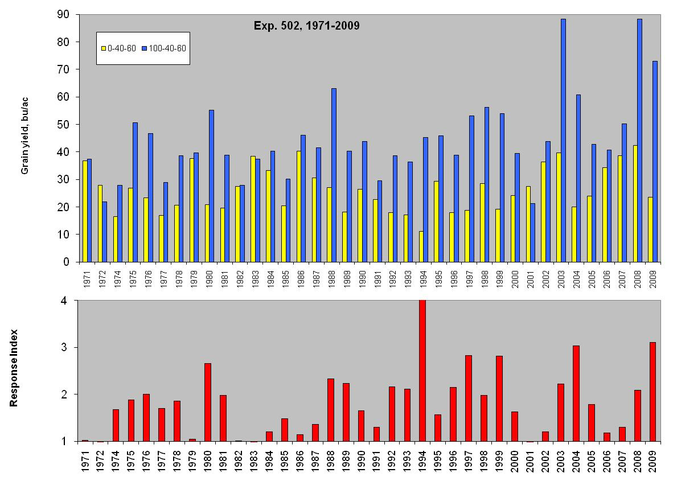
Choosing Yield Goal
Ave Yld 42 bu/ac

Slide 11
N Need (Theoretical)
Exp. 502, 1971-2009
Optimum N Rate Max Yield
Avg. 51 lb N/ac +/- 39 Avg. 44 bu/ac +/- 15

Slide 12
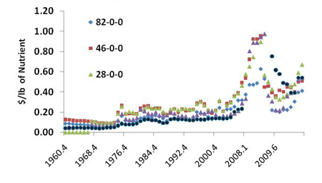
Rising Prices = Rising Risk
Notes:
Graph of Prices since 1990. Shows why nutrient management has become increasingly important.

Slide 13
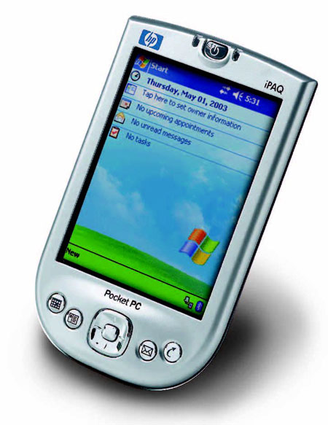
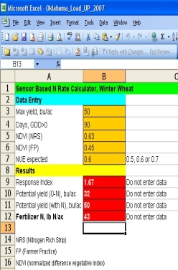
Solutions
N-Rich Strip
Sensor Based N Rate
  Green-Seeker Sensor
VRT

Slide 14
Progress timeline
1991: Developed optical sensors and sprayer control systems to detect bindweed in fallow fields and to spot spray the weed
1993: Sensor used to measure total N uptake in wheat and to variably apply N fertilizer.
1994: Predicted forage biomass and total forage N uptake using NDVI (Feekes 5).
1994: First application of N fertilizer based on sensor readings. N rate was reduced with no decrease in grain yield.
1996: Worlds first optical sensing variable N rate applicator developed at OSU
1997: OSU optical sensor simultaneously measures incident and reflected light at two wavelengths, (670 ±6 nm and 780 ±6 nm) and incident light is cosine corrected enabling the use of calibrated reflectance.
1997: Variable rate technology used to sense and treat every 4 square
1998: Yields increased by treating spatial variability and OSU’s In-Season-Estimated-Yield (INSEY)
1998: INSEY refined to account for temporal variability
1999: Found that adjacent 4 square foot areas will not always have the same yield potential
1999: Entered into discussions with John Mayfield concerning the potential commercialization of a sensor-based N
2000: N fertilizer rate needed to maximize yields varied widely over years and was unpredictable; developed RI
2001: NDVI readings used for plant selection of triticales in Mexico.
2001: NFOA algorithm field tested in 2001, demonstrating that grain yields could be increased at lower N rates when N fertilizers were applied to each 4 square feet (using INSEY and RI)
2002: Ideal growth stage in corn identified for in-season N applications in corn via daily NDVI sampling in Mexico as V8.
2003: CV from NDVI readings collected in corn and wheat were first used within NFOA’s developed at OSU.
2003: When site CV’s were greater than 18, recovery of maximum yield from mid-season fertilizer N applications was not possible in wheat
2004: Calibration stamp technology jointly developed and extended within the farming community
2004: OSU-NFOA’s (wheat and corn) used in Argentina, and extended in China and India.
2005: USAID Grant allowed GreenSeeker Sensors to be delivered in China, India, Turkey, Mexico, Argentina, Pakistan, Uzbekistan, and Australia.
2006: Delivery of 586 RAMPS and 1500 N Rich Strips (using RCS and SBNRC approaches respectively) in farmer fields across Oklahoma resulted in an estimated service area exceeding 200,000 acres and increased farmer revenue exceeding $2,000,000.
2010: Estimated that the N-Rich Strip was utilized on 400,000 acres in Oklahoma. Average increase in profit of $10/ac
Notes:
14
This shows a timeline in the development of sensor based technology for crop production. Some key accomplishments since the development of the sensors include
1994 - the determination that feekes 5 was the growth stage for predicting wheat yield
1996 – Variable N rate applicator developed at OSU
2002 – determined that corn yield could be predicted from sensor readings taken at V8 growth stage.

Slide 15
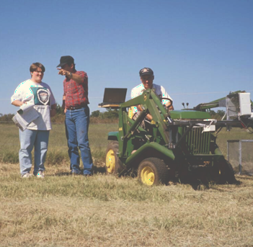
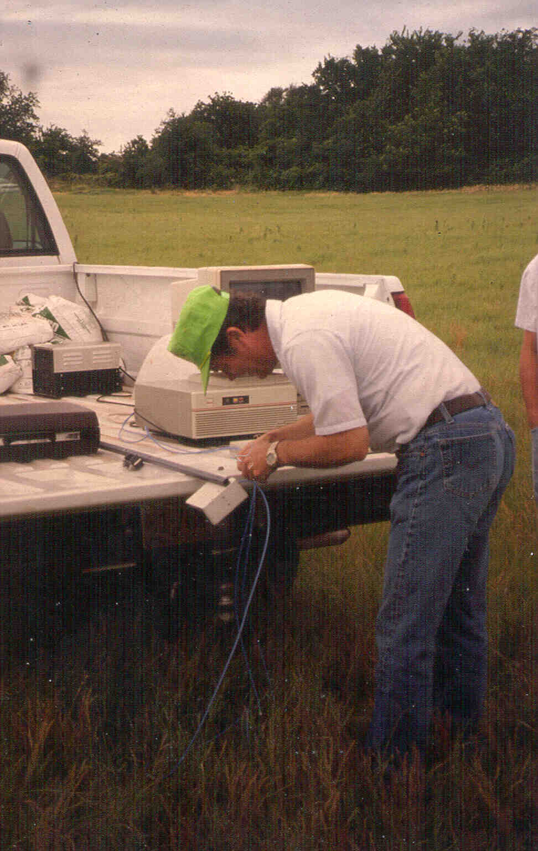
1993
Dr. Marvin Stone adjusts the fiber optics in a portable spectrometer used in early bermudagrass N rate studies with the Noble Foundation, 1994.
Sensor readings at ongoing bermudagrass, N rate * N timing experiments with the Noble Foundation in Ardmore, OK. Initial results were promising enough to continue this work in wheat.

Slide 16
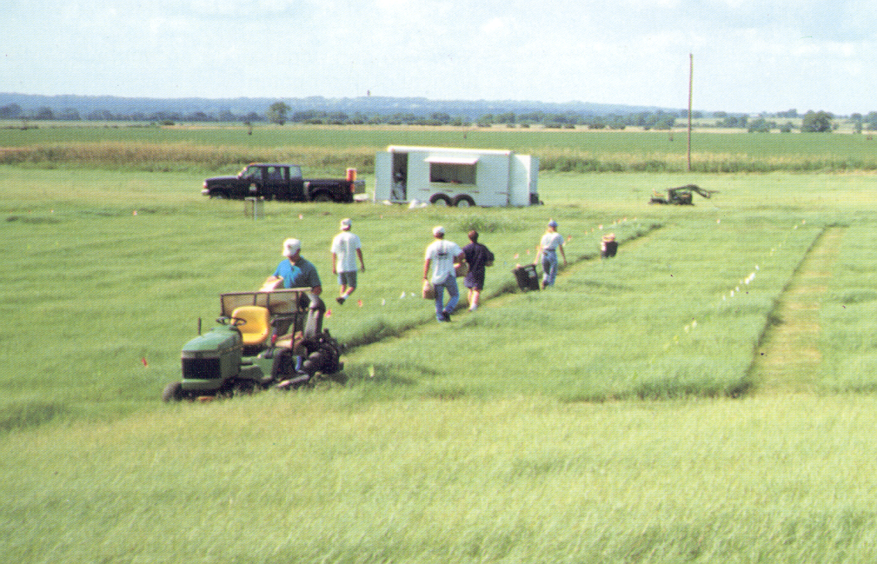
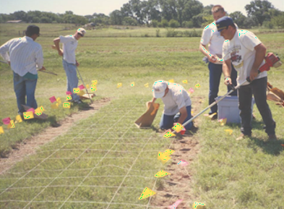
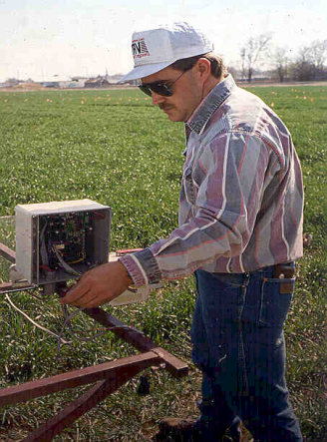
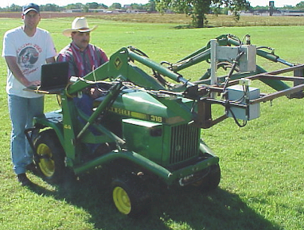
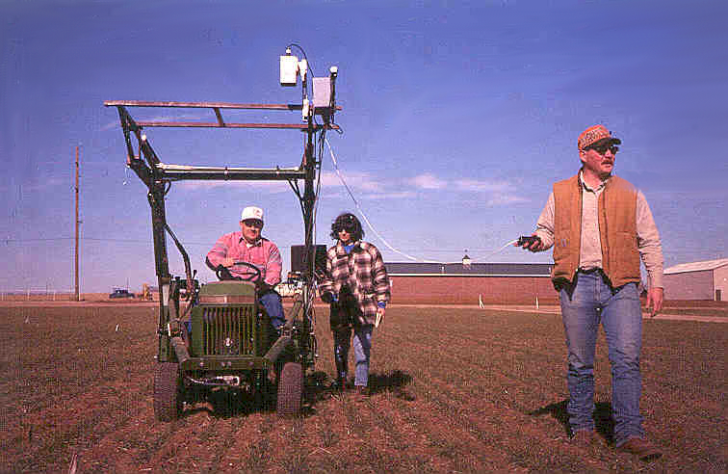
Samples were collected from every 1 square foot. These experiments helped to show that each 4ft² in agricultural fields need to be treated as separate farms.
1995
New ‘reflectance’ sensor developed.
Extensive field experiments looking at changes in sensor readings with changing, growth stage, variety, row spacing, and N rates were conducted.

Slide 17
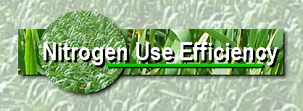
1997
In 1997, our precision sensing team put together two web sites to communicate TEAM-VRT results. Since that time, over 20,000 visitors have been to our sites. (www.dasnr.okstate.edu/precision_ag)
www.dasnr.okstate.edu/nitrogen_use
The first attempt to combine sensor readings over sites into a single equation for yield prediction A modification of this index would later become known as INSEY (in-season estimated yield), but was first called F45D.

Slide 18
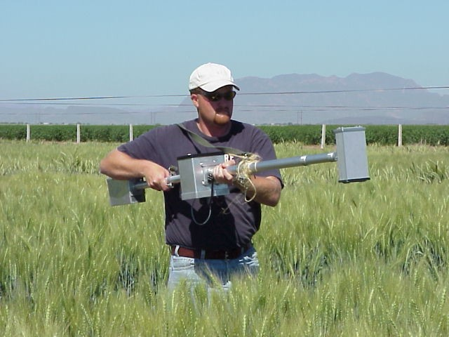
Cooperative research program with CIMMYT. Kyle Freeman and Paul Hodgen have each spent 4 months in Ciudad Obregon, MX, working with CIMMYT on the applications of sensors for plant breeding and nutrient management.
1998
Cooperative Research Program with Virginia Tech

Slide 19
Discovered that the N fertilizer rate needed to maximize yields varied widely over years and was unpredictable in several long-term experiments. This led to his development of the RESPONSE INDEX.
2000
Predicted potential response to applied N using sensor measurements collected in-season. Approach allowed us to predict the magnitude of response to topdress fertilizer, and in time to adjust topdress N based on a projected ‘responsiveness.’
RI Harvest
RI NDVI

Slide 20
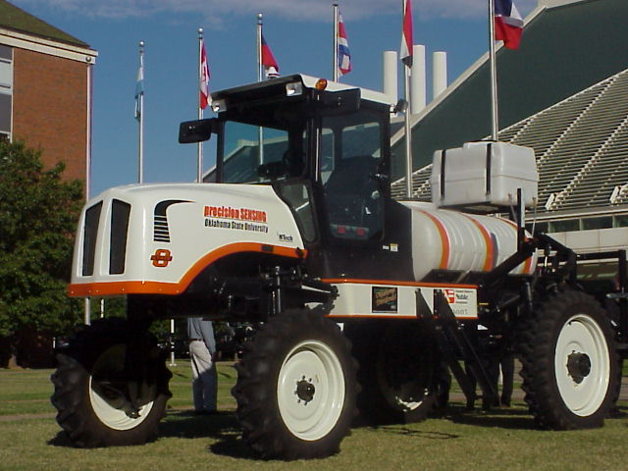
2001
N Fertilizer Optimization Algorithm (NFOA):
1. Predict potential grain yield or YP₀ (grain yield achievable with no additional N fertilization) from the grain yield-INSEY equation, where;
INSEY = NDVI (Feekes 4 to 6)/days from planting to sensing (days with GDD>0)
YP₀ = 0.74076 + 0.10210 e ^{577.66(INSEY)}
2. Predict the magnitude of response to N fertilization (In-Season-Response-Index, or RI_{NDVI}). RI_{NDVI}, computed as; NDVI from Feekes 4 to Feekes 6 in non-N-limiting fertilized plots divided by NDVI Feekes 4 to Feekes 6 in the farmer check plots (common fertilization practice employed by the farmer). The non-N limiting (preplant fertilized) strip will be established in the center of each farmer field.
3. Determine the predicted yield that can be attained with added N (YP_{N}) fertilization based both on the in-season response index (RI_{NDVI}) and the potential yield achievable with no added N fertilization, computed as follows:
YP_{N} = (YP₀)/ (1/R_{INDVI}) = YP0 * RI_{NDVI}
4. Predict %N in the grain (PNG) based on YP_{N} (includes adjusted yield level)
PNG = -0.1918YP_{N} + 2.7836
5. Calculate grain N uptake (predicted %N in the grain multiplied times YP_{N})
GNUP = PNG*(YP_{N}/1000)
6. Calculate forage N uptake from NDVI FNUP = 14.76 + 0.7758 e 5.468NDVI
7. Determine in-season topdress fertilizer N requirement (FNR)= (Predicted Grain N Uptake - Predicted Forage N Uptake)/0.70
FNR = (GNUP – FNUP)/0.70
Work with wheat and triticale plant breeders at CIMMYT, demonstrated that NDVI readings could be used for plant selection
Engineering, plant, and, soil scientists at OSU release applicator capable of treating every 4 square feet at 20 mph

Slide 21
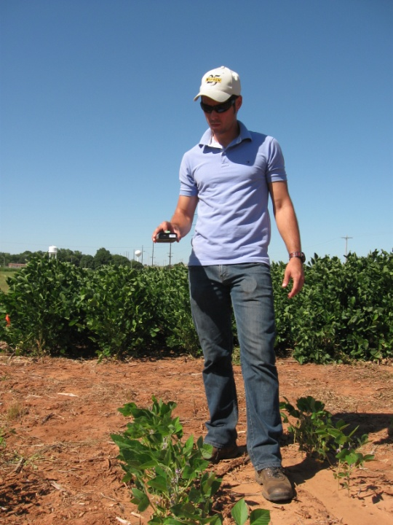
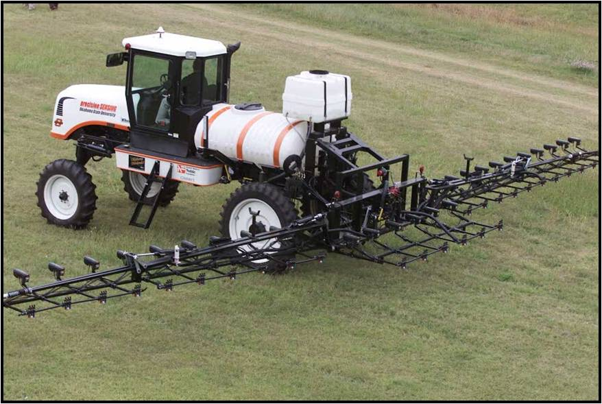
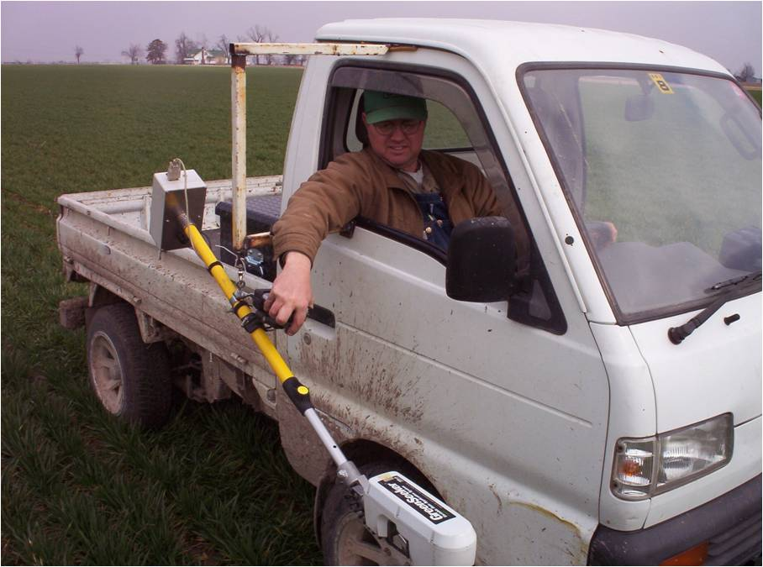
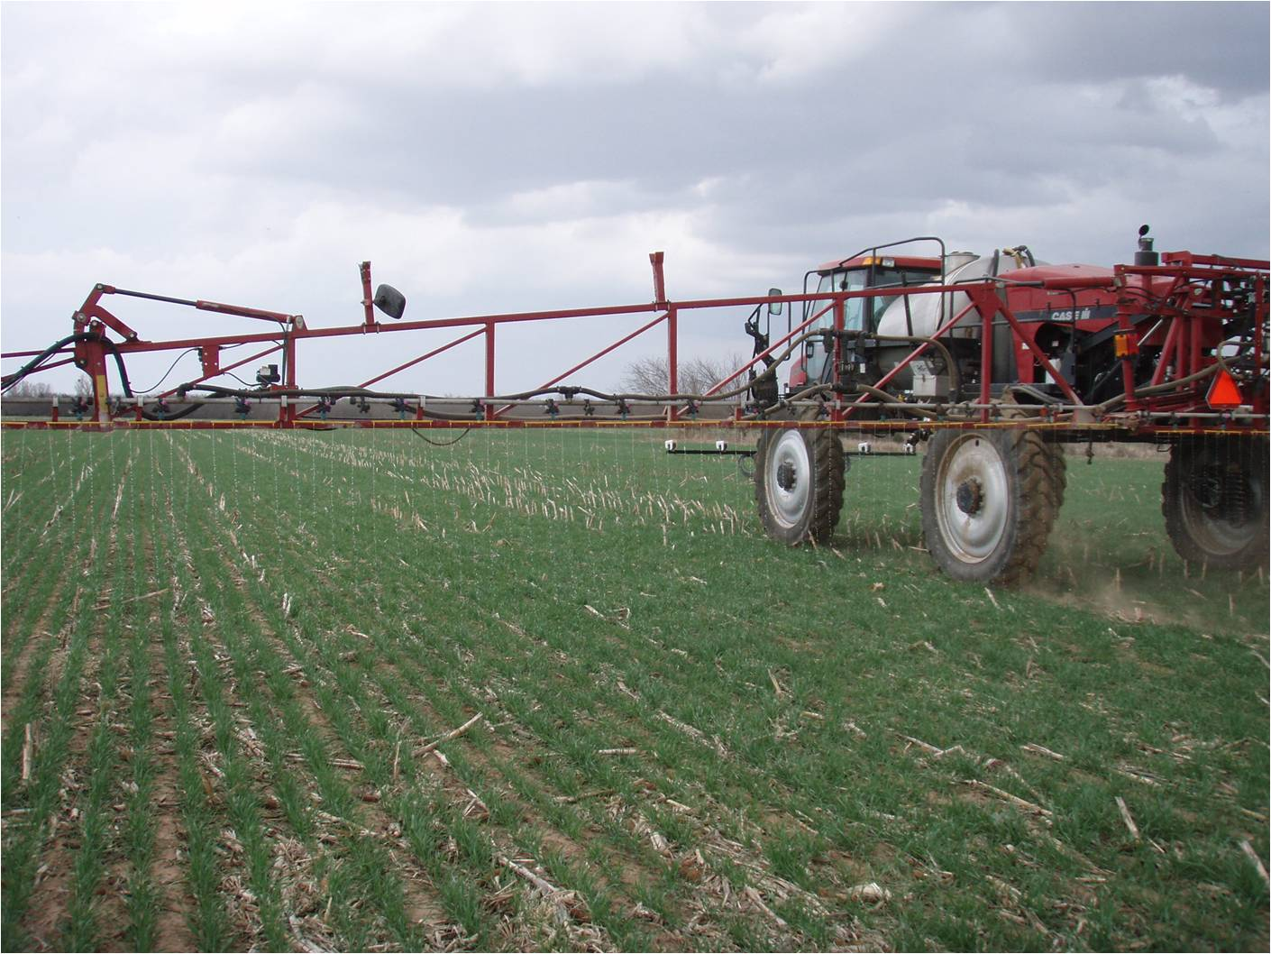
Optical Sensors

Slide 22
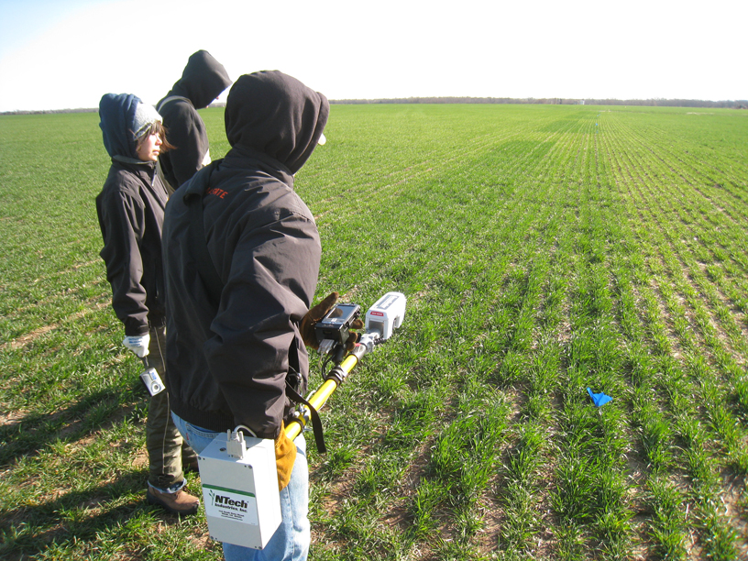
N-Rich Strips
Are Very Visual..
BMP?
Risk Aversion?
Sales and Service?

Slide 23
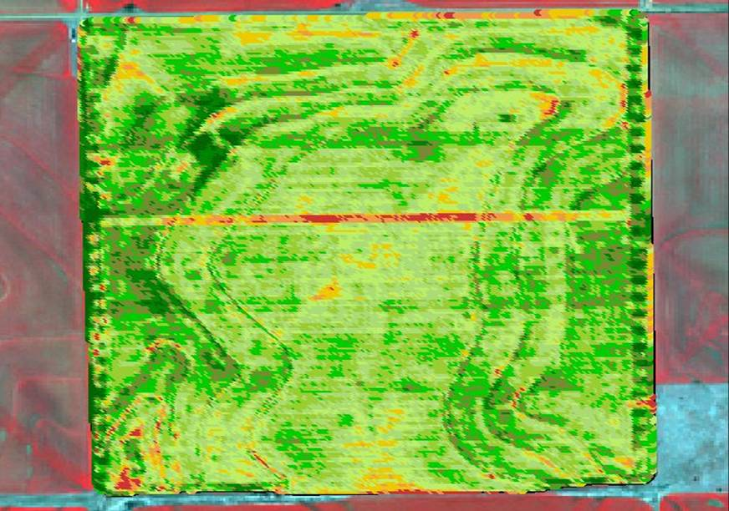
N-Rich Strip
A Strip with enough N for the full season.
  Double pass with the applicator.
Used as a Reference.
N - Rich
No - P

Slide 24
N-Rich Strips
What: A high rate of N applied in, across, through, over or under each and every field
How Much: Minimum of 125% of yield goal recommended rate, this includes residual and preplant.
How and Where: 10 to 100 ft wide, anywhere representative.
When: Winter crops; before or after sowing (1+ months), Summer crops; before or immediately after planting.

Slide 25
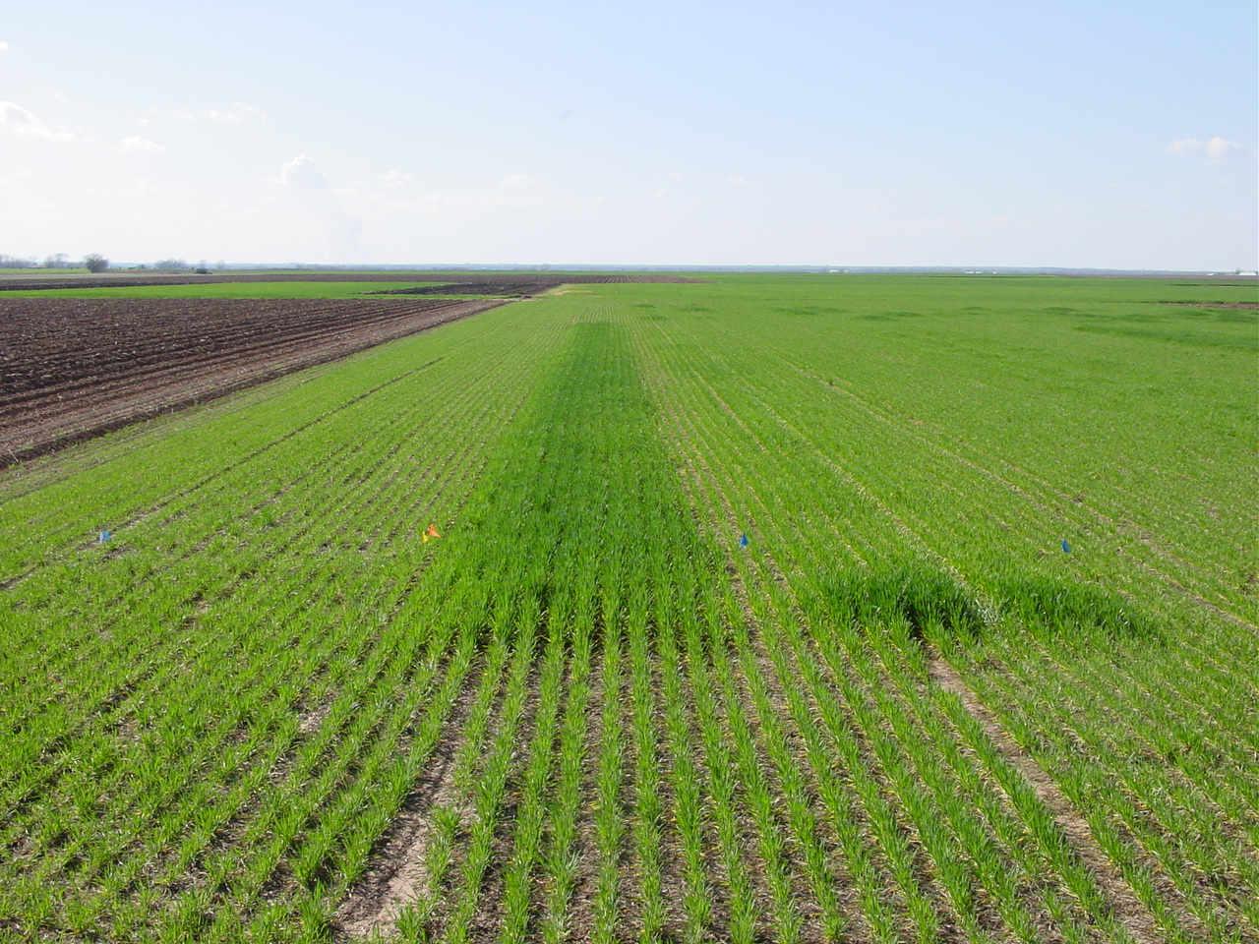
N-Rich Strip
Will tell you:
Yes, I need Nitrogen
No, I do not Need any!
Notes:
In response years the N-Rich strip is EASY to find. This one is Screaming FEED ME!!!

Slide 26
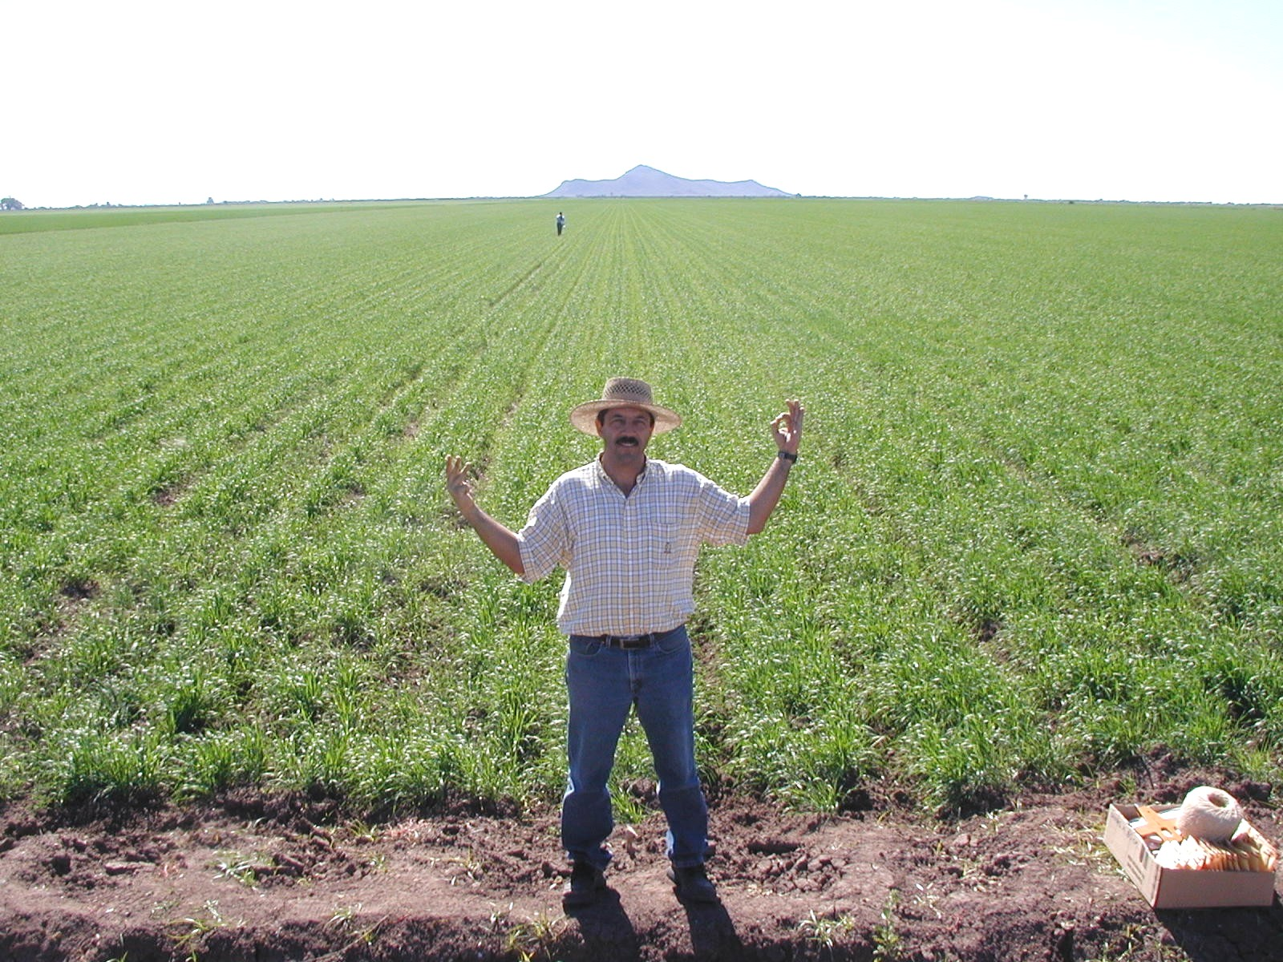
N-Rich Strip
Mid-Season Evaluation of N Rich Strip (Ciudad Obregon, MX)
Average Wheat Yields = 150 bu/ac (irrigated spring wheat)
300 lbs N ac⁻¹ 0 lbs N ac⁻¹
Notes:
But in other years the N-Rich strip will never show it. More N is NOT needed.
26

Slide 27
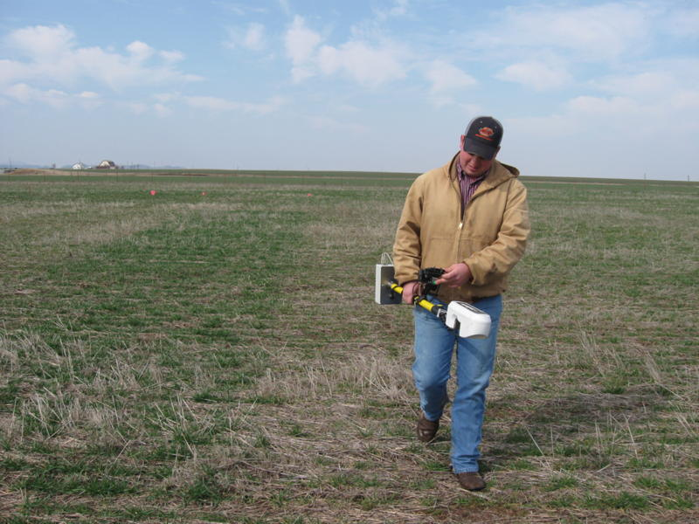
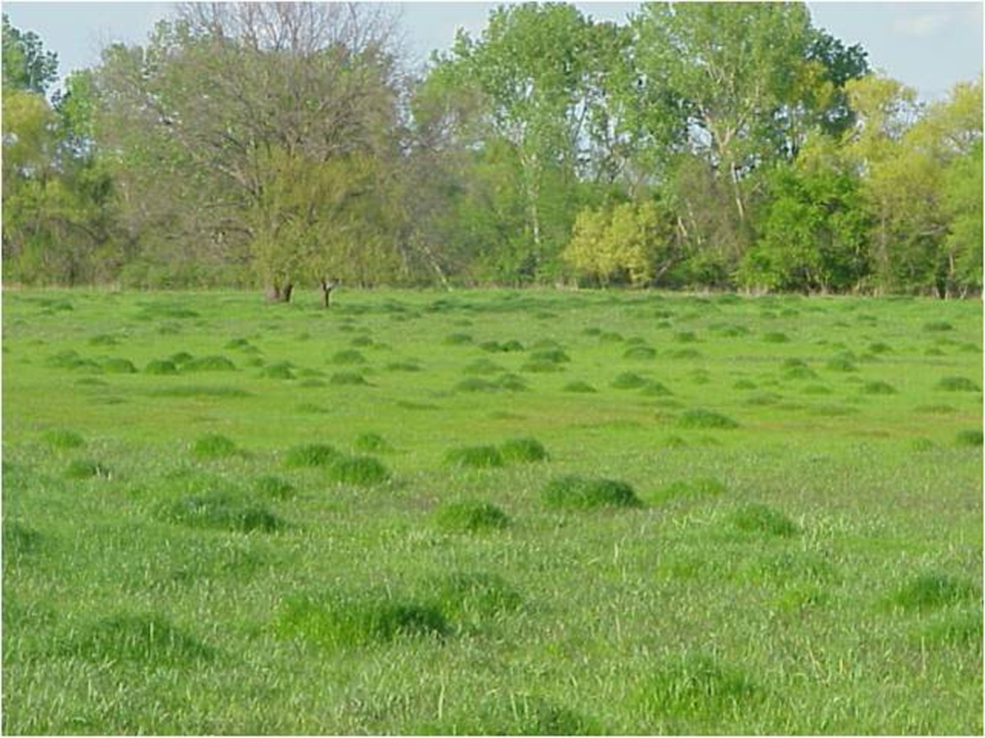
N-Rich Strips

Slide 28
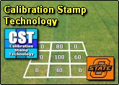
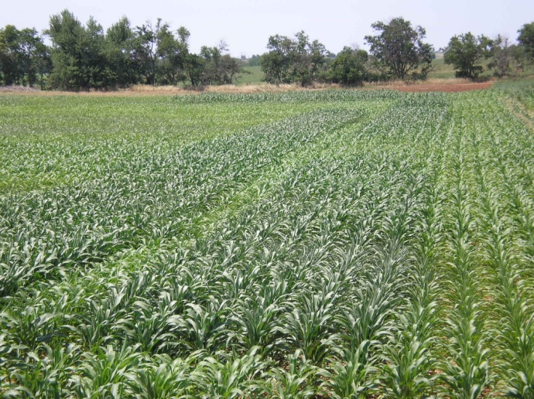
Evolution of Multi rate NRS

Slide 29
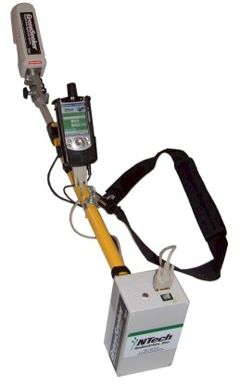
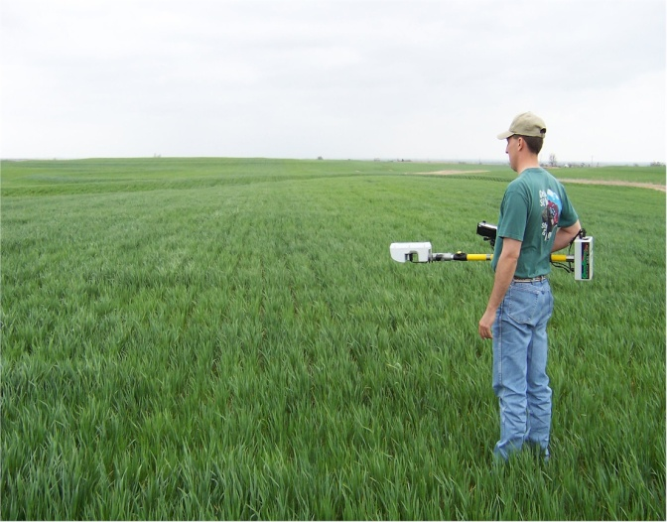
Sensor Based N Rate Calculator
SBNRC and the N-Rich Strip
Using Sensor Data and the Nitrogen Fertilizer
Optimization Algorithm, N-Rates are prescribed for each field and its condition/environment.
Notes:
To get an exact Mid-Season N rate for each field the Green Seeker sensor must be used with the N-Rich Strip.
The N Rate is computed using the Sensor Based Nitrogen Rate Calculator SBNRC.

Slide 30
Sensor Based Nitrogen Rate Calculator?
What is needed for a
Response Index
Yield Prediction Model
Nitrogen Removal
The calculation looks like:
N Rate =
(Potential Yield of Farmer Practice * RI)* N in Grain/NUE
Notes:
This is the basics behind the N rate Calculation.
We predict yield with the sensor.
The predicted yield of the reference is compared to the rest of the field (farmers practice)
For example N-rich Pot yld= 50 bu and the farmer practice pot yld 40 bu. This means to meet max yield we have to supply enough N to make 10 bushel.
We know N that is need for 10 bushel and the efficiency. F we used the adage of 2 lbs of N per bushel.
So in a rough calculation that field would need 20 lbs of N.

Slide 31
Consistant Yield and Response
Ave Yld 42 bu/ac

Slide 32
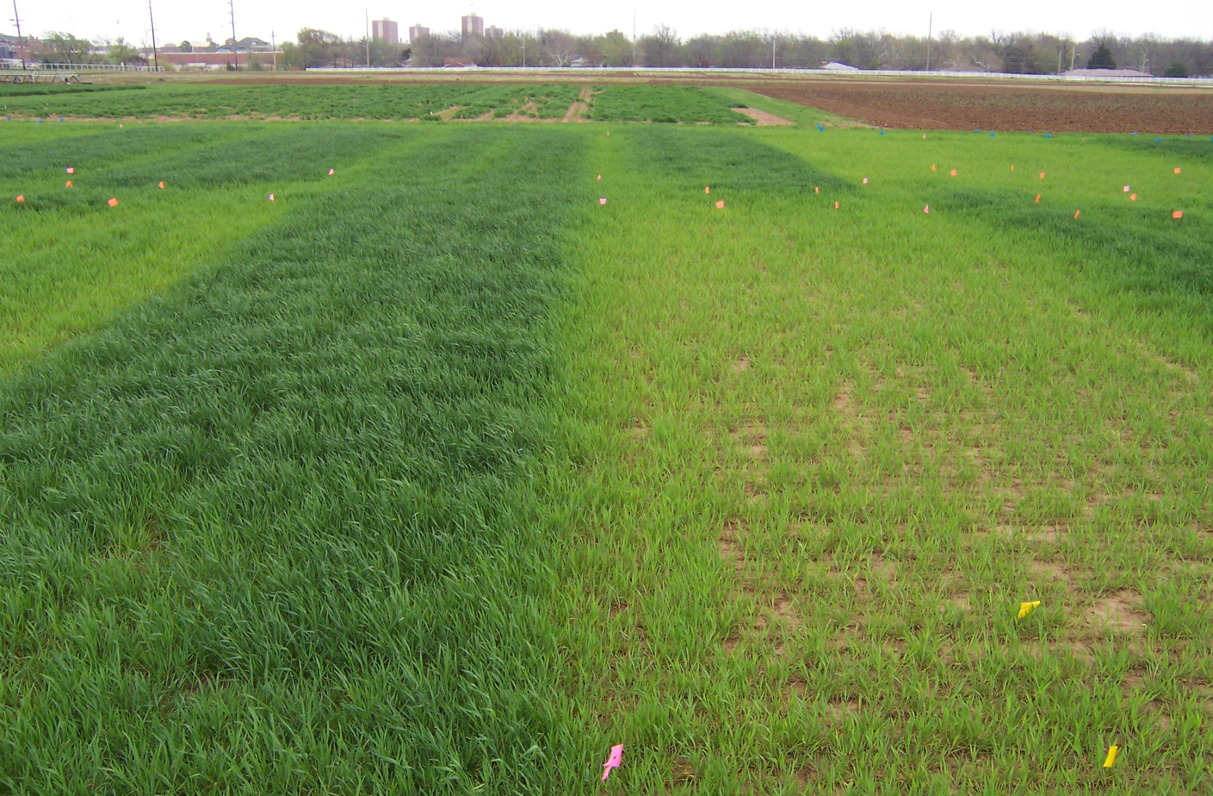
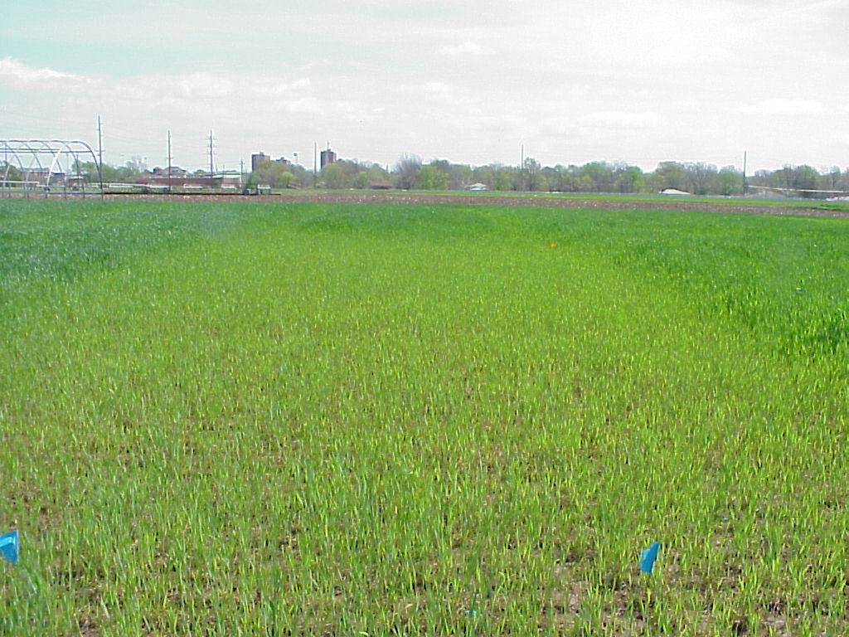
Response Index
2004
variable from year to year in the same field
1995
Long term N-P-K Experiment
(1969-2008)
Dr. Billy Tucker
Notes:
32

Slide 33
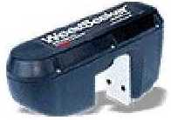
GreenSeekerTM Sensor Light Detection and Filtering
Detection of
Reflected
NIR and RED
+Sun
Notes:
33
The GreenSeeker emits its own light and filters out that of the sun. This means the Sensors can be operated day or night and the amount of direct sunlight is not a factor.

Slide 34
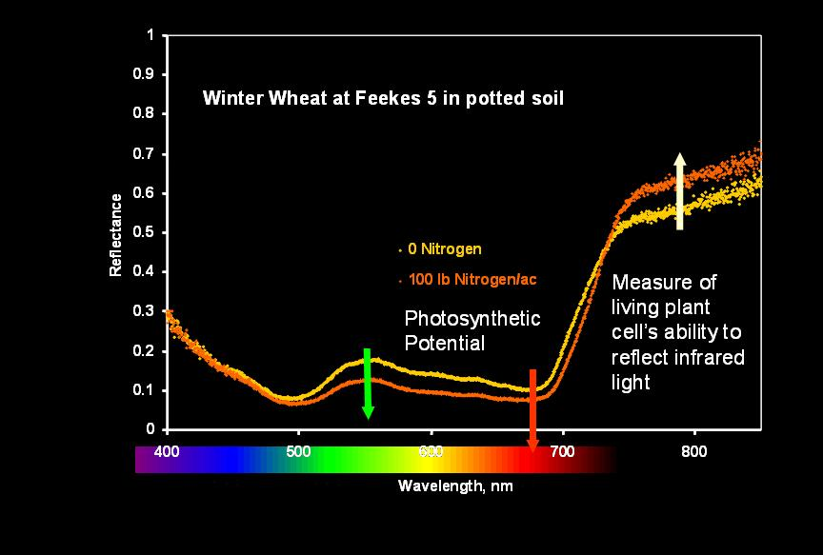
Spectral Response to Nitrogen
NDVI=
NIR – Red
NIR + Red
NIR
Red
Notes:
Importance of this Graphs.
In the Red Wavelength The 0 reflects more than the 100 lb rate. Plants want to absorb red for Photosynthesis, the more leaf area the more Red is absorbed.
In the NIR Wavelength The 100 reflects more than the 0 lb rate. NIR wavelengths cause heat. Healthier plants will reflect more NIR.
So Red is an indication of leaf area and photosynthetic potential and NIR is a measure of plant health.
NDVI is a relationship of Red and NIR reflectance.

Slide 35
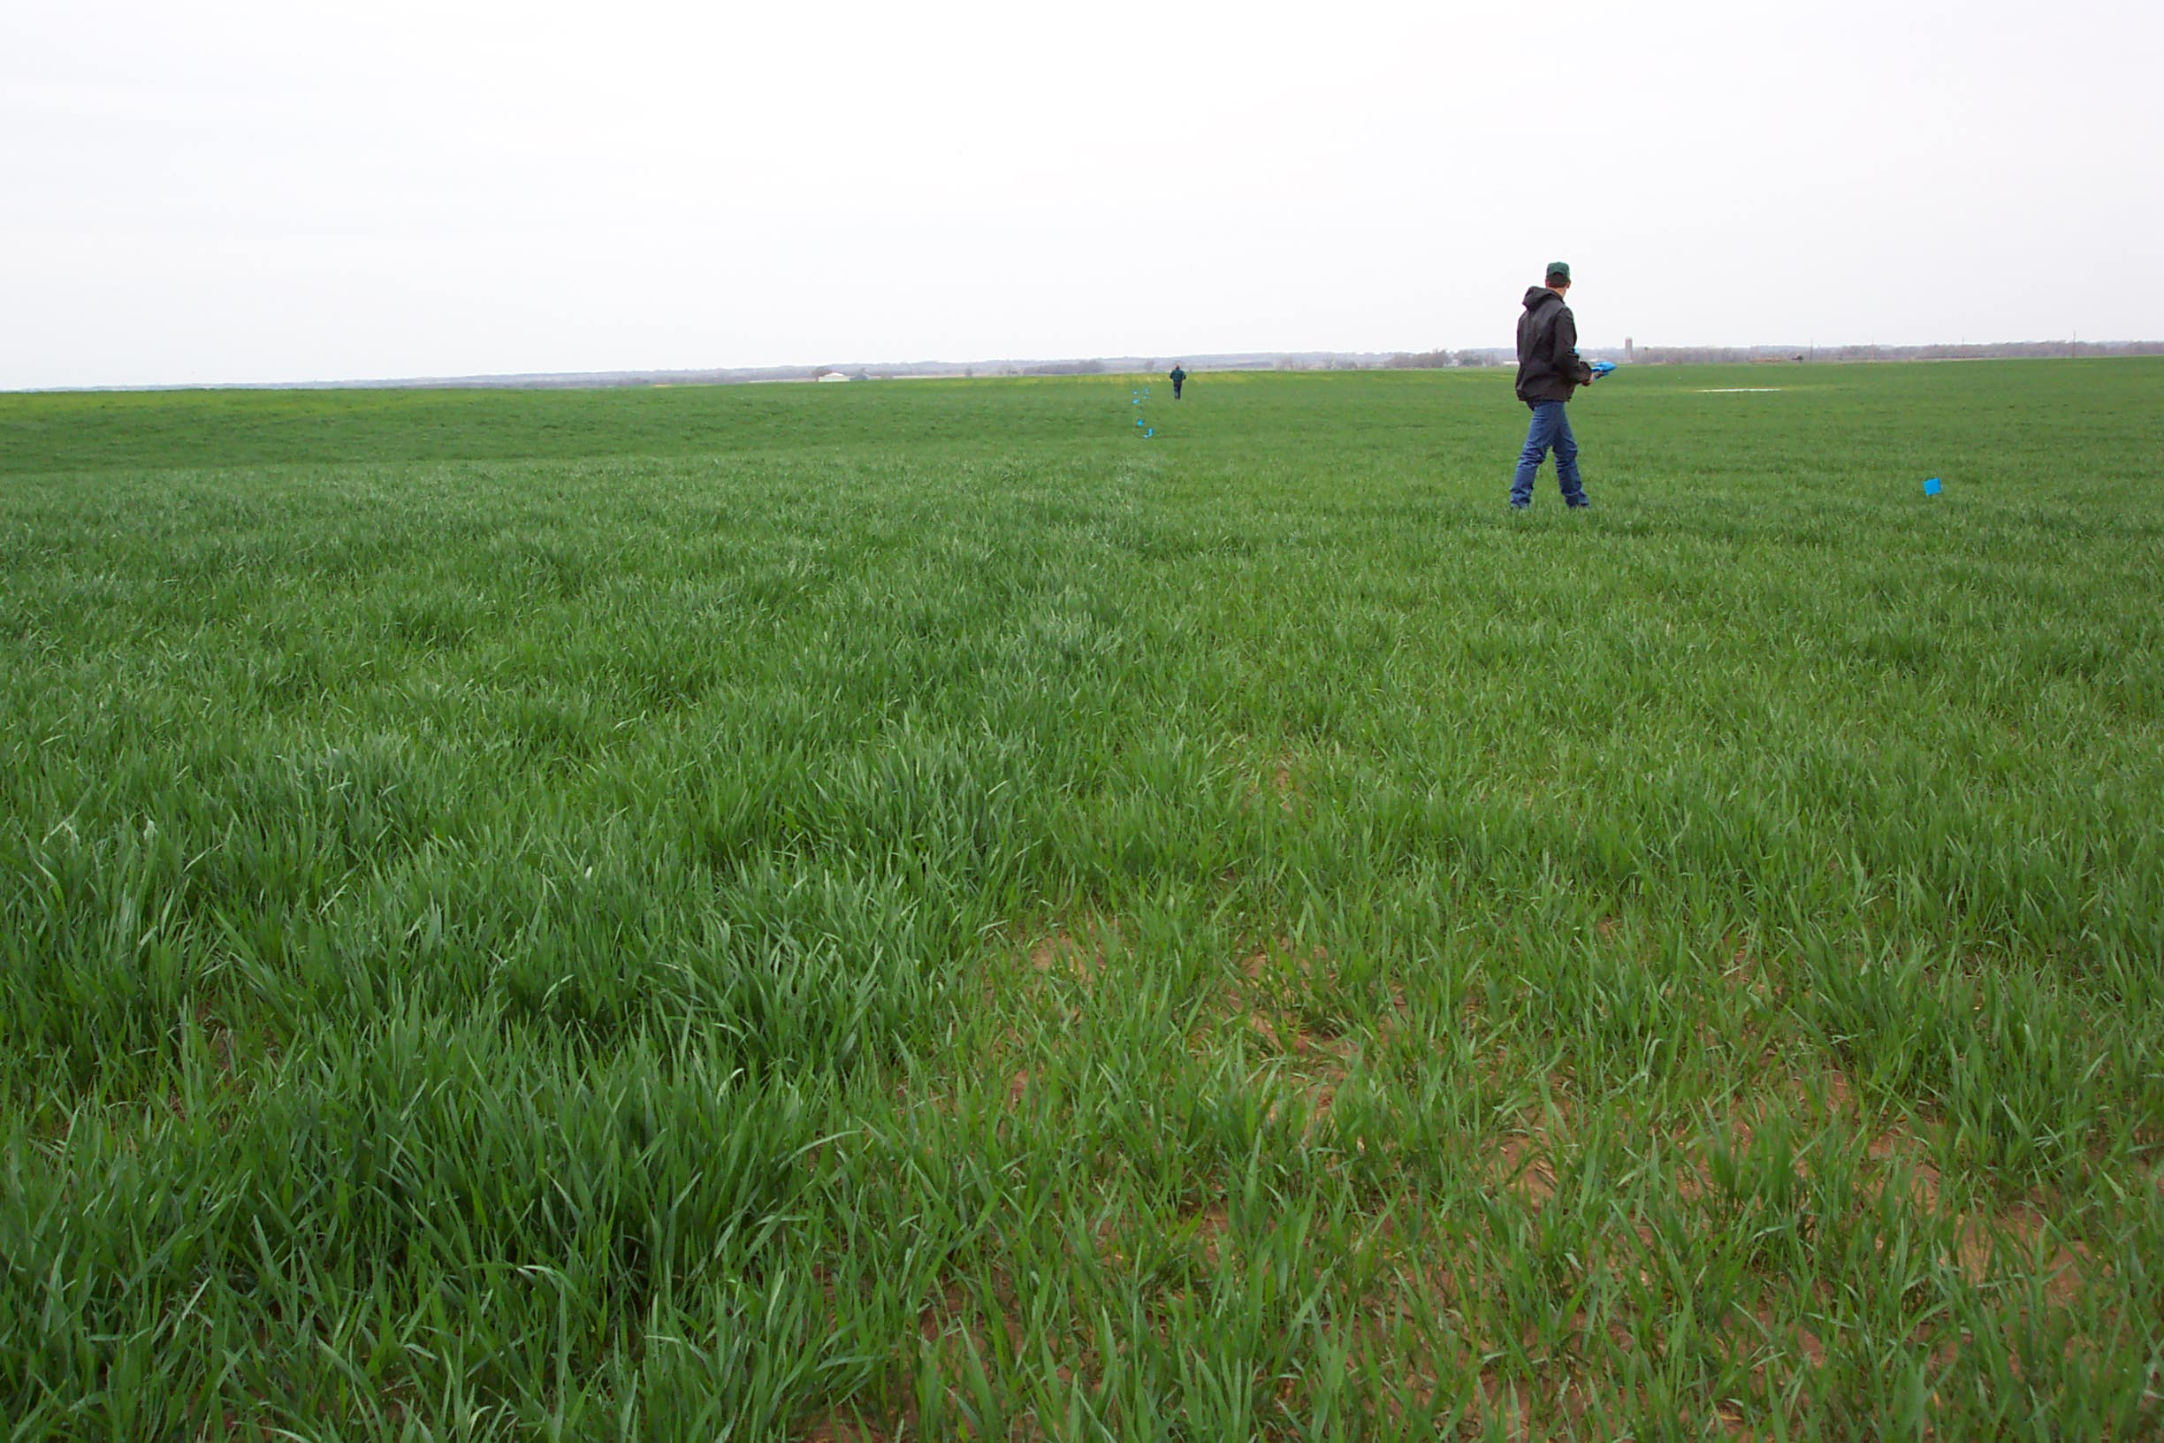

Matt Steinert, Covington, OK (March 20, 2003)
Predicted yield
with N fertilization
(YP_{N})
Response Index =0.75/0.57 = 1.31
RI
N-Rich Strip
Farmer Practice
Planting date
Predicted yield
with no added N
fertilization (YP₀)
days from planting to sensing
NDVI (sensing date)
INSEY = (NDVI/days from planting to sensing where GDD>0)
YPN = YP0 * RI
Fertilizer N = (Grain N uptake at YPN – Grain N uptake at YP0)/0.7
Jim Schepers
Dennis Francis
Notes:
35

Slide 36
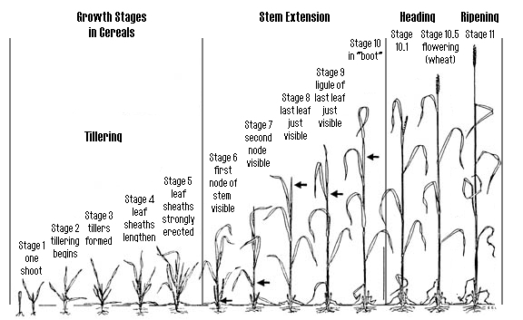
Can Yield Potential (similar to “yield goals”) be Predicted MID-SEASON?
Better than a preplant N decision?
Sensing
Notes:
36

Slide 37
WINTER
WHEAT
NDVI at F5
INSEY
=
days from planting to F5, GDD>0
+Good predictor of final grain yield
+Requires only one sensor reading
+Works over different regions/biotypes
Units:
N uptake, kg ha⁻¹ day⁻¹
where GDD>0
Notes:
37

Slide 38
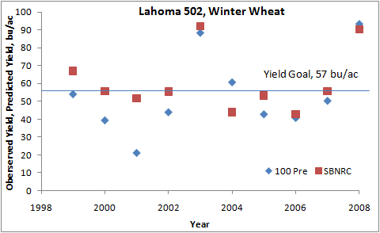
Yield Prediction
SBNRC (YP0*RI =YPN)
100 Pre (100 lbs N/ac applied preplant)
Notes:
Predicted Yield or Yield Potential.
Blue Diamond actual Yield. Red Square Predicted.
We cant predict when something bad happens after sensing, but the definitely predict trends.
And in the two years of outstanding yield 2003 and 2008.
We predicted record breaking yields in Febuary.
38

Slide 39

SBNRC
Online
www.nue.osktate.edu
Notes:
39
Yield Prediction, response Index, and the Greenseeker are all brought together for world to see at NUE.OKSTATE.EDU.
Countries listed our those who have adopted the technologies developed in Oklahoma.

Slide 40
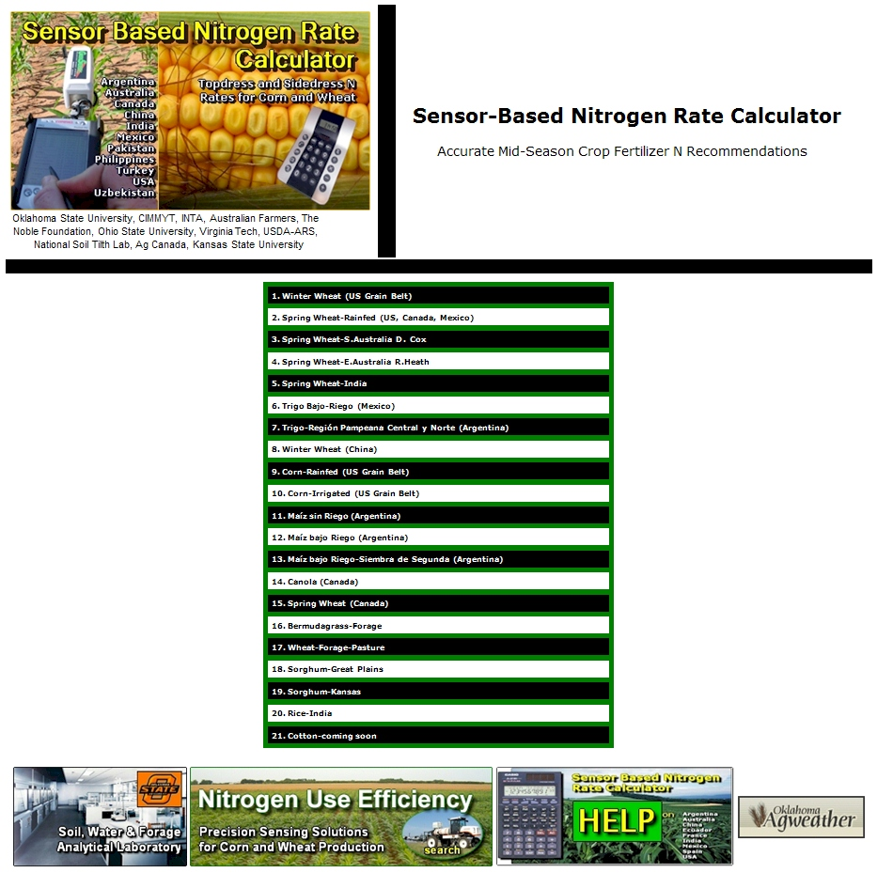
Motivate
Now at 24 Crops
and Regions
Notes:
40
Each line on this page is the calculator for a different crop or region.
Ex. Wheat OK, Corn OK, Sorghum KS, Wheat China, Wheat Canada…..

Slide 41
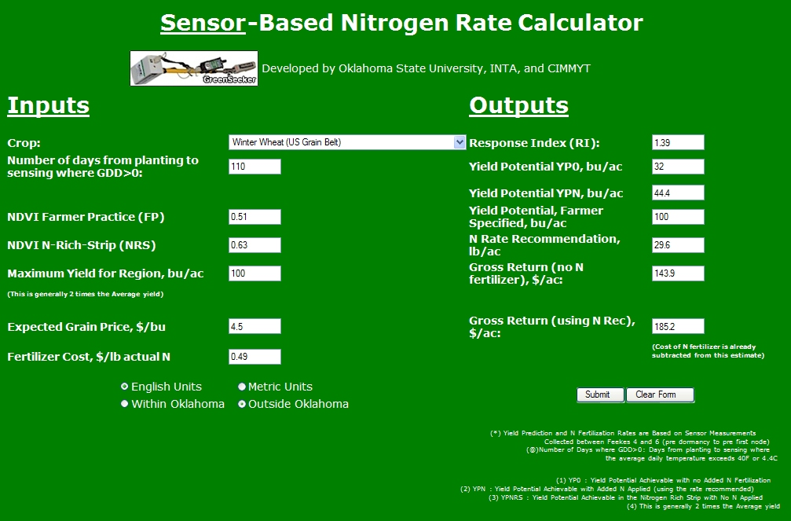
Notes:
41
Online Calculator.
You input planting data, or numbers of days from planting. NDVI of reference and NDVI of farmer practice plus some Econ. (Grain and Fert Price)
Output is RI, Potential Yield without Fert., Potential Yield with Fert. N rate recommendation, Gross $ with and w/o fert.

Slide 42


Sensor Base N Rate Calculator
IPAQ (load-up files)
Notes:
The calculator for the handheld PDA. NO economics but the rest is the same.
Great for in-fied decisions.

Slide 43
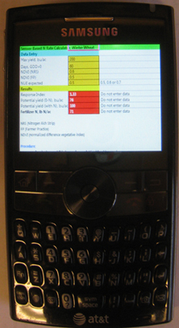
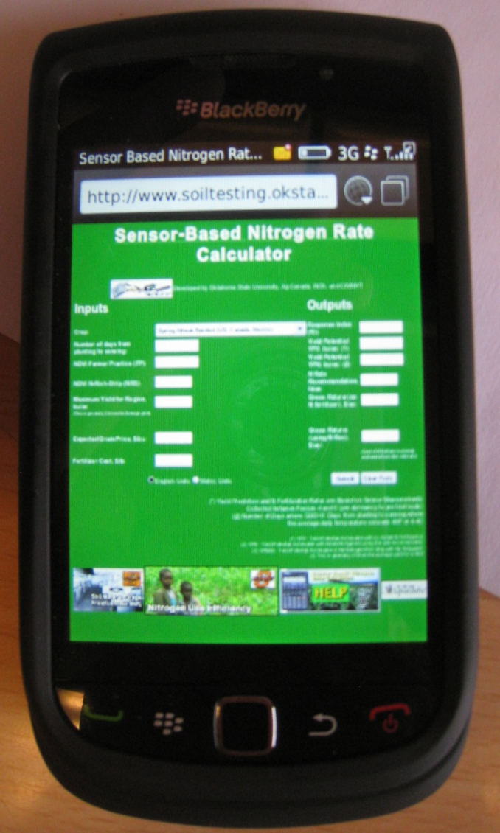
Smart Phones

Slide 44
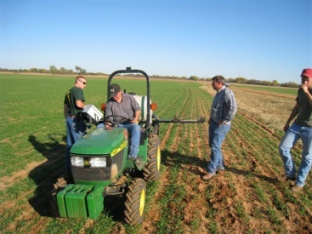
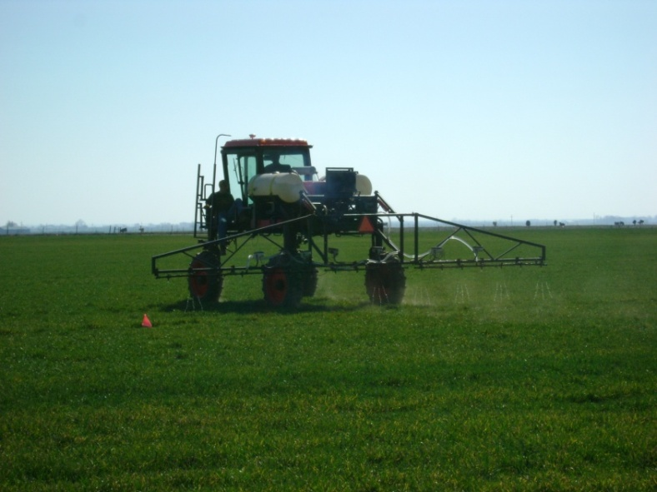
Research
Applied the N-Rich strips
Sensed strips and farmers field with GreenseekerTM sensor
Applied the sensor based N rate as recommended by the sensor based N rate calculator (SBNRC)

Slide 45
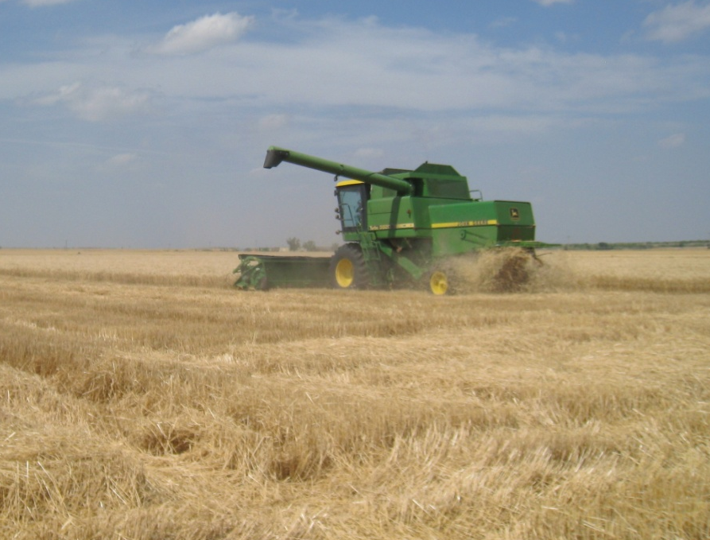
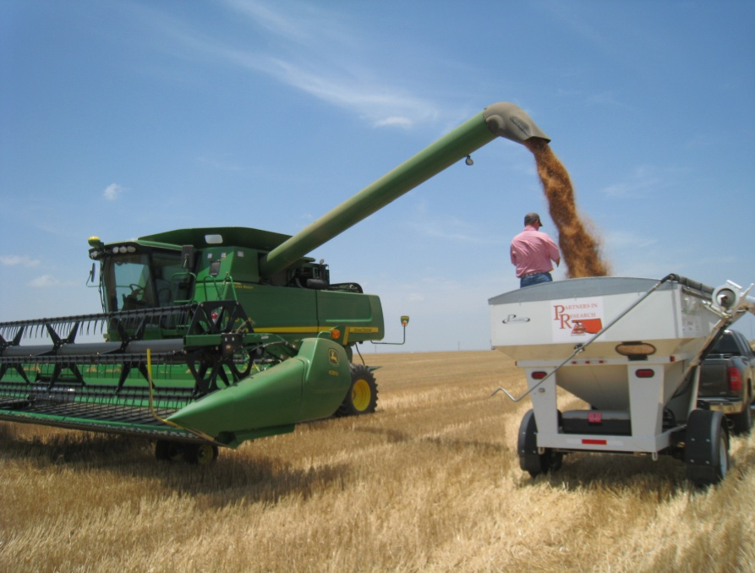
Research
Harvested with producers combine
Weighed each plot with a weigh wagon

Slide 46
2009 | Farmer Practice |  |  |  | SBNRC
Location | Nrate | Yield | Protein | NUE | Nrate | Yield | Protein | NUE
Site 1 | 39 | 23 | 11.91 | 0.18 | 48 | 26 | 12.08 | 0.22
Site 2 | 36 | 53 | 13.51 | 0.65 | 49 | 54 | 13.68 | 0.54
Site 3 | 84 | 39 |  | 0.00 | 39 | 33 |  | 0.00
Site 4 | 60 | 52 | 11.69 | 0.28 | 24 | 44 | 10.66 | 0.12
Site 5 | 60 | 59 | 14.42 | 0.02 | 7 | 61 | 14.54 | 0.72
Site 6 | 60 | 66 | 11.69 | 0.35 | 38 | 62 | 10.83 | 0.25
Site 7 | 33 | 29 | 10.15 | 0.20 | 59 | 37 | 10.20 | 0.26
Site 8 | 28 | 42 | 10.26 | 0.48 | 59 | 48 | 11.12 | 0.41
Averages | 50 | 45 | 11.95 | 0.27 | 41 | 46 | 11.87 | 0.31
2010
Location | Nrate | Yield | Protein | NUE | Nrate | Yield | Protein | NUE
Site 1 | 160 | 63 | 15.16 | 0.10 | 23 | 62 | 13.05 | 0.06
Site 2 | 60 | 39 | 12.48 | 0.19 | 49 | 40 | 12.60 | 0.27
Site 3 | 60 | 40 | 12.20 | 0.41 | 72 | 42 | 11.86 | 0.35
Site 4 | 50 | 91 | 13.57 | 0.12 | 34 | 91 | 14.25 | 0.39
Site 5 | 40 | 65 | 10.89 | 0.08 | 48 | 67 | 11.06 | 0.13
Site 6 | 50 | 45 | 15.05 | 0.02 | 12 | 46 | 14.59 | 0.07
Averages | 70 | 57 | 13.22 | 0.15 | 40 | 58 | 12.90 | 0.21
Total | 59 | 50 | 12.54 | 0.22 | 40 | 51 | 12.35 | 0.27

Slide 47
Research
Econ at 11 of 14 sites SBNRC > FP ($0.5 N and $5 Wheat, and $0.4 N and $4 Wheat)
Over all site years SBNRC N rate was 19 lbs less than FP with equal yield. So average saving is dependent on N price.
6 of 14 site SBNRC recommended more N than FP.
5 of 14 Protein was affected by method.
FP higher 3 times and SBNRC higher 2 times.

Slide 48
Sensors and No-till
There is no cookie cutter recipe
No Text Book
Learn from others Mistakes
Adopt to your farm, soil, machinery, management and mindset.
Do not go 100% the first year, but put out 100% of the strips.
Art

Slide 49
VRT
Variable Rate Technologies
Zones
  Can easily apply different flat rates in Management Zones
RT-200
  Utilizes the GreenSeeker Technology to make decisions and apply N on the go.

Slide 50
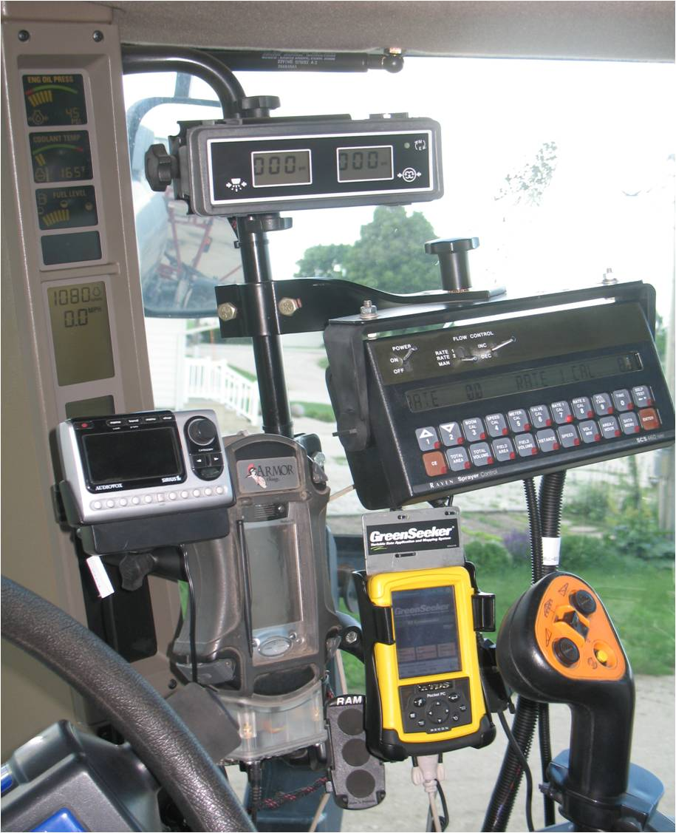
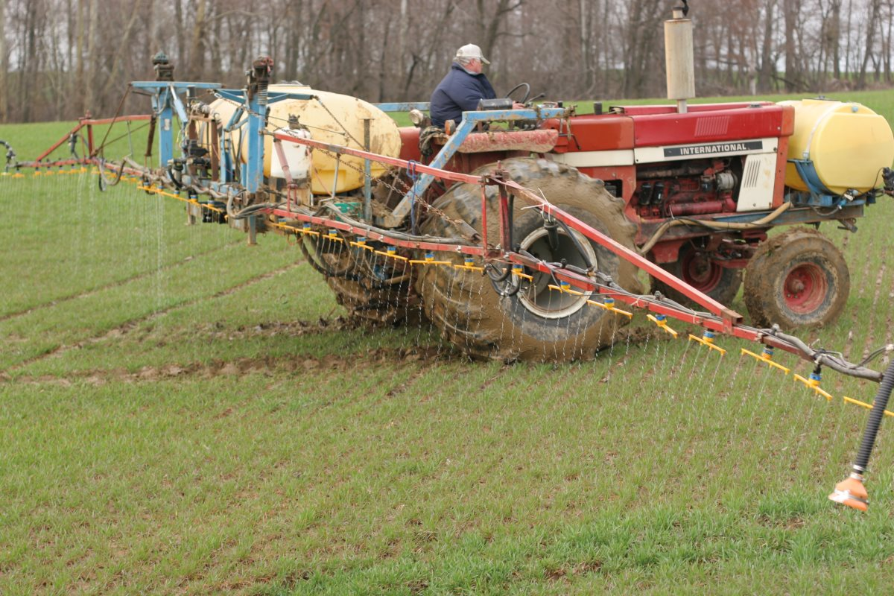
Technology LEAPS
Hood/Tires → light bar → AutoSteer

Slide 51


Sensor Function
Light signal
?
Calculate NDVI
?
Lookup valve setting
Valve settings
Light
Light
?
Apply valve setting
Valves and
Nozzles
detection
generation
?
Send data to UI
“Sensor”
Notes:
Changing the Fertilizer rate on the go works because the Sensor can “talk” to the applicator.

Slide 52


SE of Billings, OK NDVI
March 7, 2009
98 GDU > 0
NDVI

Slide 53




Notes:
Technology currently available to the producer.
Applies the same rate across the boom, and rate changes every second. Treatment area Approx. 8ft x boom width.

Slide 55

Notes:
Clarifying the standard GreenSeeker commercial nitrogen recommendation.
NRS makes good sense even without GreenSeeker

Slide 56

Record Harvest, Nevada, MO

Slide 57



Slide 58
Next Generation
Notes:
The ISOBus Designed at OSU to reduce the IN Cab Clutter. All most all applications can run through this one screen. GreenSeeker, GPS, Equiptment, ect.

Slide 59

agweather.mesonet.org
Notes:
59
The Future. We currently tying soil moisture data into the yield prediction model.
We allready use the Oklahoma MESONETto get the data on Growing Degree Days.

Slide 60



Variable Rate Technology
Treat Temporal and Spatial Variability
Returns are higher but require larger investment
Notes:
60

Slide 61




Yield per plant, based on area occupied
Yield, g/l-cm 4 0.5 3.8 8X
Recognize and Manage Spatial Variability
Notes:
Two Questions,
will 2 yield the same as 1 and 3?
Should 2 get the same amount of N?
We have the technology to fertilize these plants differenetly.
61

Slide 62
Corn, Mineralization
Large Scale Replicated SBNRC trial,
  Three Trts: Farmer Pract., SBNRC, VRT, 60’*400’ plot size
  Missouri River Bottom
  N-Rich Strip not visible
    Producer rate of 235
    SBNRC 115 lb N ac rec, VRT average 83 lb N ac-1
    195 bu/ac, 190, and 190 bu/ac respectively
Treatment | Avg Profit | Avg Yield | Total N-rate (lbs/ac)
Farmer Practice | 699 | 195 | 235
SBNRC Flat Rate | 719 | 190 | 115
RT-200 VRT | 732 | 190 | 83
N-Rich | 689 | 209 | 420

Slide 63



VRT Equipment
Notes:
This is the Scientific VRT equipment. Wheat treatment is every 2’*2’ ft, and row crops area is every 6” of every row.

Slide 64


VRT Equipment
Notes:
Drop Nozzle on the left. Picture on the right was an erroneous sensor that applied Fert 6” into the bare soil.

Slide 65


Thank you!!!
www.extensionnews.okstate.edu
Brian Arnall
373 Ag Hall
405-744-1722
b.arnall@okstate.edu
Presentation available @
www.npk.okstate.edu
Twitter: @OSU_NPK

