Slide 1
Grid Soil sampling

Slide 2

Soil Fertility Issues
Multi- Nutrient Variable Application
Much like a Ladder
One Step at a Time.
In-Season Cues
Secondary & Micros
N & S
P & K
Soil pH

Slide 3
Are you thinking about it?
What field?
When?
What resolution/size?
How often?

Slide 4
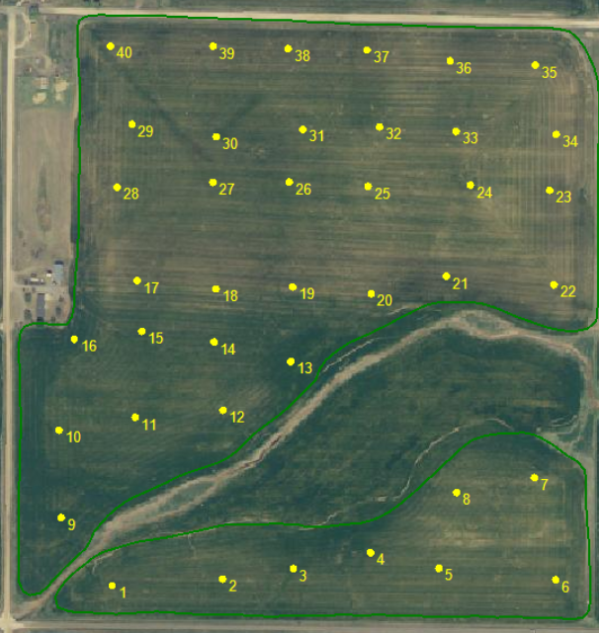
111.58 acre field

Slide 5
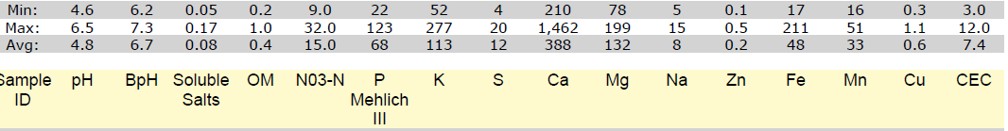
Composite
pH 4.8
Buffer Index 6.7
1.2 Lime Rec ton ac-1 (1.4 & 155 ton)
133 tons $3325
Soil Test P: 68 ppm (136 STP)
Soil Test K: 113 ppm (226 STK)
Soil Test S: 12 (YG of 120 bpa)

Slide 6
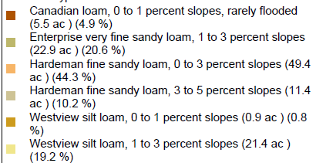
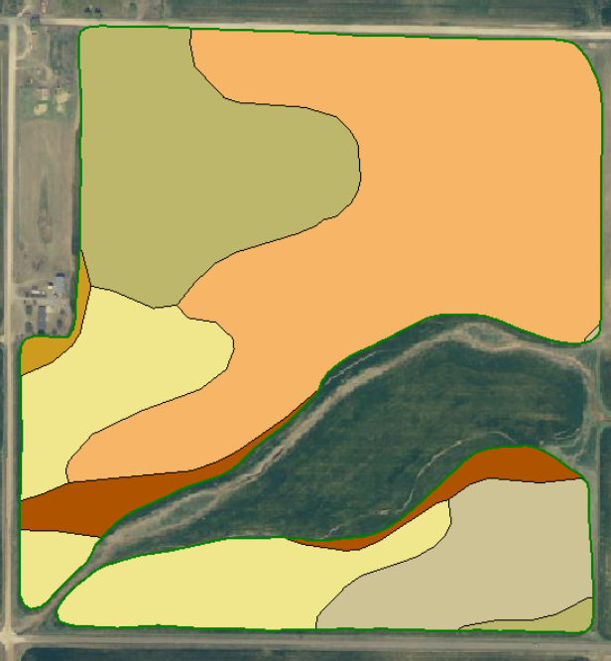
Soil Type

Slide 7
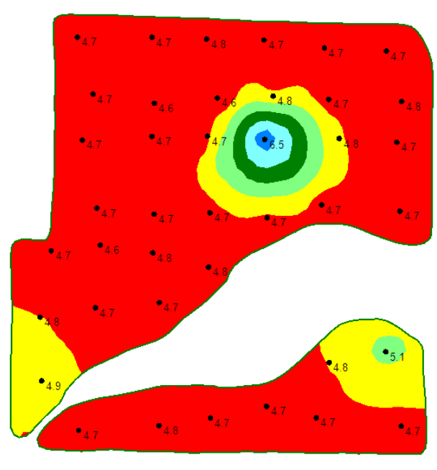
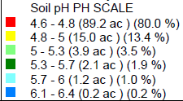
Soil pH

Slide 8
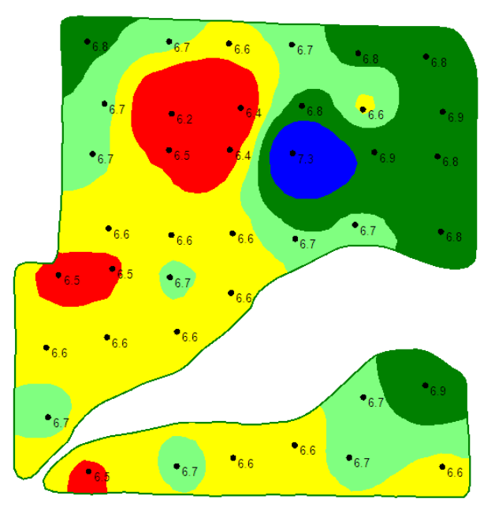
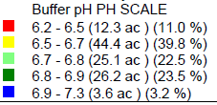
Buffer Index

Slide 9
pH Buffer Index

Slide 10
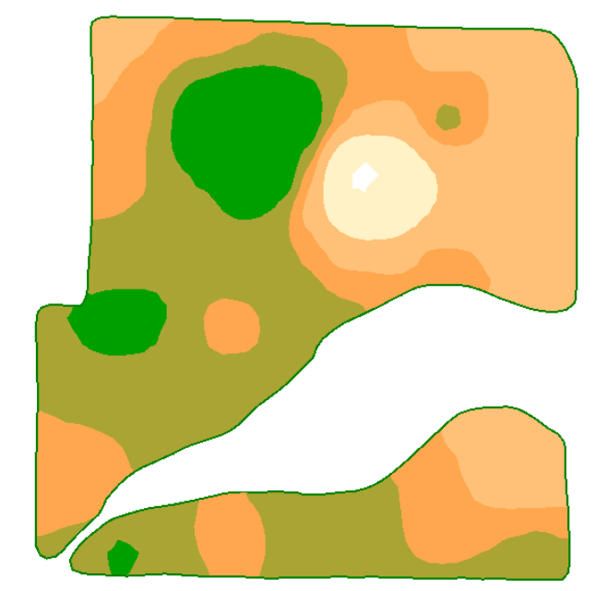
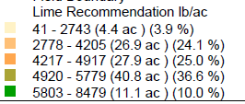
VRT Lime Map

Slide 11
Lime
VRT lime (wheat rec)
149 tons on 111 acs
@ $25/ton 3725$
4 acres Zero Rec.
26 acre with .5 ton rec
25 acre with 1 ton
44 acre with 1.7 ton
12 acre with 3 ton.
Under applied on 56 over applied on 30.

Slide 12
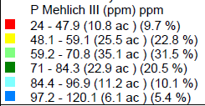
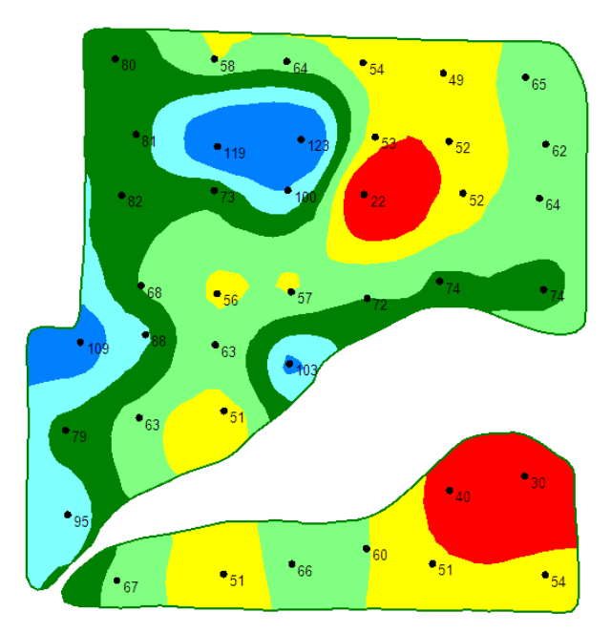
Phos

Slide 13
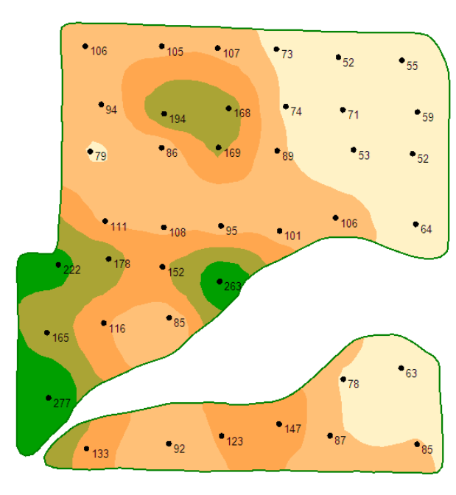
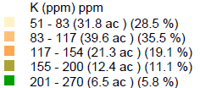
Potassium

Slide 14
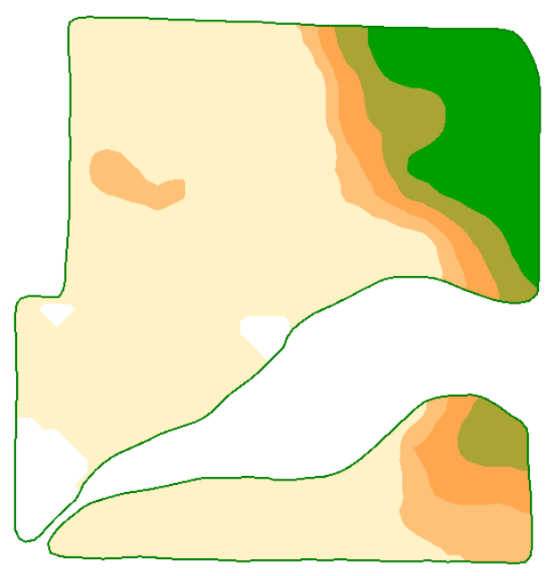
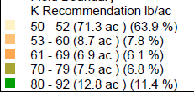
0-0-60

Slide 15
Potassium
VRT k
96 ac
2480 lb K20 approx. $1000.
40 ac 100% 0 lbs
40 ac 87% 30 lbs
32 ac 80% 40 lbs
Potential Yield loss at 60 bpa
697 bushels @4.51 = $2,819

Slide 16
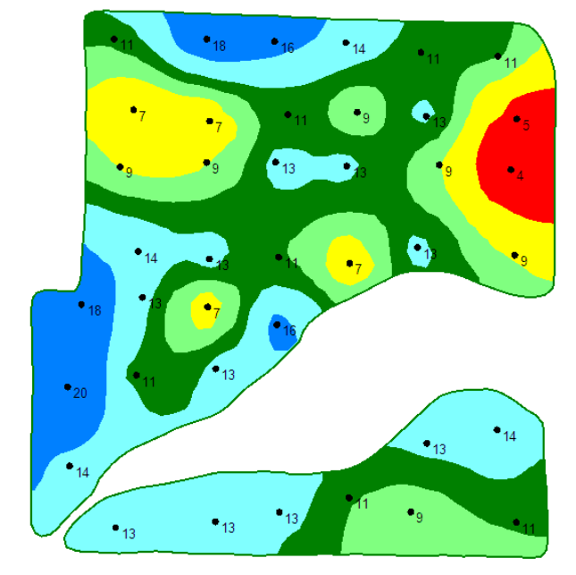
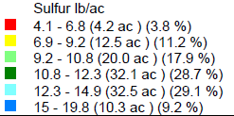
Sulfur

Slide 17
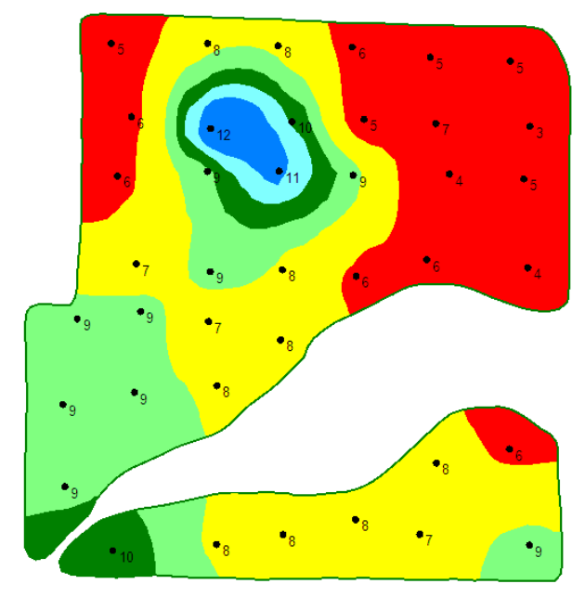
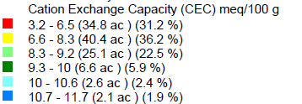
CEC

Slide 18
Field in the End
Lime flat
$3325
Lime VRT
$3725
Flat K
$0 input
$2819 in loss yield
K VRT
$1000 ( add 800 for app) $1800 more.
VRT spent +$400 on Lime, +1800 on K but made $1019 on P
Would have cost $1,100 to $1,332.
On this 111 ac Field 2.5 grid had a 1 yr net of -$600.

Slide 19
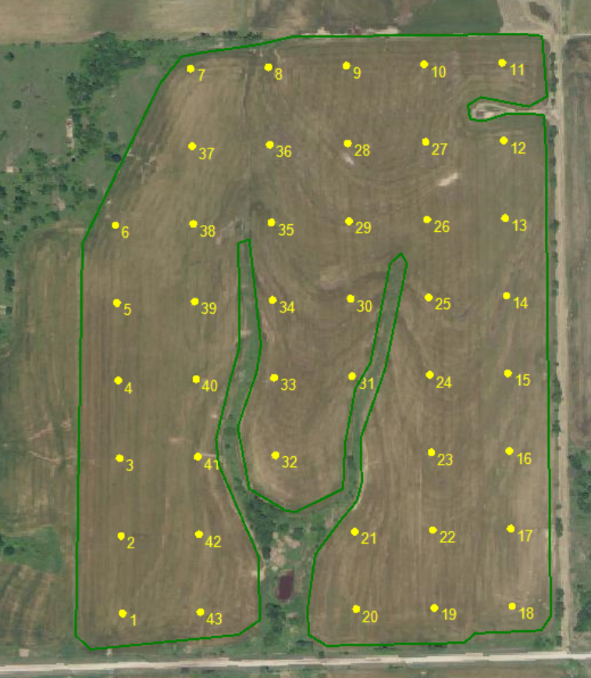
104 ac Field in Noble Co.

Slide 20
Composite
pH 5.3
Buffer Index 6.6
Lime Rec 1.7 ton ac-1
166 tons $4,420
Soil Test P: 40
P2O5 Rec 20 lbs.
2,080 lbs $832
Soil Test K: 356
Soil Test S: 19
Soil Test, everything else- good.

Slide 21
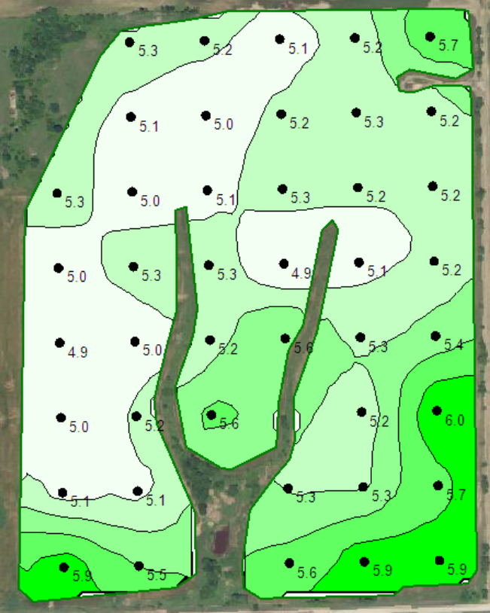
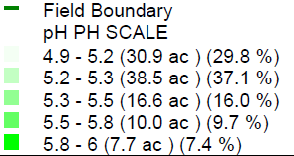
pH

Slide 22
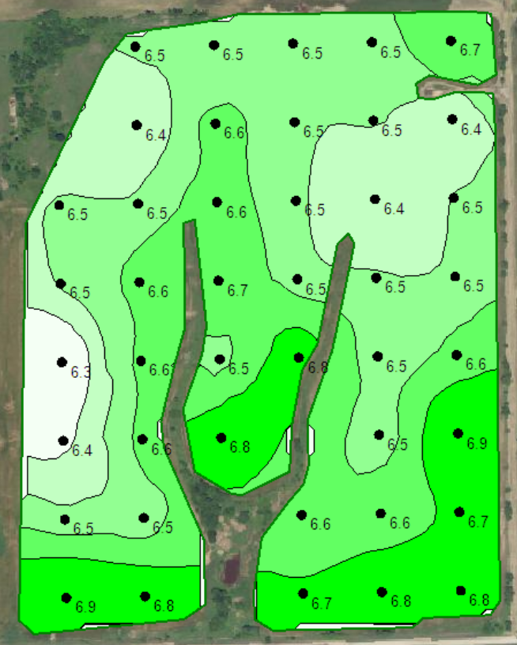
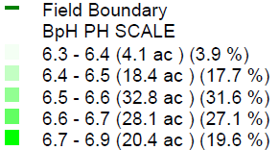
Buffer Index

Slide 23

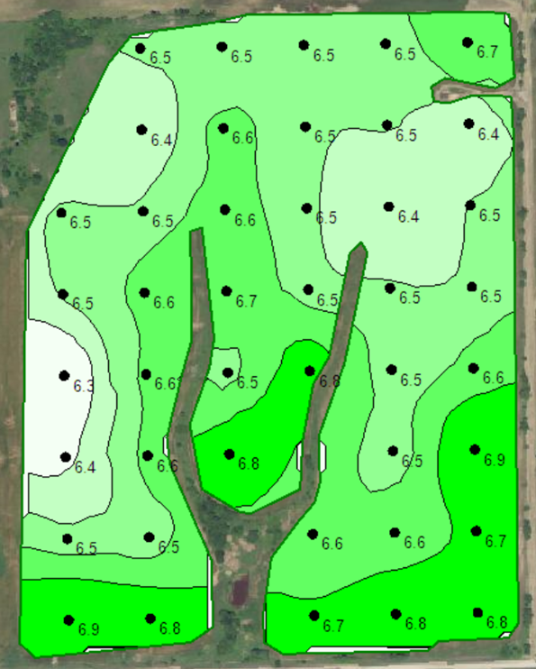
pH Buffer Index

Slide 24
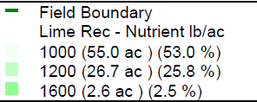
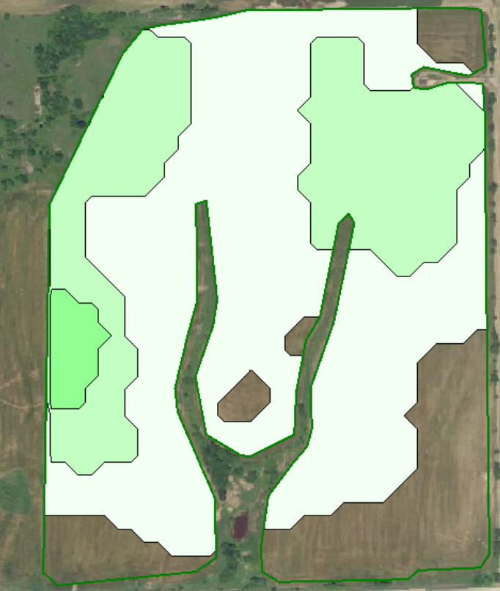
Lime Rec
Ton/ac

Slide 25
Lime
VRT lime
115 tons on 84 acs
@ $25/ton 2875$
20 acres Zero Rec.
2.6 acre with 3 ton rec
55 acre with 1 ton
25 acres about right.

Slide 26
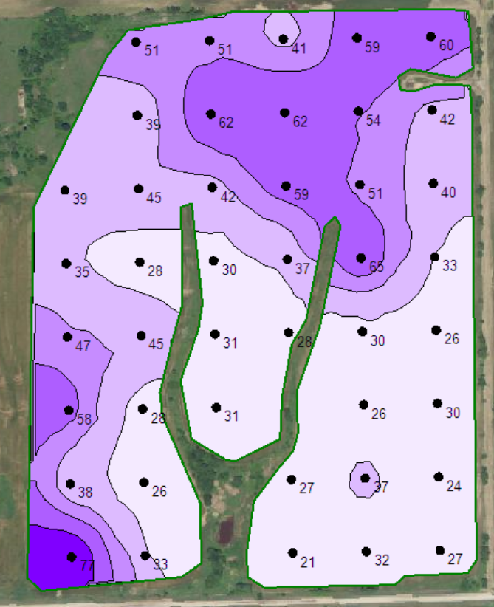
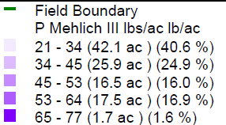
Phosphorus

Slide 27
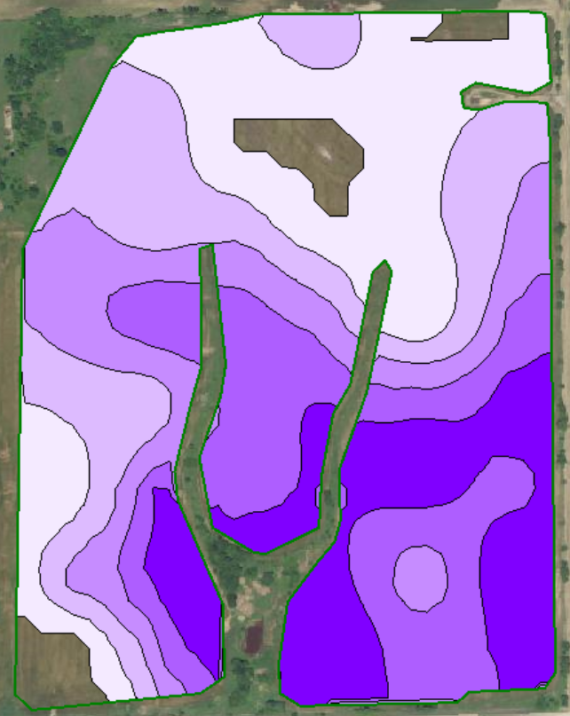
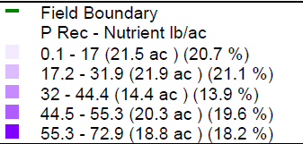
Pos Rec

Slide 28
Phos
VRT P
96 ac
3293 lb P205 approx. $1317. Over 30ac Under 52
8 ac 100% 0 lbs
22 ac 95% 10 lbs
22 ac 90% 20 lbs
14 ac 80% 40 lbs
20 ac 62% 50 lbs
18 ac 45% 60 lbs
Potential Yield loss at 50 bpa
897 bushels @4.51 = $4,045

Slide 29
Field in the End
Lime flat
$4420
Lime VRT
$2875
Flat P
$832 input
$4045 in loss yield
P VRT
$1837 ( add 520 for app) $1005 more.
VRT saved $1545 on Lime, made $3040 on P
Would have cost $1,155.
On this 104 ac Field 2.5 grid had a net of $3430.

Slide 30
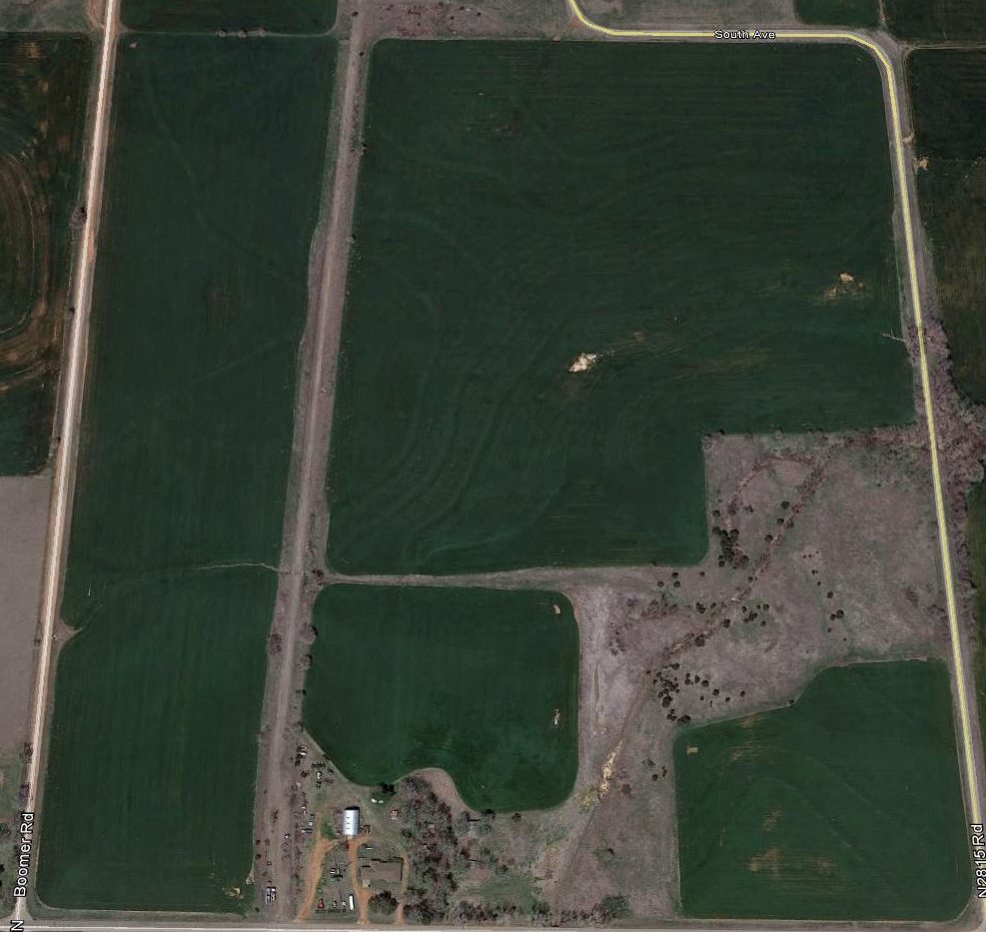
Hillsdale

Slide 31
Composite
pH 5.8
Buffer Index 6.9
Lime Rec 1 ton ac-1
101 tons $3030
Soil Test P: 64
Soil Test K: 423
Soil Test S: 13
Soil Test, everything else- good.

Slide 32
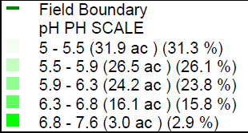
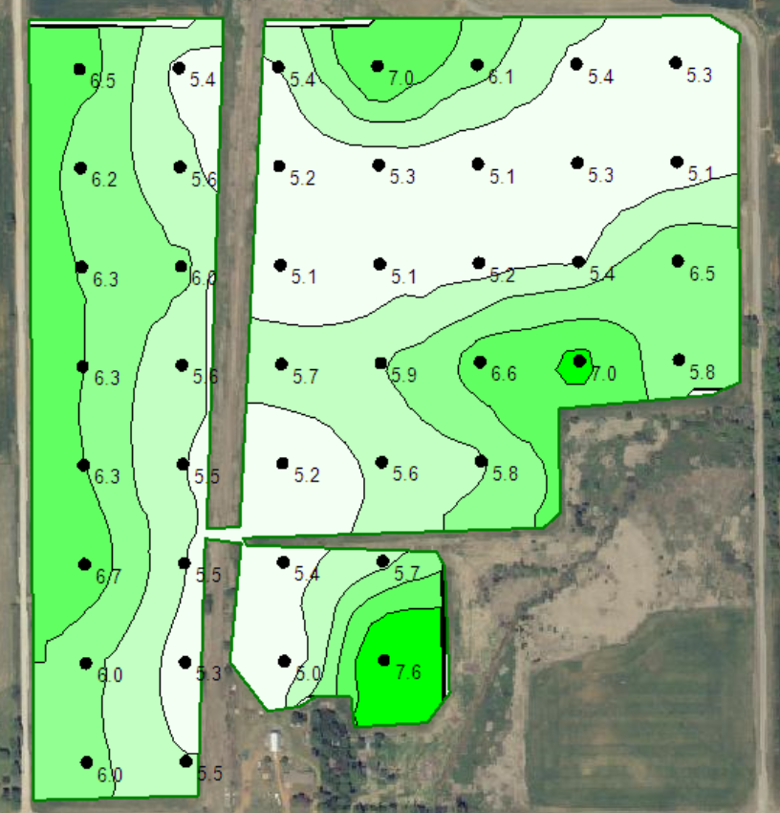
Soil pH

Slide 33
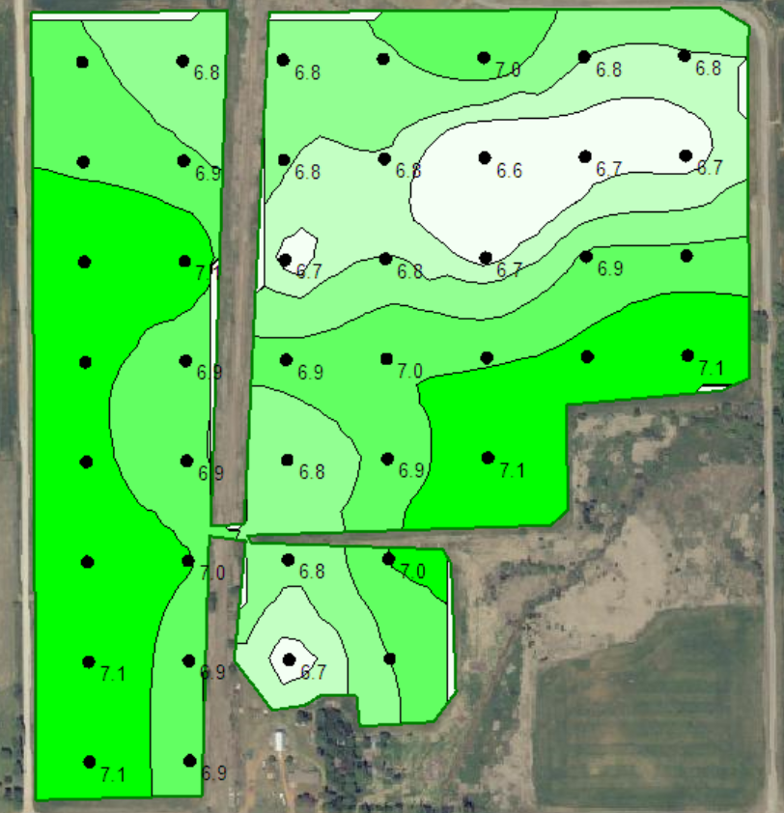
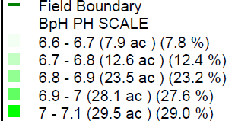
Buffer pH

Slide 34
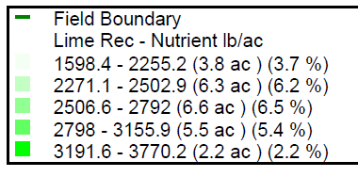
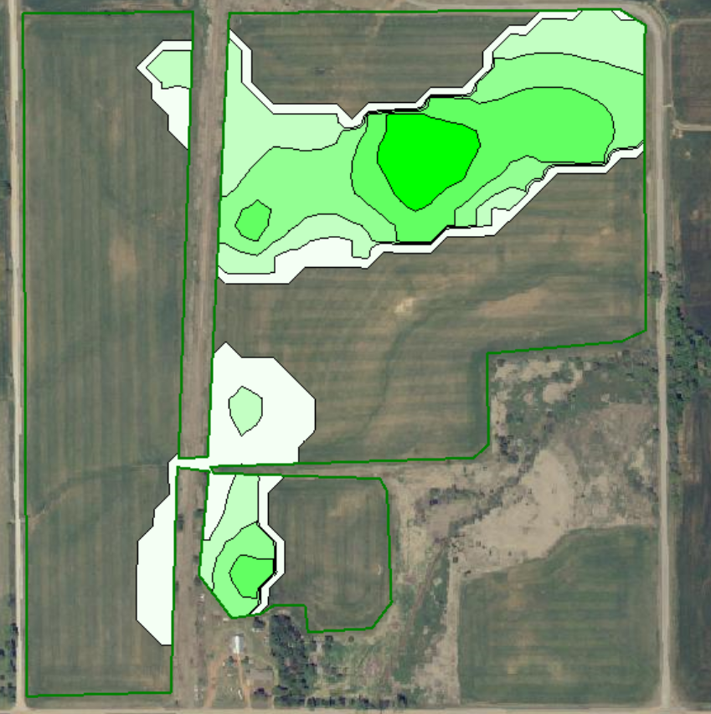
VRT Lime

Slide 35
Lime
VRT lime
32 tons on 24 acs
@ $30/ton 960$
1 ton/ac on 9 ac
1.5 ton/ac on 16
Over applied on 77
Under applied on 16

Slide 36
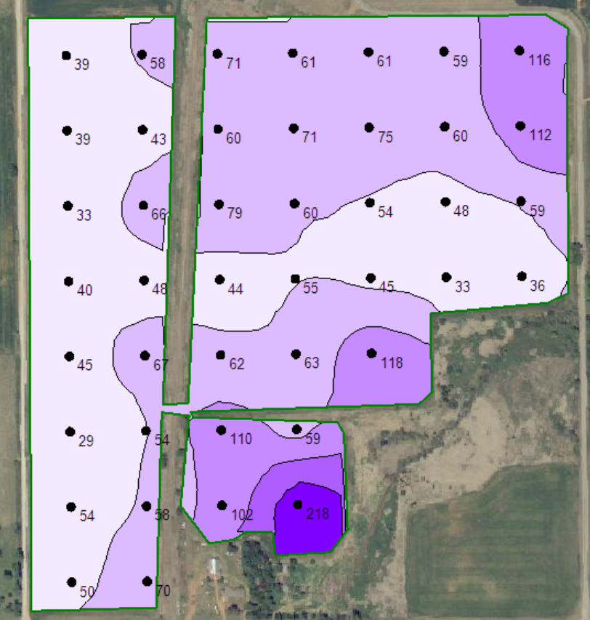
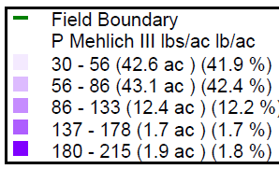
Phosphorus

Slide 37
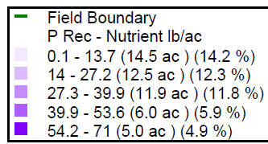
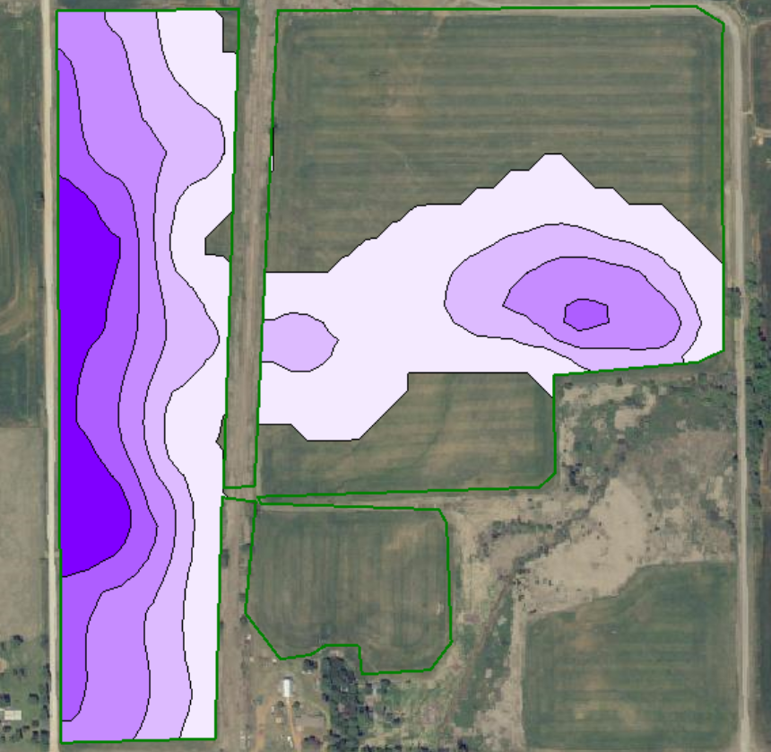
VRT P

Slide 38
Phos
VRT P
50 ac
1,350 lb P205 approx $1040 w/app.
15 ac 95%
13 ac 85%
13 ac 80%
5.5 ac 70%
4 ac 40%
Potential Yield loss at 100bpa
935 bushels

Slide 39
Field in the End
Lime flat
$3030
Lime VRT
$960
Flat P
$0 input
$4675 in loss yield
P VRT
$1040
VRT saved $2070 on Lime, made $3635 on P
Would have cost $1010.
On this 101 ac Field 2.5 grid had a net of $4695.

Slide 40
Deer Creek
75.3 Acres

Slide 41
On the Average
Soil pH 5.3
Buffer Index 6.5
Lime Rec ton/ac 2.2
Total Tons 166
Soil Test P 48
P Rec lb/ac 15
Total lbs 1130
Soil Test K 430
K rec lb/ac 0

Slide 42
pH

Slide 43
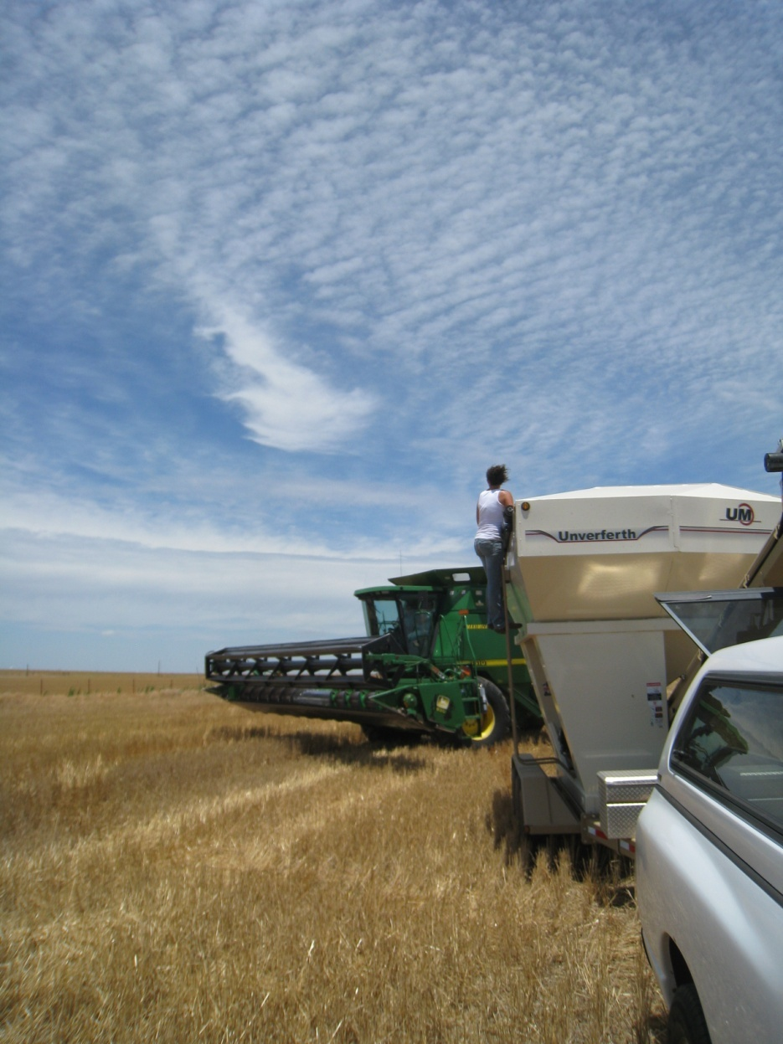
Thank you!!!
Brian Arnall
373 Ag Hall
405-744-1722
b.arnall@okstate.edu
Presentation available @
www.npk.okstate.edu
Twitter: @OSU_NPK www.Facebook/OSUNPK
YouTube Channel: OSUNPK
Blog: OSUNPK.com
www.Aglandlease.info

