Slide 1
Comparison of Guidance Systems
David Peper

Slide 2
The main focus
Guidance systems from
John Deere
Trimble
Teejet

Slide 3
Definitions
RTK (real time kinematic)- requires a base station to achieve triangulation
WAAS-a government sponsored differential correction signal, pass-to-pass accuracy of +/- 13 inches.

Slide 4
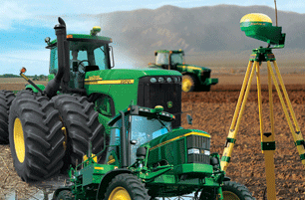
John Deere Systems
Green Star
  SF1- free differential correction signal accuracy +/- 10 inch pass-to-pass accuracy
  SF2- using a StarFire 3000 receiver, can deliver +/- 4 inch pass-to-pass accuracy
  RTK- provides +/- 1-inch accuracy and repeatability pass-to-pass, $800 subscription per year

Slide 5
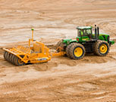
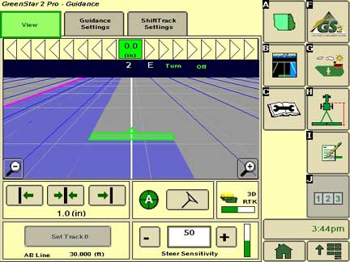
JD Displays
GS3 2630
  Full documentation
  AutoTrac capable
  Map based prescriptions
  Investment $5900
  iTEC pro capable
  Surface water pro

Slide 6
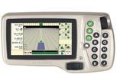
JD Displays cont’d
GreenStar 2 1800 display
  No touch screen
  No documentation
  SF1 and SF2

Slide 7
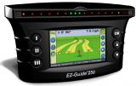
Trimble
EZ-Guide 250
  WAAS only
  Documentation
  Can’t export maps
  Built in GPS receiver
  Investment $1850

Slide 8
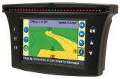
Trimble cont’d
EZ-Guide 500
  Prescription map import
  WAAS, OmniSTAR XP/HP, RTK ($800)
  Variable rate
  Investment $2995
  Requires Ag 25 Antenna ($2000)

Slide 9
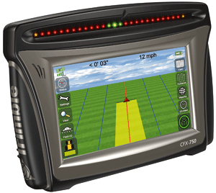
Trimble cont’d
CFX-750
  GLONASS ($2000 unlock code)
  Rate control
  Section control (up to 48 rows)
  Documentation
  Upgraded Ag 25 antenna
  OmniSTAR HP $1500
  OmniSTAR XP $800
  RTK $800
  Investment $2995

Slide 10
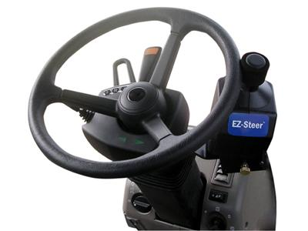
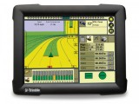
Trimble cont’d
FMX integrated display
  Monitor and map yield
  Green Seeker capable
  Prescription rate control
  EZ Steer $3500
  Investment $8000 (WASS equiped)
  Only one to use AgGPS
    FieldLevel II system

Slide 11
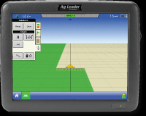
AgLeader
Integra Display
  Mapping, planter/application control
  Yield monitoring
  Map integration
  OnTrac 2 or ParaDyme autosteer

Slide 12
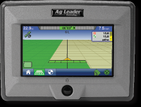
AgLeader cont’d
Edge
  Entry level
  Data logging/mapping
  Dual product control
  Auto steer capable (ParDyme)
  Both capable of WAAS, OmniSTAR XP/HP and RTK

Slide 13
Raven
Raven Envizio Pro II
  Full mapping/data logging
  Accuboom section control
  Autoboom height control
  Upgradeable to single product Variable Rate
  Investment list price $4300

Slide 14
Raven cont’d
Viper Pro/Switch Pro
  Touch screen display
    SmarTrax steering option
    On vehicle weather station option
    5 product variable rate control
    Windows XP embedded operating system
    Investment List price $6500

Slide 15
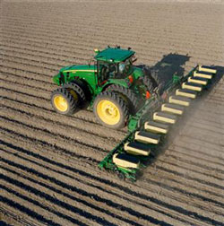
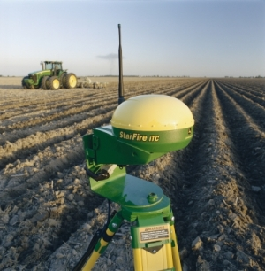
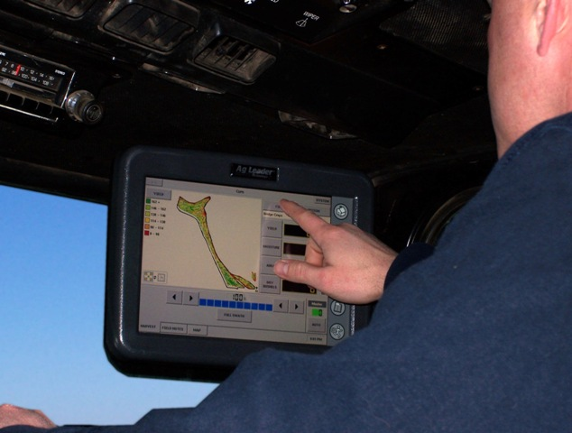
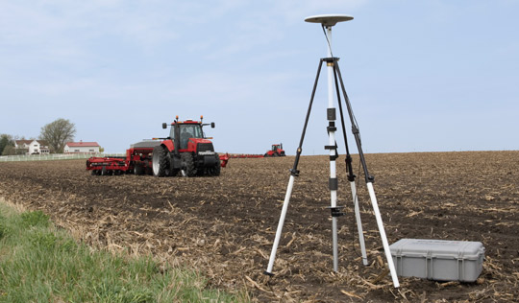
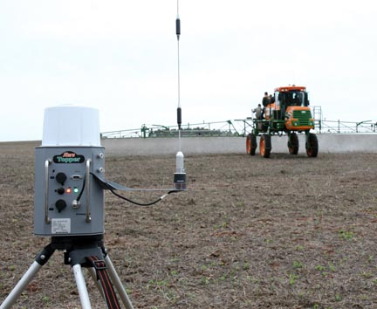
Questions?

