Slide 1
Global Positioning System

Slide 2
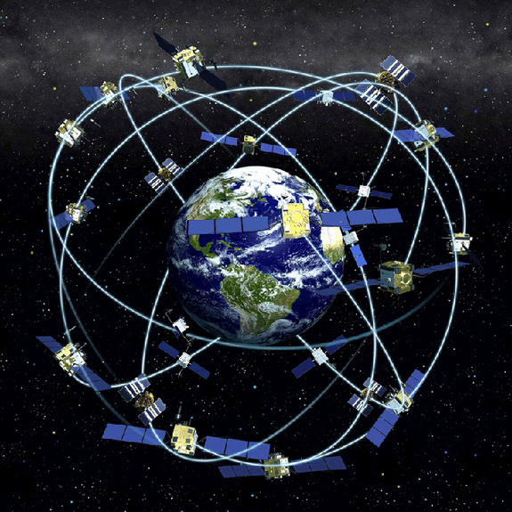
The History of GPS
Feasibility studies begun in 1960’s.
Pentagon appropriates funding in 1973.
First satellite launched in 1978.
1990’s Used in Persian Gulf War
System declared fully operational in April, 1995.
Department of Defense (DoD)

Slide 3
Three Segments of the GPS
Space Segment
User Segment
Control Segment
Ground Antennas
Master Station
Monitor Stations

Slide 4
Four Basic Functions of GPS
Position and coordinates.
The distance and direction between any two waypoints, or a position and a waypoint.
Travel progress reports.
Accurate time measurement.

Slide 5
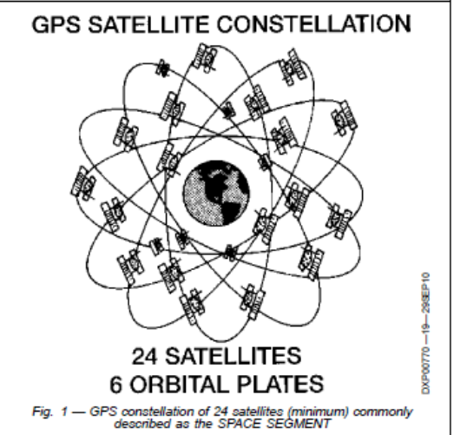
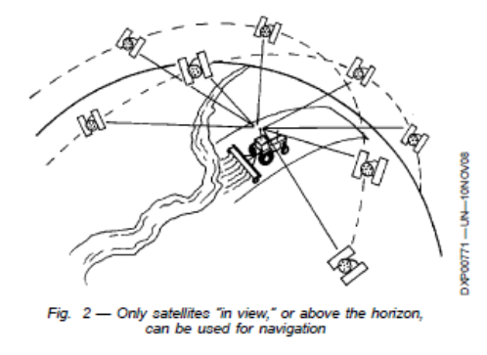
NAVSTAR, Space Segment
24+ Birds
24 Active 4 Spare
Consistently repaired/replaced.
6 paths or plates
12 hr orbit
2 or 3 atomic or nuclear clocks,
2/2 cesium rubidium; now 3 rubidium

Slide 6
Control Sector
Several Monitoring Stations
1 Master Control
Colorado Springs Co.
MC, computes clock errors tracks orbits. Sends corrective info back to satelite.

Slide 7
User Segment
Military.
Search and rescue.
Disaster relief.
Surveying.
Marine, aeronautical and terrestrial navigation.
Remote controlled vehicle and robot guidance.
Satellite positioning and tracking.
Shipping.
Geographic Information Systems (GIS).
Recreation.

Slide 8
Satellite Ranging.
Each satellite transmits
Position
Timing

Slide 9
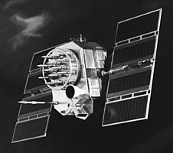
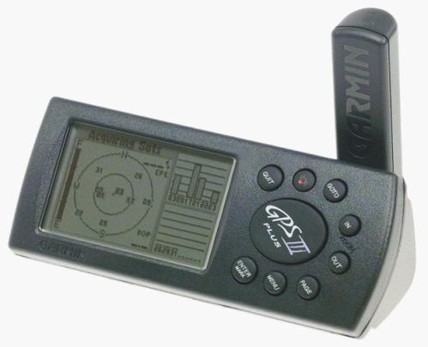
Position is Based on Time
Signal leaves satellite at time “T”
T
Signal is picked up by the receiver at time “T + 3”
T + 3
Distance between satellite and receiver = “3 times the speed of light”

Slide 10
Pseudo Random Noise Code
Time Difference
Satellite PRN
Receiver PRN

Slide 11
Real Time Differential GPS
x+5, y-3
x+30, y+60
x-5, y+3
Receiver
DGPS Receiver
DGPS Site
DGPS correction = x+(30-5) and y+(60+3)
True coordinates = x+25, y+63
True coordinates = x+0, y+0
Correction = x-5, y+3

Slide 12
Good Satellite Geometry

Slide 13
Poor Satellite Geometry

Slide 14
Poor Satellite Geometry

Slide 16
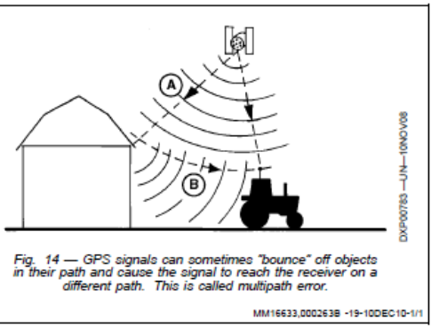
Accuracy and Factors Affecting it
Satellite Clocks
Satellite Ordit
Earths Atmosmphere
Multi-Path Errors
GPS Reciever

Slide 17
# of Satellites Needed.

Slide 18
DGPS
Differential Correction.
1 or more stationary GPS receivers located at surveyed positions.
Typical Error GPS DGPS Clock 3-8ft <1ft Orbit 3-8 <1 Lanoshpere 6.5-16 1.4 Tropo 1.6-3.3 .7 Multipath 1.6-5 1.6-5 Reciver Noise 1-3 1-3

Slide 19
Sources of Real-Time DGPS
Nationwide Differential DGPS, (U.S. Coast Guard Beacon System)
Local Base Station, User Supplied
Satelitte-based differential Corrections (WAAS, Starfire®, OminiSTAR®, ect.

Slide 20
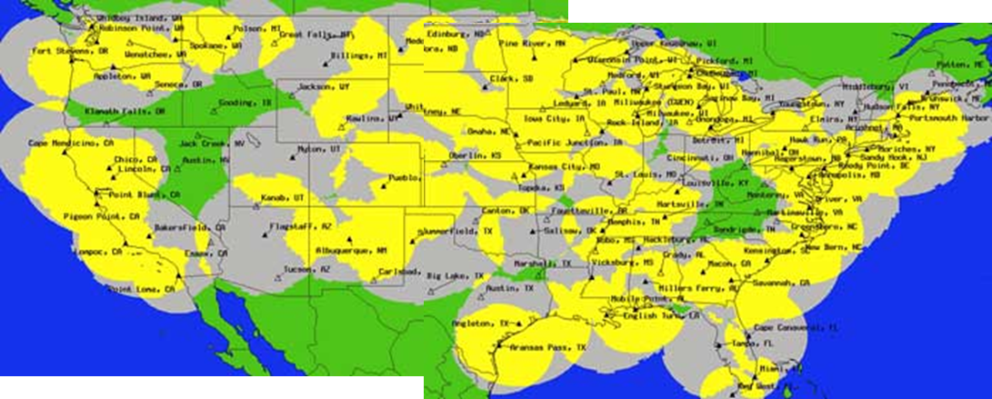
USCG Radio Beacon
285kHz-325 kHz

Slide 21
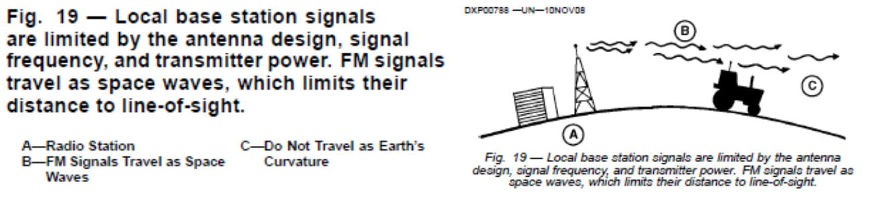
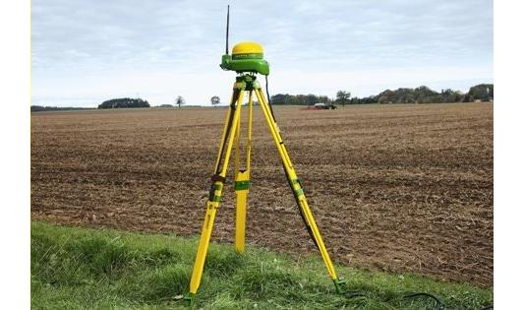
Local base Station
900 MHz-2.4GHz, Am or Fm Style (50-60 miles)
RTK- Real Time Kinematic
Centimeter Accuracy
http://www.precisepath.com/​

Slide 22
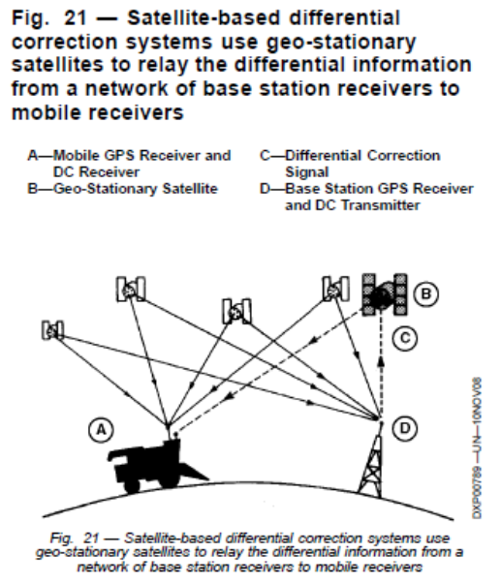
Satellite-Based DGPS
WAAS, Starfire®, OminiSTAR®
Geo-Stationary Satellites
Orbits keeps it over the same point on the ground.
Orbits the same speed as Earths Rotation
Commonly used for TV broadcast.

Slide 23
WAAS
Wide Area Augmentation System (WAAS) is an air navigation aid developed by the Federal Aviation Administration (prime contractor Raytheon Company) to augment the Global Positioning System (GPS),
WAAS uses a network of ground-based reference stations, in North America and Hawaii, to measure small variations in the GPS satellites' signals in the western hemisphere.
The WAAS specification requires it to provide a position accuracy of 7.6 metres (25 ft) or better (for both lateral and vertical measurements), at least 95% of the time.^{[2]} Actual performance measurements of the system at specific locations have shown it typically provides better than 1.0 metre (3 ft 3 in) laterally and 1.5 metres (4 ft 11 in) vertically throughout most of the contiguous United States and large parts of Canada and Alaska.^{[3]} With these results, WAAS is capable of achieving the required Category I precision approach accuracy of 16 metres (52 ft) laterally and 4.0 metres (13.1 ft) vertically.^{[4]}

Slide 24

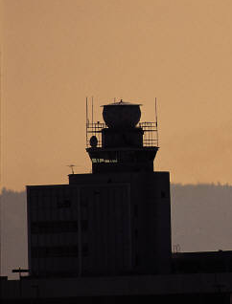
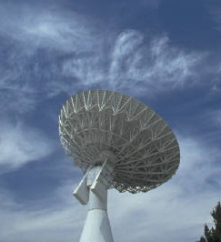
Wide Area Augmentation System
Geostationary WAAS satellites
GPS Constellation
WAAS Control Station (East Coast)
WAAS Control Station (West Coast)
Local Area System (LAAS)

Slide 25
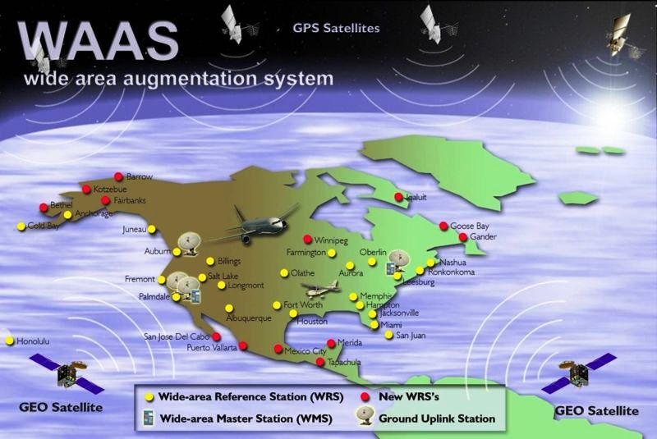
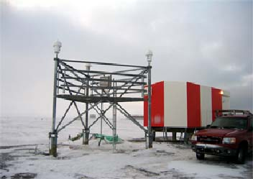
WAAS Reference Station Barrow Alaska

Slide 26
How good is WAAS?
With Selective Availability set to zero, and under ideal conditions, a GPS receiver without WAAS can achieve fifteen meter accuracy most of the time.*
+-15 meters
+ - 3 meters
Under ideal conditions a WAAS equipped GPS receiver can achieve three meter accuracy 95% of the time.*
* Precision depends on good satellite geometry, open sky view, and no user induced errors.

Slide 27
Others
StarFire – John Deere (approx $800 annual)
Omni-Star- American Mobile Sat Corp. (
GLONASS- Russia’s Global Nav
GALILEO- European Space Agency

Slide 28
Love this Pic

Slide 30
http://soil4213.okstate.edu/2011/Student_Presentations2011.htm
NAVSTAR http://spaceandtech.com/spacedata/constellations/navstar-gps_consum.shtml
Some slides adopted from Charlie Leonard, 1999 (revised 2001, 2002)

