Slide 1
Chapter 3: Soil Sampling And Soil Sensing

Slide 2
Soil Sampling
  Composite
  Zone
  Grid
Soil Measurements
  Soil Map
  Soil EC
  Soil Color

Slide 3
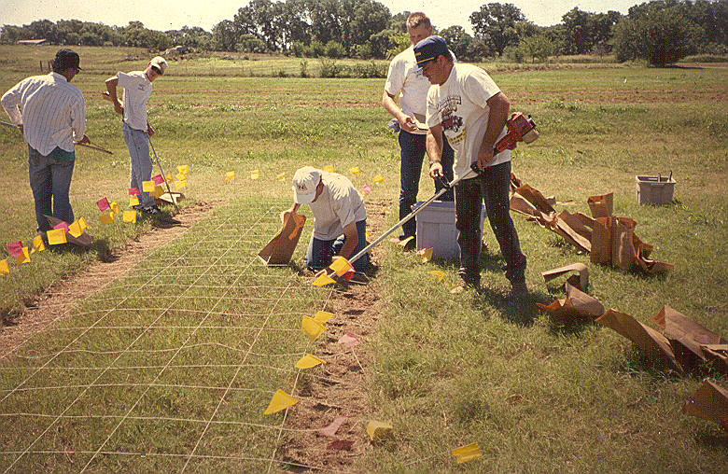

Slide 6
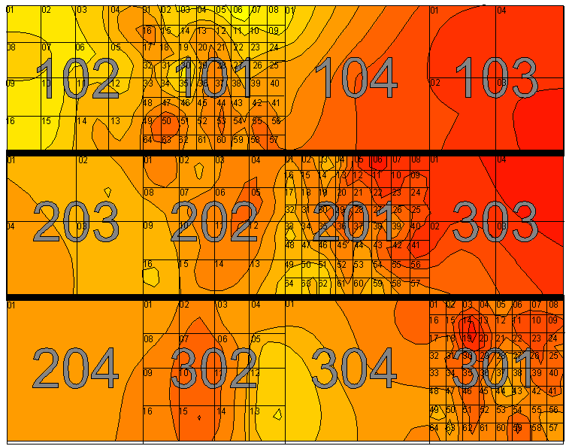

Slide 7
Sampling Strategies
Random Sampling - Sample the entire field randomly and composite the sample.
Stratified Random Sampling - Divide the field into zones or areas based on agronomic reasons. Randomly sample and composite samples with the zone.
Grid Sampling - Sample at a fixed interval or grid. Treat each the entire cell or field element based on the sample from that cell. OR Use some interpolation scheme to predict values between sample points.

Slide 8
Field Element or Cell Size
6x66
7x70
6x6
3x3
2x2
Random Sampling
Fixed Interval or Grid Sampling
Stratified Random Sampling
Sampling Zone Width

Slide 10
Location of Sampled Area for Three Sampling Strategies
No. Samples/ Replication | Row Sampled Random Sampling | 1st Sample Zone Fixed Interval or Stratified Random | Interval Between Samples Fixed Interval Sampling
1 | 1-70 | 1-70 | 70
2 | 1-70 | 1-35 | 35
5 | 1-70 | 1-14 | 14
7 | 1-70 | 1-10 | 10
10 | 1-70 | 1-7 | 7
14 | 1-70 | 1-5 | 5

Slide 11
Total Soil N - Burneyville
Sample Strategy | Strategy Error | Error – Sampling Strategy by Sample Size
 |  | 1 | 2 | 5 | 7 | 10 | 14
 | % | ___________________________%____________________________
Random | 15.9 | --- | --- | --- | --- | --- | ---
Fixed Interval | 16.4 | --- | --- | --- | --- | --- | ---
Stratified Random | 11.7 | --- | --- | --- | --- | --- | ---
LSD .05 | 2.1 | __________________________N.S.____________________________
Mean |  | 23.5 | 20.3 | 13.3 | 11.7 | 9.8 | 9.3
LSD.05 |  | __________________________2.1____________________________

Slide 12
Phosphorus - Burneyville
Sample Strategy | Strategy Error | Error – Sampling Strategy by Sample Size
 |  | 1 | 2 | 5 | 7 | 10 | 14
 | % | ___________________________%____________________________
Random | 16.6 | 39.6 | 28.6 | 16.0 | 12.3 | 10.2 | 9.8
Fixed Interval | 22.7 | 35.1 | 28.8 | 21.1 | 15.6 | 19.0 | 16.3
Stratified Random | 19.4 | 22.5 | 24.6 | 11.8 | 15.1 | 14.9 | 10.7
LSD .05 | 3.1 | __________________________7.6____________________________
Mean |  | 32.4 | 27.4 | 16.3 | 14.3 | 14.7 | 12.3
LSD.05 |  | __________________________4.4____________________________

Slide 13
Potassium - Burneyville
Sample Strategy | Strategy Error | Error – Sampling Strategy by Sample Size
 |  | 1 | 2 | 5 | 7 | 10 | 14
 | % | ___________________________%____________________________
Random | 11.9 | 25.5 | 17.5 | 10.7 | 9.7 | 8.5 | 6.1
Fixed Interval | 17.5 | 27.5 | 29.2 | 23.1 | 20.3 | 14.3 | 13.3
Stratified Random | 13.0 | 17.5 | 17.5 | 9.5 | 9.6 | 6.3 | 6.1
LSD .05 | 2.5 | __________________________6.1____________________________
Mean |  | 21.8 | 21.4 | 14.4 | 13.2 | 9.7 | 8.5
LSD.05 |  | __________________________3.5____________________________

Slide 14
Soil Organic Carbon - Burneyville
Sample Strategy | Strategy Error | Error – Sampling Strategy by Sample Size
 |  | 1 | 2 | 5 | 7 | 10 | 14
 | % | ___________________________%____________________________
Random | 13.3 | 24.1 | 19.6 | 11.1 | 9.2 | 6.7 | 6.4
Fixed Interval | 18.4 | 20.1 | 28.5 | 16.1 | 16.8 | 14.7 | 15.0
Stratified Random | 12.8 | 23.4 | 24.3 | 9.3 | 9.0 | 7.3 | 6.3
LSD .05 | 2.4 | __________________________5.8____________________________
Mean |  | 22.6 | 24.1 | 12.2 | 11.6 | 9.6 | 9.3
LSD.05 |  | __________________________3.3____________________________

Slide 15
Soil pH - Burneyville
Sample Strategy | Strategy Error | Error – Sampling Strategy by Sample Size
 |  | 1 | 2 | 5 | 7 | 10 | 14
 | % | ___________________________%____________________________
Random | 1.6 | --- | --- | --- | --- | --- | ---
Fixed Interval | 2.2 | --- | --- | --- | --- | --- | ---
Stratified Random | 1.5 | --- | --- | --- | --- | --- | ---
LSD .05 | 0.3 | __________________________N.S.____________________________
Mean |  | 3.5 | 2.2 | 1.8 | 1.5 | 1.2 | 1.0
LSD.05 |  | __________________________0.5____________________________

Slide 16
Total Soil N - Efaw
Sample Strategy | Strategy Error | Error – Sampling Strategy by Sample Size
 |  | 1 | 2 | 5 | 7 | 10 | 14
 | % | ___________________________%____________________________
Random | 6.2 | 13.3 | 8.2 | 5.2 | 3.8 | 3.7 | 3.2
Fixed Interval | 7.2 | 9.7 | 10.0 | 7.2 | 5.7 | 5.6 | 5.1
Stratified Random | 3.9 | 6.8 | 5.1 | 3.4 | 3.4 | 2.4 | 2.2
LSD .05 | 0.9 | __________________________2.2____________________________
Mean |  | 9.9 | 7.8 | 5.3 | 4.3 | 3.9 | 3.5
LSD.05 |  | __________________________2.2____________________________

Slide 17
Phosphorus - Efaw
Sample Strategy | Strategy Error | Error – Sampling Strategy by Sample Size
 |  | 1 | 2 | 5 | 7 | 10 | 14
 | % | ___________________________%____________________________
Random | 9.0 | 16.6 | 11.0 | 9.3 | 6.3 | 5.7 | 5.0
Fixed Interval | 12.2 | 19.9 | 15.4 | 12.9 | 12.9 | 9.0 | 3.0
Stratified Random | 6.5 | 17.0 | 7.5 | 5.3 | 3.4 | 3.7 | 2.2
LSD .05 | 1.3 | __________________________3.3____________________________
Mean |  | 17.8 | 11.3 | 9.2 | 7.6 | 6.1 | 3.4
LSD.05 |  | __________________________1.9____________________________

Slide 18
Potassium - Efaw
Sample Strategy | Strategy Error | Error – Sampling Strategy by Sample Size
 |  | 1 | 2 | 5 | 7 | 10 | 14
 | % | ___________________________%____________________________
Random | 11.3 | 21.7 | 16.8 | 10.6 | 8.3 | 6.3 | 4.3
Fixed Interval | 14.7 | 24.4 | 24.2 | 11.2 | 10.3 | 9.5 | 8.8
Stratified Random | 10.4 | 18.5 | 13.3 | 8.0 | 8.8 | 7.6 | 6.2
LSD .05 | 2.3 | __________________________5.6____________________________
Mean |  | 21.5 | 18.1 | 9.9 | 9.1 | 7.8 | 6.5
LSD.05 |  | __________________________3.2____________________________

Slide 19
Soil Organic Carbon - Efaw
Sample Strategy | Strategy Error | Error – Sampling Strategy by Sample Size
 |  | 1 | 2 | 5 | 7 | 10 | 14
 | % | ___________________________%____________________________
Random | 4.2 | --- | --- | --- | --- | --- | ---
Fixed Interval | 9.3 | --- | --- | --- | --- | --- | ---
Stratified Random | 5.1 | --- | --- | --- | --- | --- | ---
LSD .05 | 1.2 | __________________________N.S.____________________________
Mean |  | 10.0 | 7.4 | 5.5 | 5.5 | 4.5 | 4.1
LSD.05 |  | 1.7

Slide 20
Soil pH - Efaw
Sample Strategy | Strategy Error | Error – Sampling Strategy by Sample Size
 |  | 1 | 2 | 5 | 7 | 10 | 14
 | % | ___________________________%____________________________
Random | 1.2 | 2.0 | 1.5 | 1.3 | 0.9 | 0.8 | 0.6
Fixed Interval | 1.7 | 2.3 | 2.0 | 1.6 | 1.7 | 1.8 | 0.9
Stratified Random | 1.0 | 2.5 | 1.2 | 0.5 | 0.7 | 0.4 | 0.5
LSD .05 | 0.2 | __________________________0.5____________________________
Mean |  | 2.3 | 1.6 | 1.1 | 1.1 | 1.0 | 0.7
LSD.05 |  | __________________________0.3____________________________

Slide 21
Number of randomly selected samples required to reach 10, 5, and 2 % error from the true average value with a 90% probability
 |  |  | Number of Samples
Variable | Location | C.V. | 10% Error | 5% Error | 2% Error
Total Soil N | Burneyville | 31.2 | 11 | 41 | 81
 | Efaw | 12.3 | --- | --- | 6
Phosphorus | Burneyville | 52.1 | 29 | 92 | 270
 | Efaw | 22.9 | 5 | 22 | 105
Potassium | Burneyville | 28.9 | 10 | 35 | 140
 | Efaw | 29.4 | 10 | 35 | 140
Organic C | Burneyville | 32.2 | 17 | 54 | 165
 | Efaw | 14.1 | 2 | 8 | 43
pH | Burneyville | 4.2 | --- | --- | 4
 | Efaw | 3.2 | --- | --- | 3

Slide 22
Conclusions
Random sampling and stratified random sampling strategies require a similar number of samples to precisely describe the mean value of the soil variables measured in the 7 ft by 70 ft area.
Fixed interval sampling required more samples to produce the same precision as random or stratified random sampling.
The OSU recommendation of collecting 15 to 20 soil samples and averaging them should give us an estimate within 5 to 10% of the true mean value.

Slide 23
Conclusions
Stratified random sampling may provide a more precise measure of the true mean, when it is known that in local regions the measured value is related and not randomly distributed.

Slide 24

Distribution of Nutrients Throughout Fields

Slide 25
Drawing Lines
Lines for zones based on 1 factor
  Yield History
    Yield levels
    Yield Stability
  Topography
  Soil Type
  Soil EC
  Geography / boundaries
  Organic Matter
  Nutrient levels

Slide 26
Electrical Conductivity (EC)
Soil EC is soil electrical conductivity– a measurement of how much electrical current soil can conduct. It’s an effective way to map soil texture because smaller soil particles such as clay conduct more current than larger silt and sand particles. Soil EC measurements have been used since the early 1900’s-
Veris mobilized the process and added GPS. As the Veris EC cart is pulled through the field, one pair of coulter-electrodes injects a known voltage into the soil, while the other coulter-electrodes measure the drop in that voltage.
The result: a detailed map of the soil texture variability in the crop rooting zone

Slide 27
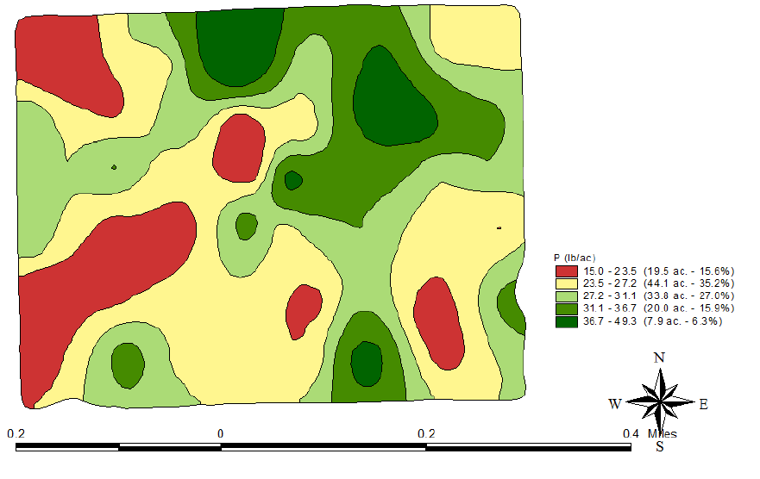
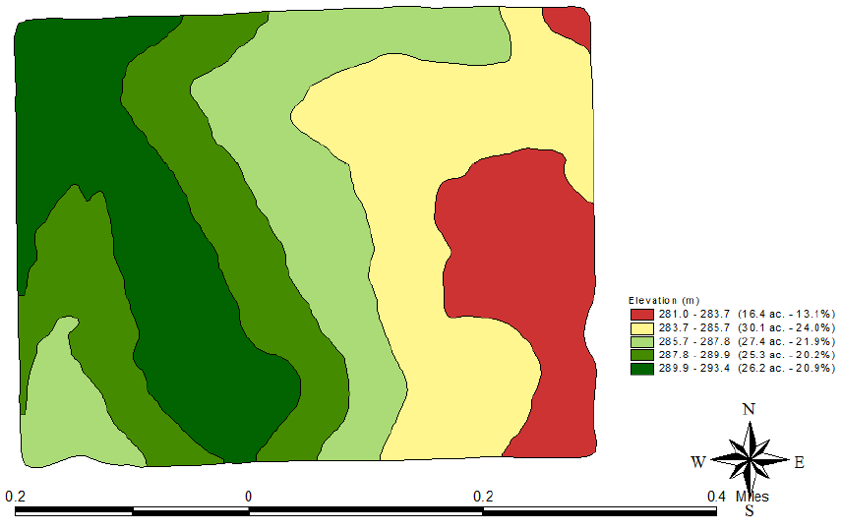
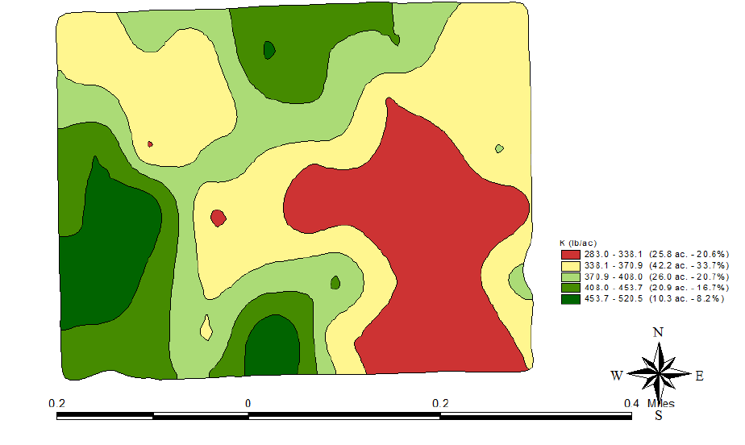
Deteriming the Variable
Using 1 factor to determine other unrelated factors
P
P
K
Elevation

Slide 28
Elevation

Slide 29
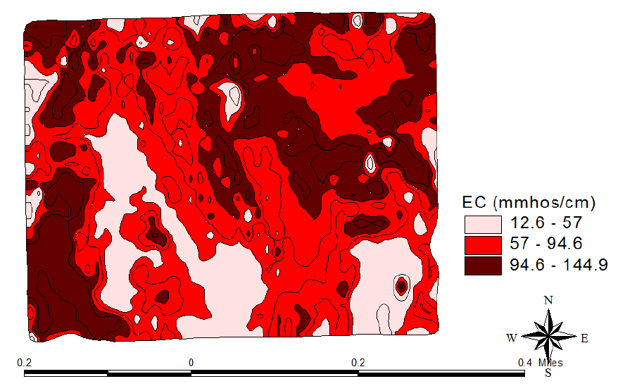
Soil EC

Slide 30
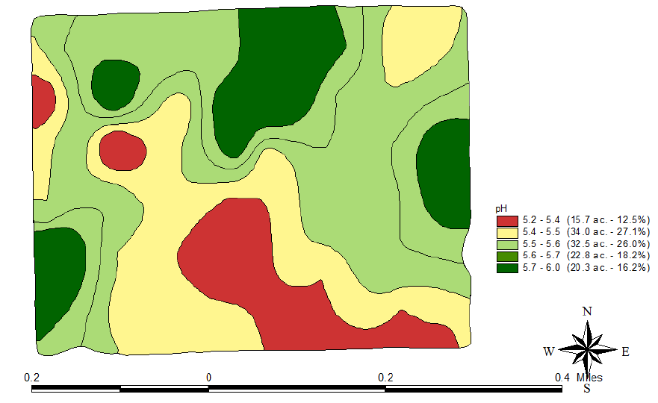
Soil pH

Slide 31
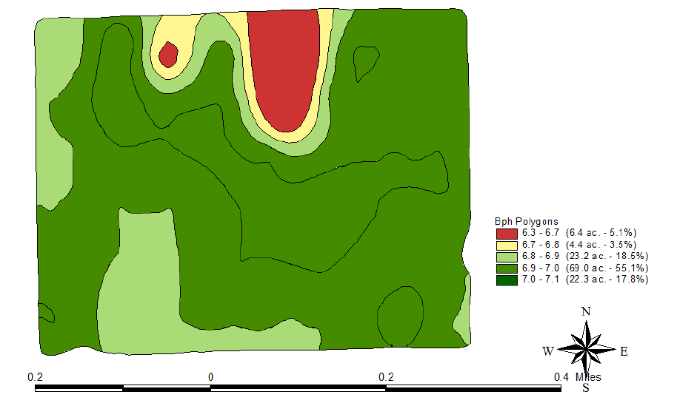
Buffer Index
Buffer Index | Lime required (tons 100% ECCE)
 | pH 6.8 | pH 6.4
Over 7.1 | None | None
7.1 | 0.5 | None
7.0 | 0.7 | None
6.9 | 1.0 | None
6.8 | 1.2 | 0.7
6.7 | 1.4 | 1.2
6.6 | 1.9 | 1.7
6.5 | 2.5 | 2.2
6.4 | 3.1 | 2.7
6.3 | 3.7 | 3.2

Slide 32
Phosphorus
Soil Test P Index | % Sufficiency | P2O5 lbs/ac
0 | 25 | 80
10 | 45 | 60
20 | 80 | 40
30 | 85 | 30
40 | 90 | 20
65+ | 100 | 0

Slide 33
Potassium
Soil Test K Index | % Sufficiency | K2O lbs/ac
0 | 50 | 60
75 | 70 | 50
125 | 80 | 40
200 | 95 | 20
250+ | 100 | 0

Slide 34
Buffer Index
Buffer Index | Lime required (tons 100% ECCE)
 | pH 6.8 | pH 6.4
Over 7.1 | None | None
7.1 | 0.5 | None
7.0 | 0.7 | None
6.9 | 1.0 | None
6.8 | 1.2 | 0.7
6.7 | 1.4 | 1.2
6.6 | 1.9 | 1.7
6.5 | 2.5 | 2.2
6.4 | 3.1 | 2.7
6.3 | 3.7 | 3.2

Slide 35
Phosphorus
Soil Test P Index | % Sufficiency | P2O5 lbs/ac
0 | 25 | 80
10 | 45 | 60
20 | 80 | 40
30 | 85 | 30
40 | 90 | 20
65+ | 100 | 0

Slide 36
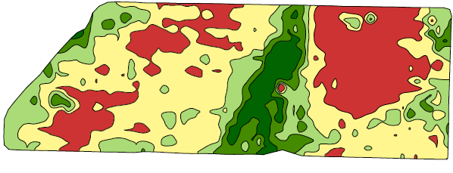
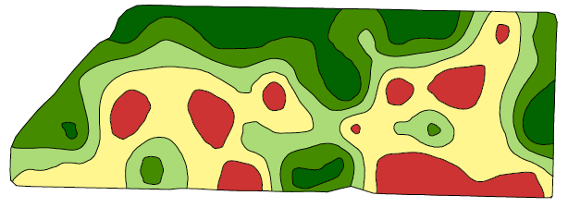
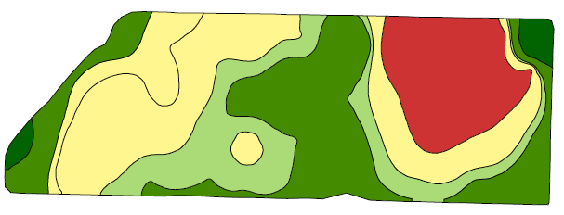
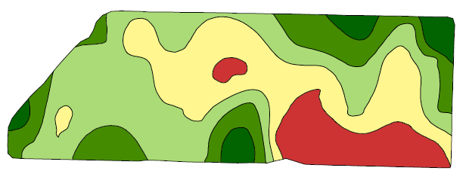
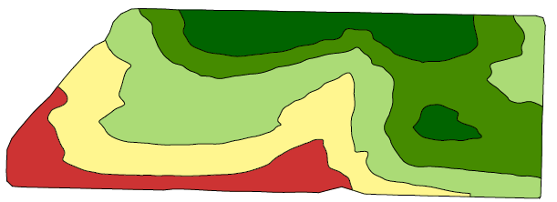
Shallow EC
K
Elevation
Soil pH
P

Slide 37
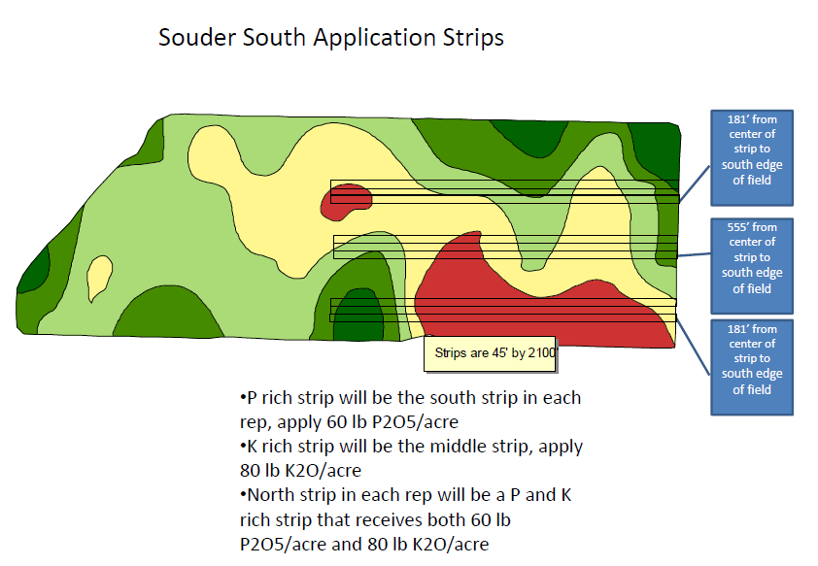
Partners in Research

Slide 38
Partners in Research
Yield closely related to BI <.0001,
Yield not statistically related to any other variable. Relationship between all micros Sig but negatively.
Yield best related to depth to limiting layer.
Trend is holding at specific sites

Slide 39
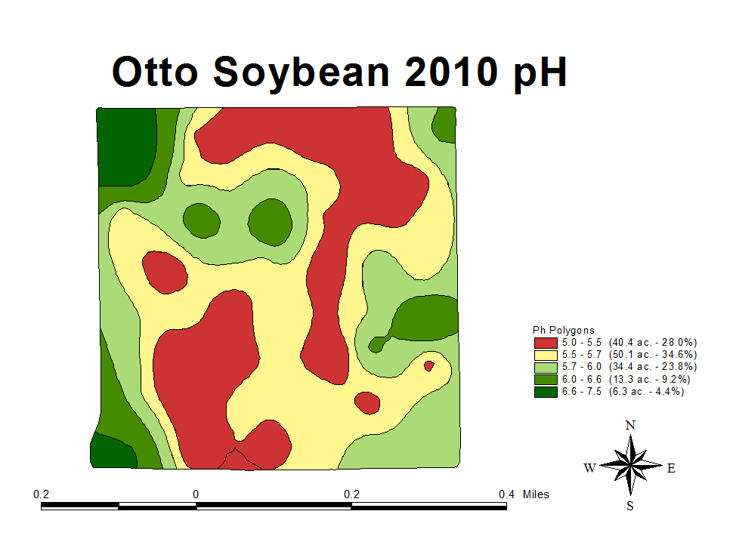
Ph

Slide 40
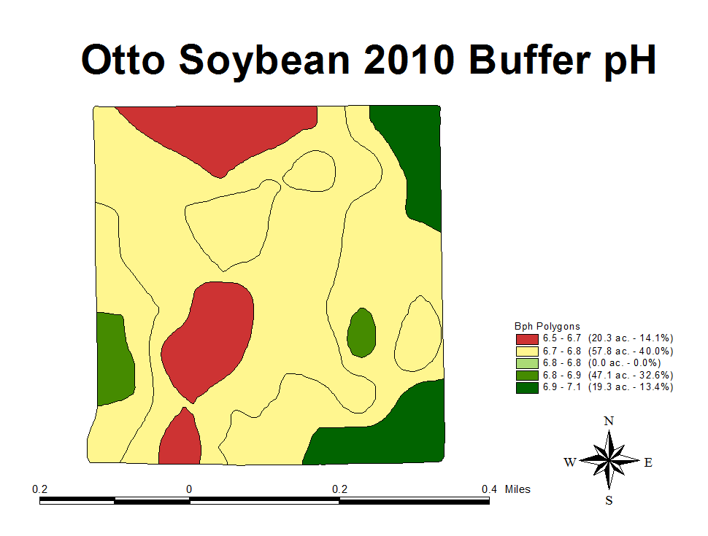
Buffer Index

Slide 41
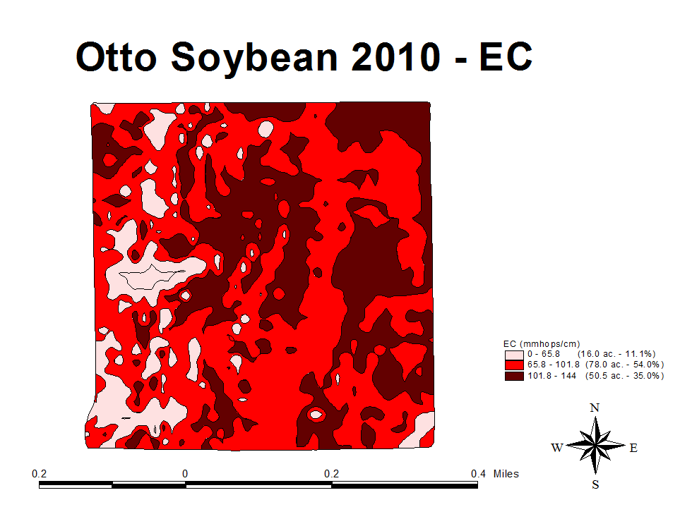
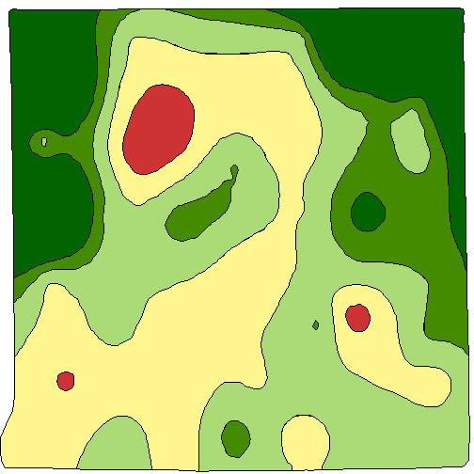
Soil pH
P
Shallow EC
Buffer Index

Slide 42
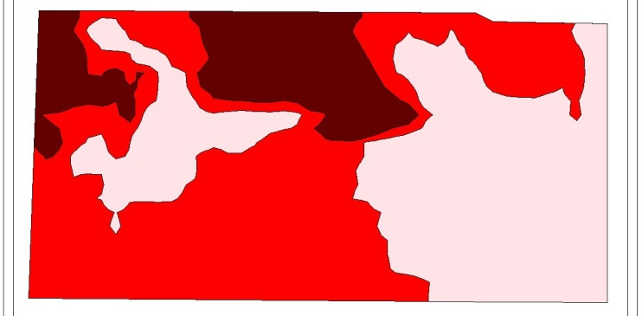
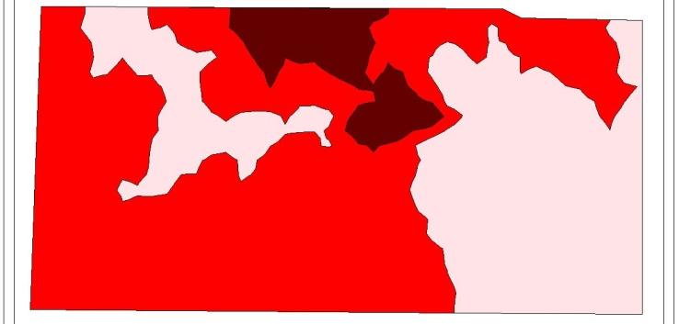
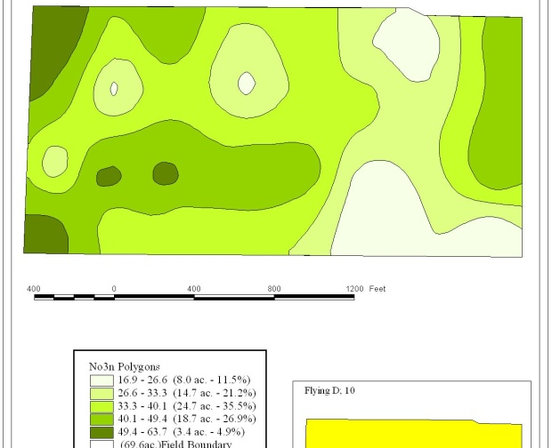
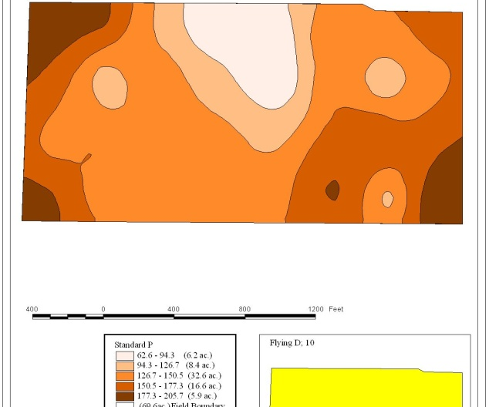
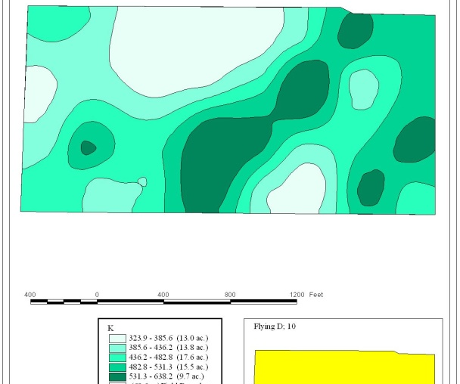
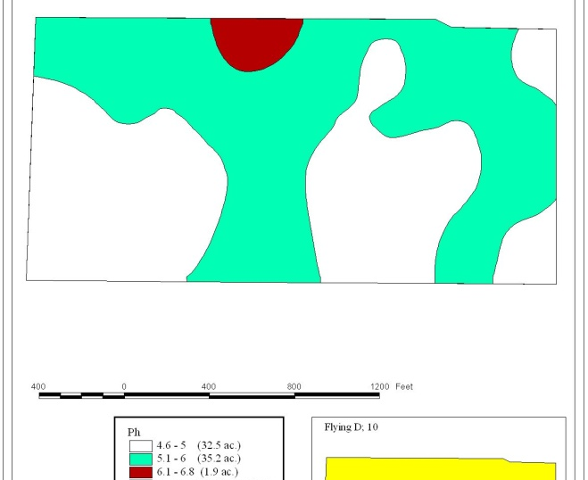
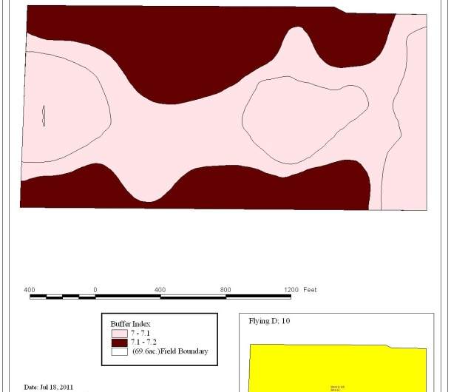

Slide 43
Variability in your fields
Zone Management
  What is the Product?
  Yield Based
  Topography based
  Soil based
Grid Soil Sampling
  What is the product?
  Is it worth the money?

Slide 44
Summary
All techniques are potentially the right way and the wrong way.
MUST have variability before you treat for variability!
Sometimes Nutrient needs are the same sometimes its not, more often its not.
Look at the cost of the method versus the economics of the production system.

Slide 45
Perfection P & K
Immobile P and K
Soil and Crop Driven
  First Year evaluate response

Slide 46
Perfection P & K
Immobile P and K
  Rate Studies in each zone
10 lbs
20 lbs
10 lbs
30 lbs
20 lbs
40 lbs
30 lbs
10 lbs
40 lbs
20 lbs
30 lbs
40 lbs

Slide 47
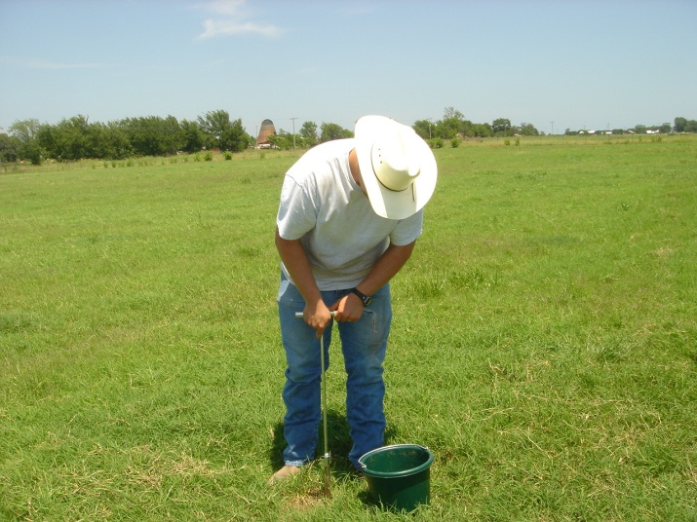
Perfection P & K
Understand the Benefits and Limitations of Soil Testing
Broad sweeping recommendations
Recommendations are Conservative in both directions
Will recommend only when likely to respond
Rate will ensure maximum yield for the majority

Slide 48
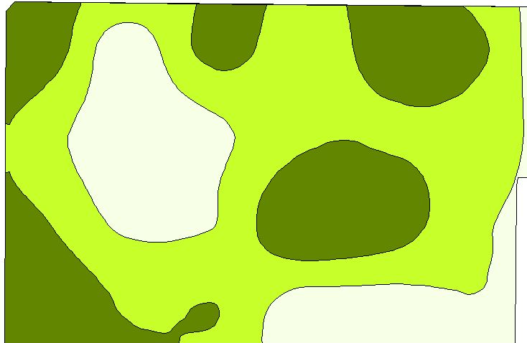
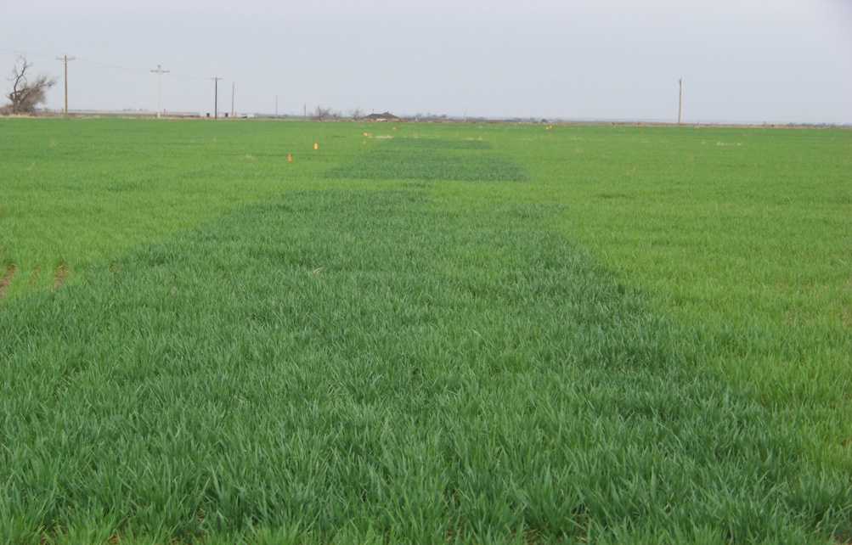
Perfection N
Mobile Nutrients N, S, B
Yield Driven!!
  Make determinations based off Environment and Plant measured in Season
High / Adequate Rate

Slide 49
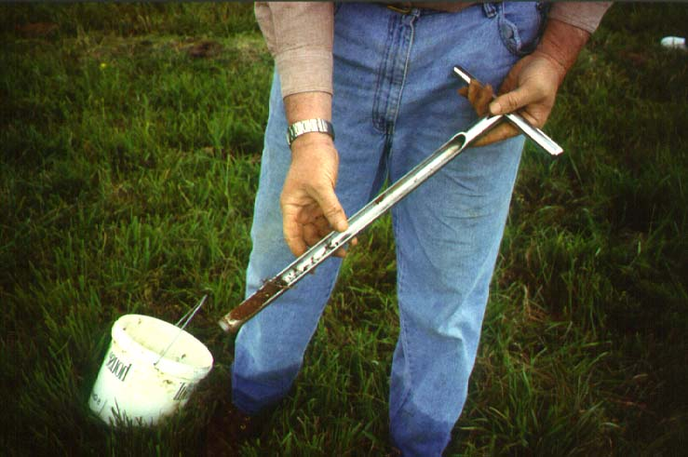
Perfection N
Understand the Benefits and Limitations of Soil Testing
Nitrogen levels in soil are not static
  Soil test in August not always relevant in March.
Dependent upon environment and yield level
Multiple yield potentials in the field
Recommendation based on Averages.

Slide 50
Perfection N
N-Rich Strip as a decision tool.
  Not Perfection
Impact of right field rate
Simple Yes or No
  No data, but means more is years of extreme.
  Years of Moisture, Nuclear
  Years of Drought, Abscent
N-Rich and SBNRC
  20 lbs N/acre on Winter Wheat, 0 difference in yield
    Price of N drives value of Practice.
  18 locations in 2 yrs, Zero samples <12% Protien

Slide 51
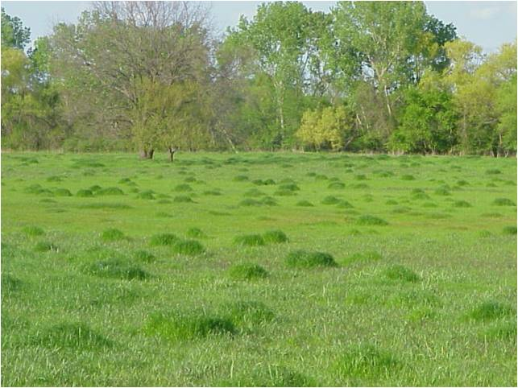
Perfection N
Fields are highly variable
  Why apply flat field rate
  Why apply even zone level rate

Slide 52
Management Zones
Great way to break the field up
Moved from
  1 rate over entire farm
  1 rate for each field
  1 rate for each zone
Smaller the application area a informed decision is made on the more precise.

Slide 53
Drawing Lines
Lines for zones based on 1 factor
  Yield History
    Yield levels
    Yield Stability
  Topography
  Soil Type
  Soil EC
  Geography / boundaries
  Organic Matter
  Nutrient levels

Slide 54
Deteriming the Variable
Using 1 factor to determine other unrelated factors
P
P
K
Elevation

Slide 55
Shallow EC
K
Elevation
Soil pH
P

Slide 56
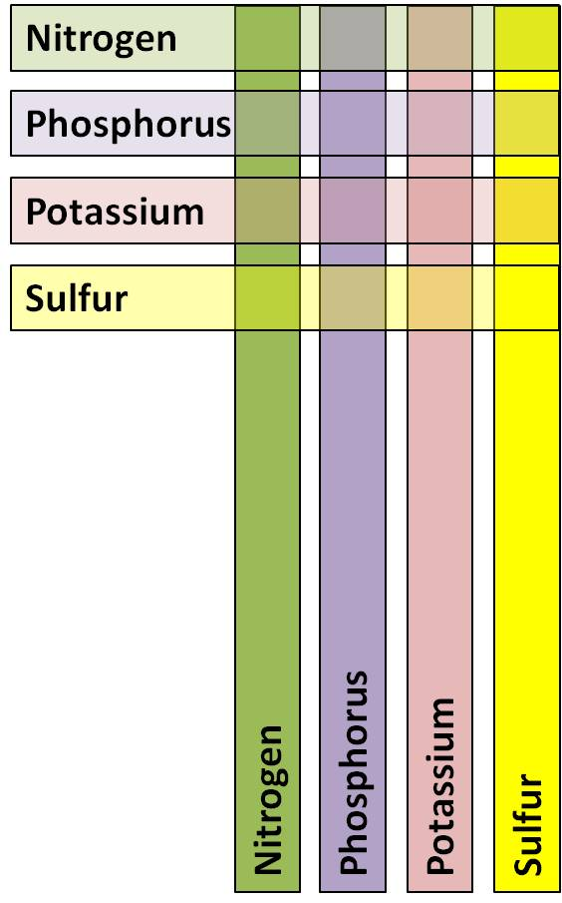
What is OSU Doing
NPKS response strips.
Looking at
  Soil Type
  Past practice
  Soil Test Values
  Cropping System
  Environment

