Slide 1
A Down to Earth Look at UAVs in Agriculture
Brian Arnall
Precision Nutrient Management
Oklahoma State University

Slide 2
Ok State has provided cease and desist.
I have not flown one.
I am very familiar with their data and use.
UAV’s and Teenagers
Cow Art, Klingenberg Farms
I want one…..

Slide 3
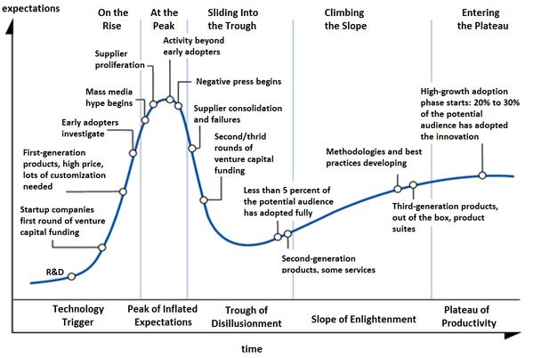

Slide 4
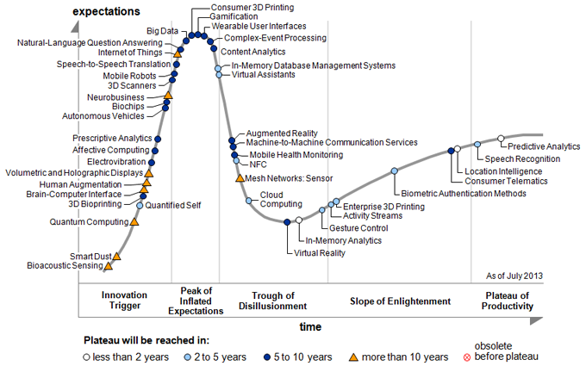
Source: Gartner

Slide 5
FAA
http://www.faa.gov/news/press_releases/
Press Release Results
12/10/2014 FAA Grants Five More Commercial UAS Exemptions
11/18/2014 FAA Statement on NTSB Decision in Huerta v. Pirker
10/08/2014 FAA Statement on MITRE's Independent Assessment and Recommendations for NextGen
9/25/2014 U.S. Transportation Secretary Foxx Announces FAA Exemptions for Commercial UAS Movie and TV Production
9/10/2014 FAA Statement
8/13/2014 FAA Announces Virginia Tech UAS Test Site Now Operational
8/07/2014 FAA Announces New York UAS Test Site Now Operational

Slide 7
Drone Sightings
http://graphics.wsj.com/faa-drones/
Published 11/26/14; records 2/22-11/11
  Significant amount 1000-7000 ft.
Oklahoma City, Okla.
Oct. 12, 2014 CORRECTED INFO FROM FAA OPS: TINKER AFB, OK/UAS INCIDENT/1424C/OKLAHOMA CITY ATCT REPORTED AN ACFT REPORTED TAKING EVASIVE ACTION TO AVOID A SMALL UAS AT 4,800 FEET, 2 FEET WIDE BLACK IN COLOR WITH A CAMERA ATTACHED ON THE BOTTOM. PILOT REPORTED UAS CAME WITHIN 10 - 20 FEET OF ACFT 10 N TINKER. LEOS NOTIFIED
  Not ag, but.

Slide 8
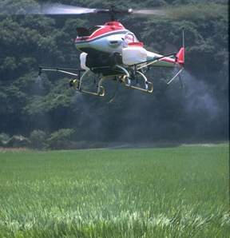
UAS/UAV/The D Word in Ag

Slide 9
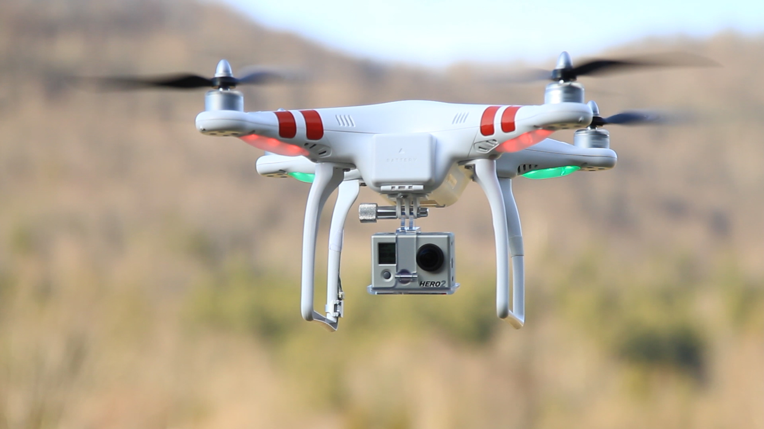
dji.com
DJI soon to have NO FLY ZONE Capability

Slide 10
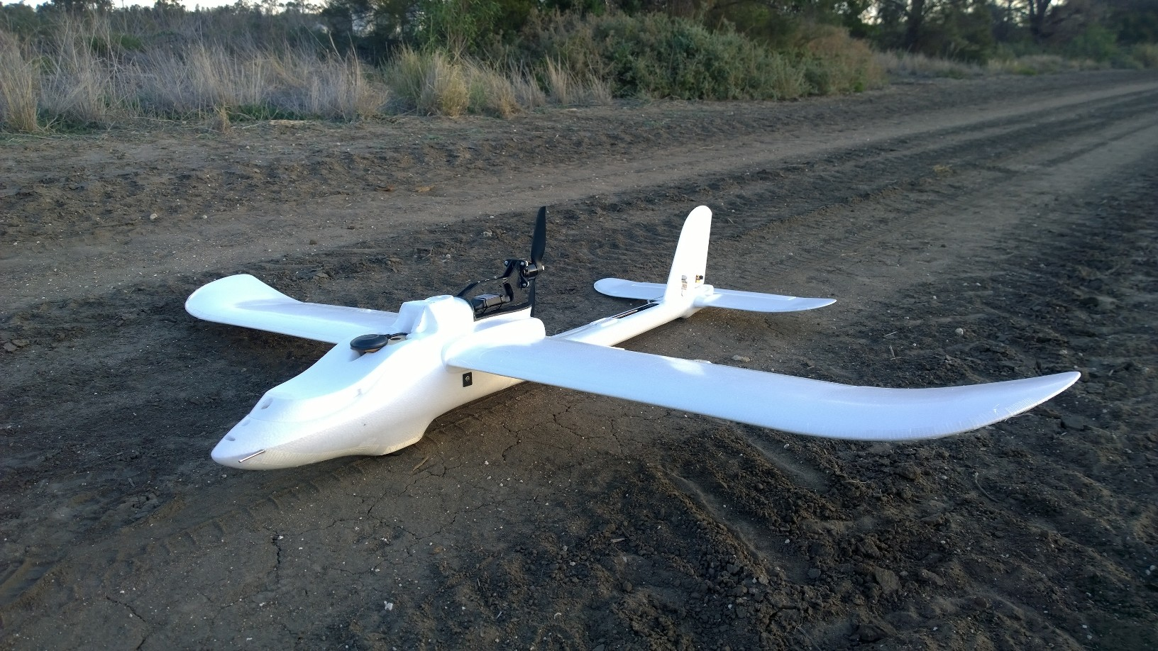
http://agmapsonline.com/

Slide 11
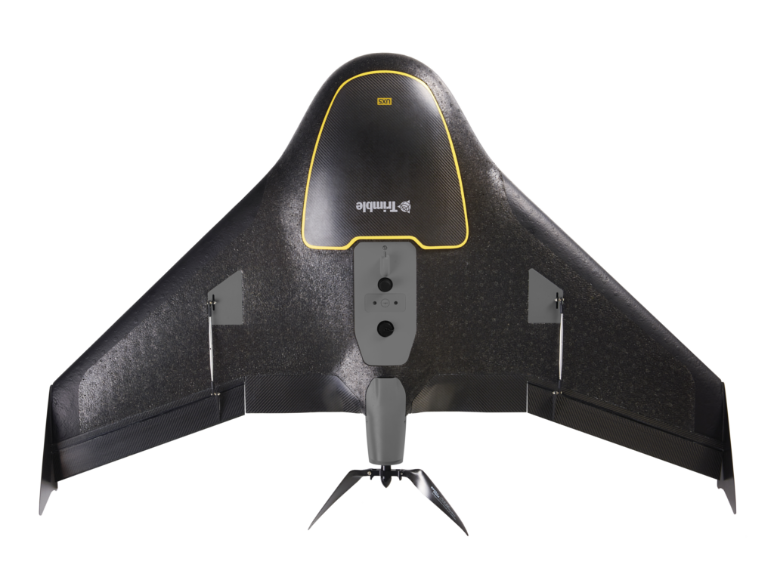
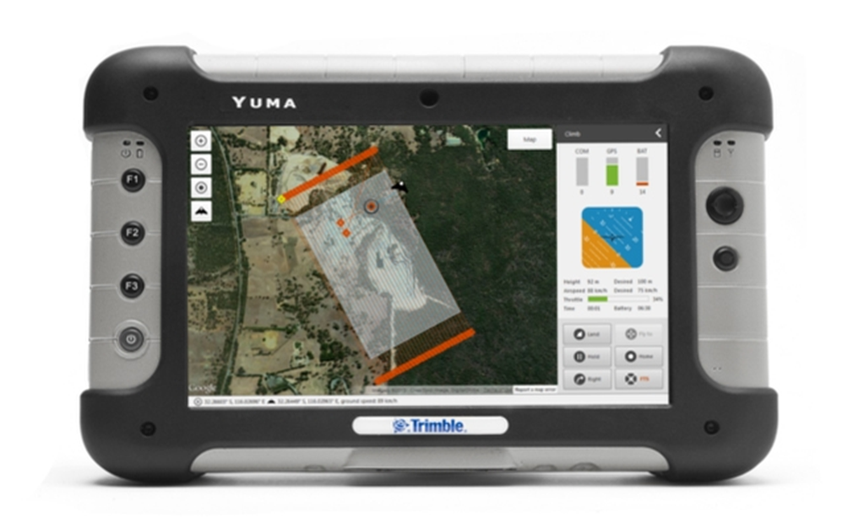
Trimble.com

Slide 12
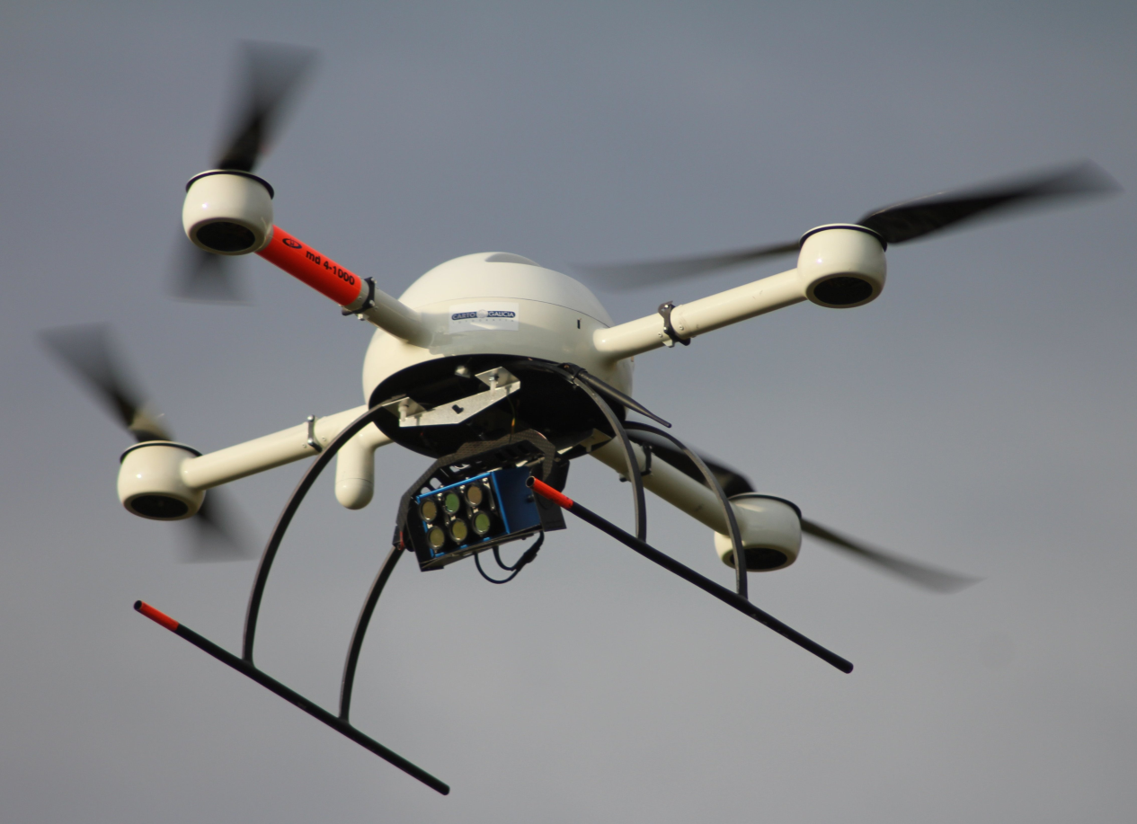
Tetracam.com

Slide 13
Hints on Platform
They will crash. Period.
  Easier to get a replace pieces the better.
Copters, Hover and stable
Planes / Fixed Wing, Covers ground

Slide 14

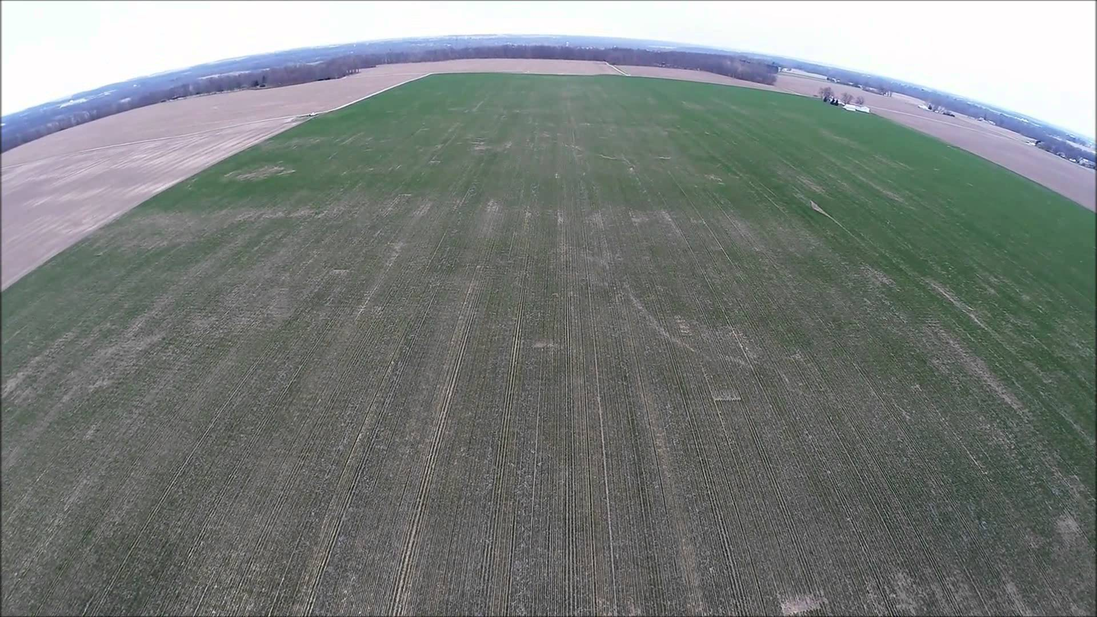
Consulting
https://www.youtube.com/watch?v=Rh7KKO12Mj8

Slide 15
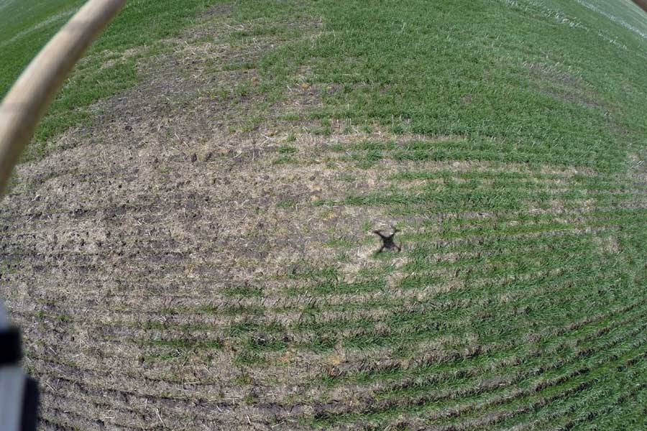
www.manitobacooperator.ca

Slide 16
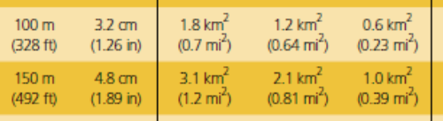
Moving Beyond the GoPro
We can collect data, and potentially a lot of it.
To Get Quality

Slide 17
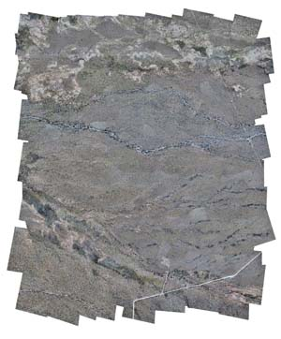
Imagery Stitching
OrthoRectification
  http://www.satimagingcorp.com/services/orthorectification/
    open sources available
    http://conservationdrones.org/post-processing/

Slide 18

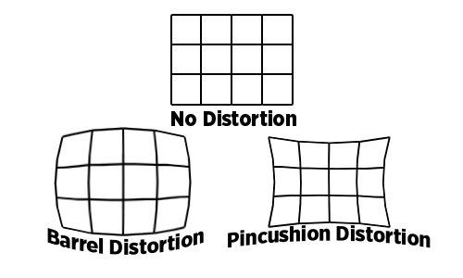
Challenges
Small footprint
Image distortion
Locating ground control
points
Relatively large errors in exterior orientation parameters (X, Y, Z, roll, pitch, heading)
  Wind comes sweeping down the plains……..

Slide 19
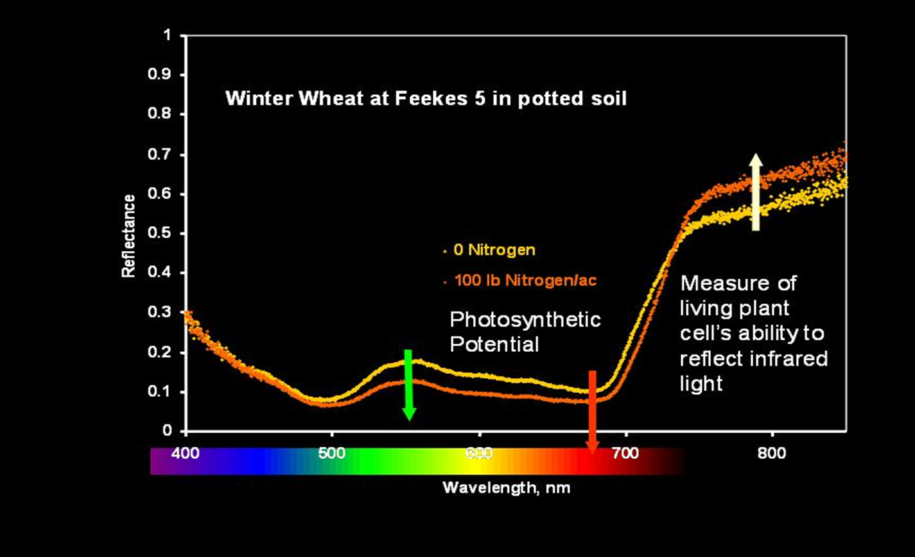
Reflectance

Slide 20
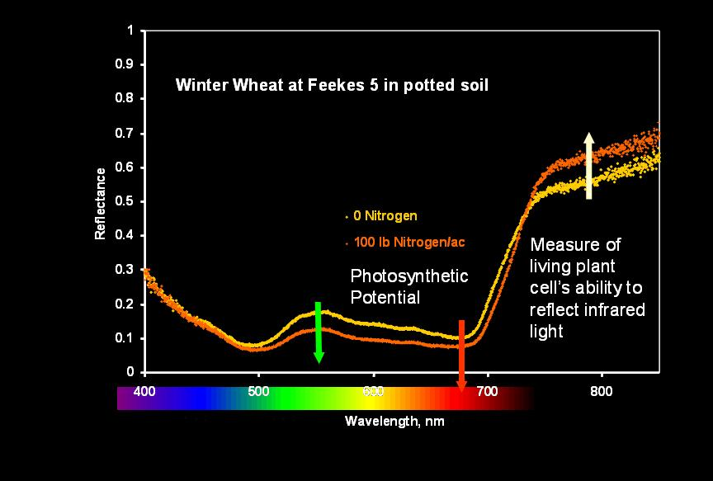
Wavelengths & Indices
NDVI and Simple Ratio
  Biomass: Red and NIR (650, 780)
  Green or Amber instead of Red (550, 590)
  Growth Stage for Amber v Red
  Red Edge 680
Chlorophyll
  SPAD (650 – 940)
Protein
  710 , 810
  (Kelly et al 04)

Slide 21
Reflectance Data
Historically satellite and aerial imagery widely used.
Ok State in the mid 90’s started investigating VRT N work.
  Evaluated Aerial and Satellite.

Slide 22
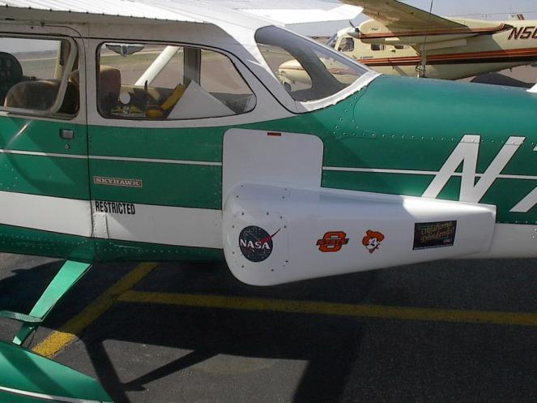
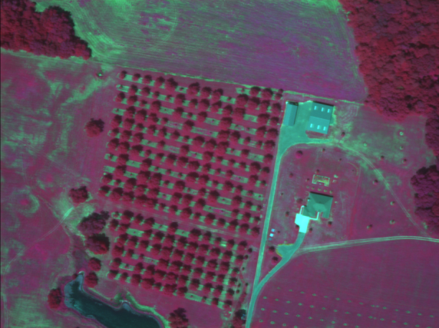
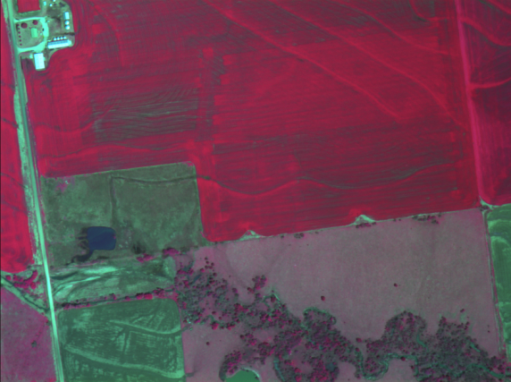
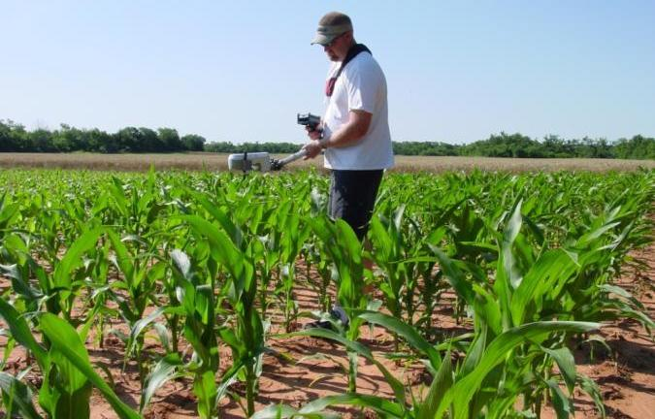
Precision Ag Research at OSU

Slide 23
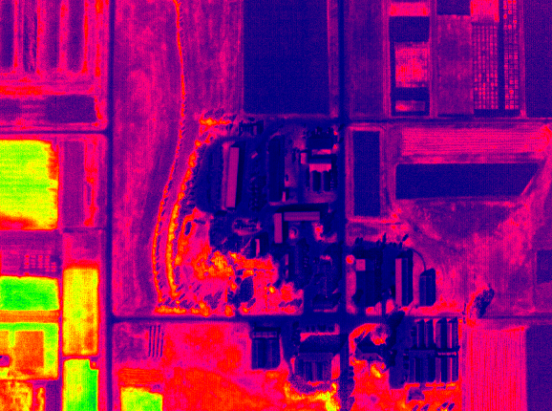
NDVI of OSU Experiment Station
1m Resolution

Slide 24
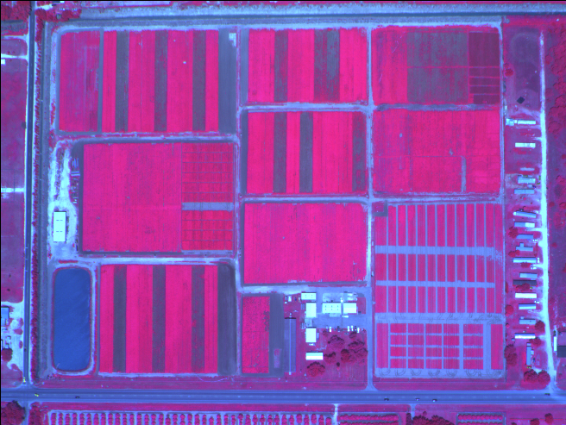
False Color (green, red, NIR) Image
< 1 m Resolution - Raw Radiometric Data
(Courtesy F. Schiebe, SST Software)

Slide 25
Passive vs Active
Active Sensor emits light, typically via LED.
Passive Sensor records reflectance of natural light.
  Sun Angle, impacted by time of day and time of year.
  Clouds
  Atmospheric interference.

Slide 26
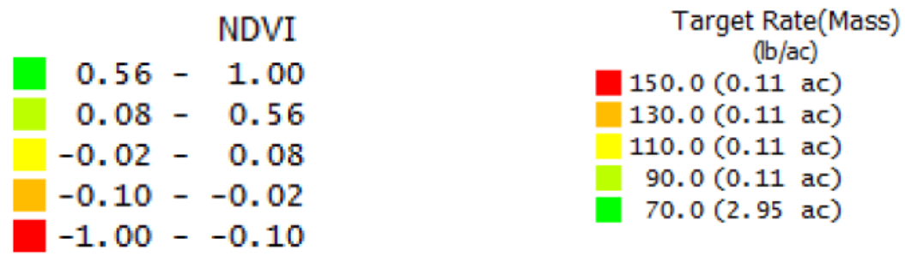
Use of relative values
*From Auto Copter
•Map segmented into NDVI values
  •Fertilizer into 150lb, 130lb, 110lb, 90lb, and 70lb
    •150lb for the lowest NDVI value
    •130lb for the middle-lowest NDVI value
    •110lb for the middle NDVI value
    •90lb for the middle-highest NDVI value
    •70lb for the highest NDVI value
*PGRs and Defoliants in cotton
*Bare Soil imagery for drainage

Slide 27
Aerial Imagery values w/o Cal
Yield Monitor

Slide 28
To Calibrate
With Spectrometer, use white plate.
NUE Wheat project with 330+ plots.
  10 to 2
  White plate
  Incoming and reflectance
  Reverse order

Slide 29
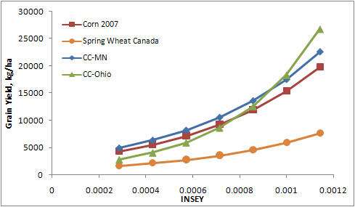
Replicated values
OSU’s use of active sensors
Relate Specific values.
Must have repeatability

Slide 30
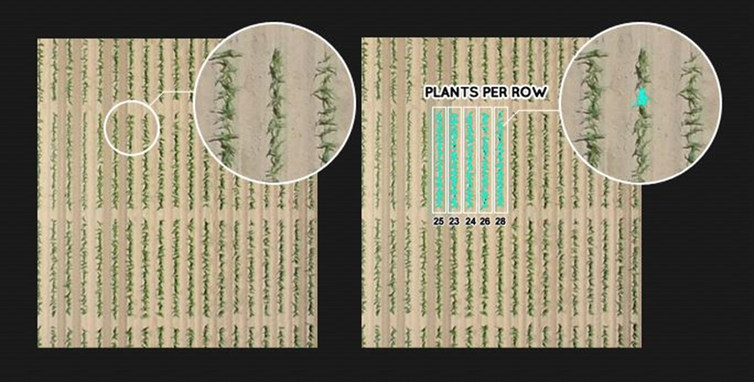
Beyond reflectance
Stand Count
  Quite easy
Canopy Temp
Soil Moisture
Soil OM
DOCUMENTATION
http://agloop.com/how-to-produce-more-with-less-the-emergence-of-uav-technology/

Slide 31
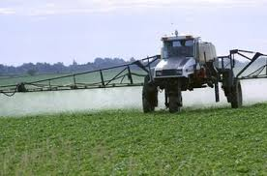
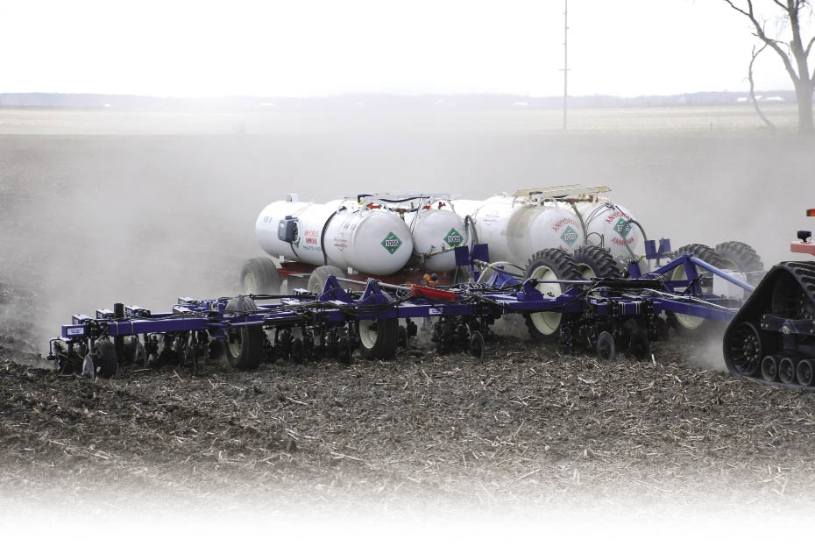
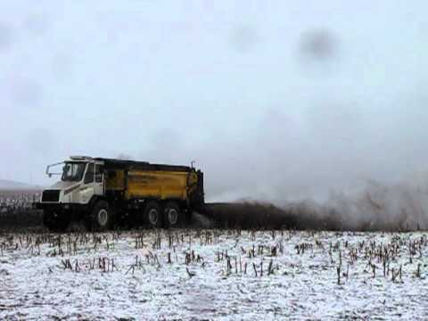
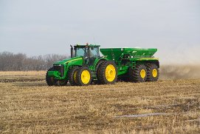
Resolution

Slide 32
Satellites
June 10-2014 Google Tuesday agreed to buy satellite startup Skybox Imaging Inc. for $500 million in cash, the latest in a number of moves by the world's largest Internet search provider to collect and provide data from the sky. Skybox has designed small, relatively cheap satellites that can collect daily photos and video of the Earth. Skybox satellites weigh roughly 260 pounds, making them much cheaper to build and launch than traditional satellites that can weigh tons. Skybox planned to launch 24 such satellites that could shoot pictures of the Earth more often.
Feb 3 2015 Wilbur-Ellis Co. has reached an agreement with Planet Labs to bring satellite imagery to the AgVerdict software platform, Wilbur-Ellis’ technology in agricultural data usage. This enhancement will significantly improve the delivery of satellite imagery to a grower, making the data available in a matter of minutes rather than days. This new feature will benefit Wilbur-Ellis customers by providing imagery using “ultra-compact” satellites that will soon scan the planet every twenty-four hours.

Slide 33
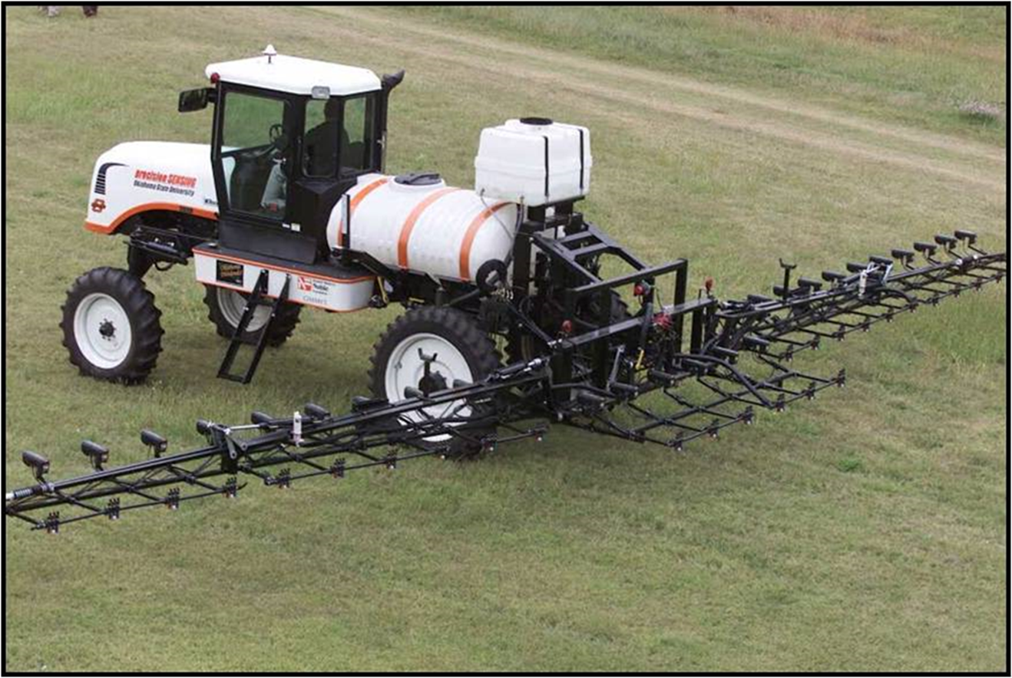
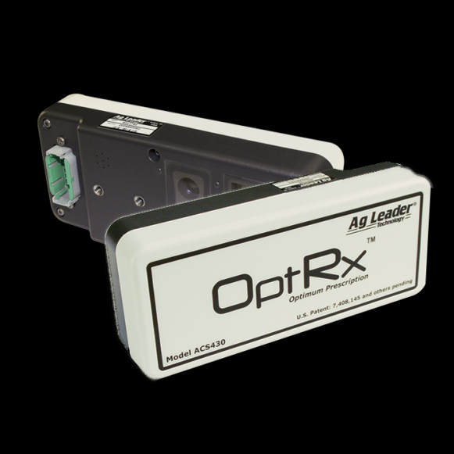
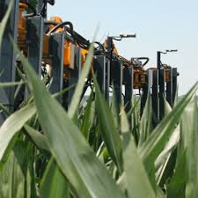
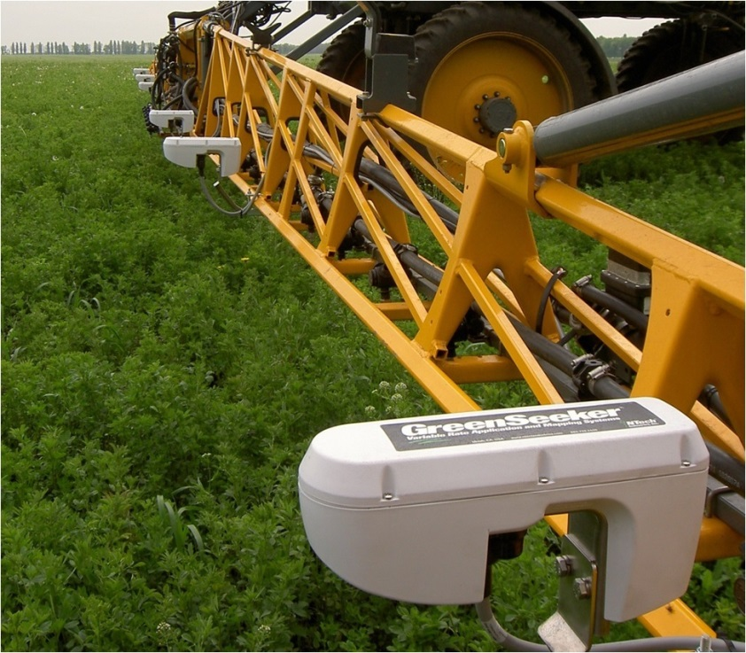
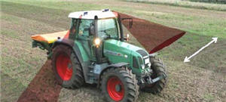
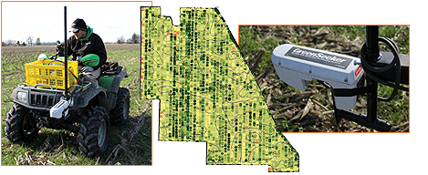
How many times are you on a field?

Slide 34
Today
Consultants can be more efficient and make more money.
    With low end UAV’s
Platforms available for high end imagery.
Companies scrambling to find
  Increase easy of data processing
  Create decision aid tools.

Slide 35
Nothing
I mean NOTHING takes the place of Scouting and good Agronomy.
NOTHING..
Get dirty walk the field, take samples.
But there is always a degree of WRONG We are dealing with a living system. More so we are dealing with a Weather Dependent system.
Have a Plan, Have a goal

Slide 36
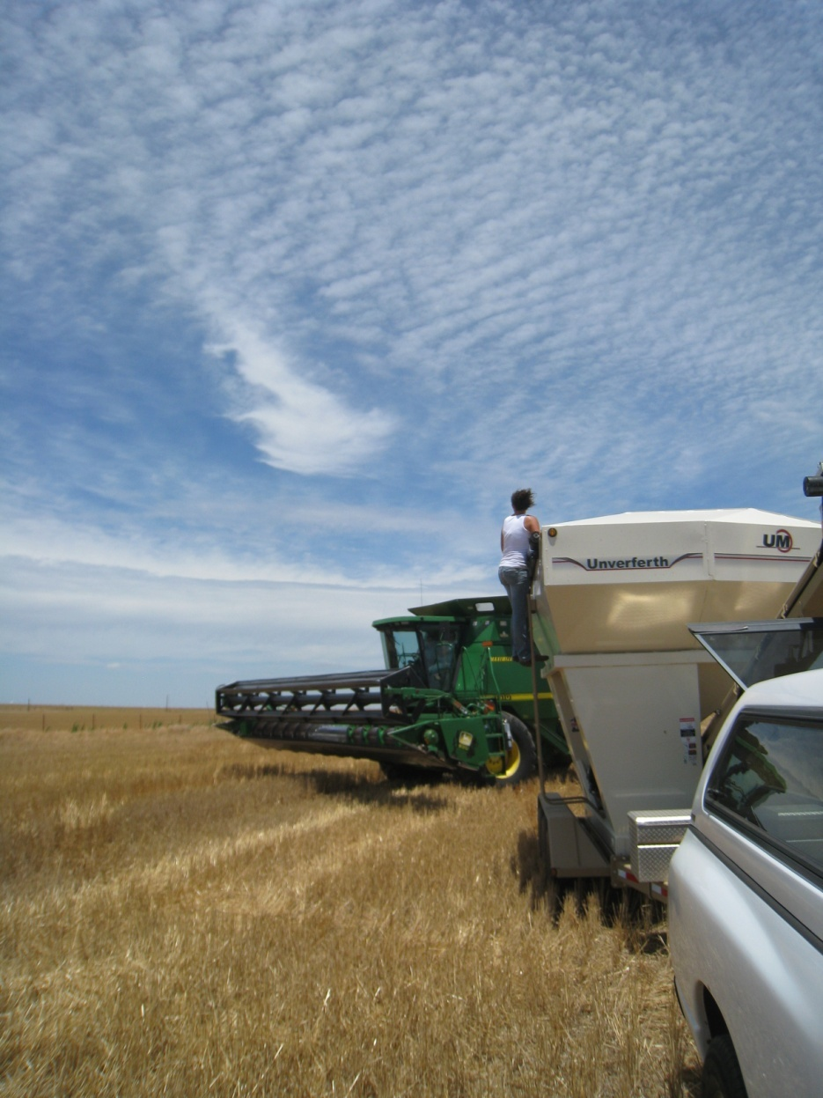
Thank you!!!
Brian Arnall
373 Ag Hall
405-744-1722
b.arnall@okstate.edu
Presentation available @
www.npk.okstate.edu
Twitter: @OSU_NPK
www.Facebook/OSUNPK
YouTube Channel: OSUNPK
Blog: OSUNPK.com
www.Aglandlease.info

