Slide 1
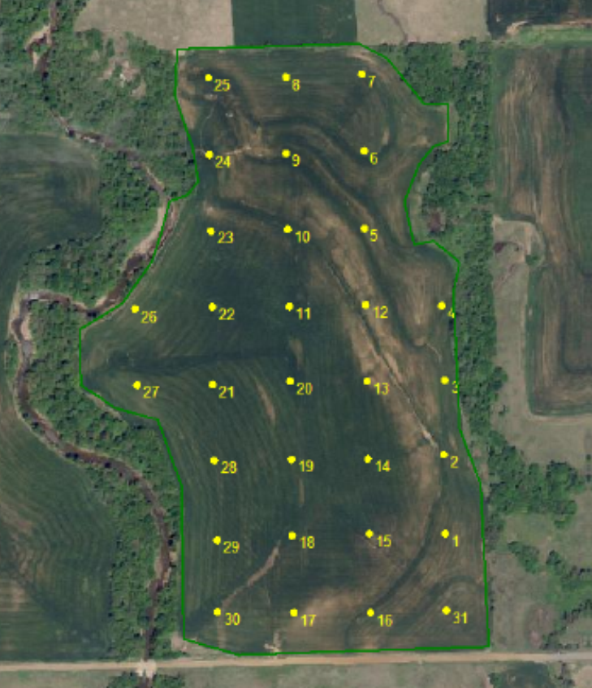
STP
75% suff
90% Suff
STK
80-90%

Slide 2
STP
75% suff
90% Suff
STK
80-90%
pH
<5.0

Slide 3
Variable Rate
VRT Lime Rec
  Total Tons 33
Difference Average – VRT
  133 tons or approximatly $3960
  *assuming $30 per ton lime

Slide 4
Variable Rate
P Rec
  Total lbs 1475
Difference Average – VRT
  + 345 lbs or approximately $190
Revenue lost of Flat rate applied
  273 Bushel or $1638
Revenue lost of no application made.
  302 Bushel or $1812
    Assuming .55 per lb P2O5 and Wheat $6 per bu.

Slide 5
Variable Rate
K Rec
  Total lbs 120
Difference Average – VRT
  + 120 lbs or approximately $66
Revenue lost of no application made.
  57 Bushel or $342
    Assuming .55 per lb K2O and Wheat $6 per bu.

