Slide 1
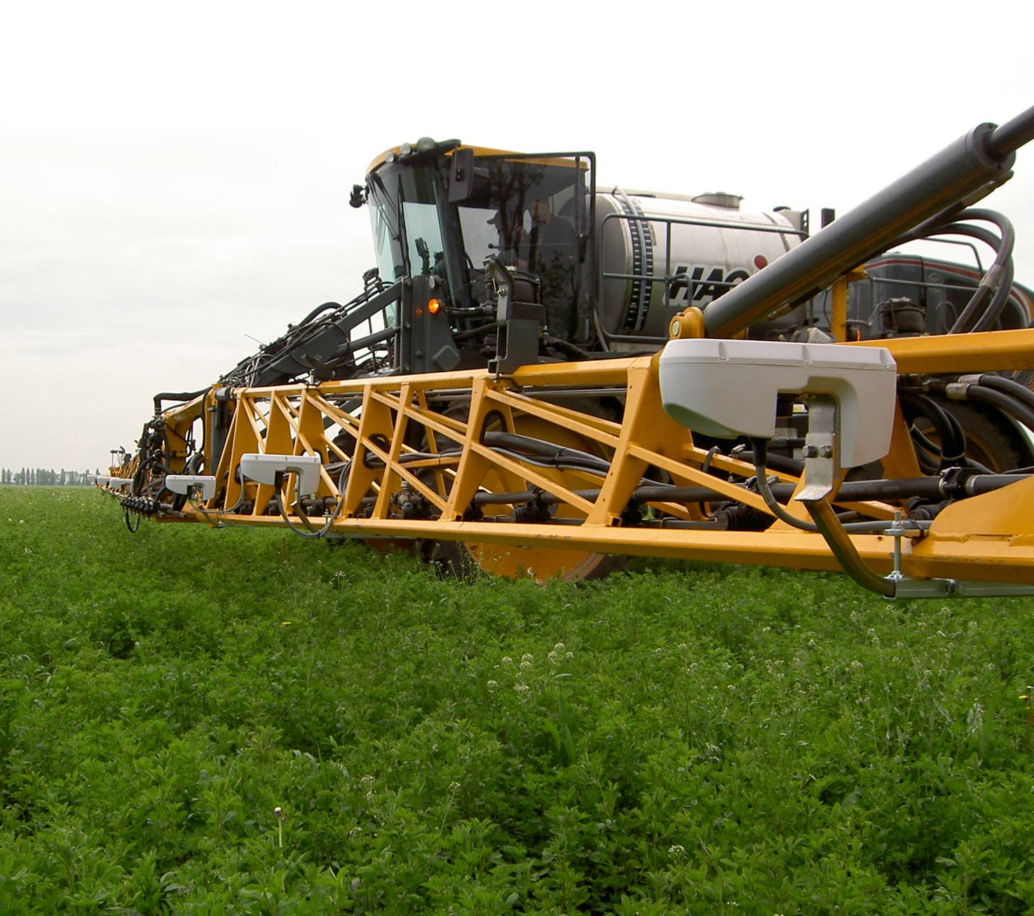
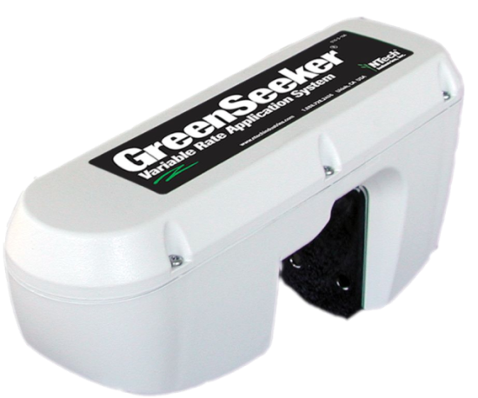
GreenSeeker ® Applicator Mounted Crop Vigor Sensors

Slide 2
GreenSeeker Farmer Field Use
First actual growers (not research) used GreenSeeker on-the-go VRA on their farms in 2005
For the 2010 season
GreenSeeker RT200 has over 500,000 acres of VRA use in North America
45,000 VRA hectares in Europe
Notes:
100’s of university research papers reference GreenSeeker technology by name

Slide 3
Economics of VRA Nitrogen with GreenSeeker
Field trails and grower experiences in corn and wheat over the last 5 + years have shown a consistent range of $10 to $15 USD per acre improvement in Profit.
Most often less fertilizer, but several cases GreenSeeker called for more N than past practice, with increases in yield or protein
Actual N demand in field varies, putting the right amount in the right place pays

Slide 4
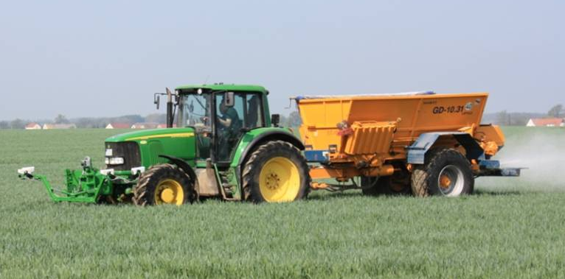
GreenSeeker Works on most Applicators

Slide 5
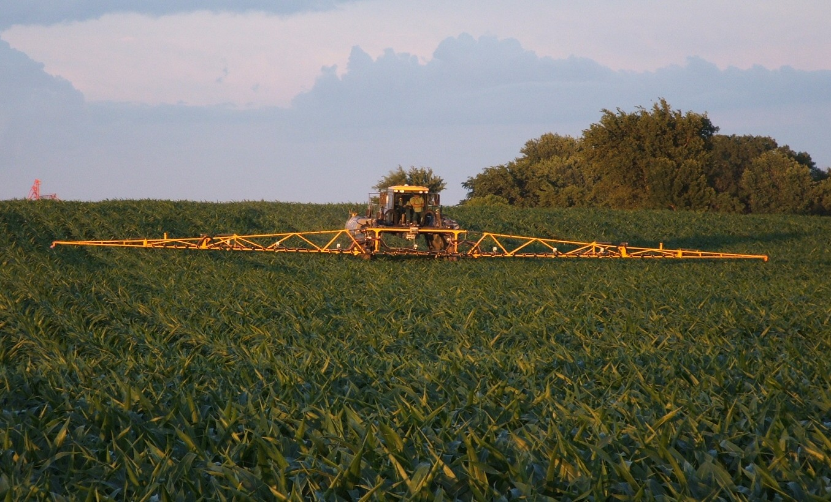
GreenSeeker Works on most Applicators

Slide 6
GreenSeeker Works on most Applicators

Slide 7
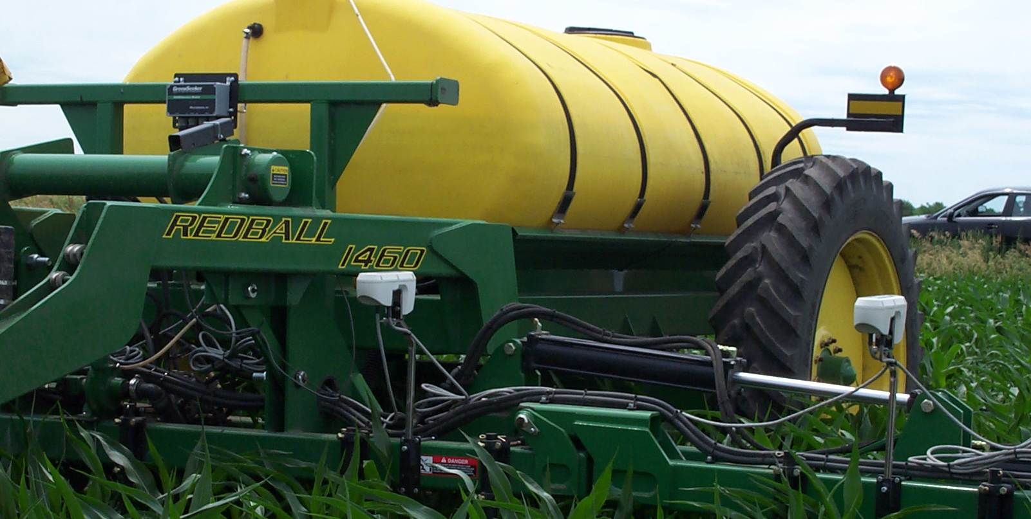
GreenSeeker Works on most Applicators

Slide 8
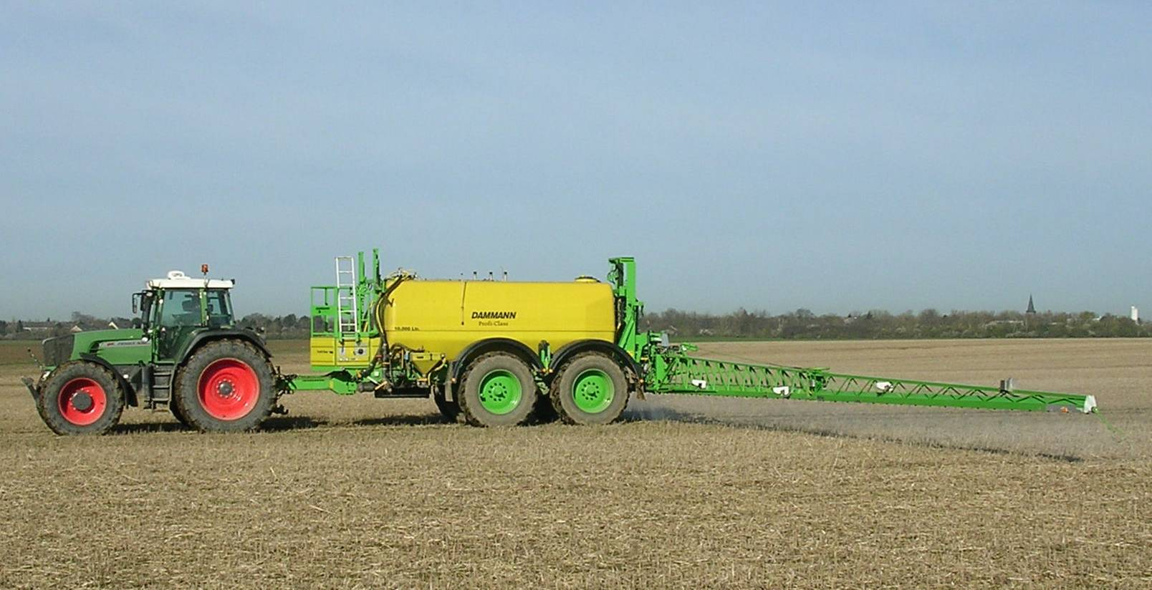
GreenSeeker Works on most Applicators

Slide 9
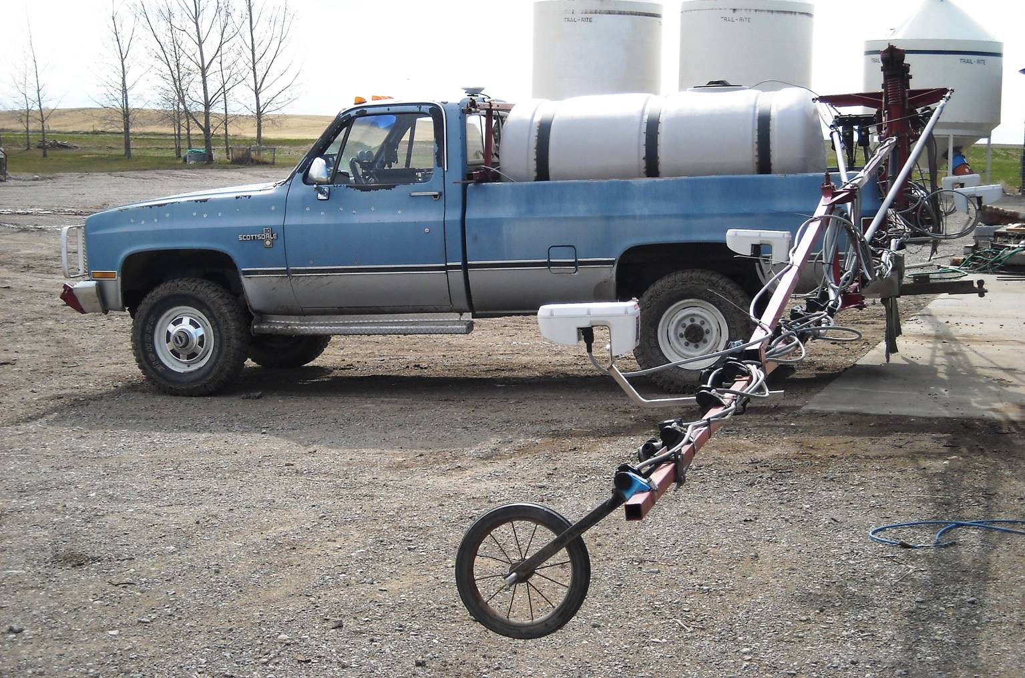
GreenSeeker Works on most Applicators

Slide 10
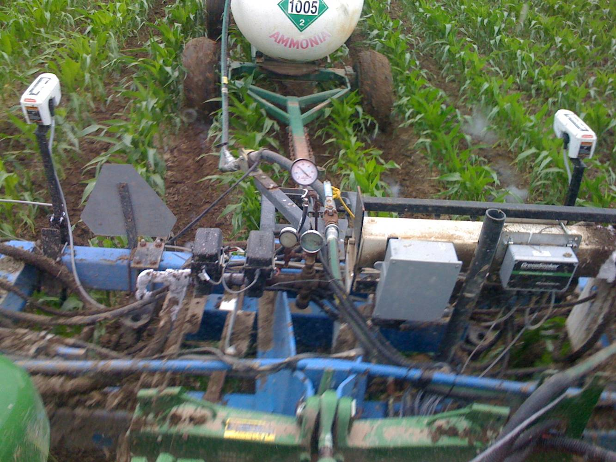
GreenSeeker Works on most Applicators

Slide 11
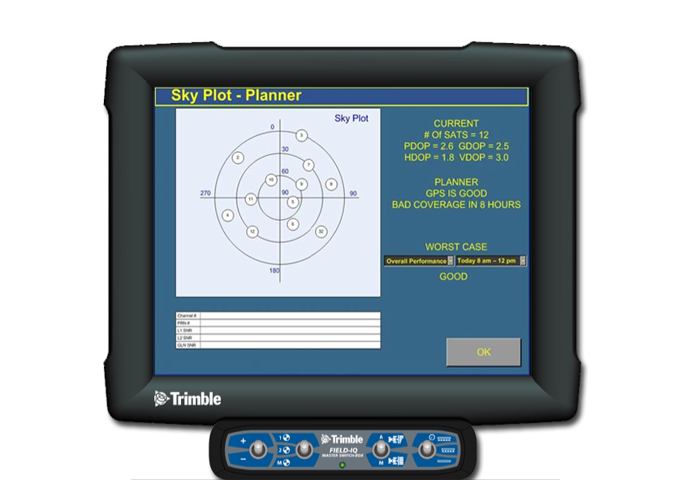
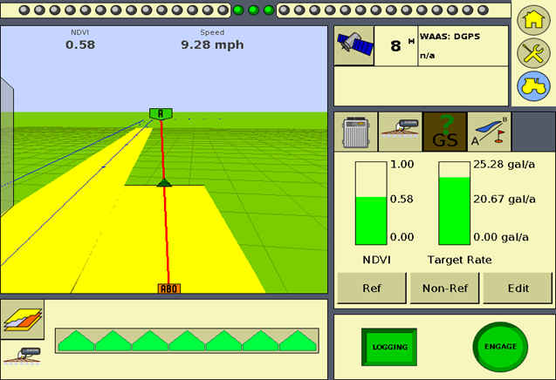
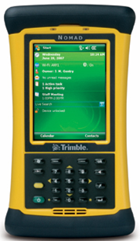
Two choices for User Interface

Slide 12
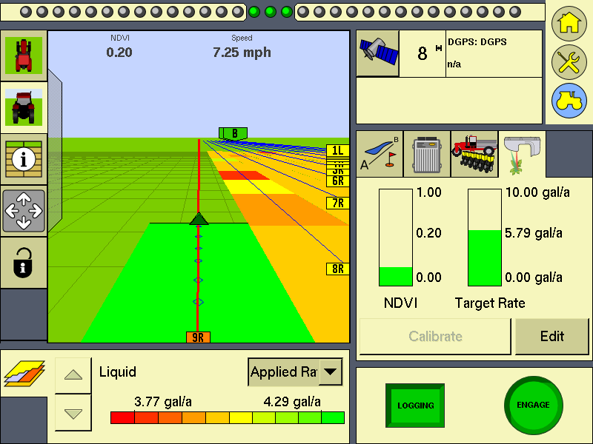
Works with any FmX rate control plug-in
Simple CAN cable connection to FMX

Slide 13
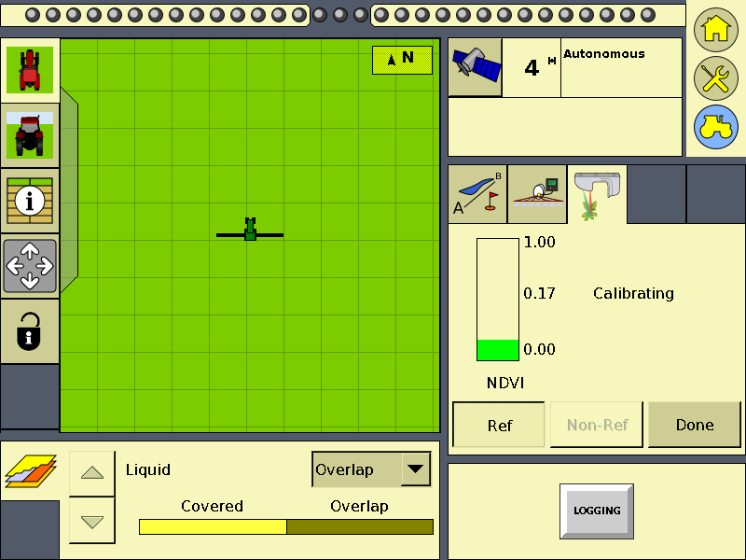
Collecting the N Rich Strip Cal

Slide 14
Collecting the Non-Ref values (area to fertilize)

Slide 15
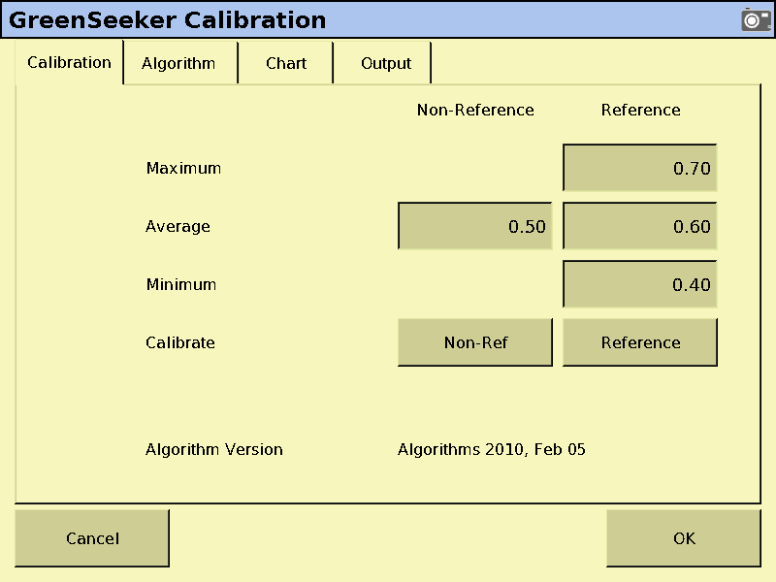
Verify Calibration Values

Slide 16
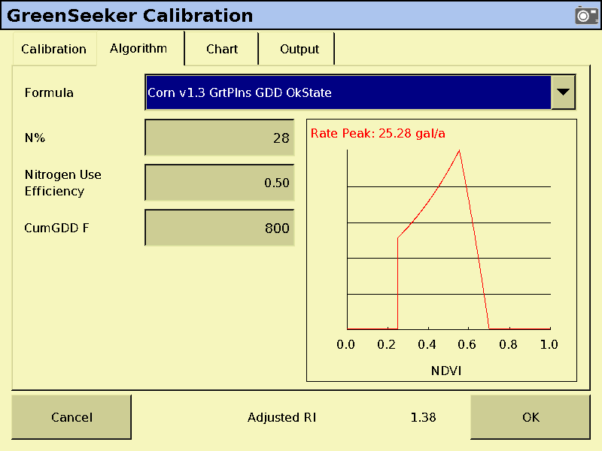
Choose Aglo and input Enviro values
Different Algorithms may have other input boxes

Slide 17
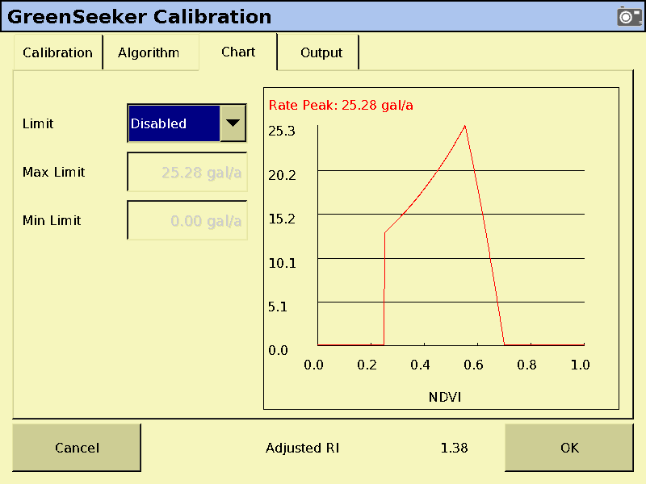
Review App Curve and set min/max

Slide 18
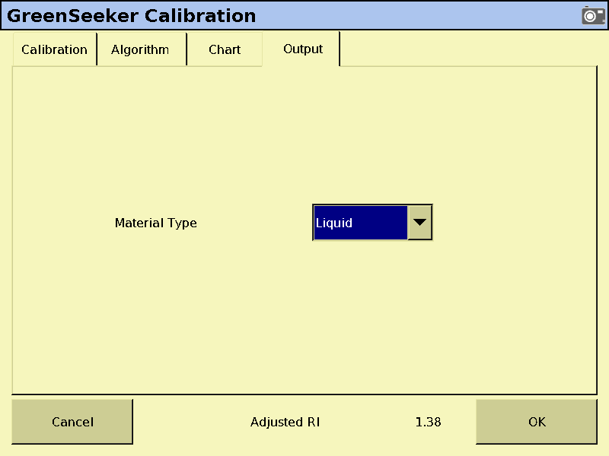
Set material Type

Slide 19
GreenSeeker Plug-In for FmX

Slide 20
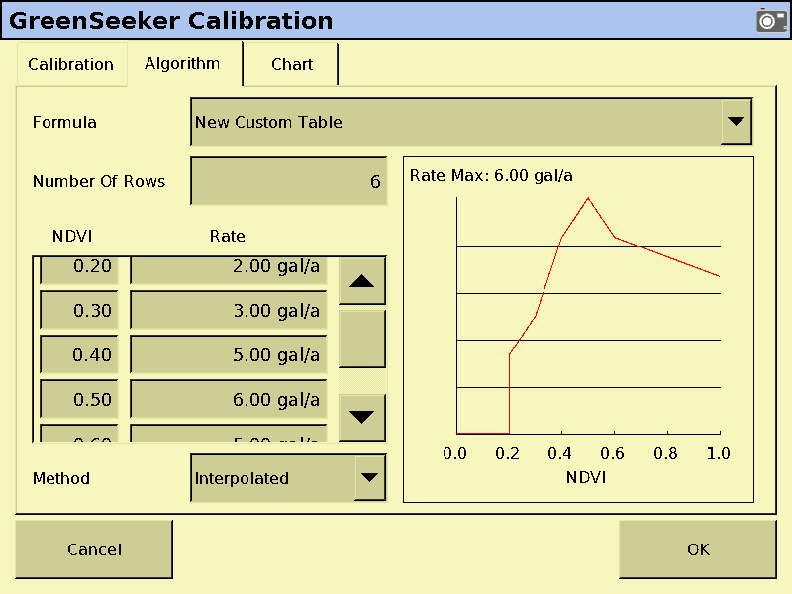
Custom Table/Algorithm
Up to 100 rows, user defined NDVI value/rate

Slide 21
RT Commander Pro Home Screen
Notes:
This is the home page of the RT Commander Pro Software which can be purchased as an upgrade to RT Commander, Version 3.9 or later. RT
To begin setup for a new sensor and historic management zone job, simply select “New Application Job”

Slide 22
RT Commander Pro Job Setup
Import of Rx Zone Modification Maps
Notes:
As with the base level RT Commander software, the operator needs to enter a field name and complete the normal 1x configuration of the rate controller, RT200 sensors and GPS communication links.
The RT Commander Pro introduces a new “Prescription Map:” field near the bottom of this first setup page. By clicking on the folder, the operator can locate the previously defined and stored management zone map from the file structure of the host monitor. This Rx map contains geo-referenced rate modification information which will be consider simultaneously with the sensor information. This map will need to be saved in .shp format.

Slide 23
RT Commander Pro Job Setup
Choice of rate modification strategy
Rx Zone Map layer selection
Notes:
There are 2 possible strategies available to modify the sensor based application rates; fixed values or multiply values. The fixed value option allows the management zone map to override all sensor information and simply apply a fixed/flat rate in the designated zone. Alternatively, the Multiply Value, allows the operator to amplify or restrict the sensor based rate by selecting a pre-determined multiplier for each management zone. In this first example, we will focus on the use of the multiply values option.
The “Data” field is used to select the layer of information within the Rx Map that contains the rate modifying information.

Slide 24
User-Defined Rate Modification Map
Rx Multiplier Values by management zone
1.50 1.0 .5
Notes:
We are now ready to begin the application
Note that the Rx zone map shows up on the apply screen as a background map.
Since we selected the “multiply values” option, the sensor based rates will be modified by the multiplier value found in each management zone. In this case there are 3 muliplier values from left to right 1.5x, 1.0x, & .5x (Note: the actual multiplier values are not displayed on the zone map.

Slide 25
Real Time NDVI Data Overlay
Real Time Application Map Overlays Management Zone Map in Background
Note Multiplier Influence on Target Rate
Notes:
Once the “Go” command is given, the variable rate application process begins.
In the above example, the sensor based rate, as determined from the “test fert rate” custom algorithm, is 13.4 GPA.
But since the applicator is in the 1.5x management zone, the target rate is amplified to 20.10 GPA.
Not that the application coverage map is built on screen in real time.

Slide 26
GreenSeeker Variable Rate App Systems
“Kits” for 4 and 6 sensor systems
System come with basic sensor brackets, hardware, sensor cables, interface module, etc.
Notes:
4 Sensor System <60 ft.

