Slide 1
Variable Rate Application
Randy Taylor
Biosystems and Agricultural Engineering
Oklahoma State University

Slide 2
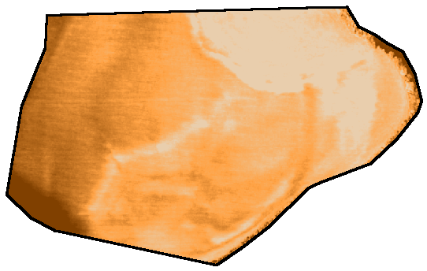
Field Scale Variability
Macro-variability
  Likely tied to soil type, landscape position, or something else
Micro-variability
  Could be sub meter or even individual plants

Slide 3
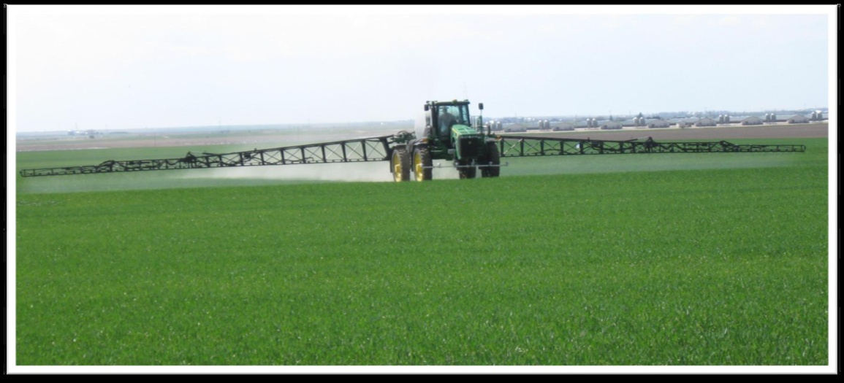
Variability View from Equipment
Longitudinal
  Down-the-row
  Response time issues
Lateral
  Across the boom
  Boom divisions
A greater distance between the control and delivery points means a lower resolution and increased scale.

Slide 4
Variable Rate Management
What measurements will be used to identify within-field variation in nutrient (if nutrient input is to be varied) supply or availability?
  The basis for variable rate inputs
What input recommendation or base input rate will be used?
What management scale will be used?

Slide 5
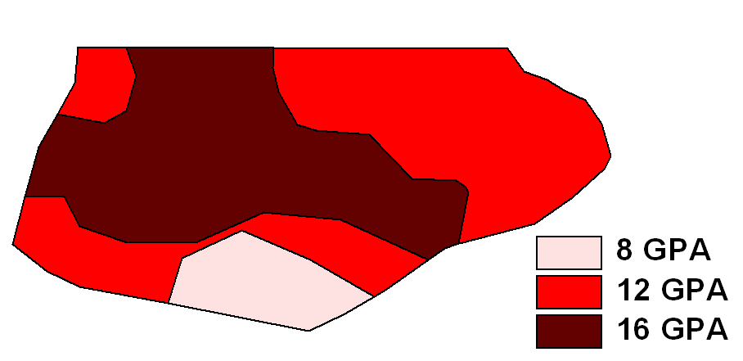
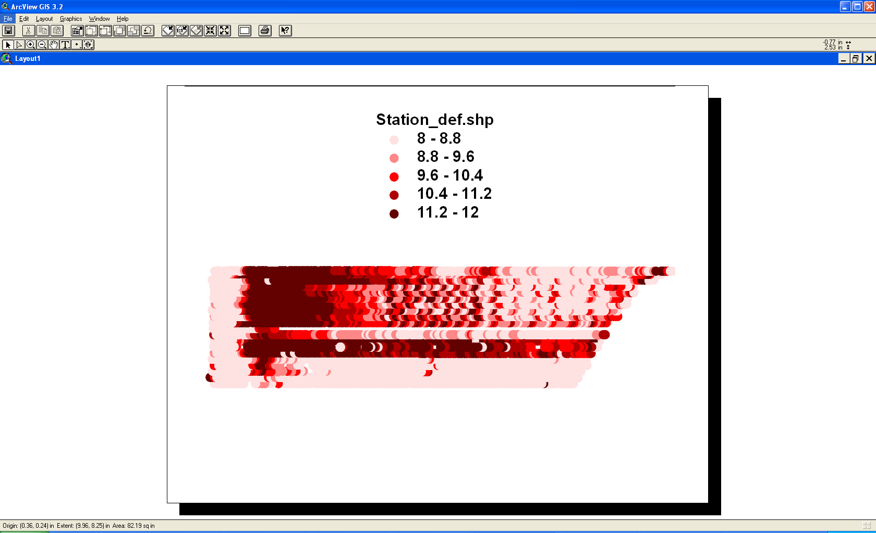
Sensor v. Map Based VRA
In a map based system, the controller receives a rate change as the applicator crosses into a new zone or application grid (step changes).
However, with a sensor based system the controller typically receives an updated rate every second and does not have the opportunity to stabilize.

Slide 6
Map-Based
Determine management scale
Apply diagnostic tools to develop prescription
Develop prescription map for the field
  Zone creation/sampling
  Grid sampling/scale
  Yield data/goal/stability
  Variable rate input prescription map

Slide 7
Map-Based Decision Inputs
Soil testing
Remote sensing of crop and soil properties
Site-specific data from yield monitors
Soil electrical conductivity maps
On-farm research trials
Other information?

Slide 8
Traditional Nitrogen Approach
N recommendation = yield goal x 1.2 – N credits

Slide 9
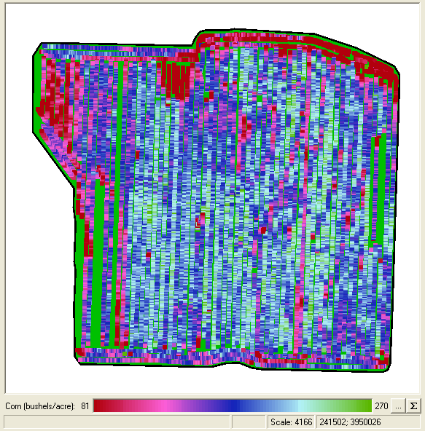
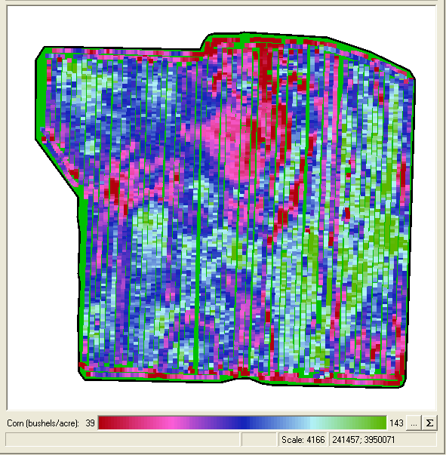
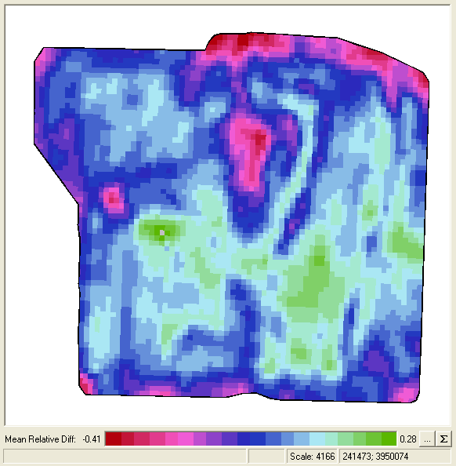
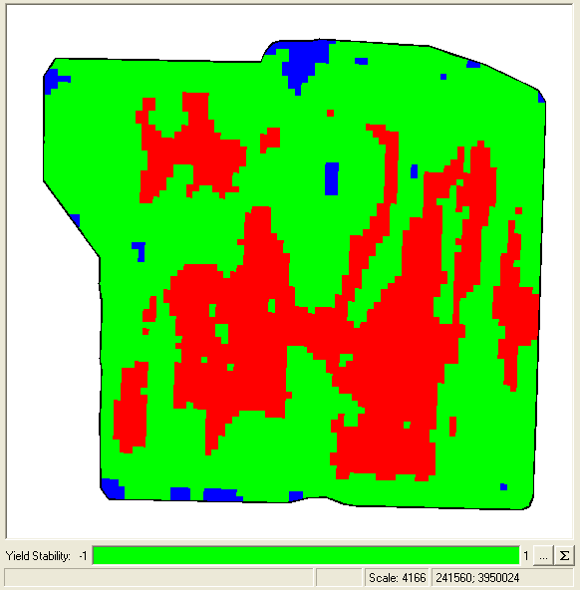
Spatial Yield Goals
Start with multiple yield maps on the same field.
Do they need to be the same crop?
Normalize each year and average the maps.
Does yield stability matter?

Slide 10
Multi-Year Yield History

Slide 11
Mean Relative Difference
A normalization method where the mean value is subtracted from the local value.
Data are aggregated into cells before subtracting the mean.
Variability of a cell over time tells us if it is stable or unstable
This method gives a better opportunity to classify consistently low or high yielding areas
Find areas where like classed cells are spatially contiguous

Slide 12
‘Whisker Plots’ of YM Data
Points are the mean relative difference for each cell
Bars are the standard deviation of yield through time.

Slide 13
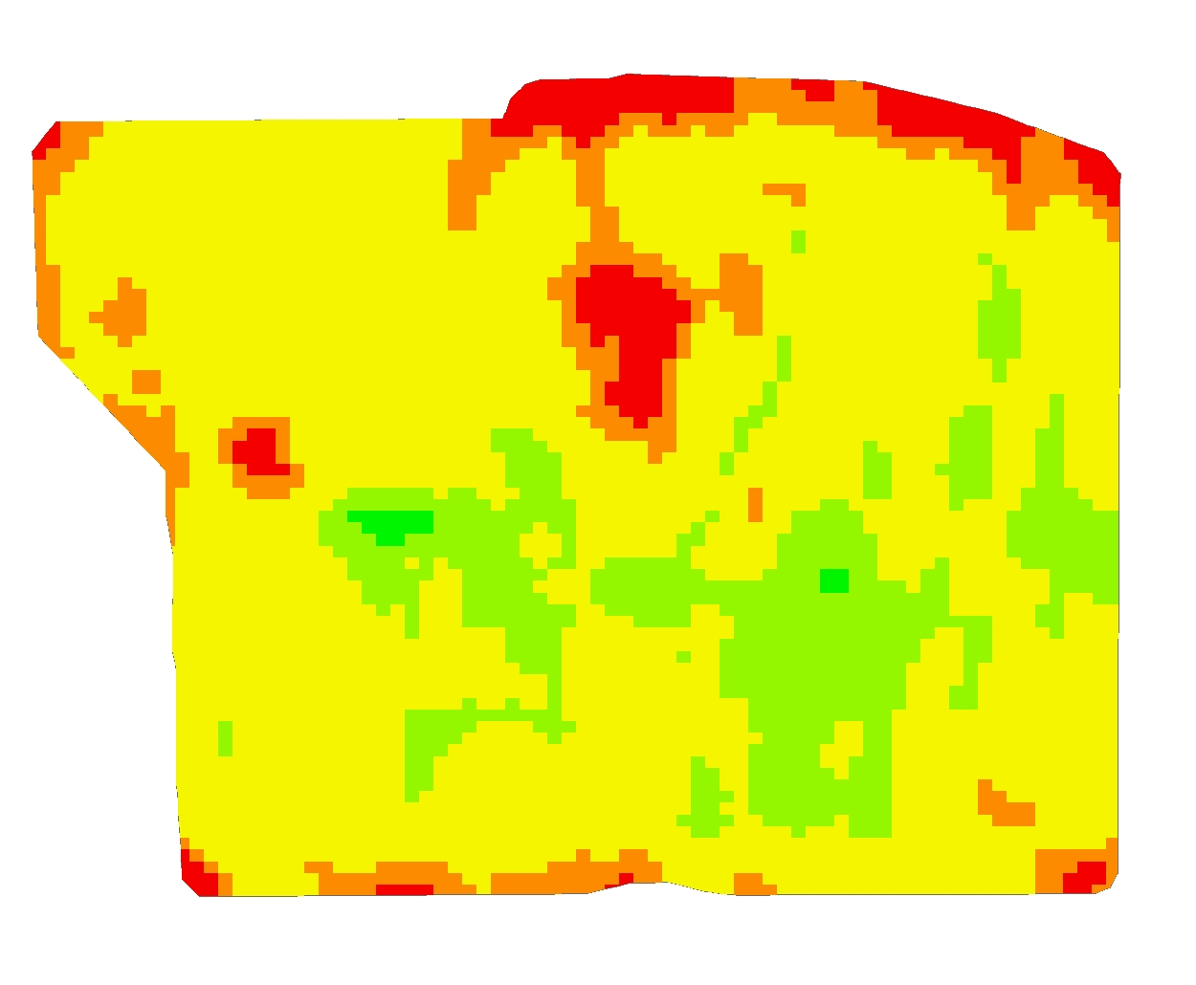
Relative Difference Map
Based on 6 crops in 4 years of yield data.
Corn-Wheat-DC Soybeans
Yellow is within +/-10% of the mean.
Green is at least 10% above average and orange is at least 10% below average.

Slide 14

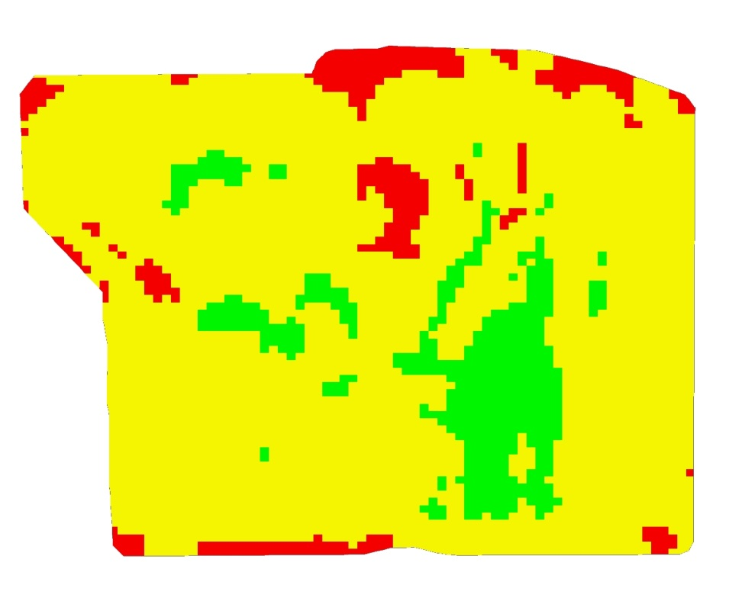
Yield Stability
Mean Relative Difference
Yield Classes

Slide 15
Yield Stability

Slide 16
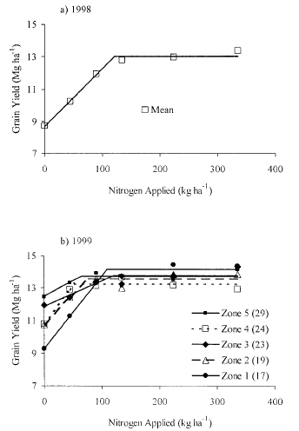
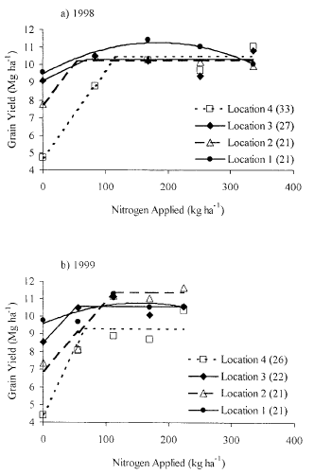
In-Field Response
“The results presented here indicated that there was, in most cases, significant variability in grain yield response to increasing N rates among in-field locations. The minimum N rate corresponding to maximum corn yield was as low as 52 kg N / ha and as high as 182 kg N / ha, considering all locations across three fields in this study. However, variability in yield responses to N was not consistently related to soil OM content.”
Schmidt, J.P., A.J. DeJoia, R.B. Ferguson, R.K. Taylor, R.K. Young, and J.L. Havlin. 2003. Corn Yield Response to Nitrogen at Multiple In-Field Locations. Agron. J. 94:798–806.

Slide 17
Management Zones
“Grain yield response to N was also shown to be significantly different across management zones. This study showed that spatially variable crop parameters could potentially be managed using SSMZs.”
Inman, D., R. Khosla, D. G. Westfall, and R. Reich. 2005. Nitrogen Uptake across Site Specific Management Zones in Irrigated Corn Production Systems. Agron. J. 97:169–176 (2005).

Slide 18
Traditional Method – Smaller Scale
“Over 13 site-years, no consistent benefit (either increased yield or reduced soil residual NO3-N) was observed with variable rate N application. There was no disadvantage to using variable rate N application in terms of N applied or grain yield, but no advantage that would justify the cost and effort of variable rate application with procedures used in this study.”
Ferguson, R.B., G.W. Hergert, J.S. Schepers, C.A. Gotway, J.E. Cahoon, and T.A. Peterson. 2002. Site-Specific Nitrogen Management of Irrigated Maize: Yield and Soil Residual Nitrate Effects. Soil Sci. Soc. Am. J. 66:544–553.

Slide 19
Traditional Recommendations
Traditional recommendations are typical very ‘coarse’ and were developed for wider geographic regions (maybe even statewide).
Applying these on smaller scales (sub-field) may not be sufficient to see a response.
True site-specific response functions will be generated on site.

Slide 20
Sensor-Based
Measure crop status in the field
Apply input at variable rates to meet crop needs
Need to relate the measurement to the crop need

Slide 21
Prescriptions
There are three inputs that are currently being VR applied for cotton
  Plant growth regulators
  Defoliants and boll openers
  Nitrogen
Where will you get your prescription?
  Land Grant
  Industry
  Home Grown

Slide 22
Sensor-Based Decision Inputs
Plant or canopy reflectance
Chlorophyll measurements
On-the-go or remotely sensed crop canopy imagery
Pre-selected N prescription
In-field reference strip may be needed

Slide 23
Normalized Difference Vegetative Index - NDVI
Calculated from the red and near-infrared bands
Equivalent to a plant physical examination
Correlated with:
  Plant biomass
  Crop yield
  Plant nitrogen
  Plant chlorophyll
  Water stress
  Plant diseases
  Insect damage
Varies from -1 to 1
  Soil NDVI = -0.05 to .05
  Plant NDVI = 0.4 to 0.9
  Typical plants with
  soil background NDVI=0.3-0.8
NDVI from different sources vary
  Bandwidths for Red, NIR vary
  Irradiance vs. reflectance based

Slide 24
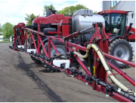
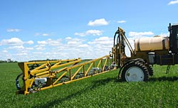
Sensor Configurations

Slide 25
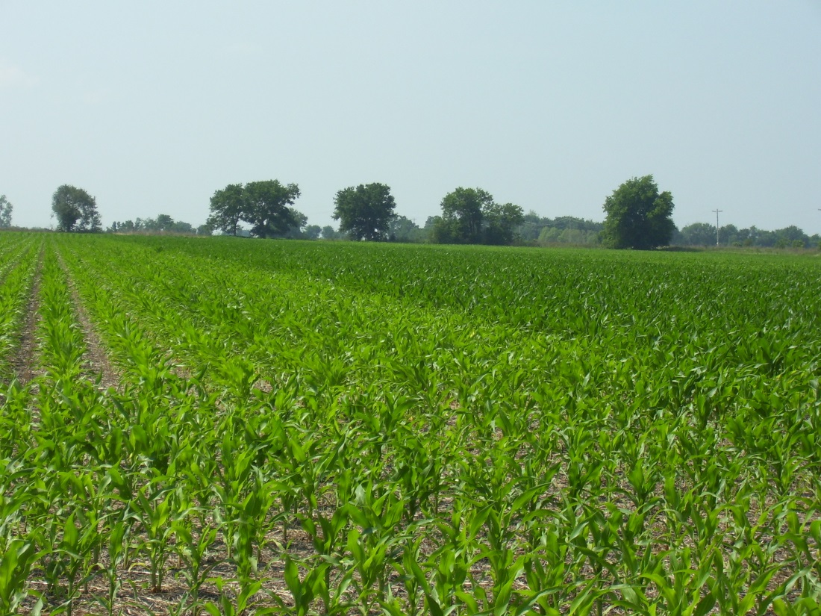
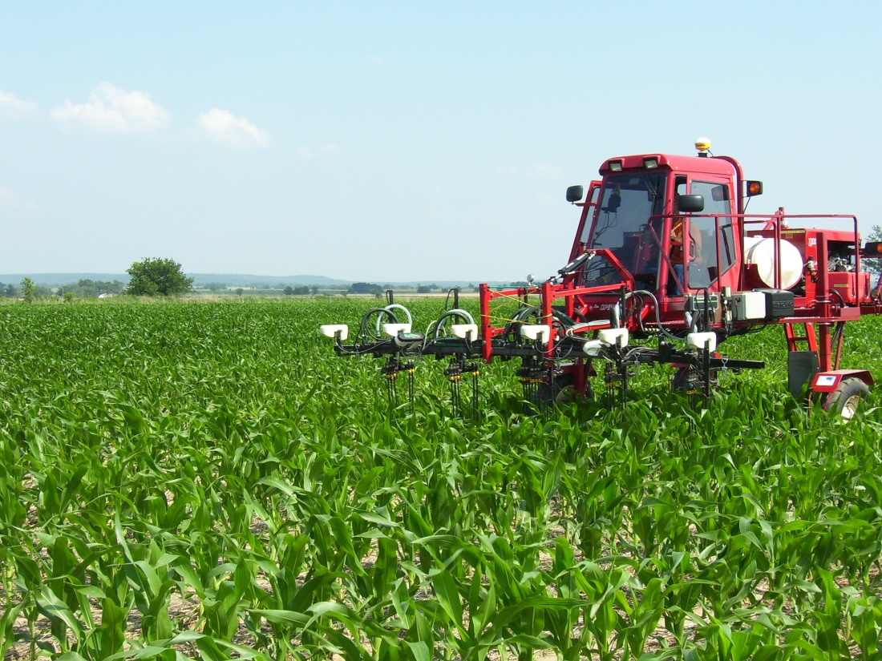
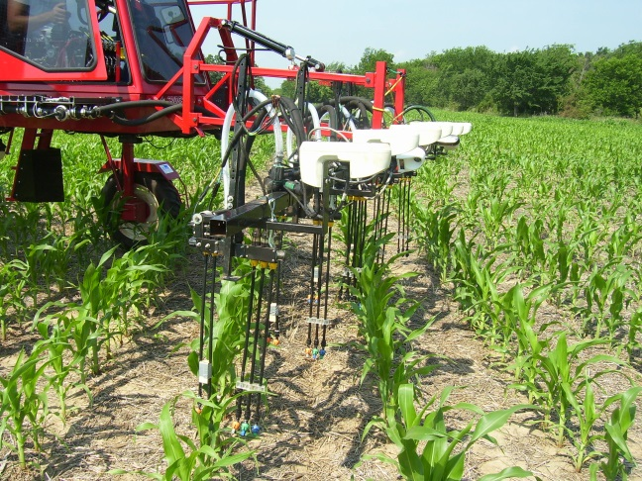
Sensor Based Nitrogen Management

Slide 26
Rate Controllers and Tuning
Prescriptions should not be developed without considering rate controller performance.
Worry about the macro variability within the field.
Are you capturing the general trend?

Slide 27
Challenges
Measuring differences at larger scales
  Non uniform plots
Matching application and harvest equipment
Harvesting plots
Managing data with potential errors

Slide 28
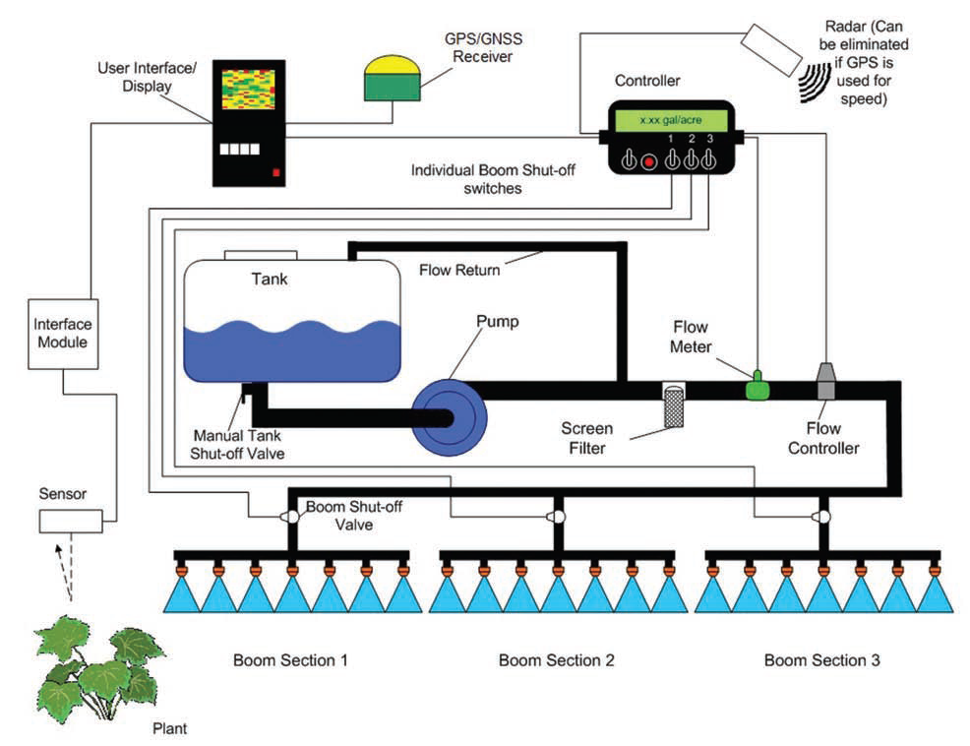
Equipment

Slide 29
Liquid Systems
Most commercial rate controllers can be set to about a 2 second response time.
Multiple control sections will require multiple control valves and possibly flow meters.
Pulse width modulation and binary valve systems have promise.

Slide 30
Typical Controller Adjustments
Valve Speed
  May be the only adjustment
Brake Point
  When do you start slowing down
Dead-Band
  How good is good enough?

Slide 31
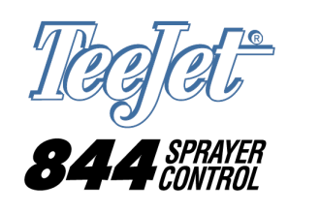
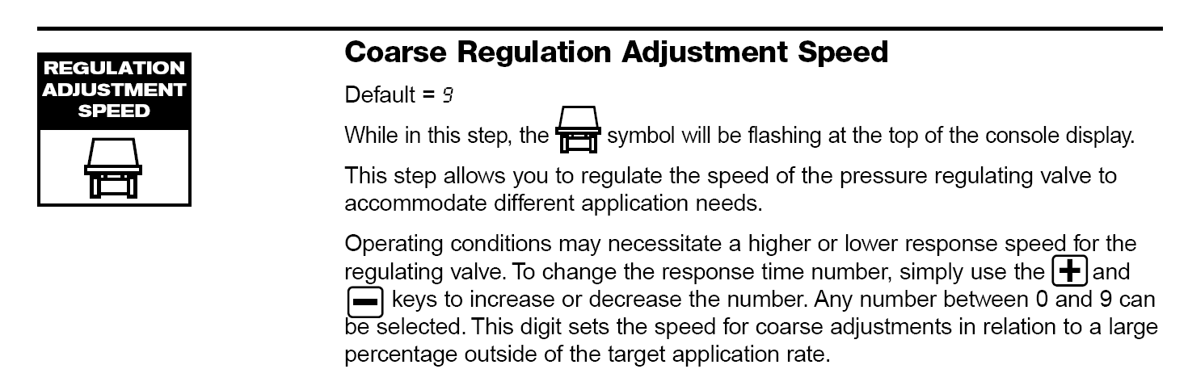
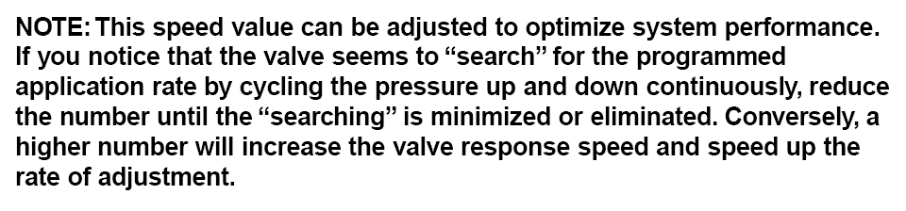

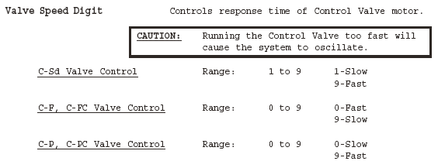
Setting Valve Speed

Slide 32

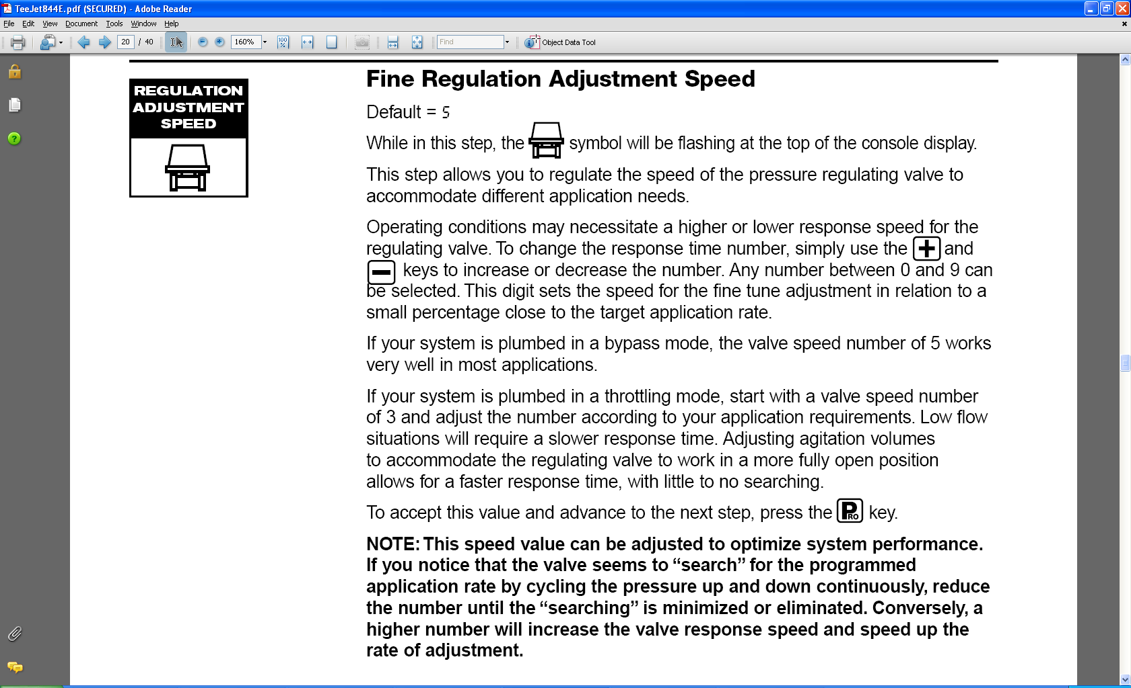
Brake Point (~Damping)
Do your passengers ride with a hand on the dash?

Slide 33
Underdamped System
As-Applied Data from Mid-Tech TASC-6200

Slide 34
Dead-Band
2% Dead-Band
Range where adjustment is deemed unnecessary (within a tolerable range of the target).

Slide 35
Raven 440 with PWM

Slide 36
Importance of Valve Settings
40% Brake Point
3% Dead-Band
10% Brake Point
2% Dead-Band

Slide 37
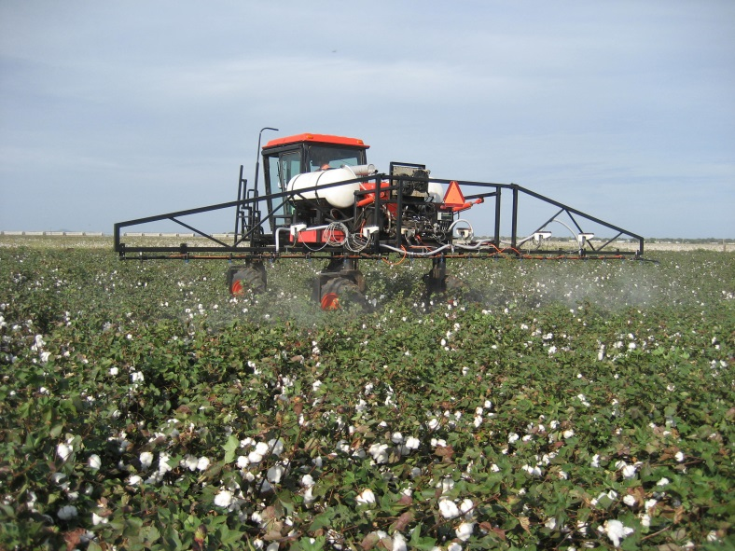
Variable Rate Liquid Applicators
Direct Injection
  Complex
  Time lag
Fixed orifice nozzles
  Flow proportional to square root of pressure
  Difficult to achieve range in flow rates
Pulse Width Modulation
Variable orifice nozzles
  Pressure/Flow relationship is more complex

Slide 38
Orifice Metering

Slide 39
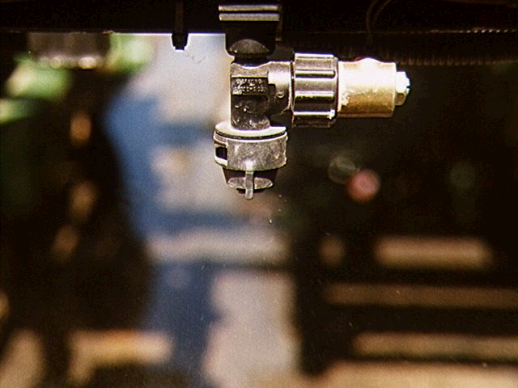
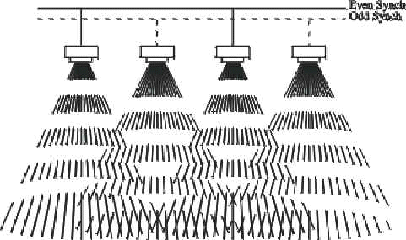
What PWM Does
Allows control of both nozzle pressure and flow independently
Increases the effective operating range by a factor of 4 (8:1 versus 2:1) compared to fixed orifice nozzles.
Controls flow by pulsing the nozzle.
Even coverage using blended pulse technology
LONG ON TIME = HIGH FLOW RATE
SHORT ON TIME = LOW FLOW RATE

Slide 40
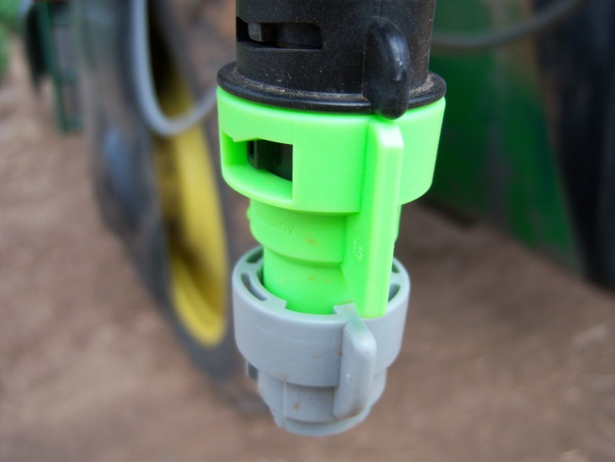
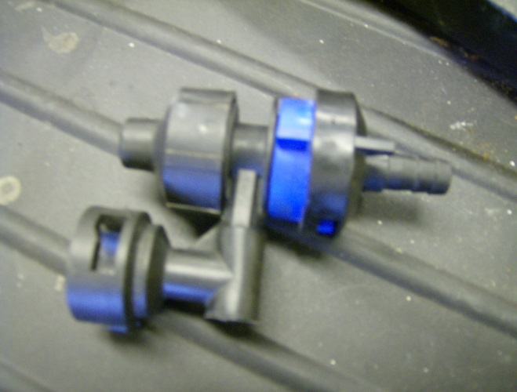
Nozzles and Rate Changes
Variable orifice nozzles open up as flow to the nozzle increases. This results in a greater flow for a given pressure and a much wider flow range.

Slide 41
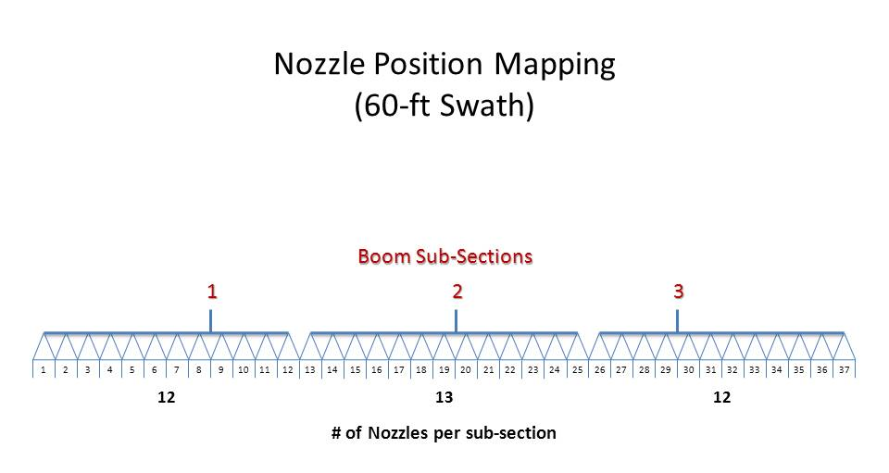
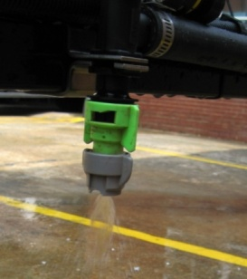
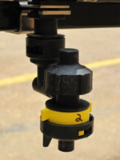
Nozzle Tests

Slide 42
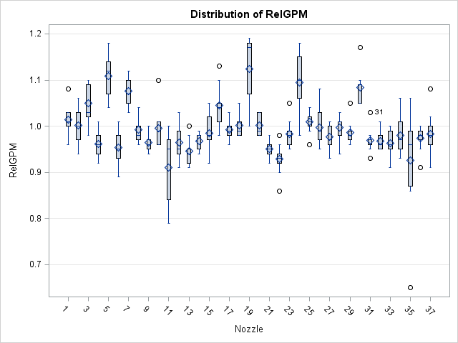
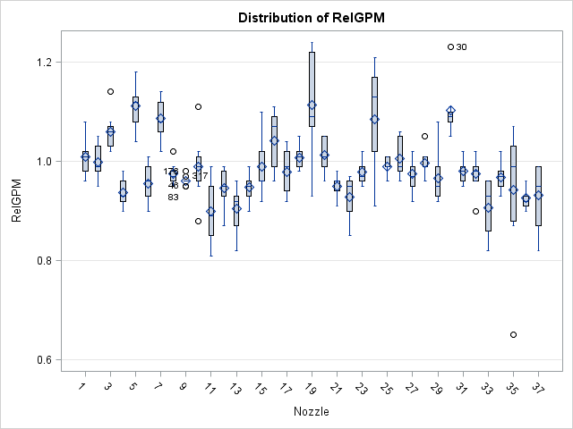
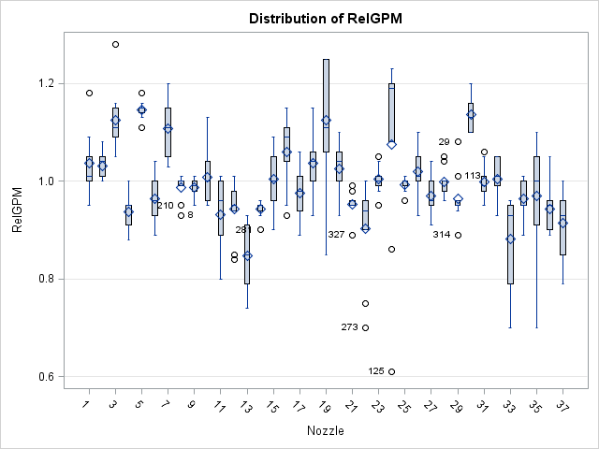
TurboDrop VR
Nozzles 5 and 19 over applied at all flows
Nozzle 30 over applied at low and medium flows
No nozzles under applied at medium and high flows
More variability at low flow

Slide 43
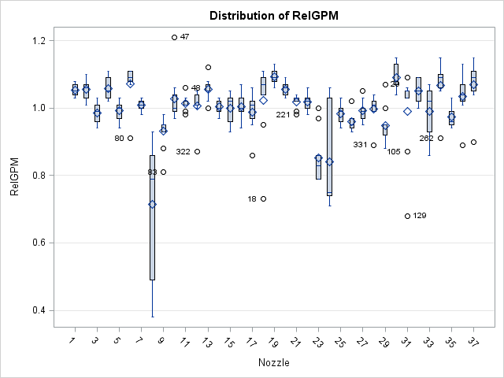
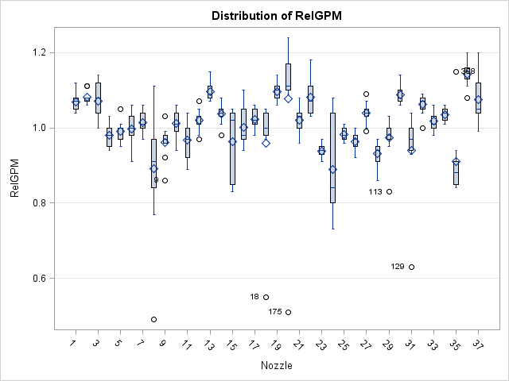
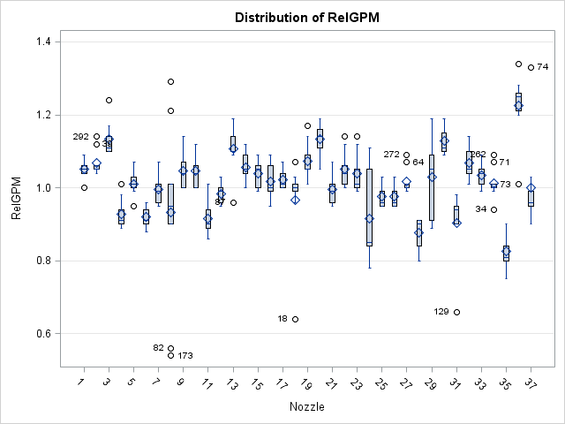
VeriTarget
Five nozzles over applied at low flow while two under applied.
At medium and high flows the tendency was under application but overall performance was better.

Slide 44
Granular VRT
Granular distribution/delivery systems follow two basic designs
  Gate/belt or chain/spinner
  Metering wheel/air boom
While both systems can be used for variable rate application, reducing the application scale to a partially width is really not feasible

Slide 45
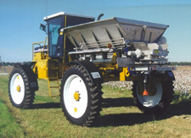
Spinner Spreaders
Reducing application scales with spinner spreaders is really not feasible.
The material is centrally metered and distributed.
Furthermore, VRA with spinner spreaders is a challenge.
  Spread distribution patterns are typically a function of flow rate onto the spinner

Slide 46
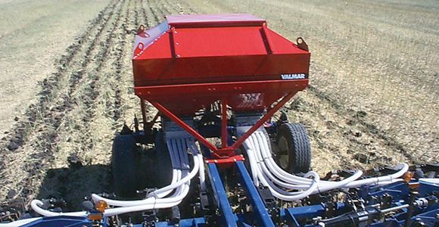
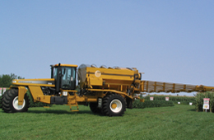
Air Boom Systems
The material is centrally metered, but patterns are created locally.
The primary challenge is lag time from the metering system to the point of application

Slide 47
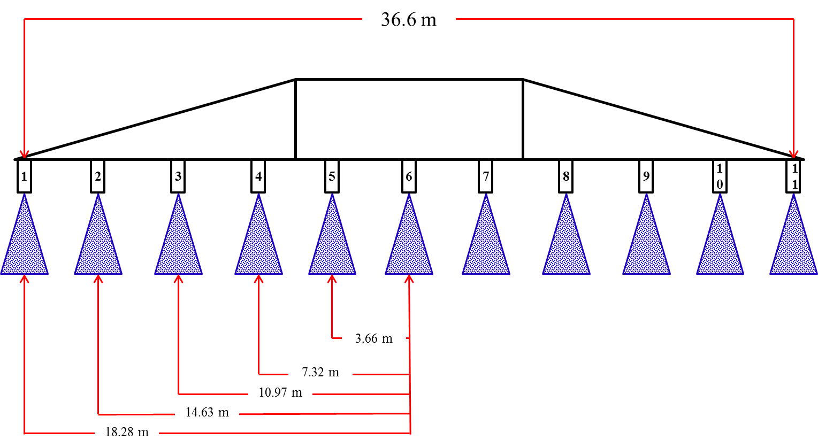
Application Error During Turns
OmniRow from Raven for planters
Pinpoint Control from Capstan Ag Systems
  Static tests with simulated turns and speed (12 mph).
  Application rate was 10 GPA

Slide 48
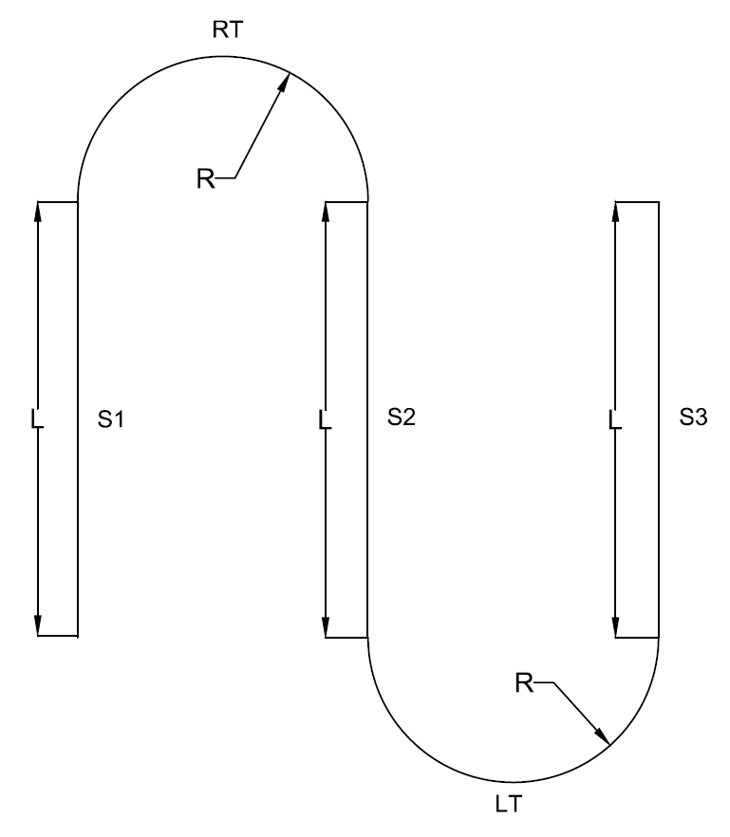
TCS Evaluation
Simulated Test Path
Measured and target nozzle flows for a 120 foot boom in left and right turns. The turn radius is 90 foot.

Slide 49
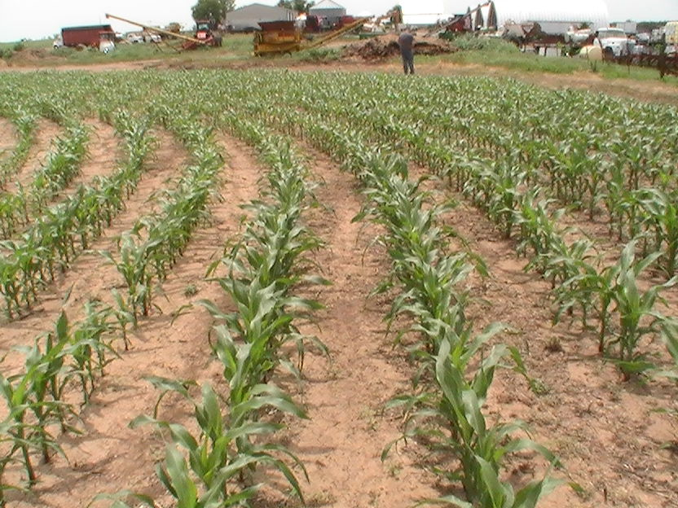
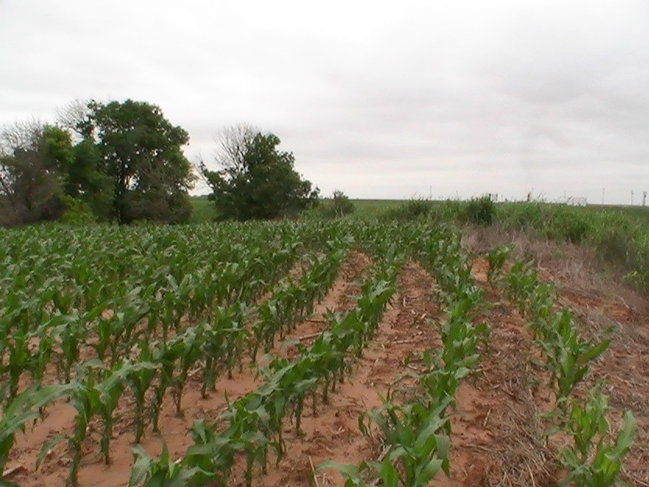
Population Variability

Slide 50
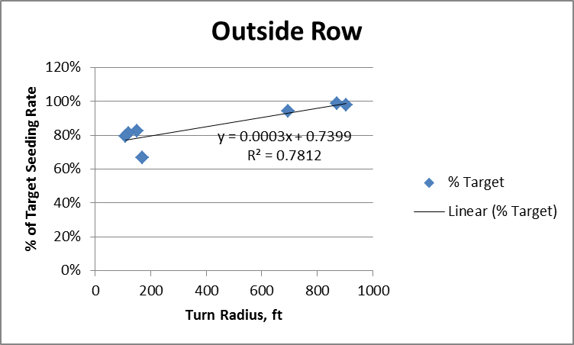
Relationship to Turn Radius

Slide 51
Questions
Randy Taylor
Randy.Taylor@okstate.edu
405-744-5277

