Slide 1





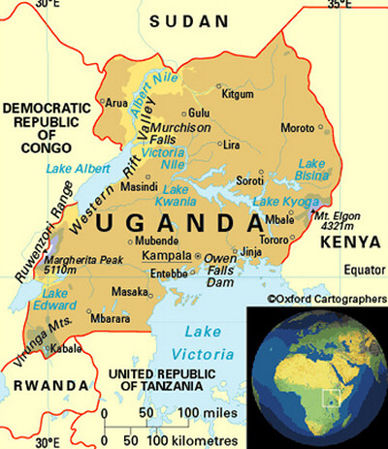
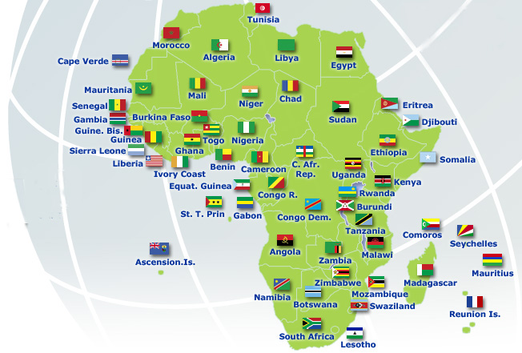
Precision Livestock Farming in Uganda
A Combined effort (St Jude Family Projects, NARO and The Communities)
the need to go digital

Slide 2
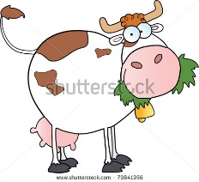
Future Livestock Farm Operations
-The last 20 years have increasingly emphasized animal health, welfare, food quality, choice, differentiation, consumer values in amongst Uganda farmers and those around the world.
-The race for Animal Protein in diets, It takes 2.0 pounds of corn to produce one pound of chicken, live weight, according to the National Chicken Council.
-It takes 2.6 pounds of corn to produce one pound of beef, live weight (includes bone, fat, etc.)
-National Pork Board says it takes 3.6 pounds of corn to produce one pound of pork, live weight.
-Next 30 will have increased food demand as an additional pressure due to the rapid increase in the World Populations.
-With lower than 3% farmers left in the USA, the trend of modern agriculture is seen on a decline.
-Increasing food demands in the World prompting strikes, demonstrations and insecurity.

Slide 3
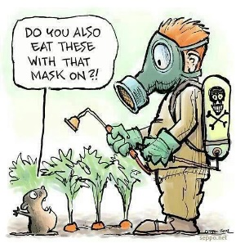
  -Larger farming operations will remain in business.
  -Narrower profit margins.
  -Increased feed, energy and labor costs.
  -Animals managed by fewer more technically skilled workers.
  -Greater degree of automation.
  -The Concept of recycling almost every thing on the farms, the integrated model, St Jude Farm Uganda.
  -Bridging the Farming digital divide.
  -Sensitizing people about Precision Livestock farming and benefits.
  -The believe in Renewable Energy and its benefits.
  Farm Big but mind the environment,(St Jude farm advise to farmers)
  Example Al Safi Dairy farm Riyadh Saudi Arabia, is the World’s largest dairy in the world with 37,000 heads of Holstein cattle, they supply milk to the entire world, lets ask our selves how have they managed to achieve this in the Desert?
  http://www.alfaisaliah.com/
  Answer: Its all about Smart Farming.
  I BELIVE IN LARGE SCALE ORGANIC FARMING – LETS REACH OUT

Slide 4
Farm information/Data
Unlimited on-farm data storage
  -Web based backup options
Faster computers allow more sophisticated on-farm and real time data processing
  -Integrated data management and decision support systems
Technologies adopted in larger industries (defense, consumer electronics) reduce costs for applications in smaller industries (agriculture)
Rampant increase in On-farm Software technologies especially large operations in Uganda viz Jesa farm Uganda, the need to go digital.
Record Keeping promoted amongst rural farmers in Uganda, using NARO provided laptops at the Village Model Units, these help farmers through providing cattle and other farm animals like pigs, poultry and goats and monitor progress and health of animals and how farmers have benefited.
Helping farmers analyze data and make well informed decisions.
Provision of market from the government for the produced milk and meat and other animal products, viz. eggs, pork etc. St Jude through MOP and Cooperatives.

Slide 5
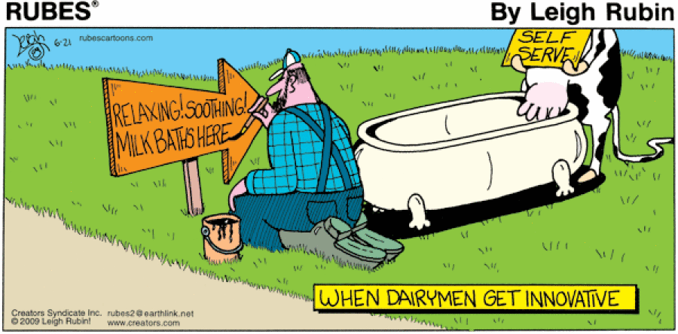
Details on the technology
Current farms can be ‘precise’
Is a continuous scale
Existing examples may include
  -Automatic out of parlour feeders
  -Pedometers (The device records how far, how often and how fast the cow is ambling around and sends regular updates to a computer. Because animals are know to become hyper active oestrus or when they are in season)
  -In-line electrical conductivity (used to detect clinical mastitis using in line electrical conductivity measured on line from the whole udder, e.g. the Jesa Farms Uganda) the collected data over time in milking is studied for every milking and if there is a deviation in the expected EC average readings then, a signal warning is given and due to that an indication of mastitis is confirmed.

Slide 6
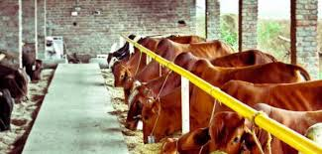
Key Elements
-Using technologies to measure physiological, behavioral, and production indicators
-Supplement the observational activities of skilled herdspersons
-Focus on health and performance at the cow level
-Optimize economic, social, and environmental farm performance.
-Make more timely and informed decisions

Slide 7
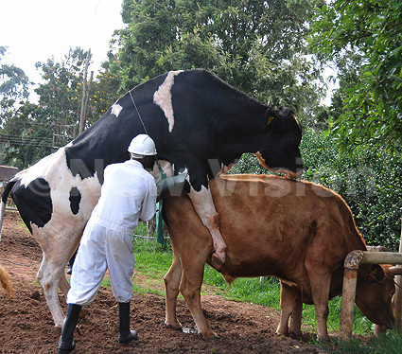
-Minimise medication (antibiotics) through preventive health.
-Pro-active animal health strategy
-Precision Dairy Farming is inherently an interdisciplinary field incorporating concepts of informatics, biostatistics, ethology, economics, animal breeding, animal husbandry, animal nutrition and process engineering

Slide 8
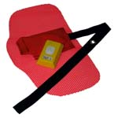
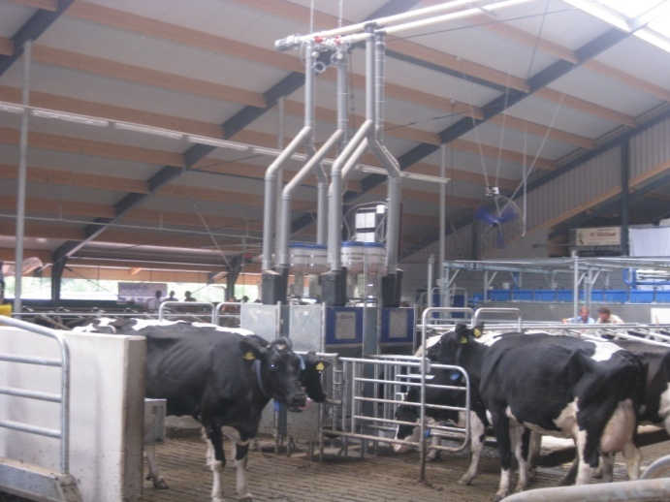
Examples of technologies
-Precision (individual) feeding
-Regular milk recording (yield and components)
-Pedometers (activity meters)
-Pressure plates (measuring the blood pressure)
-Milk conductivity indicators
-Automatic estrus detection
-Body weight
-Temperature

Slide 9
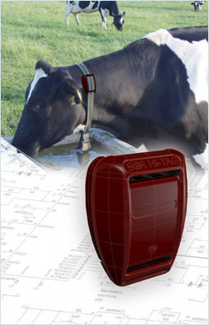

Recent or future technologies
-Lying behavior
-Ruminal pH
-Heart rate
-Global positioning systems
-Feeding behavior
-Blood analyses
-Respiration rates
-Rumination time
-Locomotion scoring using image analysis

Slide 10
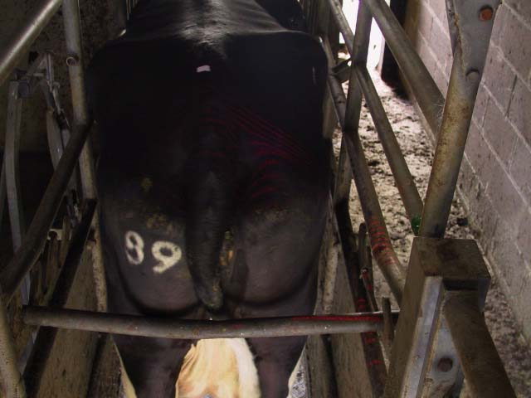
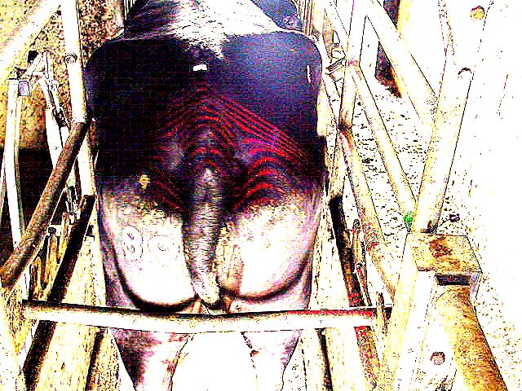
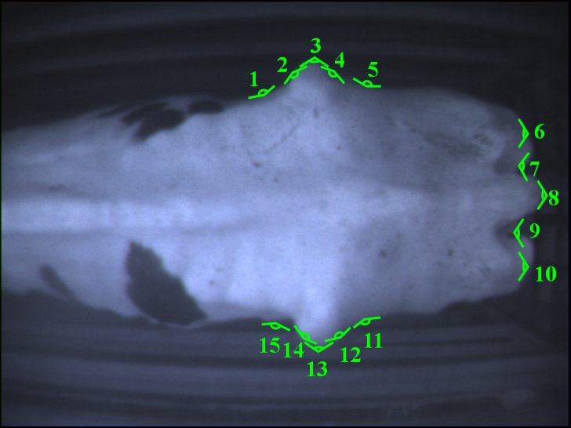
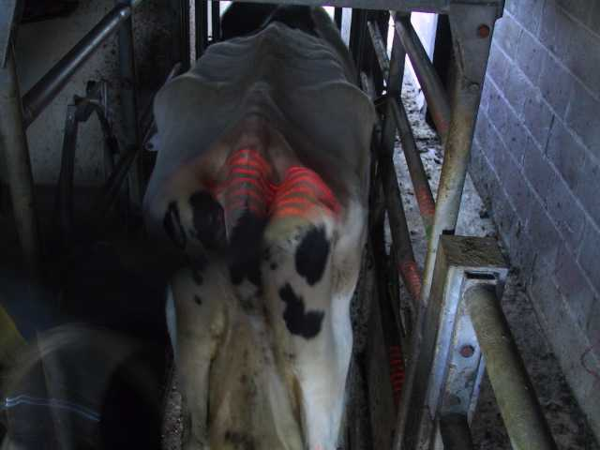
Automatic Condition Score
Animal’s general health condition and body is studied and based increase in body appearance, fat layers and reserves help in milk let down in the animal and general performance.

Slide 11
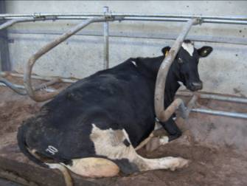
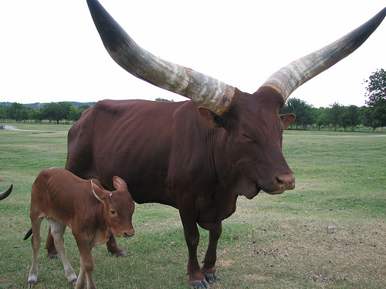
The Ice Tag Activity Monitor
On-farm evaluation of lying time:
  Identification of cows requiring attention (lameness, illness, estrus) through changes in patterns
  Assessment of facility functionality/cow comfort
  Potential metric to assess animal well-being

Slide 12
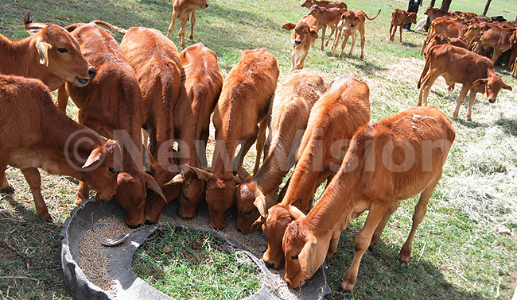
Health/oestrus (activity monitors)
Pregnancy (progesterone)
Image analysis for anatomical measurements
Milk fatty acid composition (spectra)
Stress levels (cortisol)
Environment gas levels (i.e. CO², NH³)
Air born pathogen levels
Pollutants
Its important to study the condition of animals on a commercial far, in order to maximize profits on farms.

Slide 13
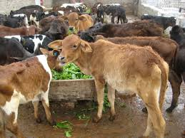
Genomics
Precision Dairy Farming/genomic selection synergies may lead to improvement in health traits
But, need enough high quality phenotypic data to calculate the SNP (single nucleoid polymorphism) effects
  Maybe contract certain farms to record data
  May have to pay for data
We base all this on Pedigree and Progeny testing of parents and off springs respectively comparing data before decisions are taken.

Slide 14
Reality Check
Many technologies are in infancy stage
  Promoted by technophiles
Not all technologies are good investments
  Economics must be examined
Sociological factors must be considered

Slide 15
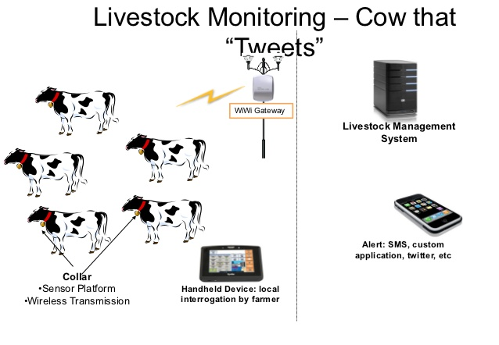
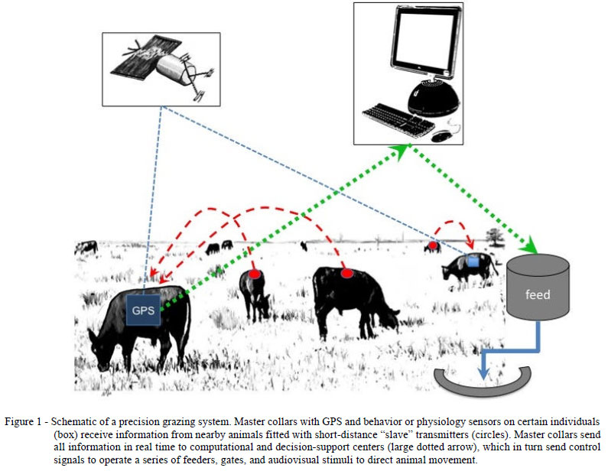
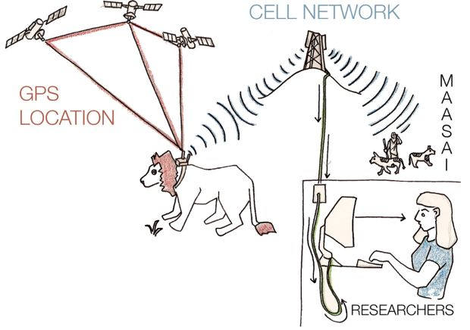

Slide 16
Conclusions
-Exciting technologies now available and more in development
-Technologies may have considerable impact on genetic evaluations
  Harvesting data
  Payments to record collectors
-Adoption rates affected by sociological factors and technology development strategies
-Will lead to bigger dairy herds but successful implementation relies on software to integrate all available information running on fault free hardware in a hostile environment
Thank You All for Your Time and Attention

Slide 17
Sources
St Jude Family Projects and Group of Companies (www.stjudefamilyprojects.org)
National Agricultural Research Organization (http://www.naro.go.ug/)
Buganda Kingdom Ministry of Agriculture and Natural Resources (http://www.buganda.or.ug/)
United Nations Food and Agricultural Organization (http://www.fao.org/)

