Slide 1
Remote Sensing for Site-Specific Crop Management
Chapter 8

Slide 2
Abstract
This chapter provides a brief overview of the development of remote sensing tools that are used to assess crop health. Today there are a wide variety of sensing options available to crop producers and researchers alike, which allow for close observation of the crop. Remote sensing information can be collected by unmanned aerial vehicles (UAVs), manned aircraft, and satellite platforms.

Slide 3
Definition of Remote Sensing
The coining of the term “remote sensing” goes back to a whitepaper prepared in the early 1960s by the staff of the Geography Branch, Office of Naval Research. Chief architect of that paper was Evelyn L. Pruitt, who was searching for terminology to enhance her discussion of a proposed major air–photo interpretation project. She was in search of a term that would include regions of the electromagnetic spectrum beyond the visible range, because she felt that it was in these nonvisible wavelengths that the future of interpretation seemed to lay. The term “aerial” was also too limited in view of the potential for viewing the Earth from space. Thus, the term “remote sensing” was delivered (Pruitt, 1979).
What exactly is “remote sensing”? Many individuals have attempted to describe the nature, scope, and meaning of the term (e.g., Fussell et al., 1986), but one representative definition suggests that it is “the measurement or acquisition of information of some property of an object or phenomenon, by a recording device that is not in physical contact with the object or phenomenon under study” (Colwell, 1983). This lengthy description can be simplified by recognizing that remote sensing consists of:

Slide 4
Definition of Remote Sensing
Technology and techniques (for data collection and sometimes mapping)
Data collection done by means of instrumentation (sensors)
Sensors carried on “platforms” (satellites, manned and unmanned aircraft)
Platforms positioned at a distance (i.e., noncontact, nondestructive recording, at distances ranging from a few meters to many thousands of kilometers)
Sensors operating in various parts of the electromagnetic spectrum (i.e., they make use of visible light, infrared energy, etc.)

Slide 5
Proximal sensing
“Proximal sensing” is very similar, with one exception; the sensors are positioned very close to the target, ranging from those in physical contact with the target to a few meters away. Proximal sensing includes investigators carrying instruments into the field for data collection (and deploying them in hand-held fashion), as well as sensors mounted on farm implements or other mechanical devices such as all-terrain vehicles.

Slide 6
A Brief History of Remote Sensing in Agriculture
Scientists have used aerial photographs to conduct soil and crop surveys . Most of such early work (e.g., 1920s and 1930s and later) involved general crop inventories that were conducted by USDA, NRCS.
The first Earth-resources-oriented satellites in the early 1970s, when it became possible to monitor agricultural lands over broad geographic areas.

Slide 7
Platforms: Aircraft or Satellites
A good synonym for the term “remote” might well be “distant.” But, just how far from the target must a sensor (and its platform) be in order for it to truly be considered “remote”? Scientists and resource managers make use of several different kinds of platforms, including unmanned aerial vehicles (i.e., drones), operating only a few meters above the Earth’s surface, piloted aircraft flying at hundreds to thousands of meters, and satellites operating at many thousands of kilometers above the terrestrial surface. All of these systems qualify as being “remote” from terrestrial targets.

Slide 9
Sensors: Imaging or Nonimaging
The sensors employed for data collection can be either imaging or nonimaging. An output of an imaging sensor is an aerial photograph (e.g., Fig. 8.1), although there are many different types of aerial photos that one can acquire ranging from black-and-white to color formats. Many aerial camera systems today allow collection of multispectral information which can be reproduced in a range of false-color formats (e.g., Fig. 8.2)

Slide 10
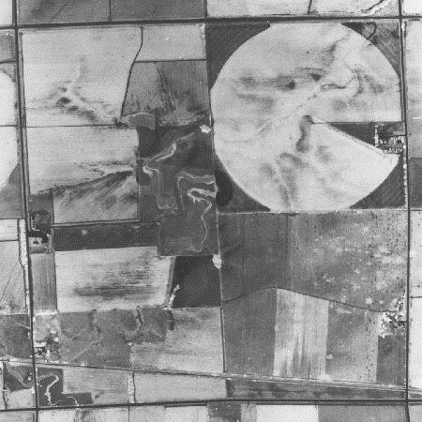
Fig. 8.1.
Panchromatic aerial image in Nebraska, University of Nebraska-Lincoln Conservation and Survey Division.

Slide 11
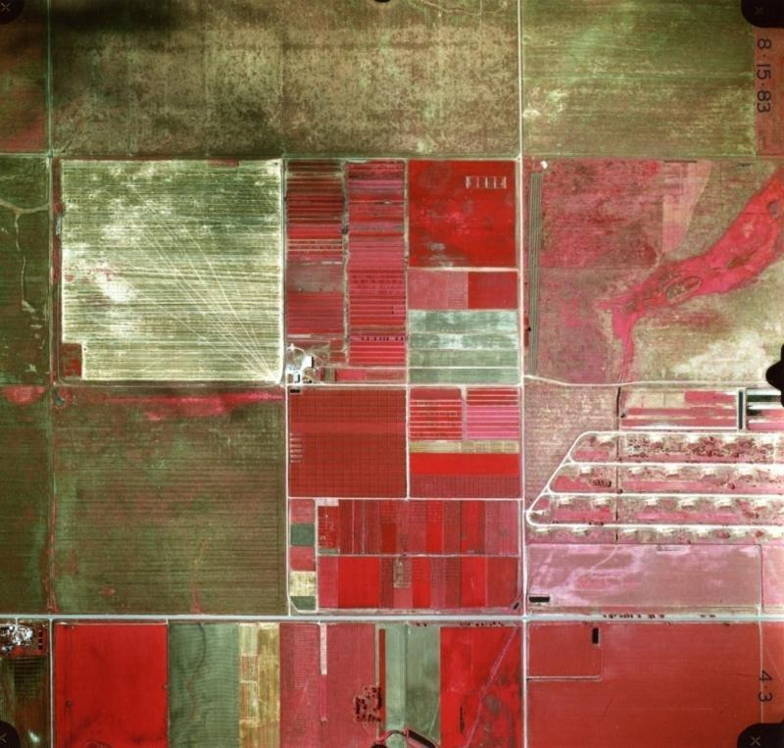
Fig. 8.2.
False-color near-infrared image, South Central Research Station, University of Nebraska, Clay County, NE. circa 1983. Center for Advanced Land Management Information Technologies (CALMIT), University of Nebraska-Lincoln.

Slide 12
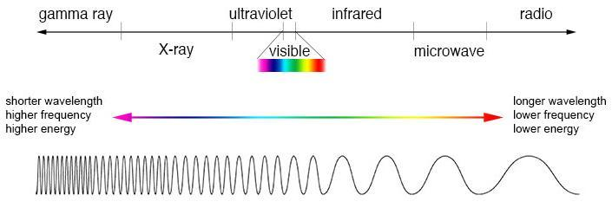
Fig. 8.3.
The electromagnetic spectrum (Source: NASA GSFC).

Slide 13
Nonimaging sensor
A nonimaging sensor, on the other hand, yields a totally different type of product, and it is most often deployed in a field setting (i.e., in situ or proximal), although it is possible to deploy such sensors in aircraft. Figure 8.4 is a “spectral profile” generated by a spectroradiometer, a device that provides both the intensity of reflectance at many different wavelengths (sometimes thousands) as well as the spectral distribution of the reflectance (i.e., how the total signal is apportioned, wavelength by wavelength). Such diagnostic curves are very important in understanding the physical basis for spectral response (more on that later).

Slide 14
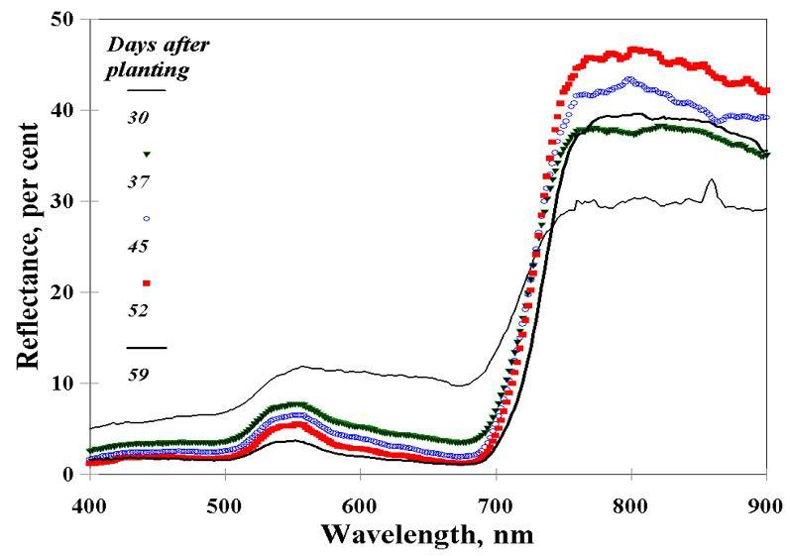
Fig. 8.4.
Corn canopy reflectance as influenced by days after planting (Center for Advanced Land Management Information Technologies [CALMIT], University of Nebraska-Lincoln).

Slide 15
Soil and crop reflectance

Slide 16
Sensors: Active or Passive
Sensors are classified as either passive or active. Passive sensors make use of energy that exists naturally in our environment; for example, sunlight. Ordinary digital cameras make use of reflected sunlight, with detectors that are sensitive to the blue, green, and red portions of the visible spectrum, to produce conventional color photographs. Thus, the digital camera clearly is a passive sensor. Other types of energy, such as heat, exist naturally in the environment, and can be sensed.

Slide 17
Sensors: Active or Passive
Active sensors, on the other hand, produce their own energy for sensing. Radar is a good example of an active sensor. Such systems, which operate in the microwave portion of the spectrum, generate thousands of tiny pulses per second, and those electronic pulses are reflected by ground targets at various levels of intensity. Those that are deflected and return from the target to the sensor system can be captured and used to produce an image of radar backscatter. The backscatter at various radar frequencies (i.e., wavelengths) from different terrestrial targets can studied in another way; they can be analyzed in a nonimaging manner to characterize a target based on their returns (Narayanan et al., 1992).

Slide 18
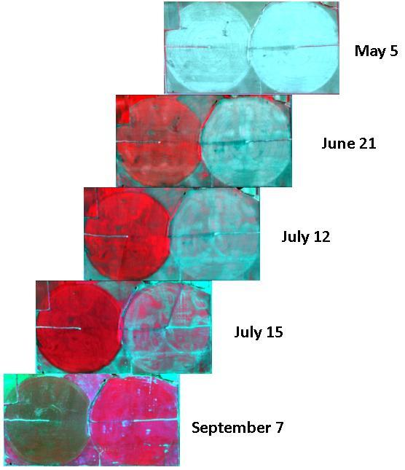
The same effect of Fig 8.4 can be translated to an image format. Figure 8.5 shows, by means of a “false-color composite of red, green and NIR bands,” views of an irrigated corn field (left column of circular pivots) compared with a field of irrigated soybeans (right column of circular pivots). Notice how the color patterns in both fields change over time, with the bright red tones being indicative of actively photosynthesizing green vegetation, and a strong signal in the near-infrared region.
Fig. 8.5.
False-color near-infrared comparison of corn (left field) and soybean (right field) canopies throughout the growing season (CALMIT AISA sensor system). In these images, red indicates more biomass, blue and green less biomass.

Slide 19
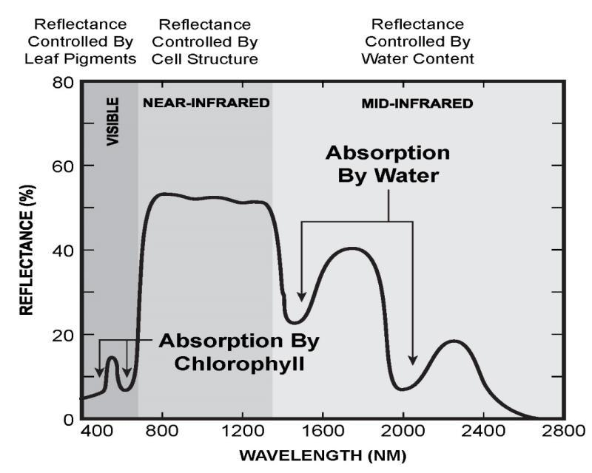
The Spectral Signature of Vegetation: What Does It Tell Us?
Fig. 8.6.
Primary factors influencing plant canopy reflectance.

Slide 20
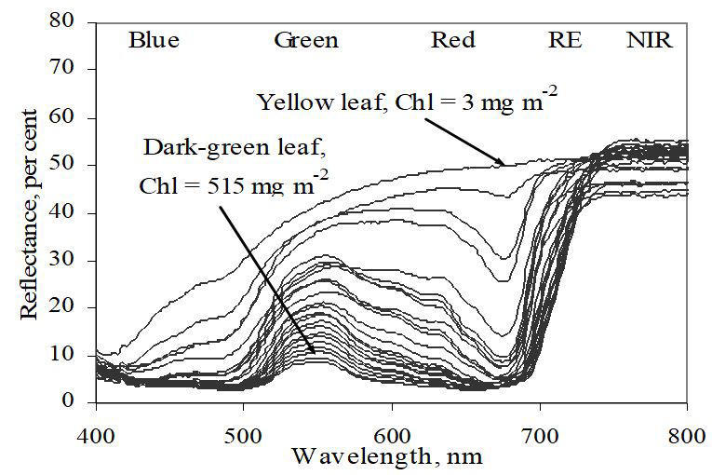
Figure 8.7 depicts a series of spectral profiles that illustrate the effect of increasing chlorophyll on the signal from grape leaves. The lines in the graph summarize chlorophyll densities ranging from a minimum of 3 mg m⁻² to a maximum pigment content of 515 mg m⁻². The main point here is that increasing chlorophyll causes a pronounced (and orderly) increase in absorption (i.e., a decrease in reflectance) in the visible region of the spectrum. The effect is especially dramatic in the red region.
Fig. 8.7.
Effects of grape leaf chlorophyll content on canopy reflectance (Steele et al., 2008).

Slide 21
Vegetation Indices
As mentioned above, reflectance in specific wavelength regions is related to various plant attributes: plant pigments influence reflectance in visible regions, cell structure and canopy architecture influence reflectance in near-infrared regions, and leaf water content influences reflectance in mid-infrared regions. By evaluating reflectance in multiple wavelength regions, one can begin to infer specific properties of plants, in particular if plants are stressed. Scientists use the concept of a vegetation index (VI) to explore the relationships of reflectance in two or more spectral regions on plant properties, combining information from multiple wavebands into a single value. More than 150 vegetation indices have been developed, often with assessment of specific plant properties in mind. The most widely known VI is the Normalized Difference Vegetation Index (NDVI) (Rouse et al., 1974). The Normalized Difference Vegetation Index uses the relationship of reflectance in visible (normally red) and near-infrared regions, using the formula:
Values for NDVI will range between -1.0 and +1.0.

Slide 23
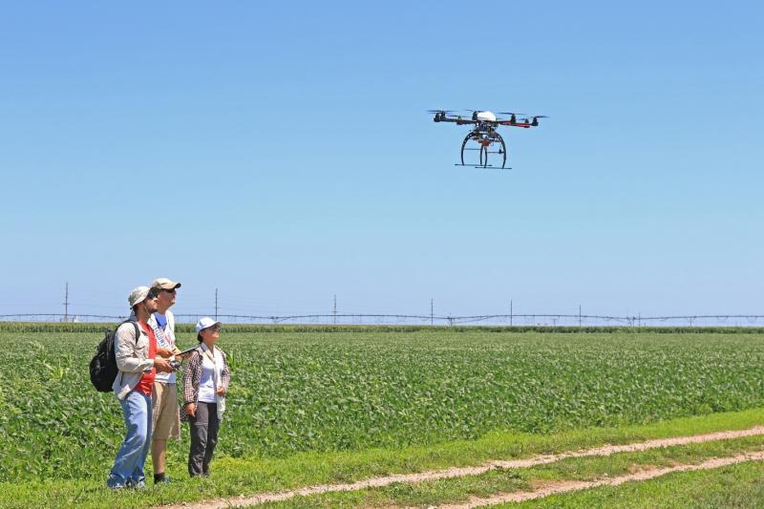
Ag Applications
Nutrient
Water
IPM
Research
Figure 8.8.
Use of a multirotor UAS with a 5 band multispectral sensor for crop stress research in Nebraska.

Slide 24
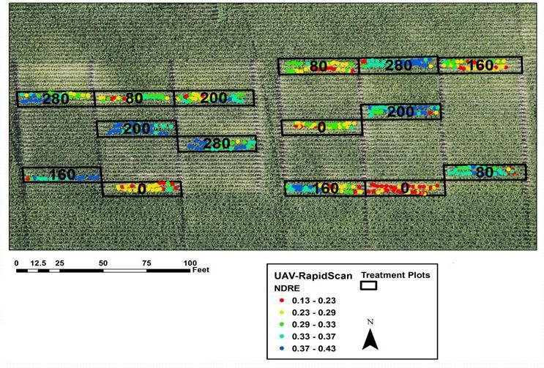
Fig. 8.9.
Use of a UAS-mounted multispectral active canopy sensor to assess nitrogen status of corn. Background image is from a UAS-mounted high resolution standard camera (RGB). Normalized difference vegetation index red edge (NDRE) values superimposed over the background image were collected with a UAS-mounted active sensor operated at a distance approximately 1.5 m over the canopy. Numbers within each treatment plot are fertilizer nitrogen rate in pounds per acre. (University of Nebraska-Lincoln).

Slide 25
Opportunities and Limitations
There are several challenges to accurate crop management using remote sensing technologies. One drawback to satellite platforms, and to a lesser extent manned aircraft, has been the time delay between data acquisition and delivery to the operator, which can be several days. If a satellite revisit time is once every five to six days or greater, and clouds periodically cover the area of interest, timely sensing and intervention can be difficult. Aerial sensing can be scheduled around cloud cover, but still scheduling of manned aircraft can be an issue. Unmanned aerial systems have greater flexibility in that they can be more easily scheduled to optimize data collection. However, their ability to cover larger areas is more limited than satellite or manned aircraft. It is likely that UAS systems will become more widely used in agriculture in the future, allowing greater temporal density in remote sensed data than has been cost effective with satellite or manned aerial platforms. Regardless of the platform, there is a need for research that will separate sources of crop stress and directly estimate nutrient deficiencies without the use of reference treatments within the field (Mulla, 2013).

Slide 26
Opportunities and Limitations
Remotely sensed information can be very useful to identify areas with issues within fields. Accurately identifying the cause of such issues with spectral reflectance information is challenging, and the subject of current research. A common approach with current technologies is to use remote sensing methods with high temporal and spatial resolution to identify anomalous areas of fields, then use ground scouting to identify the underlying cause. Maps of problem areas developed from remote sensed imagery can then be used to direct spatial treatment to address issues. It is likely there will be continued integration between remote sensing, proximal sensing, vehicle-mounted and in situ sensing platforms. Management systems will more fully integrate sensor information from these various platforms to provide timely, and increasingly more automated, control of inputs such as fertilizer, irrigation, and pesticides.

Slide 27
Videos
Video 8.1. What crop management decisions are best served by remote sensing? http://bit.ly/crop-management-remote-sensing
Video 8.2. How can farmers use reflectance information in making decisions? http://bit.ly/reflectance-information
Video 8.3. What opportunities does remote sensing create? http://bit.ly/remote-sensing-opportunities
Video 8.4. How is remote sensing used in cotton production? http://bit.ly/remote-sensing-NZ
Video 8.5. How is remote sensing used in New Zealand? http://bit.ly/cotton-production
Video 8.6. How is remote sensing used in aerial application? http://bit.ly/aerial-application

Slide 28
Study Questions
What portion of the electromagnetic spectrum constitutes the visible range (to the human eye)?
Provide a definition of ‘vegetation index’.
Differentiate ‘remote’ sensing from ‘proximal’ sensing.
A(n) ___________ sensor produces its own energy for sensing.
What is the principle wavelength range for thermal infrared sensing?
Which remote sensing platform is best suited to coverage of many square miles on a weekly basis?
The following sensors have different _____________ resolution: one sensor detects in the wavelength range of 700–800 nm, another sensor detects in the wavelength range of 700–720 nm.
A healthy plant typically reflects more in the ___________ visible waveband, and absorbs more in the __________ visible waveband and the ____________ visible waveband.
The most commonly known vegetation index, the Normalized Difference Vegetation Index, uses reflectance in __________ and __________ wavebands.
Which remote sensing platform can be readily deployed on short notice for crop scouting?

