Slide 1
Soil Variability and Fertility Management
Chapter 6

Slide 2
Among the numerous challenges of crop production is the management of soil nutrients, soil moisture content and crop and soil variability. One of the first problems that was addressed in precision agriculture was site-specific nutrient management (Pierce and Nowak, 1999). Since then, advancements have been made in the creation of mathematical approaches that can be used to help match fertilizer recommendations to soil and crop productivity. This chapter will review sources of soil variability and current management tools and techniques to help growers manage soil variability.

Slide 3
Sources of Soil Variability
Variability can result from many factors, including those from inherent differences produced during soil development, the result of erosion following tillage, and systematic errors from uneven application of fertilizers and manures (Franzen, 2011). Variability is discussed in more detail in Chapter 2 (Kitchen and Clay, 2018).

Slide 4
General Soil Sampling Basics
Soil sampling is variable in three dimensions
There is two-dimensional variability that is most often considered: forward, backward, and side to side.
But there is also vertical variability.
Tillage and lack there-of complicates the Vertical.
Banding, No matter depth highly complicates Horizontal.
Starter for row crops complicates less.

Slide 5
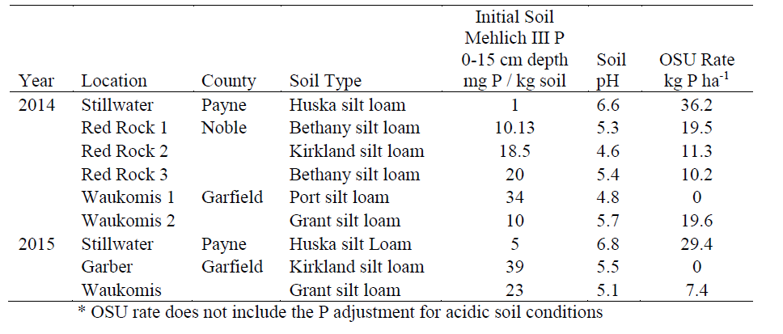
Watkins et al.
Minimum of 10 years in a no-till management system.

Slide 6
Watkins et al.

Slide 7
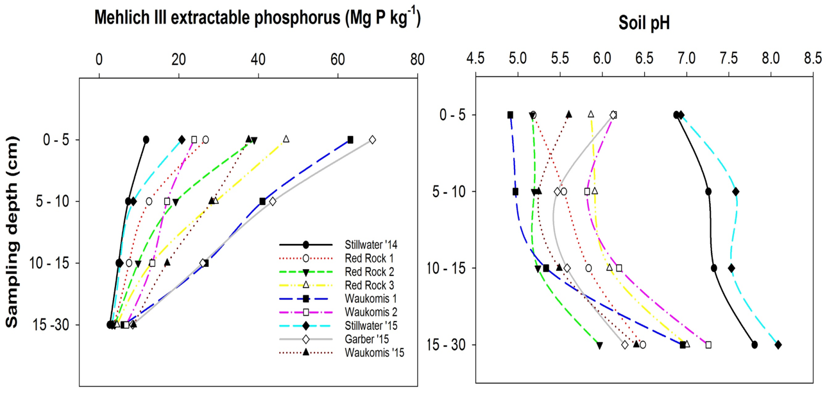
Sampling

Slide 8
9 On farm No-till Wheat P Response Studies
Watkins et al.
Year | Location | Sampling Depth | Mehlich III Extractable P |  |  | Soil pH
 |  |  | Min | Max | Ave | Min | Max | Ave
 |  | cm | Mg P kg⁻¹
2014 | Stillwater | 0 -5 | 2.2 | 41.1 | 11.8 | 5.9 | 8.1 | 6.9
 |  | 5 -10 | 2.9 | 43.3 | 7.3 | 6.3 | 8.2 | 7.3
 |  | 10 -15 | 2.3 | 12.7 | 4.9 | 6.2 | 5.2 | 7.3
 |  | 15 -30 | 1.5 | 5.3 | 2.7 | 6.6 | 9.1 | 7.8

Slide 9
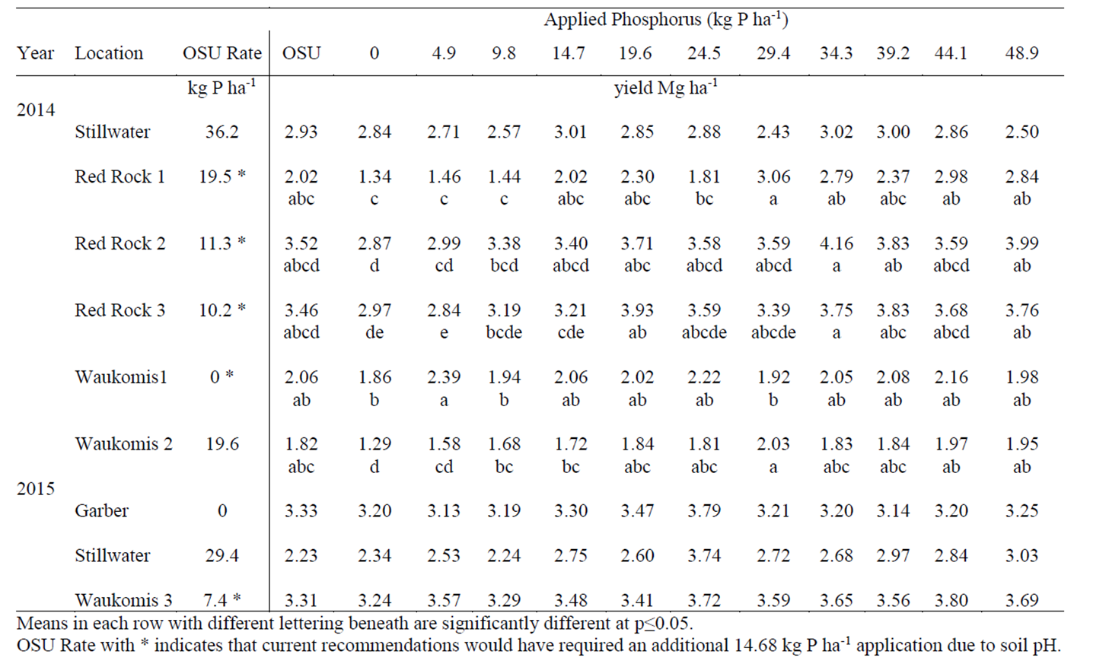
Watkins et al.

Slide 10
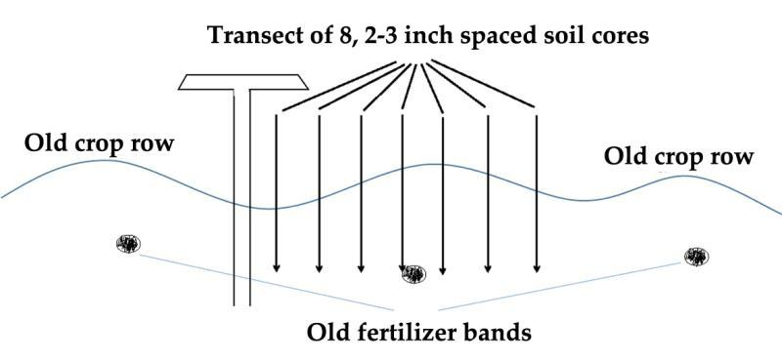
Sampling in Banded Fields.
Fig. 6.1.
Sampling strategy for soil P and K in a transect perpendicular to row direction spanning at least one complete row. Sample depth could be 6 to 8 inches depending on the sampling depth basis of regional, state, province or state P and K recommendations.

Slide 11


How we Do Nitrogen – Corn
Option 1:
Well, ___________ (fill in name) did it this way.
Option 2:
What did __________ (fill in name of guy down the road that grows good corn) do?

Slide 12
How N is done.

Slide 13
Source | Location | Years | Time period | † (0-N) Yield Range | ‡ High N Yield Range |  | *Optimum N rate kg ha⁻¹
 |  |  |  | ---- Mg ha⁻¹ ---- |  |  | Min | Max | Avg. | SD
Bundy et al. (2011) | WI | 21 | 1958-1983 | 1.6-7.6 |  | 4.3-8.8 | 50 | 233 | 130 | 53
Bundy et al. (2011) | WI | 9 | 1984-1997 | 2.7-5.6 |  | 5.7-9.96 | 58 | 235 | 179 | 51
Mallarino and Torres (2006) | IA | 20 | 1979-2003 | 0.8-5.9 |  | 5.1-12.4 | 81 | 237 | 165 | 49
Mallarino and Torres (2006) | IA | 14 | 1985-2010 | 1.4-6.2 |  | 5.3-12.8 | 134 | 239 | 197 | 32
Varvel et al. (2007) | NE | 5 | 1995-2005 | 6.6-10.9 |  | 10.4-13.3 | 73 | 193 | 131 | 49
Jokela et al. (1989) Carroll | MN | 3 | 1982-1984 | 5.5-7.3 |  | 7.1-9.1 | 5 | 131 | 84 | 69
Jokela et al. (1989) Webster | MN | 3 | 1982-1984 | 1.7-5.6 |  | 1.8-8.7 | 70 | 113 | 91 | 21
Fenster et al. (1976) Waseca | MN | 5 | 1970-1975 | 3.2-7.4 |  | 7.1-10.6 | 60 | 199 | 135 | 50
Fenster et al. (1976) Martin A | MN | 7 | 1970-1976 | 3.8-8.2 |  | 4.0-9.6 | 23 | 126 | 69 | 36
Fenster et al. (1976) Martin B | MN | 6 | 1971-1976 | 6.2-11.3 |  | 6.2-12.0 | 0 | 37 | 18 | 15
Al Kaisi et al. (2003) | CO | 3 | 1998-2000 | 5.6-10.2 |  | 8.3-10.8 | 66 | 111 | 91 | 23
Ismail et al. (1994) NT | KY | 20 | 1998-2000 | 2.1-7.4 |  | 5.2-10.9 | 35 | 230 | 128 | 46
Ismail et al. (1994) CT | KY | 20 | 1970-1990 | 1.9-9.5 |  | 3.5-10.4 | 0 | 203 | 98 | 52
Rice et al. (1986) NT | KY | 15 | 1970-1985 | 3.1-4.9 |  | 5.7-9.2 | 102 | 178 | 144 | 30
Rice et al. (1986) CT | KY | 15 | 1970-1985 | 1.9-6.1 |  | 5.0-8.8 | 69 | 204 | 124 | 47
Stecker et al. (1993) Columbia | MO | 3 | 1988-1990 | 3.3-5.6 |  | 6.0-10.1 | 99 | 194 | 153 | 49
Stecker et al. (1993) Novelty | MO | 3 | 1988-1990 | 4.5-7.2 |  | 6.7-9.9 | 45 | 182 | 103 | 71
Stecker et al. (1993) Corning | MO | 2 | 1989-1990 | 5.0-6.0 |  | 8.2-8.5 | 90 | 117 | 104 | 20
Peterson et al. (1989) | NE | 4 | 1983-1986 | 2.1-6.4 |  | 3.9-10.0 | 11 | 218 | 104 | 88
Eck (1982) | TX | 2 | 1977-1978 | 2.7-4.4 |  | 5.6-5.9 | 59 | 116 | 88 | 40
Shapiro et al. (2006) RS 51cm | NE | 3 | 1996-1998 | 6.2-8.9 |  | 9.4-11.1 | 69 | 96 | 83 | 13
Shapiro et al. (2006) RS 76cm | NE | 3 | 1996-1998 | 5.0-8.9 |  | 7.1-11.0 | 13 | 114 | 75 | 54
Meisinger et al. (1985) MT | MD | 4 | 1974-1977 | 1.8-2.6 |  | 5.8-8.2 | 127 | 233 | 183 | 45
Meisinger et al. (1985) PT | MD | 4 | 1974-1977 | 2.7-4.2 |  | 5.1-8.1 | 36 | 196 | 142 | 75
Gehl et al. (2005) Rossville | KS | 2 | 2001-2002 | 6.4-7.9 |  | 11.3-12.6 | 182 | 204 | 193 | 15
Gehl et al. (2005) Scandia | KS | 2 | 2001-2002 | 2.7-7.4 |  | 3.8-11.5 | 51 | 160 | 105 | 77
Total |  | 198 |  |  |  | Average | 62 | 173 | 120 | 45
 |  |  |  |  |  | SD | 44 | 55 | 43 | 20

Slide 14
Nitrogen in the Crop - EONR
Source | Location | Years | Time period | † (0-N) Yield Range | ‡ High N Yield Range | *Optimum N rate kg ha⁻¹
 |  |  |  | ---- Mg ha⁻¹ ---- |  | Min | Max | Avg. | SD
Mallarino and Torres (2006) | IA | 14 | 1985-2010 | 1.4-6.2 | 5.3-12.8 | 134 | 239 | 197 | 32
Varvel et al. (2007) | NE | 5 | 1995-2005 | 6.6-10.9 | 10.4-13.3 | 73 | 193 | 131 | 49
Jokela et al. (1989) Carroll | MN | 3 | 1982-1984 | 5.5-7.3 | 7.1-9.1 | 5 | 131 | 84 | 69
Jokela et al. (1989) Webster | MN | 3 | 1982-1984 | 1.7-5.6 | 1.8-8.7 | 70 | 113 | 91 | 21
Fenster et al. (1976) Waseca | MN | 5 | 1970-1975 | 3.2-7.4 | 7.1-10.6 | 60 | 199 | 135 | 50
Fenster et al. (1976) Martin A | MN | 7 | 1970-1976 | 3.8-8.2 | 4.0-9.6 | 23 | 126 | 69 | 36
Fenster et al. (1976) Martin B | MN | 6 | 1971-1976 | 6.2-11.3 | 6.2-12.0 | 0 | 37 | 18 | 15
Shapiro et al. (2006) RS 51cm | NE | 3 | 1996-1998 | 6.2-8.9 | 9.4-11.1 | 69 | 96 | 83 | 13
Shapiro et al. (2006) RS 76cm | NE | 3 | 1996-1998 | 5.0-8.9 | 7.1-11.0 | 13 | 114 | 75 | 54
Gehl et al. (2005) Rossville | KS | 2 | 2001-2002 | 6.4-7.9 | 11.3-12.6 | 182 | 204 | 193 | 15
Gehl et al. (2005) Scandia | KS | 2 | 2001-2002 | 2.7-7.4 | 3.8-11.5 | 51 | 160 | 105 | 77

Slide 15
Stanford Equation

Slide 16
Stanford Equation

Slide 17
Theoretical Equation

Slide 18
Nitrogen in the Crop - EONR
1.67 1.58 .51 .77 1.14 1.36 3.22 2.22 1.33 1.5 1.4
Average of 68 lbs with 49 BPA, 1.5 lbs N per bushel

Slide 19
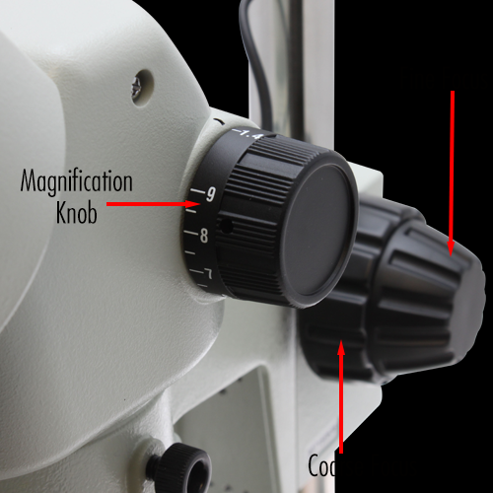
Fine and Course Control
Fine Control
Making high resolution decisions using low resolution recs.
Recommendation maps are at < 1 acre resolution and critical value that represents a whole state.
How Precise is that.
Course Control

Slide 20
Where is the opportunity
N-Crop: Is the yield Temporally Variable? Spatially Variable?
N-Soil: Do you have 2% OM and inconsistent weather?
E-Fert - is your texture or landscape spatially variable?
Can you adjust based on Management.

Slide 21
How we Do Phosphorus
Soil Testing was the basis
Determine immediately and potentially available P.
Relate back to Correlation Calibration work. (50s-60s)
“Critical” Values Est.

Slide 22
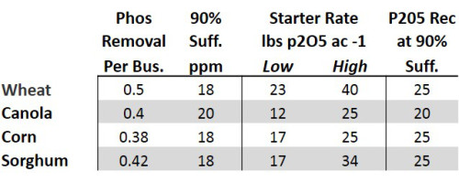
How we Do Phosphorus Recs
Sufficiency program
Feed the Plant
Intended to estimate the long-term average amount of fertilizer P required to, on average, provide optimum economic return in the year of application. There is little consideration for future soil test values

Slide 23
How we Do Phosphorus Recs
Build-Maintain (Replacement)
Apply enough P to or K to build soil test values to a target soil test value over a planned timeframe (e.g. 4-8 years), then maintain based on crop removal and soil test levels
NOT intended to provide optimum economic returns in a given year, but minimize the probability the P or K will limit crop yields while providing for near maximum yield potential
Crop | Harvest unit | P in yield
Corn | Bushel | .38
Soybean | Bushel | .8
Wheat | Bushel | .5

Slide 24
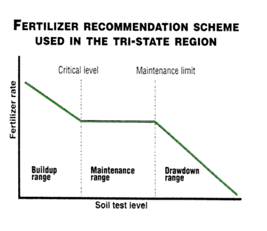
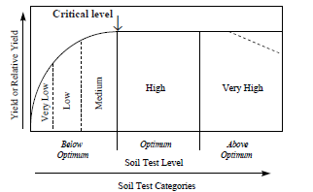
How we Do Phosphorus Recs
Build-Maintain (Replacement)
Sounds good and makes sense right.
If we are using this approach.
Does rate matter.
Build-up maintain fertilizer scheme suggested by the Ohio State University.
Nutrient response curve based on soil test, Rutgers Cooperative Extension.

Slide 25
Understanding Crop Response to Fertilizer Low Soil Test Levels
Low yields without additional fertilizer
EOR range is narrow
Optimum rate is minimally affected by grain:nutrient price ratio

Slide 26
Understanding Crop Response to Fertilizer Medium Soil Test Levels
Expected yield without fertilizer is higher
Range of potentially optimal rates is wider
In a single-year decision framework, EOR is very sensitive to grain:nutrient price ratio
As price ratio↓ EOR ↑

Slide 27
Understanding Crop Response to Fertilizer High Soil Test Levels
No or minimal response to added fertilizer

Slide 29
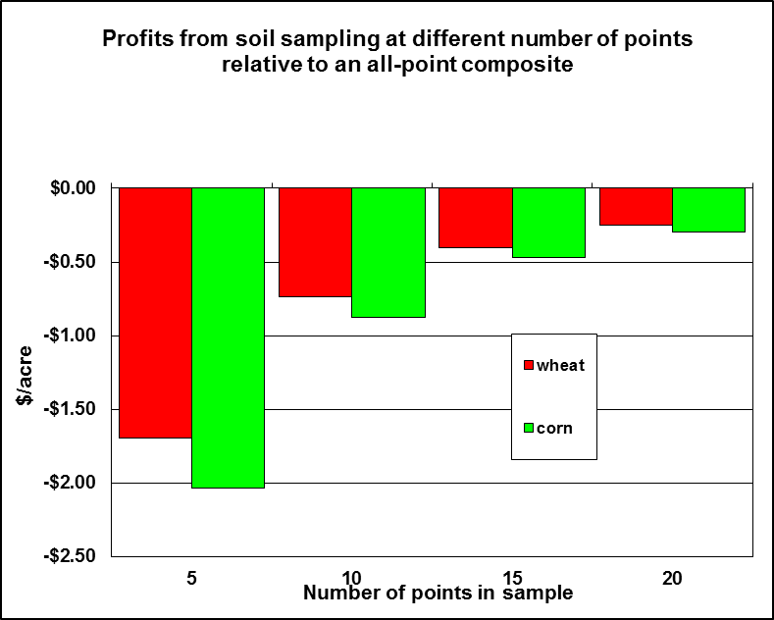
Economics of Accuracy

Slide 30
How we Do VRT Phosphorus Recs
How is it done?
Soil : Yield : Soil x Yield: Yield : Soil
Grid/Zone Sample, Yield Goal 3-5 yr
Grid/Zone, Multi Year Yield, 3 yr
Grid/Zone, Update Yield each year.

Slide 31
How we Do VRT Phosphorus Recs
Equation for soils below optimum is:
P Rec = (Optimum P – Observed P) *16 / build years + Crop Removal
For soils test in the optimum range:
Prec = Crop Removal
For Soils in High Range
Prec = Crop Removal *(((Optimum P level + 12.5) – observed P)/7.5)
This gradually tapers the rec to 0 once we are 12.5 ppm above optimum
Optimum Range is 22.5-27.5 ppm for Row Crops , 20-25ppm for cool season grass and similar, 15-20ppm for Warm Season grass and similar

Slide 32
How we Do VRT Phosphorus Recs

Slide 33
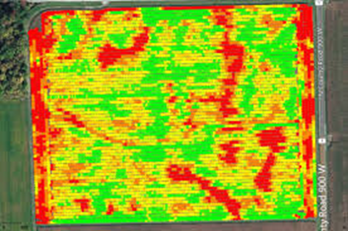
How we Do VRT Phosphorus Recs
Likelihood of VRT based on Sufficiency being off is high.
Interpolation of P based on grid is a stretch.
Yield monitor data has a higher resolution of positional accuracy.
Current VRT using a Course Knob to adjust P.
If replacement rates are used soil testing is essential

Slide 34
Original Soil Development
The five soil forming factors (Jenny, 1941) are parent material, vegetation, climate, topography and time.
PM- Internal drainage, deep acidity,
In the coastal plains of the eastern United States, the development of the present coastline has resulted in swirling patterns of sands of different silt and clay content (Duffera et al., 2007). Soils with less silt and clay are more susceptible to mid-season drought, while those with greater silt and clay content are more resistant to drought, due to their greater water-holding capacity.

Slide 35
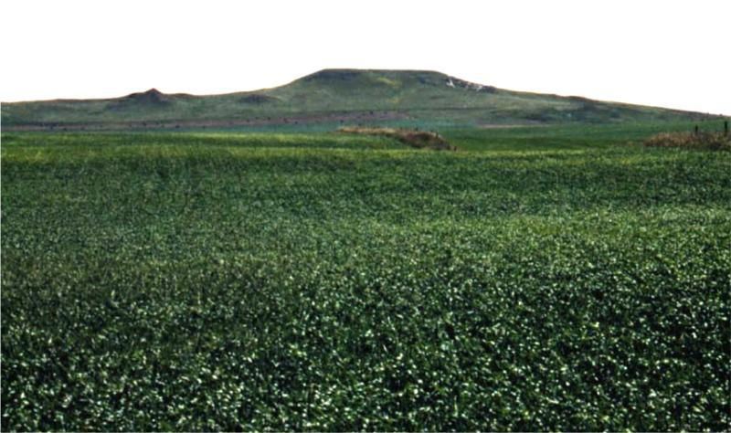
Parent material
In western North Dakota, for example, different soil textures within a field are present at different elevations due to layers of sandstone or siltstone (Fig. 6.2). A soil originating from sandstone has less available water when compared with a soil originating from a siltstone.
Fig. 6.2. Landscape in western North Dakota near Hettinger. Soils within a field could be the result of weathering more than one sedimentary parent material.

Slide 36
Salinity
In some soils, areas of high sodium, or sodic, soils are present. The sodium may originate from sodium-bearing rocks, such as sodium feldspars in the parental loess materials in south Illinois, or from shales in North Dakota and South Dakota
In the area west of Grand Forks, ND, some sodium-affected soils are the result of salty artesian systems from deep underground ancient sea deposits
Excessive soil sodium results in a randomization of the soil clays that greatly reduce water percolation and crop rooting depth. In lowsodium, higher-calcium soils, clays tend to bind together in regularly structured micro- and macroaggregates.

Slide 37
Erosion
In areas to the east of the North American Great Plains, water erosion is a major factor impacting long-term sustainability.
In shoulder areas and ridge tops, much if not all of the original top soil has been lost over time. In valley floors, depressions, and toe slopes, some of the A horizon has been deposited.
Productivity of hilltops and slopes is low compared to depressions, mostly due to the lack of topsoil, which results in increased crusting, lower water holding capacity, and surface layer presence of high lime, which was originally capped with high organic matter soils at the surface, but are now gone and more susceptible to conditions such as iron deficiency chlorosis and water stress

Slide 38
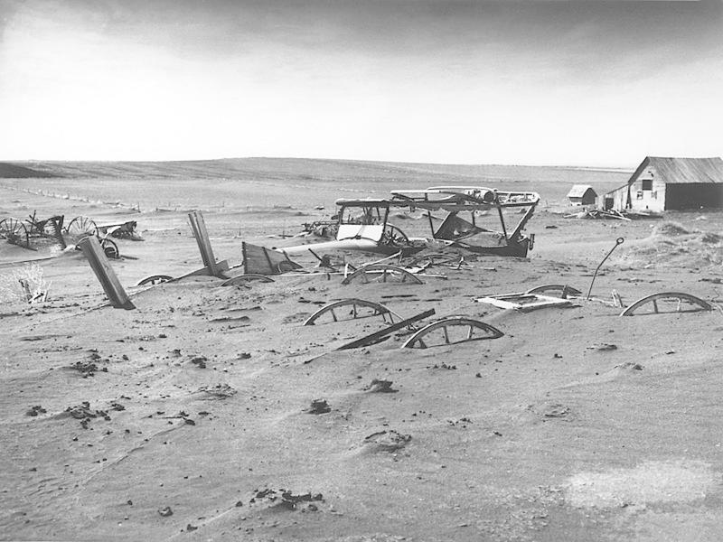
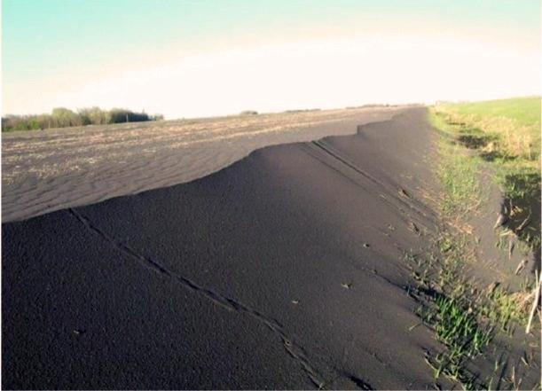
Fig. 6.3. A wagon in South Dakota, 1934, nearly covered with eroded topsoil (Source: USDA). Aftermath of topsoil erosion due to wind, northern Red River Valley, North Dakota early 1990s. A. C. Cattanach, American Crystal Sugar, retired, image used with permission.

Slide 39
Systematic Variability
Application of fertilizers and manures can result in systematic variability (Fig. 6.4). Systematic variability is non-natural soil variability due to the activities of human. Examples of systematic variability are application of fertilizer and/ or manure either too close, resulting in increased nutrient content in strips in the direction of travel, and application of fertilizer and/or manure too far between passes, leaving untreated strips of soil between wider strips of applied nutrients

Slide 40
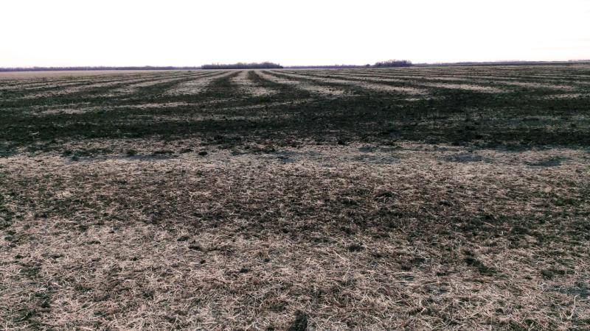
Systematic Variability
Fig. 6.4. Manure misapplication northwest of Fargo, ND.

Slide 41
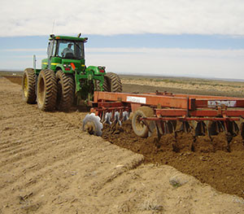
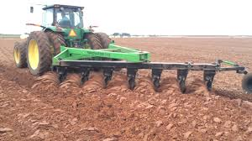
Systematic Variability

Slide 42
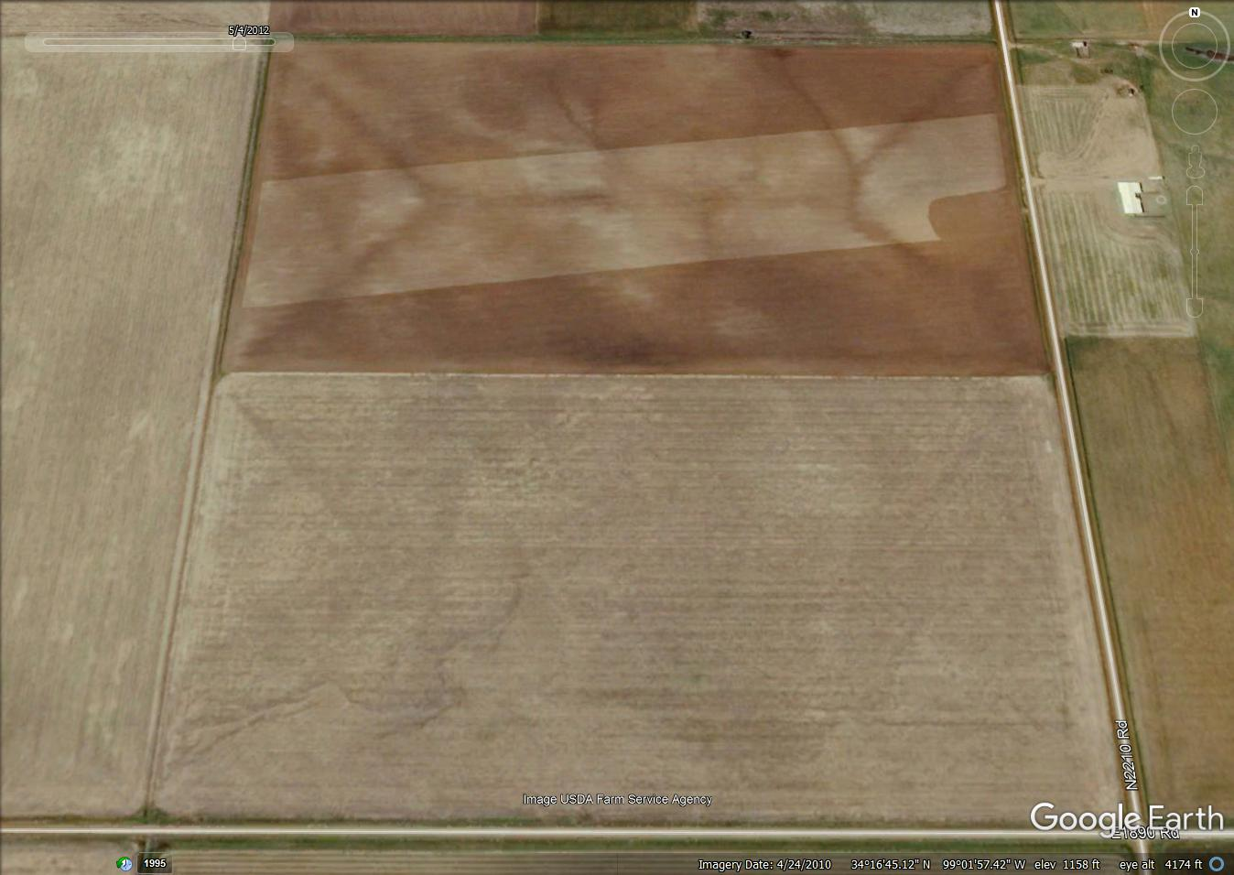
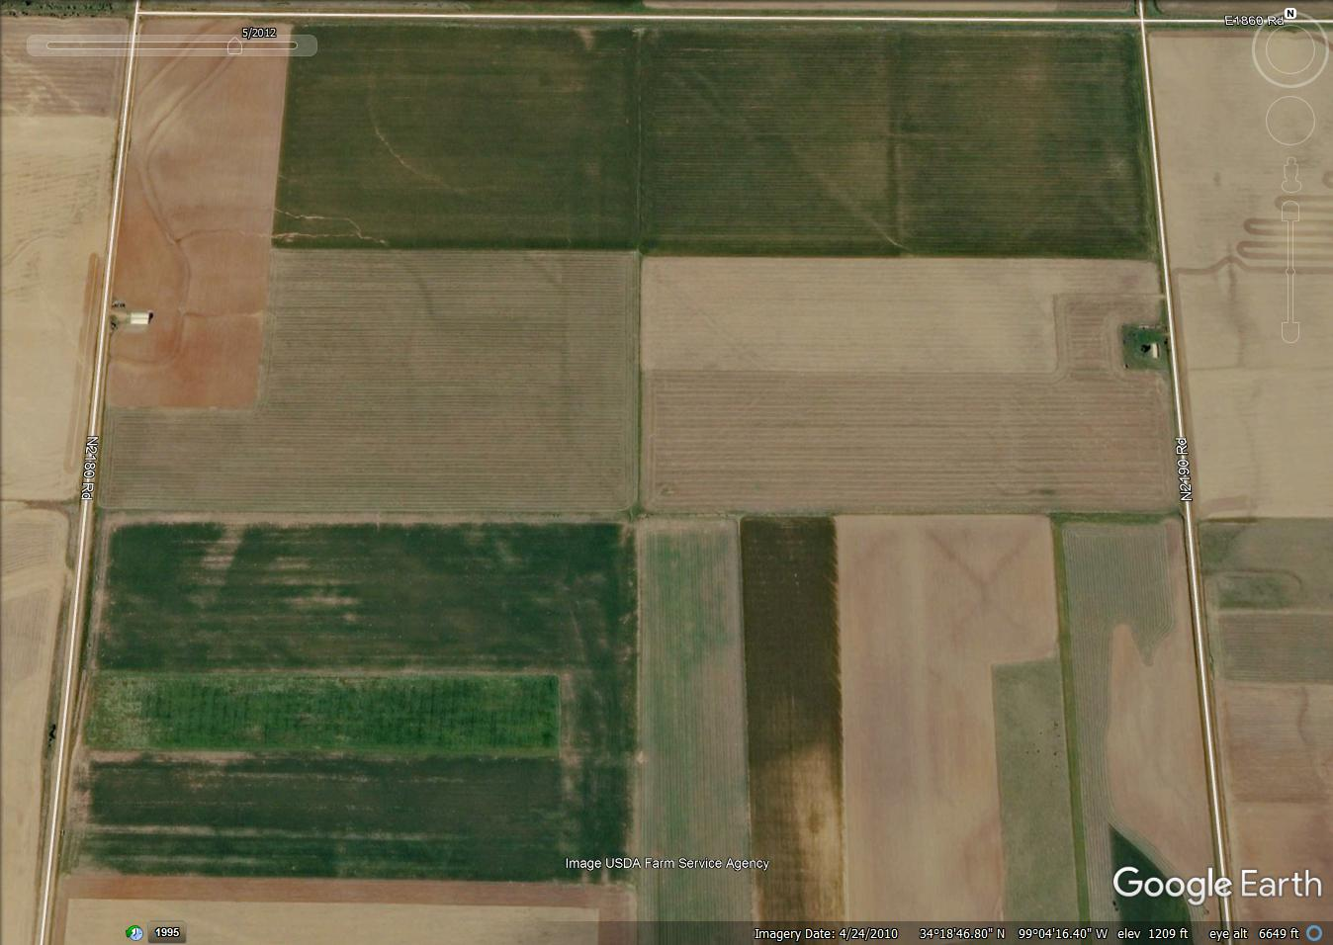

Slide 43
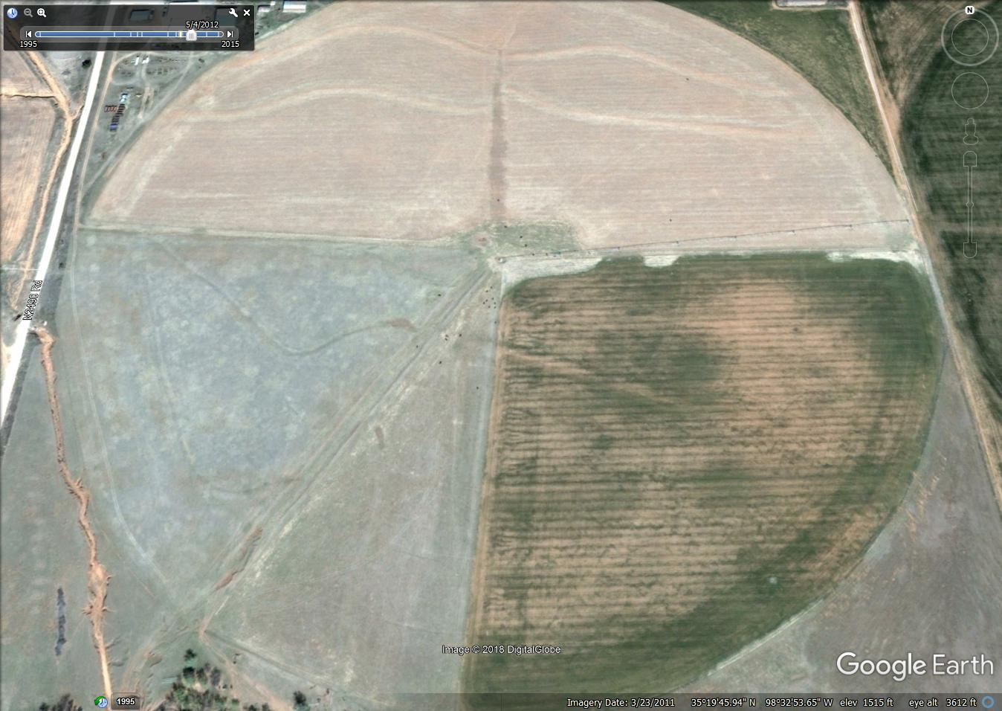
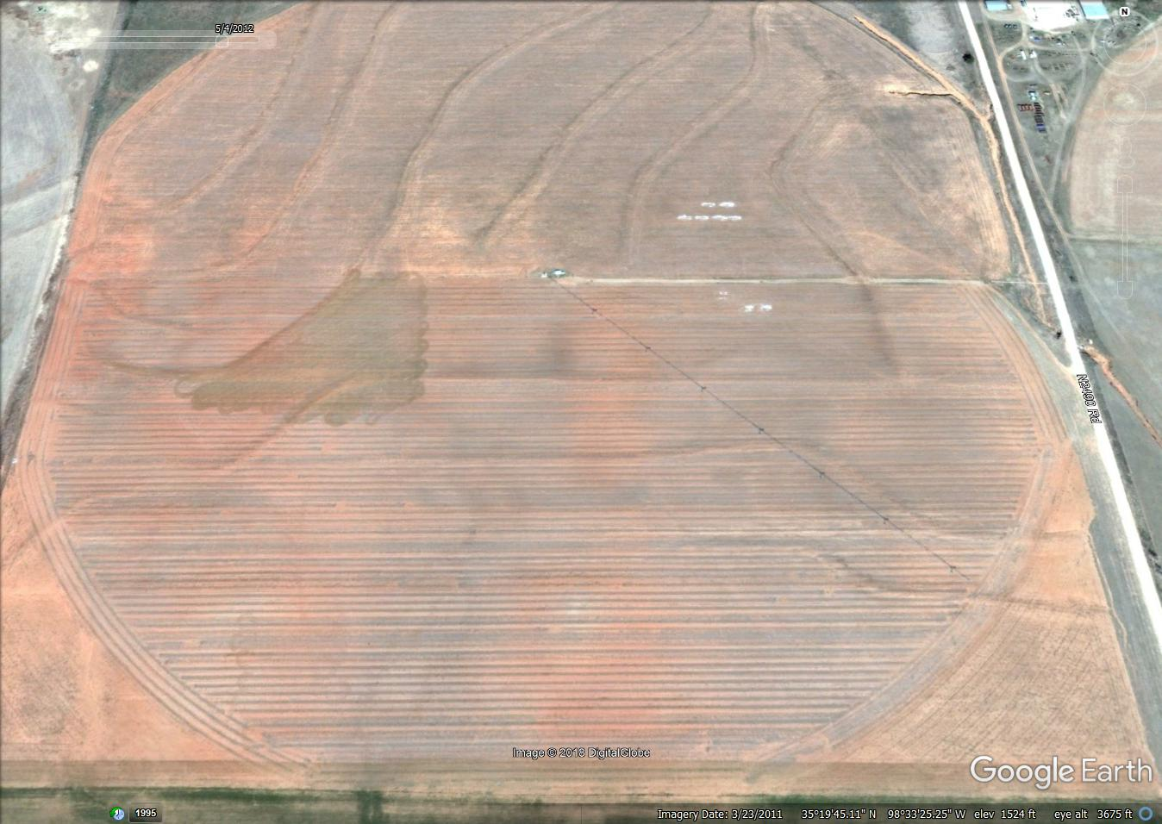

Slide 44
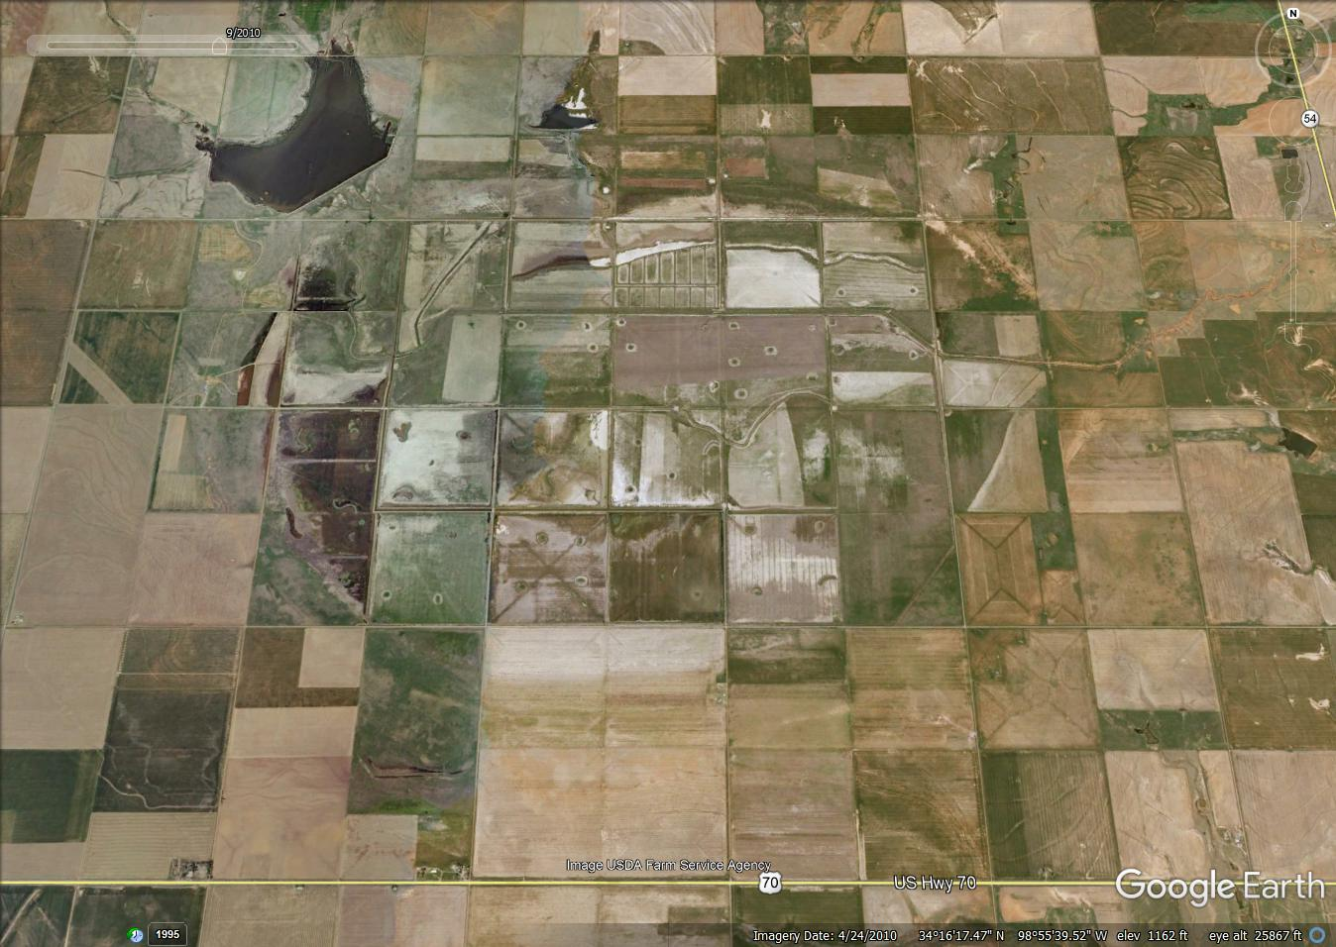
KMZ file

Slide 45
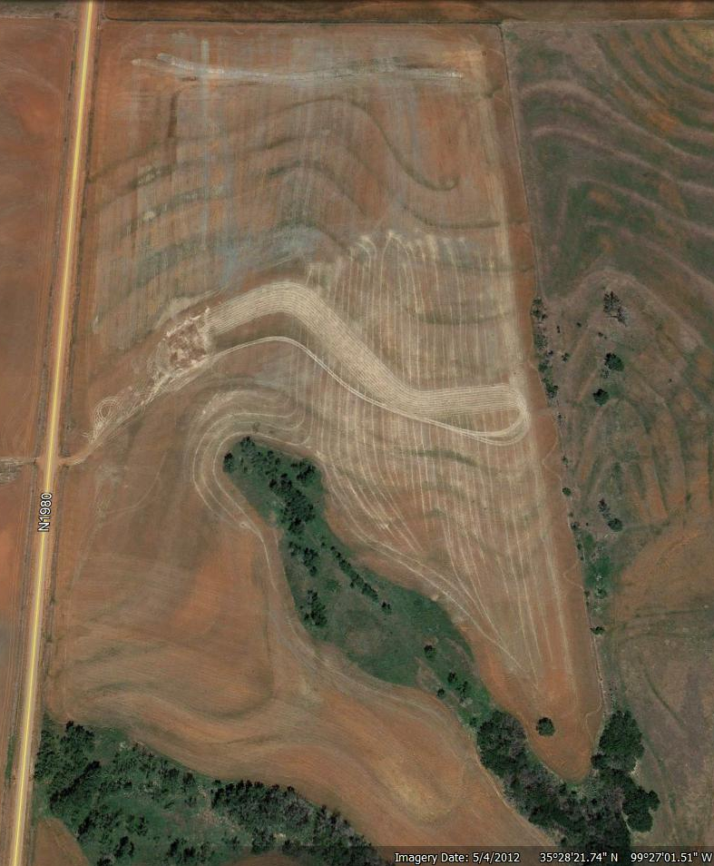
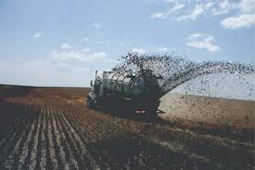
Systematic Variability

Slide 46
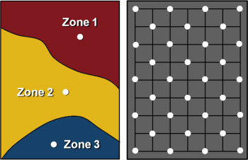
Soil Sampling Strategies for Site-Specific Nutrient Management
The grid sampling philosophy is based on the assumption that nutrient levels are random, unrelated to anything in nature, and should be sampled without any sampler bias toward where to place the sample locations.
Zone sampling philosophy assumes that nutrient levels and the patt erns in which they appear in a fi eld are the result of some logical reason.

Slide 47
Grid Sampling
Grid sampling is used and preferred in regions where past fertilization or manure application has been high. Native fertility levels that tend to be zone-based have been masked and overwhelmed through past fertilizer and manure applications. Grid sampling is used when there is no apparent logical method of dividing a fi eld into relatively homogeneous areas.

Slide 48
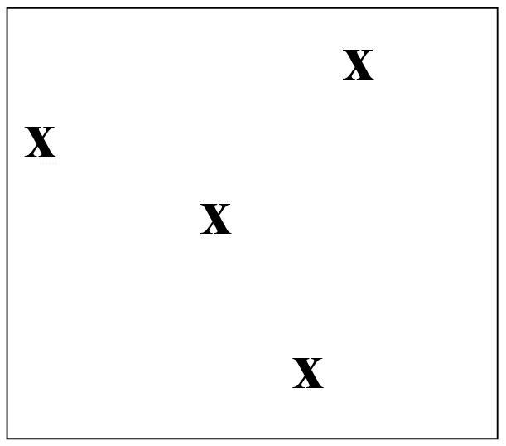
Grid Sampling
Random sampling might be appropriate in a fi eld with no recent history of fertilization or manure, such as a government set-aside program break-out fi eld or an old pasture to be converted to cropland.
Fig. 6.5. Random sampling example.

Slide 49
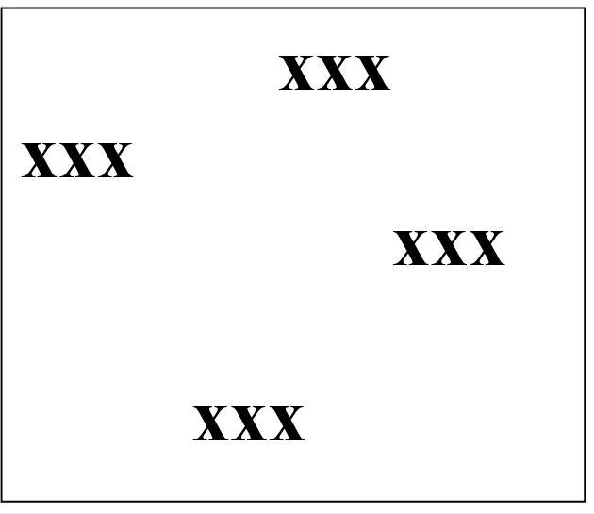
Grid Sampling
The clustered approach is a type of random sample that might help compensate for small-scale variability and larger-scale variability by grouping two to three sample core composites around random points
Fig. 6.6. Random cluster sampling example.

Slide 50
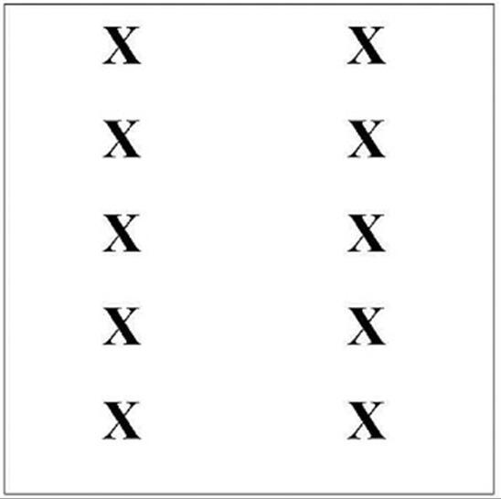
Grid Sampling
Regular systematic was a common grid sampling approach in the era before GPS (global positioning system) receivers. This approach allowed a sampler to use a vehicle tachometer or even “step off ” distances to achieve the desired patt ern.
Fig. 6.7. Regular systematic grid sampling example.

Slide 51
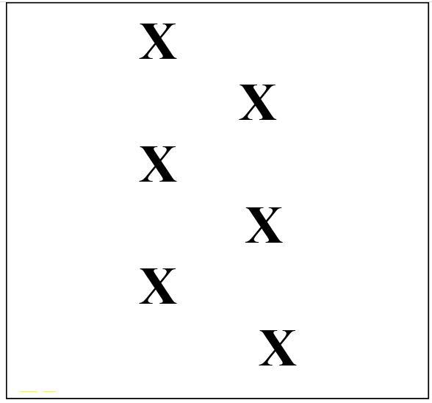
Grid Sampling
A staggered start systematic recognized that systematic errors in one direction are possible, and the start and end of each sampling rank was off set to try to compensate for these errors in one direction
Fig. 6.8. Staggered start (or triangular, or diamond) grid sampling example.

Slide 52
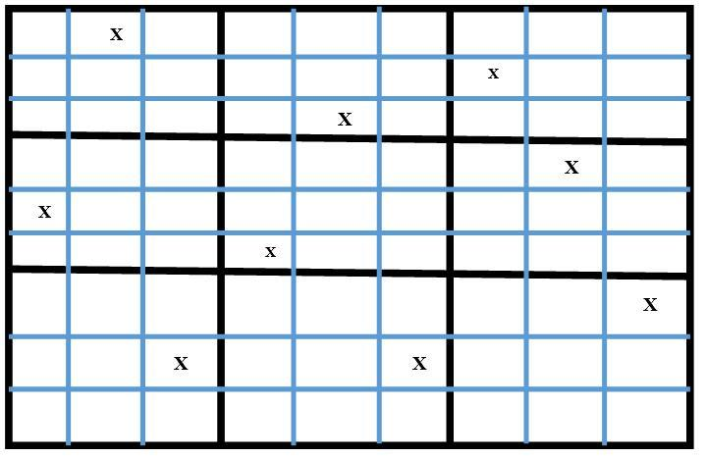
Grid Sampling
The systematic unaligned grid was made practical through a combination of GPS and field software that would allow random grid locations within a systematic grid. This approach minimizes the effects of systematic errors in two directions. It is also the method that most supports kriging: the statistical interpolation method that relates distance to value estimation between sampling points. The systematic unaligned grid is probably the method most used by commercial grid samplers today.
Fig. 6.9. Systematic unaligned grid sampling example.

Slide 53
Grid Sampling
To adequately represent field nutrient levels in fields where the range of variability is great enough that different recommendation rates of nutrients are represented, about a sample per acre grid is required (Franzen and Peck, 1995; Franzen et al., 1998). The expense and time required for such intensive sampling has led many growers to use a sampling density less than this, usually one sample per 2.5 acres (1 ha)

Slide 54
Zone Sampling
Zone sampling strategies were developed in North Dakota and other states where a more con-servative approach to fertilization has historically been used due to the high frequency of crop fail-ure due to drought, and to a lesser extent, floods. In these areas, patterns of fertility, particularly for residual soil nitrate but also for P, K, soil pH and other nutrients, are stable over time. The levels for particular nutrients may increase or decrease over time, but the patterns they form in the fields are remarkably stable.

Slide 55
Zone Sampling
A number of tools are available to delineate nutrient management zones: topogra-phy, satellite imagery, aerial imagery, soil electrical conductivity (EC) sensors, soil electromagnetic sensors (EM), and multiyear yield maps (Franzen, 2008). The use of NRCS–published soil survey boundaries is highly discouraged, because most only depict polygons over 2.5 acres (1 ha) size, and soils change over time. Unfortunately, this is often the first ‘tool’ that some use to define zones because they are easy to access; however, they should not be used unless the polygons in the soil survey match well with boundaries defined by some of the tools mentioned previously (Franzen et al., 2002).

Slide 56
Topography
Within fields, topography influences crop pro-ductivity and nutrient availability to crops. The obvious affect is the thickness of A-horizon (the organic rich layer at the soil surface).
Nitrogen management is greatly affected by topography and the texture of parent material. Nitrogen in the form of nitrate is affected by two important processes: leaching and denitrifica-tion. Soils with a high leaching potential tend to be loamy texture or sandier, on higher landscape positions. Soils with high denitrification potential tend to have a greater clay content in lower land-scape positions.

Slide 57
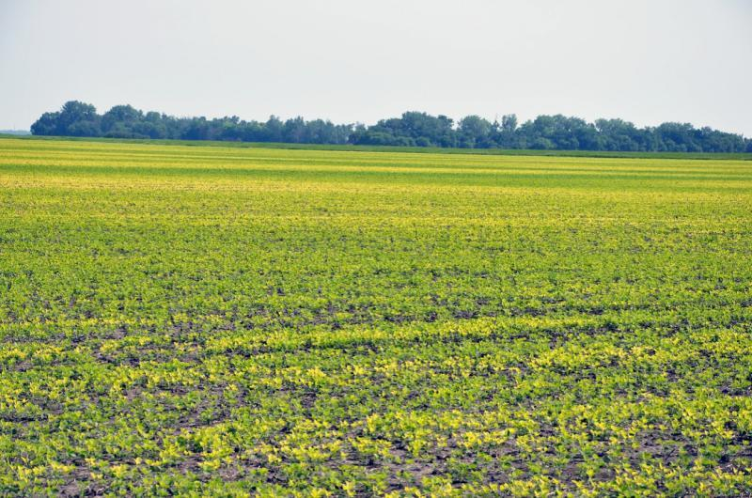
Topography
Fig. 6.10. “Level” elevation in Red River Valley of North Dakota. Severe iron deficiency chlorosis is located on “bumps” in the landscape, where centuries of summer upward water movement has resulted in accumulated lime and soluble salts. Greener areas are leached of lime and salts.

Slide 58
Imagery
Satellite imagery quality and pixel size have improved during the past twenty years. Where LandSat satellites once provided pixels about 100 ft2 (30 m), newer satellites in an affordable context provide 10 to 15 ft2 (3 to 5 m). Additional satellites provide even greater resolution; however, these have not provided additional nutrient boundary definition and result in more confusion of pat-terns than firm definition. Satellite imagery has the advantage of obtaining large tracts in a single image. However, satellite imagery always has the disadvantage of cloud interference (Bu et al., 2017).

Slide 59
Imagery
Aerial imagery from aircraft has been used for many years to identify problems in fields. For use in zone delineation, aerial imagery that data can be collected on cloudy days. However, this is also a disadvantage in that image contains cloud shadows. The extent of the image depends on the altitude of the aircraft. At an altitude of 5000 ft (1500 m), about 160 acres (65 ha) of land can be photographed.
UAV’s, unless allowed to operate at the height of aircraft, are forced to take a series of images that are ‘stitched’ together. The images may be obtained several minutes of time apart, and different sun angles may confound the final imagery.

Slide 60
Electrical Conductivity
Soil clay content, moisture content, nutrient lev-els and soluble salts contribute to different electrical conductivity (EC) readings. A popular EC detector is manufactured by Veris Technologies (Salinas, KS). It uses a series of coulters, with electrodes at one of the edge coulters and one internal to send an electrical signal through the soil, which arcs through the soil and is detected in another coulter electrode, provid-ing a ‘shallow’ EC reading and ‘deep’ EC reading in a single pass through the field (Fig. 6.11).

Slide 61
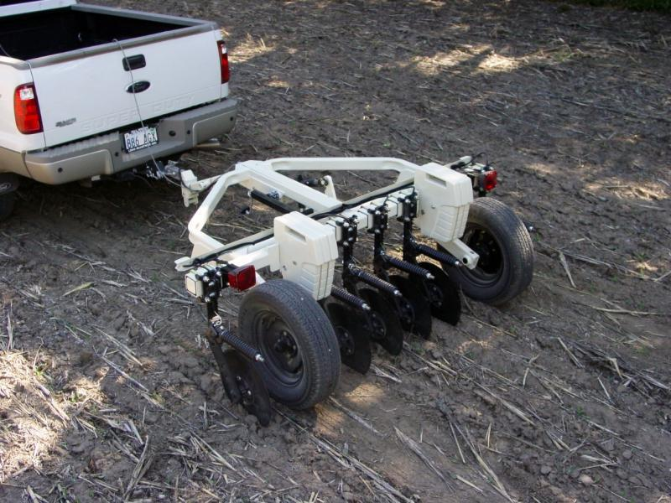
Electrical Conductivity
The coulters are in contact with the soil during readings, and the soil needs sufficient moisture to allow the electrical signal to travel from one coulter to another. In some regions, the EC readings are directly related to a single soil trait. In regions of low soluble salt content, the instrument can be used to estimate soil clay content, which is useful in predicting crop pro-ductivity potential (Sudduth et al., 2005). In other regions, including North Dakota, soil clay, moisture, and soluble salts are present independently of each other.
Fig. 6.11. Veris Technologies soil EC sensor. Courtesy of Veris Technologies, Salinas, KS.

Slide 62
Electromagnetic Sensors
Electromagnetic (EM) sensors measure the capacity to measure changes in the soils ability to conduct and accumulate electrical charge (Chapter 9; Adamchuk et al., 2018). In physics, electricity and magnetism are mathematically related, thus enabling the use of either one for a similar purpose. Electomagnetic sensors have been used to map the depth of a clay limiting layer in Missouri. It is also a zone delineation tool, producing zone maps similar to those developed using the EC sensor.

Slide 63
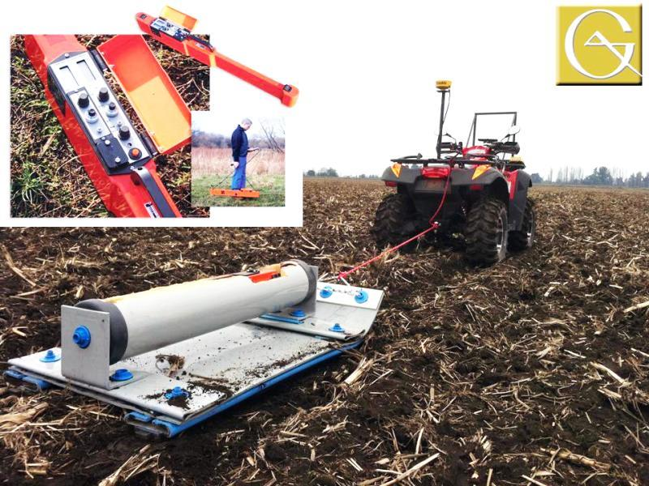
Electromagnetic Sensors
The EM sensors can also be used in fields with rocks without harm to the sensor (Fig. 6.12).
Fig. 6.12. EM-38 sensor, and electromagnetic sensor, courtesy of Geonics, Ltd., Mississauga, ON.

Slide 64
Multiyear Yield Maps
To be most useful, several years of yield maps should be integrated into a multiyear yield map (Franzen et al., 2008; Chapter 5, Fulton et al., 2018). Whether a fi eld has had a history of a sin-gle crop or a diverse crop rotation, the same general procedure should be followed to create the multiyear yield map. A fi eld that has been in continuous wheat might average 80 bushels per acre (5 Mg ha-1) one year and 20 bushels per acre (1.2 Mg ha-1) another year. The actual bushels for the fi eld therefore cannot be used when the data sets are combined.

Slide 65
Multiyear Yield Maps
Standardization is a simple mathematical exer-cise that converts bushels per acre into relative yield. In the example year of high wheat yield with high-est yield of 80 bushels per acre (5 Mg ha-1), divide each yield by 80. The range of yield is then 0 to 1. If the next year is canola, and the highest canola yield was 3500 pounds per acre, divide each yield by 3500. The range of yield is from 0 to 1.

Slide 66
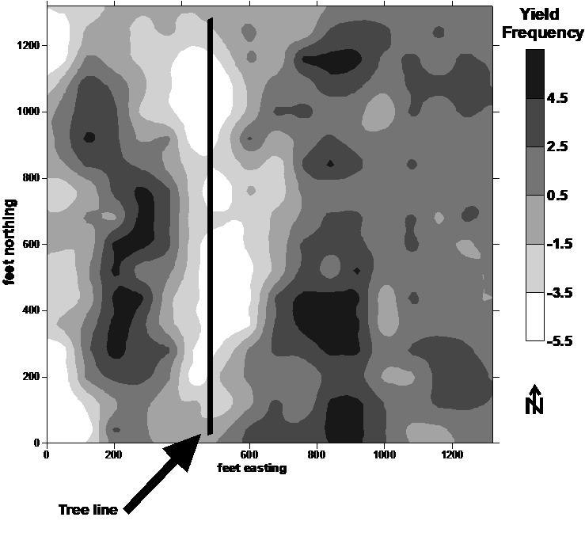
Fig. 6.13. A multiyear yield map of corn and soybean rotations in a 40-acre field near Thomasboro, IL, over 4 yr. Yield frequency is relative yield from the mean (0) value. Positive values are increasing yield over mean yields, while negative values are decreasing yield from the mean. From Franzen, 2006.

Slide 67
Combinations of Zone Mapping Tools
Management zone soil nutrient maps are often based on elevation, soil nutrient levels, crop reflec-tance, EC, and yield maps (Franzen et al., 2011). These maps can be produced by first producing individual zone maps of each tool database for the field. A layering program then is used to superim-pose the value and location of each zone map pixel geographically over the corresponding pixel of the other zone map(s). A clustering program then is used to analyze the patterns from each zone map to produce the final multi-zone map. An example of this approach is available in Clay et al. (2017).
The choice of zone number is largely left to the consultant or grower. Usually three to five zones for fields from 40 acres (16.1 ha) to 640 acres (259 ha) are selected. Up to 10 zones have been used to man-age fields in extreme cases.

Slide 68
Selecting a Soil Sampling Strategy
Grid sampling has been most useful for farms that have received large amounts of fertilizer or manure in the past, which overwhelms any relic of natural soil nutrient variation. Examples of this are many areas in Iowa, Illinois and Indiana, where the fertilizer “buildup and maintenance” approach have resulted in high soil test levels. There is vari-ability in these fields, but the variability is all in the ‘high’ range, so the recommendation would be the same. Because of the uniformity of recommen-dation, a 2.5-acre grid (1 ha) is acceptable in these fields. If there is high variabililty in the recom-mendation, then a high sampling density may be required to create an accurate map (Franzen and Peck, 1995; Mallarino and Wittry, 2004).

Slide 69
Selecting a Soil Sampling Strategy
Zone sampling is most useful for soil nitrate where the fertilizer recommendation is based on the resid-ual soil nitrate (Morris et al., 2018). Residual soil nitrate is related to water movement and crop productivity, which is most often related to topography and natu-ral variation. In areas where farmers fertilize using a more conservative ‘sufficiency’ approach, even soil phosphorus and potassium levels are best delineated using a zone approach. In the sufficiency approach, the farmer fertilizes each crop, and although rate is linked to soil test level, the goal is to apply the most profitable fertilizer application in a given year, not to build a soil test level to a higher fertility status. In Iowa, Mallarino and Wittry (2014) reported that the grid approach was best for soil phosphorus, while the management zone approach was better for potas-sium and soil pH (Mallarino and Wittry, 2004).

Slide 70
Selecting a Soil Sampling Strategy
So what would you do.

Slide 71
Videos
Video 6.1. How can the knowledge of spatial variability facilitate decision making in fields? http://bit.ly/spatial-variability
Video 6.2. Why is soil testing better with precision agriculture? http://bit.ly/soil-testing-better
Video 6.3. Zone sampling vs. grid sampling. http://bit.ly/zone-sampling-vs-grid-sampling
Video 6.4. How can yield maps aid with soil sampling? http://bit.ly/yield-maps-soil

Slide 72
Chapter Questions
How might field topography influence soil nutrient variability?
Name four factors other than topography that might influence natural soil nutrient variability.
Name two factors that might contribute to systematic variability of soil nutrients.
Fields where high rates of phosphate and potash fertilizer were applied in a soil test buildup
program would benefit from which site-specific soil sampling strategy for P and K: grid or zone?
Name four possible tools that might be utilized to help delineate soil nutrient zones.
What soil sampling strategy is used most often to avoid systemic soil sampling errors and why is it more effective than other strategies?

