Slide 1
Yield Monitoring and Mapping
Chapter 5

Slide 2
Intro
Yield monitors provide the ability to not just estimate yield, but to identify the location in the ﬁeld where yield is produced. Yield monitors provide information that is valuable for a multitude of management purposes, including estimating the amount of nutrients removed by the harvested crop, estimating proﬁtability, developing management zones, and analyzing impacts of treatments used in on-farm studies. These topics are discussed in associated chapters within this book. However, proper yield monitor calibration and maintenance is necessary to ensure that production and farm business assessments based on yield data are accurate and reliable. The purpose of this chapter is to provide background information on grain and cotton yield monitoring systems, guidance on preparing to harvest a ﬁeld, techniques to improve accuracy, details of the importance of cleaning yield monitor data, identifying potential errors in yield monitor data, and providing guidance on using yield monitor data to improve ﬁeld understanding.

Slide 3
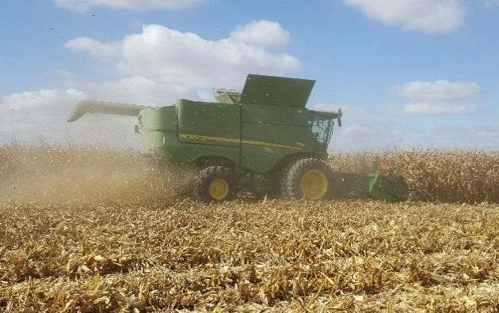
Yield Monitors.
Currently, commercially available systems are available for grains corn, wheat, oats, soybeans, cotton and sugarcane

Slide 4
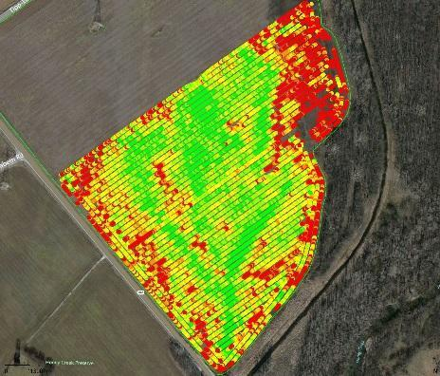
Yield Map
These systems estimate yield as the crop is harvested and produce information that can be used to produce yield maps
Fig. 5.1.
Yield monitor and yield map (courtesy Ohio State University).

Slide 5
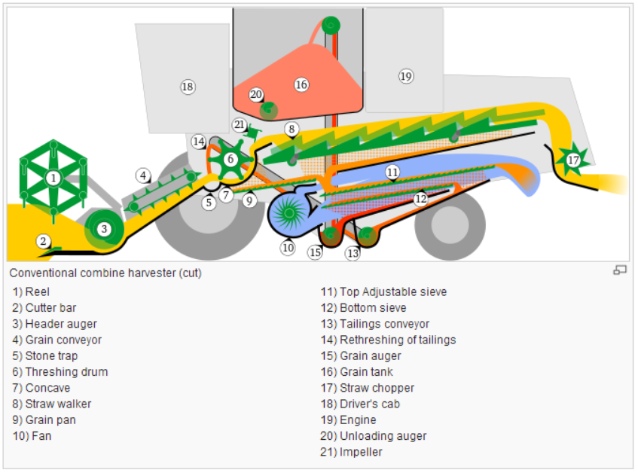
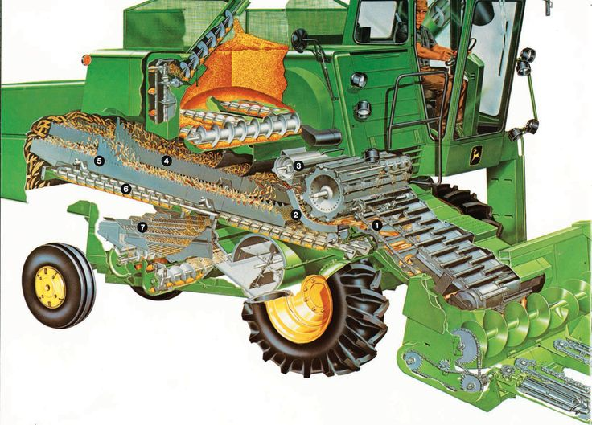
How a combine works
https://www.youtube.com/watch?v=FDjGx-94yao
https://www.youtube.com/watch?v=0IvGF8kjQUs
https://www.youtube.com/watch?v=fVwnJKZgiP4

Slide 6
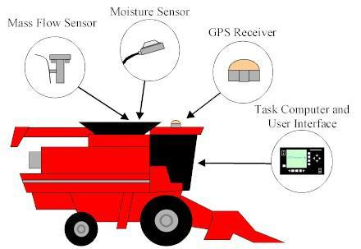
Yield monitor Components
A yield monitor estimate the mass of the harvested grain and assign it to the area from where it was harvested. However, the area is not a fixed value, and it is dependent on header width, and combine speed. The accuracy of the calculated yield is dependent on the calibration of the moisture and mass or volume sensors, and accuracy of the differential global positioning system receiver (DGPS), moisture sensor
Fig. 5.2.
Basic components of a grain yield monitoring system (courtesy of the University of Kentucky). This illustration shows some of the standard and basic components required to properly operate a yield monitor system on a grain combine. These components will be similar on a cotton harvester, except there will be no moisture sensor.

Slide 7
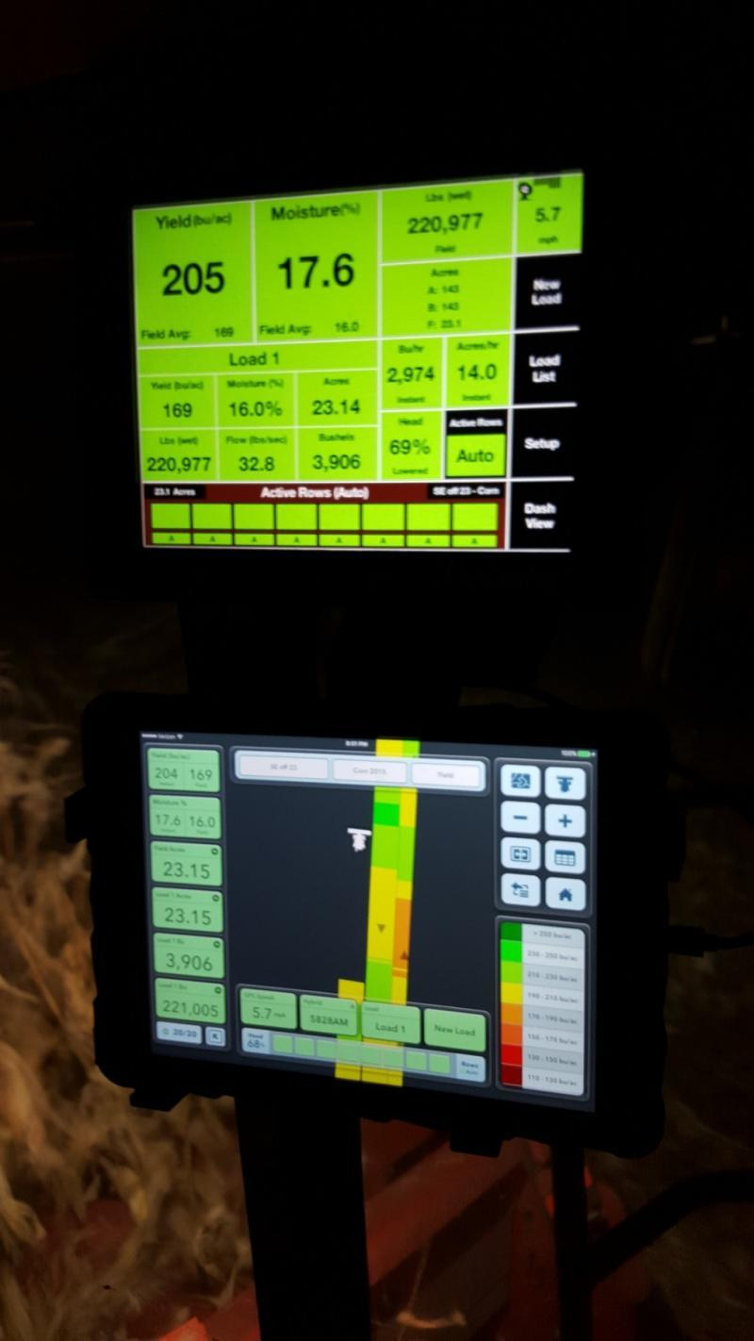
User Interface
The user interface (UI) provides a linkage between the farmer and the sensors. In many situations, the peripheral components are grouped together into a working system. The UI is usually located in the combine cab and it is used to: i) convert the output from different sensors into data for storage, display, and later use; ii) provide the GNSS (also called GPS); iii) provide access to external storage devices; iv) provide a display and keyboard that can be used to monitor and control the devices associated with the yield monitor system; and v) provide real-time harvest information
Fig. 5.3.
Illustration of an in-cab yield monitor display providing both instantaneous grain yield plus creating a yield map on-the-go. Field summary data including average yield and grain moisture along with accumulated amount harvested (courtesy of Ohio State University).

Slide 8
Differentially Corrected GNSS Receiver
The GNSS receiver can also be used as the ground speed sensor. Depending on the type of yield monitor installed and the harvester or combine manufacturer, it is sometimes easier to obtain ground speed from the GNSS. However, ground speed can also be obtained from either a radar speed sensor or a wheel counter that may be available on the machine. The advantage of GNSS information or ground speed radar over a wheel rotation counter is that wheel slippage does not influence calculated speeds.

Slide 9
Mass Flow Sensors
Various methods have been developed to indirectly estimate the mass of the material being harvested. The type of yield monitor employed is dependent on the type of crop harvested. The two main types of mass flow sensors can be characterized crop such as cotton has so little mass per volume, an impact plate does not work very well for estimating its yield. An optical style volume sensor is a much better choice for a crop such as cotton.

Slide 10
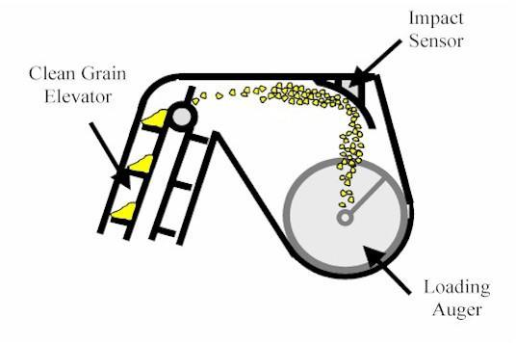
Impact Plates
In many yield monitor systems, the grain weight or volume is measured by a mass flow sensor that consists of an impact plate positioned near the top of the clean grain elevator (Fig. 5.4, 5.5). The sensor measures the force generated as grain impacts the plate after it is accelerated off of the elevator conveyor paddle. That force is a function of the mass and velocity of the bulk material as it makes contact with the impact plate. Since the geometry of the elevator is known or can be measured, the grain velocity can be estimated from the elevator speed (measured by a sensor on the elevator) and the elevator geometry (distance from the top of the elevator, orientation of the impact plate and elevator, etc.).
Fig. 5.4.
Typical installation of an impact sensor in the clean grain elevator housing (courtesy of the University of Kentucky).

Slide 11
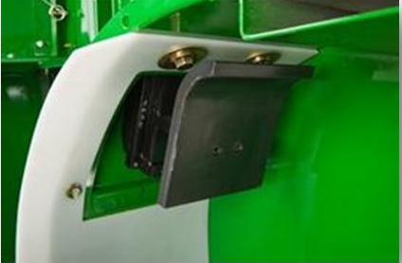
Impact Plates
Since yield monitors must translate the impact sensor readings into mass estimates, mass flow sensors require regular calibration. Sensor calibration should be conducted during harvest preparation and different calibrations should be done for different crops. Calibration is conducted by harvesting and weighing multiple loads of grain, then recording the load weights in the yield monitor in-cab display.
Fig. 5.5.
Example impact style grain mass flow sensor (courtesy of AgLeader).

Slide 12
Measuring Volume with a Photoelectric Sensor
A photoelectric sensor estimates the volume of product that passes through a light beam. These sensors have two main components: a light emitter and a light sensor.
The emitter and sensor are mounted on opposite sides of the ducts or elevator that direct the product flow. The ratio of time that the light beam is broken versus unobstructed is related to the volume of the product. The light beam is interrupted when the harvested product passes through the path between the emitter and the sensor.
https://www.youtube.com/watch?v=sl8wHbs-VAI

Slide 13
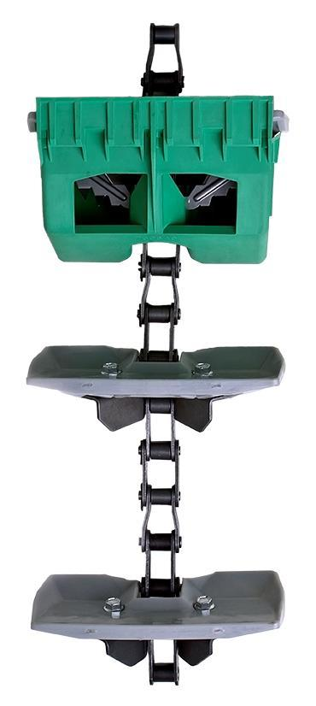
Measuring Volume with a Photoelectric Sensor
On a grain combine, the photoelectric sensor measures the volume of grain contained on each paddle of the clean grain elevator (Fig. 5.6). On a cotton harvester, the sensor is located on the conveyance duct before the cotton passes into the basket on the harvester. On a grain combine, one drawback to optical volume sensors is that operation of the combine on a sloped portion of the field causes grain to shift to one side or the other on the elevator paddle.
Fig. 5.6.
Illustration of the Precision Planting YieldSense grain property tool that measures and adjust for variations in varying properties (e.g., test weight) on-the-go.

Slide 14
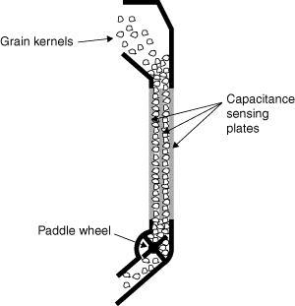
Volumetric Flow Sensing Alternatives
Grain moisture content is generally calculated based on the dielectric properties of the harvested grain. The dielectric properties are related to the grain’s ability to store energy in an electrical field, which is directly related to grain moisture content. The sensors are often referred to as capacitance-based moisture sensors since capacitors also store energy in an electric field. The dielectric constant is measured using a calibrated capacitance sensor, from which the grain moisture content is calculated using known relationships.
Fig. 5.7.
Illustration of a side Mounted Moisture Sensor for a grain combine (courtesy of the University of Kentucky).

Slide 15
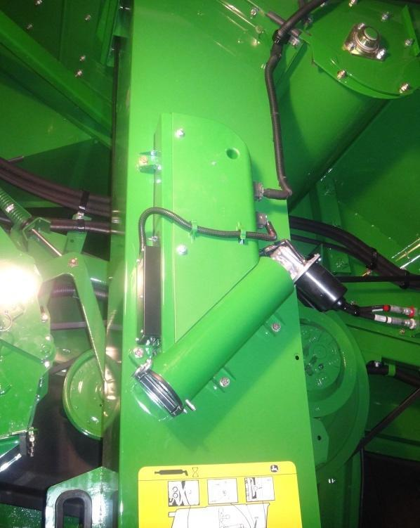
Moisture
Most moisture sensing devices are placed either in the clean grain auger (fountain augers) or on the side of the clean grain elevator (Fig. 5.7). The most desirable location for the moisture sensor is on the side of the clean grain elevator due to mounting ease, easier access for maintenance, and the limited grain flow through the device since this configuration only samples out of the elevator rather than measuring the entire grain stream (Fig. 5.8).
Fig. 5.8. Example side mounted grain moisture sensor.

Slide 16
Other Sensors
Fan Speed Sensor: On some harvesters such as cotton pickers, a fan speed sensor is also included in the yield monitoring system. Simply, this sensor becomes important to (e.g., cotton bolls) calculate the velocity of the material as it passes by the yield sensors.
Elevator Speed Sensor: By monitoring the speed of a shaft directly coupled to the elevator drive, a simple ratio can be used to determine the frequency of the paddles passing the impact plate and it can be used for mass flow rate signal conditioning.
Header Position: Most yield monitoring systems use the position of the header (i.e., “down” during harvesting operations and “up” when turning) as the means to start and stop data collection.

Slide 17
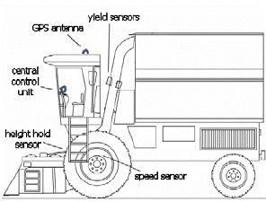
Cotton
1. GNSS receiver using differential correction(which was previously was called a GPS receiv-er),
2. In-cab display,
3. Header height sensor,
4. Ground speed sensor if not using the GNSS for speed measurements, and
5. Flow sensor mounted on the duct.
Fig. 5.9. Sensors used to measure yield on a cotton picker (Markinos et al., 2005).

Slide 18
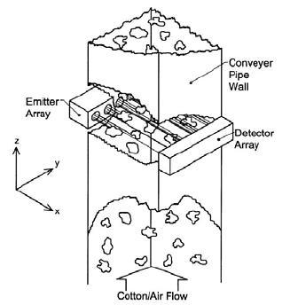
Cotton
Fig. 5.10.
Illustration of an optical sensor array measuring cotton within the duct carrying cotton from the spindles to the basket. The output or detection of cotton is converted to a yield estimate (Markinos et al., 2005).

Slide 19
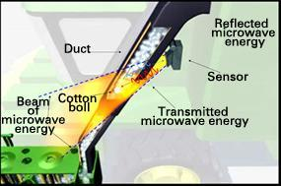
Cotton
Fig. 5.11. Illustration of microwave technology measuring cotton in the plastic duct work carrying cotton from the spindles to the basket (courtesy of John Deere).

Slide 20
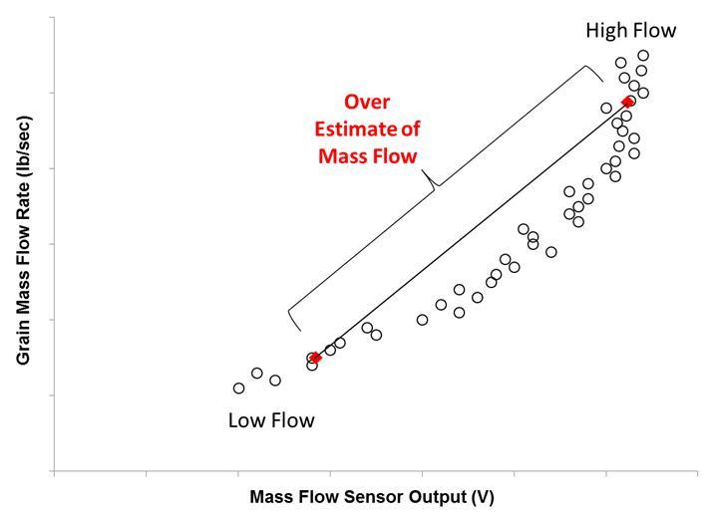
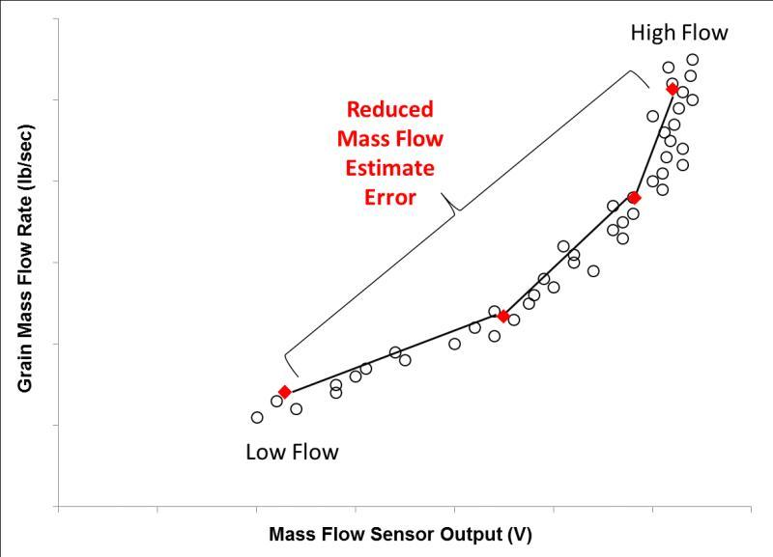
Calibration
Fig. 5.12. Mass flow sensor response is nonlinear with the illustration showing the difference between a two-point and multi-point calibration procedure (courtesy of Luck and Fulton, 2014).

Slide 21
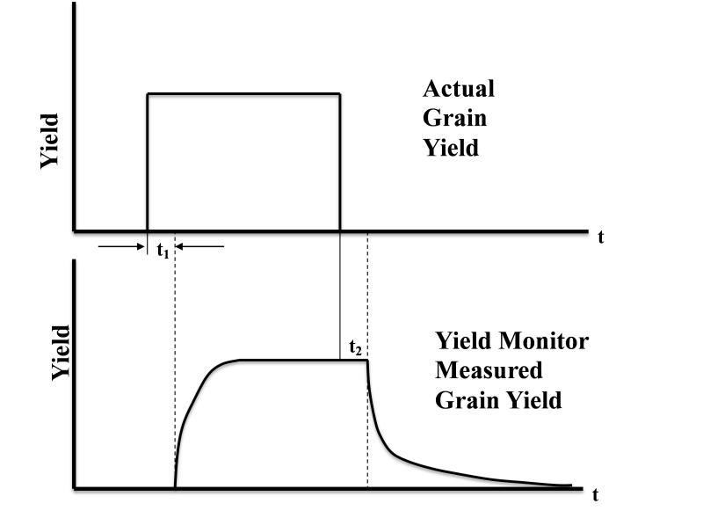
Data Cleaning
One of the problems with yield monitor data is that the actual and estimated values may not match due to one or multiple error sources not being accounted for.
Fig. 5.13. Actual and measured yield data collected from a field.

Slide 22
Improving Accuracy of Yield Monitor Data
Highlight common causes of yield estimate errors.
Using old calibration data: Systematic errors are produced by using old calibration data. With time, calibrations can change due to machine wear or sensor output drift.
Calibration loads do not span the flow rates: When calibrating the yield monitor system, it is important to calibrate the system for the full range of expected values.
Poor calibration of the moisture, temperature, and speed sensors: Poor calibration of these sensors results in incorrect estimates.
Inaccurate setting of the number of rows.

Slide 23
Improving Accuracy of Yield Monitor Data
Sudden Ground speed changes: Rapid changes in the combine speed can result in erroneous yield estimates.
Wear of the flighting in the clean grain elevator: As the flighting wears, the ejection speed of the grain leaving the elevator declines, which reduces the estimated yields.
Changing speed setting on the clean grain elevator: If the speed settings on the clean grain elevator are changed, it is important to recalibrate the mass flow sensor.
Buildup of plant residue or other debris on the sensor plate: With operation, there is often a buildup of residue or debris on the sensor plate.

Slide 24
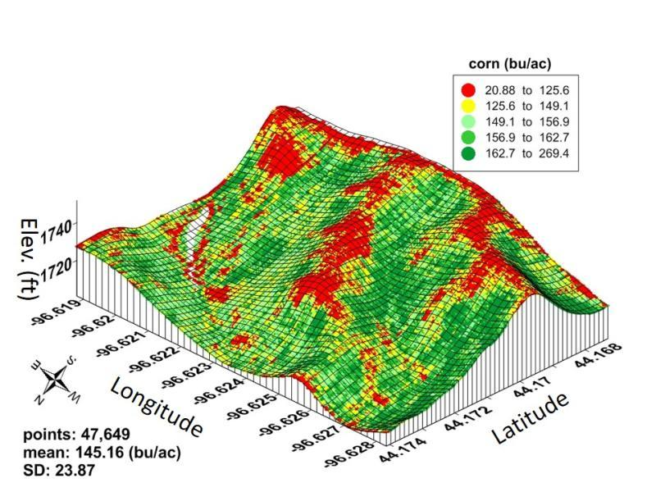
Using and Understanding Yield Monitor Data
Looking for commonality or correlations.
Fig. 5.14. A yield map superimposed on an elevation map. The low maize yields in the summit/shoulder positions cannot be eliminated, but the magnitude of the differences can be reduced (Courtesy South Dakota State University).

Slide 25
Videos
Video 5.1. How does a cotton yield monitoring system work? http://bit.ly/cotton-yield-monitoring
Video 5.2. How do cotton yield maps aid in making decisions? http://bit.ly/cotton-yield-maps
Video 5.3. Pre-harvest equipment check. http://bit.ly/pre-harvest-equipment
Video 5.4. Calibration and harvesting system check. http://bit.ly/calibration-and-harvesting
Video 5.5. Poor yield data = poor decisions. http://bit.ly/poor-yield-data
Video 5.6. Post-harvest yield data cleaning. http://bit.ly/post-harvest-yield
Video 5.7. Why does yield mapping need special attention? http://bit.ly/yield-mapping-attention

Slide 26
Study Questions
What sensors need to be calibrated when preparing to harvest a field?
What factors influence calibration constants?
You harvest a 50,000 lb of corn from a field containing at 22% moisture. How many pounds and bushels of corn do you have at 15.5% moisture?
What will happen to the yield monitor data when the combine slows down? What happens when the combine speeds up?
Why does yield monitor data need to be cleaned?

