Slide 1
Basics of a Geographic Information System
Chapter 4.

Slide 2
Intro
Geographic Information Systems (GIS) is a broad-encompassing term used for software that has the capacity to conduct analysis and create maps using geospatial information (i.e. data that has a known geographic location). Geographic Information Systems has been around since the 1960sbut was a well-kept secret, used mainly by large corporations or research institutions. It did not become a mainstream technology until the Global Positioning System (GPS) became available in the early 1990s. the combining of the GIS, GPS, and variable-rate equipment technologies provided growers the opportunity to display maps and apply variable-rate treatments. the purpose of this chapter is to provide the components of GIS, functions of GIS, qualities of GIS, and strength and weaknesses of different systems.

Slide 3
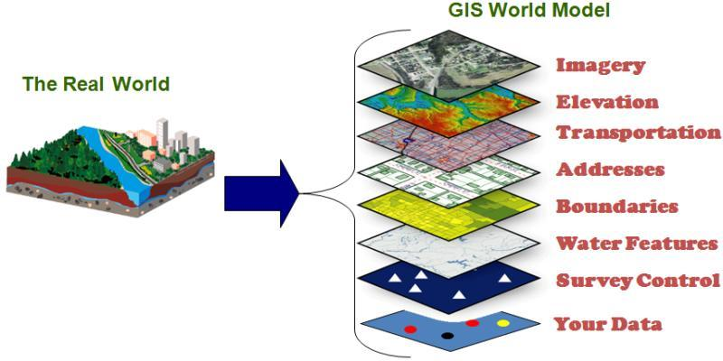
Data Layers
A data layer is a geographic representation of a specifi ed type of object. All real-world objects can be mapped as a feature within a data layer. The word “object” is a term that refers to real world physical things or identifi able actions. The word “feature” is a term that refers to the representation of an object on a map.
Fig. 4.1. In a GIS the real world is modeled (or mapped) with a series of data layers. Each data layer represents one type of real world object. (Source: Henrico.us Geographic Information Systems)

Slide 4
Data Layers
Each boundary object would be represented by a polygon feature
displaying the shape of a field.
An example data layer might be all the field boundaries for a specific grower.
A data layer can contain one field boundary or thousands of field boundaries, but the data layer would not include any other type of object except for field boundaries.
Two other data layers are Tile Lines and Soil Sample locations.
These three examples are listed because features in a data layer are represented by either a point, line or polygon. Displaying all three of the example data layers together in a GIS creates a digital map.

Slide 5
Data Layers
A data layer has two components: a map component and an attribute table.
The map component made up of the point, line ,and polygon features that represent objects in the real world.
Point features represent those objects in which the location alone is needed
Lines represent those objects which the location and length is needed
Polygons are used to represent objects in which location and area are needed

Slide 6
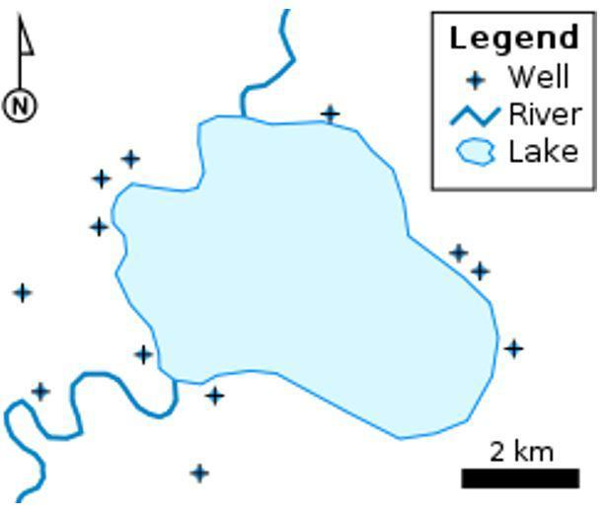
Map Components
It is possible that an object could be represented by any of the three types of features depending on its use. Using an orchard as an example, each tree could be represented by points, rows of trees could be represented by lines, or blocks of trees as polygons.
Fig. 4.2.
This example map of a lake, uses points to represent locations of wells; line to represent the length and location of streams; and a polygon to represent the area and location of a lake.

Slide 7
Map Components
Attributes are those characteristics of interest or concern for a specified data layer. These attributes are in the form of data values that have been collected for objects in the real world and need to be associated to a feature on a map.
The attribute table is an organized matrix within the data layer for the purpose of storing this data.
Attribute values are usually defined by the type of data that it is. The most common types of data are: numerical, text, date, and true or false. Numerical data refers to real numbers (those that are used in calculations).

Slide 8
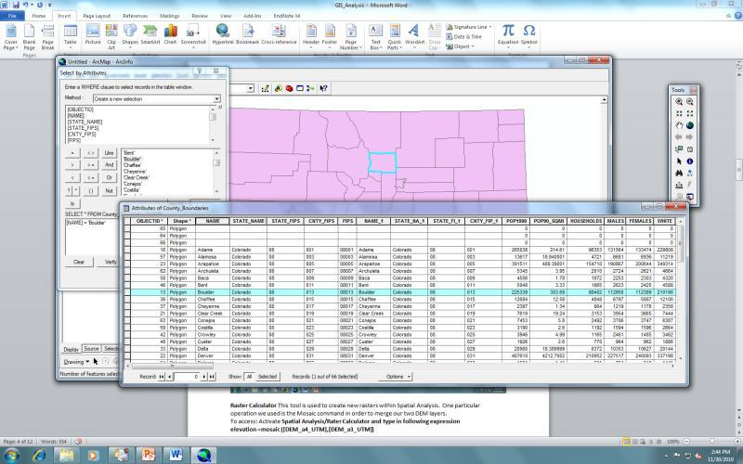
Map Components
Figure 4.3 is a data layer of counties within the state of Colorado. Shown is a map of the counties (the feature) and the underlying attribute table. There is one selected feature in the map that is highlighted in blue; the record for that county is also highlighted in blue within the attribute table
Fig. 4.3.
Each of the purple polygon features in this data layer represents a county in the state of Colorado. This is the map component of the GIS. The matrix of rows and columns is the table component of the GIS. Each row holds information about one of the features. The county that is highlighted in the table is also highlighted on the map. (Source: Brase ArcGIS)

Slide 9
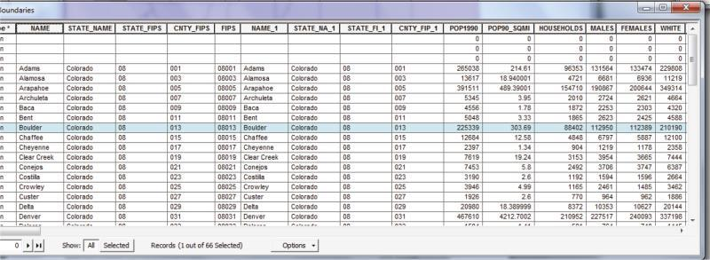
Map Components
Fig. 4.4.
The row that is highlighted is for the county of Boulder, which had a population in 1990 of 225339. Pop1990 is an “attribute”; 225339 is an “attribute value”. (Source: Brase ArcGIS)

Slide 10
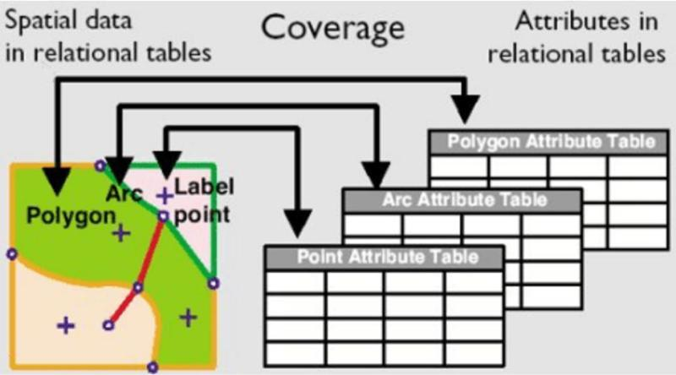
Map Components
Fig. 4.5.
The map and table are interconnected. Basically the table is providing information about the map features. The spatial data in the map is tied to the attributes in the table (Source: http://www.geog.ucsb.edu/).

Slide 11
Functions of a GIS
The attribute table and map components of a GIS allow for several important functions that make it valuable for users. Most GIS programs will have these functions, and this ability is a defining characteristic of an effective program.

Slide 12
Functions of GIS
Display of Data: The most basic function of a GIS is the display of data layers, aligning them together to make a map. Each data layer has properties and settings that allow the features to be symbolized differently and labeled.
Storage of Data: Data is stored within the attribute table of each data layer.
Retrieval of Data: Access to data values for each attribute of each data layer feature is a key function of a GIS. It is important to point out that these data sets can be huge, and there needs to a method of viewing information from a specified spatial region or attribute range.
Manipulation of Data The data as it is entered into the database may not be in a norm that is ready to use or that is functional for analysis. Data often needs to be manipulated for accuracy and usability.
Analysis of Data: Once the data has been retrieved and manipulated, advanced functions are used to analyze the data. This function summarizes, combines, compares, and establishes relationships between layers of data.
Presentation of Data: This function is different than the “Display of Data” which creates a map.

Slide 13
Qualities of a Geographic Information System
Robust is a term to describe the number of functions and capabilities within the software. Some GIS software programs concentrate on mapping, while others concentrate on data management.
Intuitiveness is a term that describes how easy the interface of the GIS is to operate by the user.
Scalability of a software refers to the multiple levels that software has to meet the various needs of users. Some users will be strictly viewing spatial data, while other users will be doing advanced analytics.

Slide 14
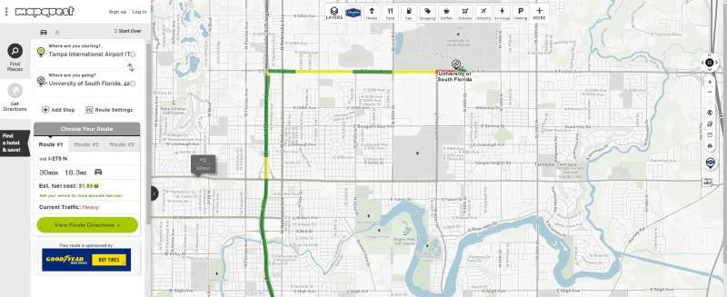
Using Geographic Information Systems to Solve Problems
Mapquest is an online service for finding addresses and calculating route directions (Fig. 4.6). It uses data layers of roads, interstate exits, county and state boundaries, aerial imagery, and points of interest to create a map.
Fig. 4.6.
Mapquest is a GIS with a specific function, determining route. The user is allowed to set some parameters which results in a listing of roads to get to final destinations. Many of these examples of GIS are similar in appearance; a map view window with a panel for displaying the list of data layers and settings (Source: MapQuest).

Slide 15
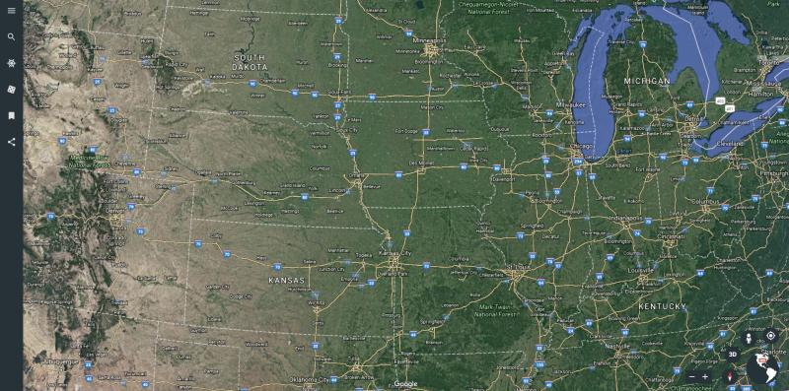
Using Geographic Information Systems to Solve Problems
Google Earth is an online service that can map data layers on a 3-D surface of earth imagery (Fig. 4.7). It has the flexibility to add and view a selection of preloaded data layers, and it also allows the user to add their own data layers using a format known as.kmz.
Fig. 4.7.
This is a base image of the Midwest United States in Google Earth. Viewing this reference map as a 3D topographical map is also possible (Source: Google Earth).

Slide 16
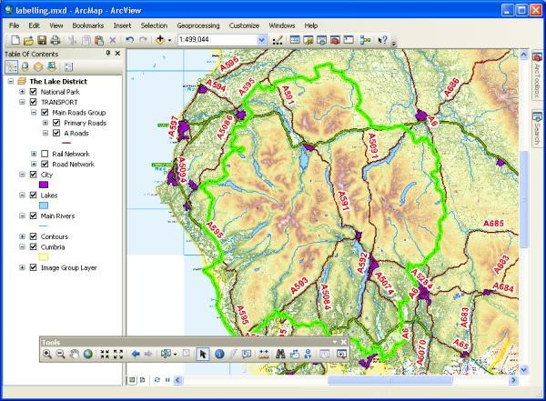
Using Geographic Information Systems to Solve Problems
ArcGIS is a commercial GIS (Fig. 4.8) which is used for mapping and analytical functions in the health, agriculture, emergency services, weather and/or climate industries. It holds a major market share for worldwide GIS use and is considered as one of the most robust GIS available
Fig. 4.8.
ArcGIS is a very advanced GIS with many tools and multiple applications. The graphic shows a map of a watershed within a national park (ESRI).

Slide 17
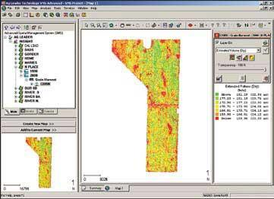
Using Geographic Information Systems to Solve Problems
SMS Advanced is a precision agricultural GIS that has many of the same features and functions of a commercial GIS, but has tools focused on agricultural applications (Fig. 4.9). In comparing SMS to ArcGIS, SMS automatically calculates acres for field polygon features, whereas ArcGIS requires the use of a specific tool. SMS will average several years of yield data with the click of a single button, whereas ArcGIS requires multiple steps and tools. However, overall SMS has a limited number of analytical tools compared to ArcGIS.
Fig. 4.9. Shown in this SMS map is a yield map with a legend of yield values on the right. On the upper left is a listing all data layers available to the user (AgLeader).

Slide 18
Mapping and Geography
A large part of precision farming is the use of digital mapping. Understanding mapping and geodesy is fundamental to the analysis and interpretation of georeferenced spatial data.
Geodesy: the branch of mathematics dealing with the shape and area of the earth or large portions of it.

Slide 19
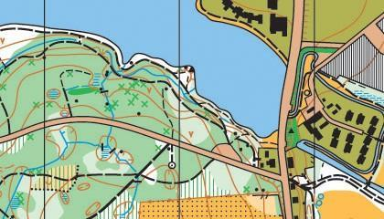
Mapping
Real world objects are represented on a map using various points, lines, or polygon shape features (Fig. 4.10). A legend is used to identify what each represents. Color can also represent different characteristics or attributes.
Fig. 4.10. A map should model the real world. It is not meant to look like the real world, but rather it uses drawn features to represent objects in the real world. The graphic on left is a map that uses point, line and polygon features to represent objects (Creative Commons Attribution-Share Alike 3.0).

Slide 20
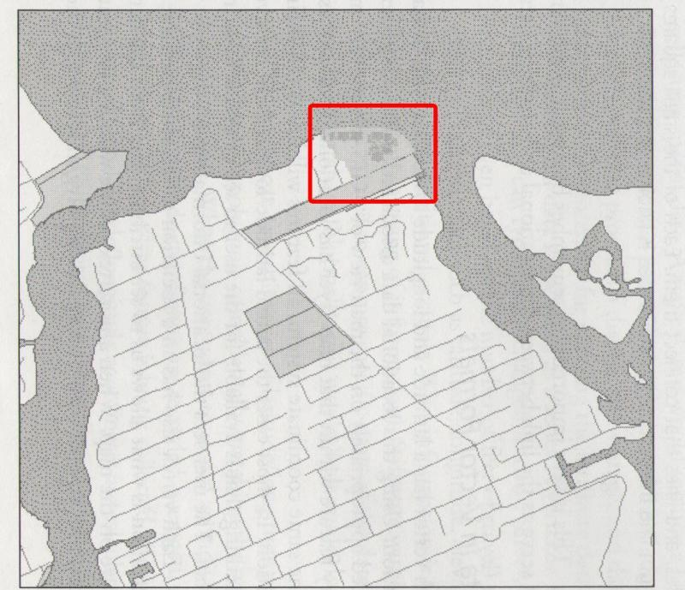
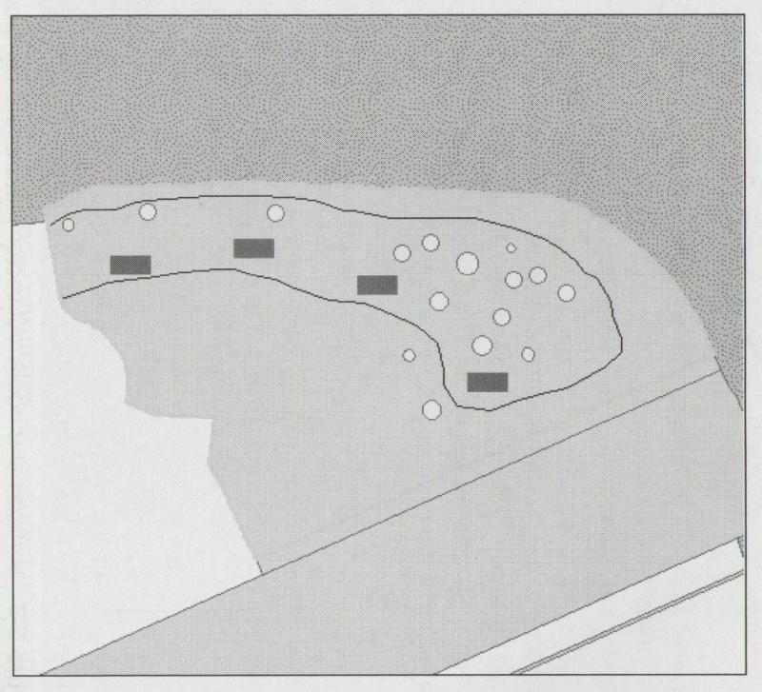
Mapping
The choice of how an object is represented on a map is dependent on the purpose of the map. Using Fig. 4.11a as an example, trees are displayed as points. At the degree of detail of the map, the purpose is only to show the location of the trees. In Fig. 4.11b trees are displayed as polygons because the purpose is to show the relative size of each tree.
Fig. 4.11. A. This example of a map shows the detail of a harbor. Polygons are used to represent land areas and ownership plats, with lines to represent streets. Within the area enclosed by the red square is a park which uses points to represent trees. Points were used because the size of trees was not important in this map, only the location. (Source: Brase ArcGIS ) B. This map of the inset shows more detail of the park. In this map, the trees are represented by polygons in order to show relative size differences.

Slide 21
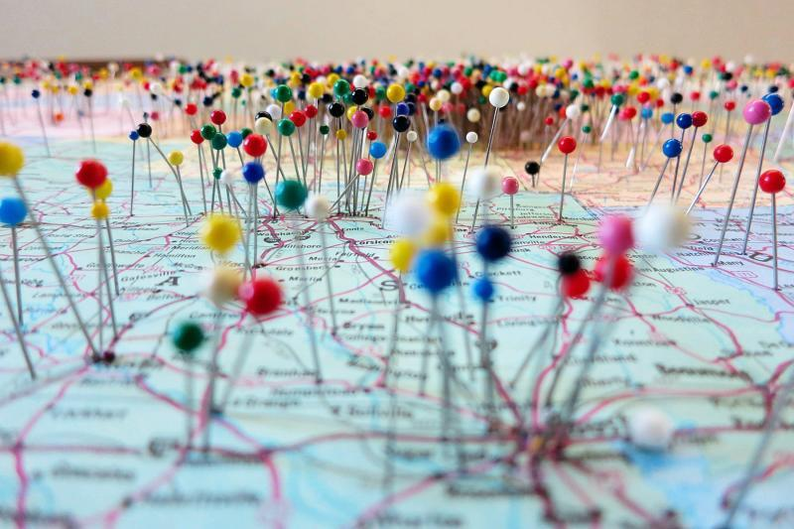
Paper vs Digital
“Hard Copy” is used to reference printed materials or resources that a person can touch and hold. Examples are paper maps (Fig. 4.12), atlases, or paper road maps.
Fig. 4.12. A paper map is static and cannot be manipulated other than physically such as stick pins (Source: https://flic.kr/p/aDSYZf).

Slide 22
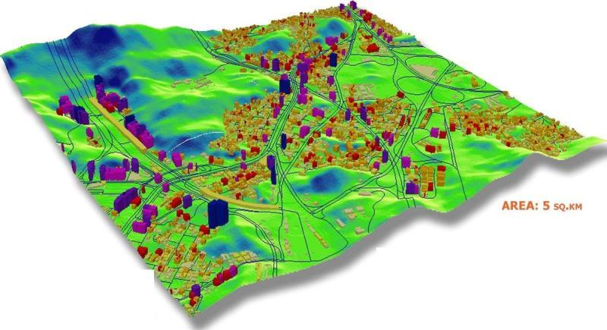
Paper vs Digital
“Digital” refers to data, materials, resources and other things that are in an electronic format used in a computer. Digital maps (Fig. 4.13) are viewable and created on a computer. Digital maps are flexible and dynamic, with the user determining how the map is displayed, the scale, and the specific features that are included in the map.
Fig. 4.13.
A digital map can be manipulated including the user’s choice of features and displaying it in different thematic colors or as the map on the left in 3-D (ESRI).

Slide 23
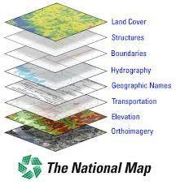
Geo-referencing
Georeferencing is the process of associating geographic coordinates to a digital map so that it aligned properly “to the world” (Fig. 4.14)
Fig. 4.14.
A digital GIS map is made up of many data layers. Each layer contains one type of feature. Georeferencing is what allows each layer to be stacked up on top of each other in its proper space. Another way of saying this is that they are aligned to their proper spot in the world (By United States Geological Survey [Public domain], via Wikimedia Commons).

Slide 24
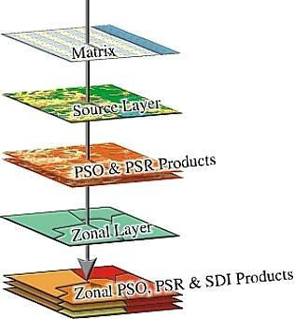
Geo-referencing
Georeferencing allows two different digital maps to properly align with each other (Fig. 4.15). Not all digital maps are georeferenced. However most maps in precision agriculture have been created with GPS which calculates coordinates as the data is being collected and are therefore georeferenced. Georeferencing is a key concept that underlies all GIS functions.
Fig. 4.15. Shown is a digital map laid on top of an aerial image. Notice how they align perfectly. This is because both layers are georeferenced and so are aligned (Upper Midwest Environmental Sciences Center - U.S. Geological Survey).

Slide 25
Data Formats: Vector or Raster
The previous section discussed the two components of a GIS, the map and the table. Data layers used within a GIS will have locational data (where an object is located and provides the georeferencing for the map) and attribute data (characteristics of the object for the table). Data formats refer to how the locational and attribute data is stored and displayed. Vector and raster are two types of data layers that are used in precision farming.

Slide 26
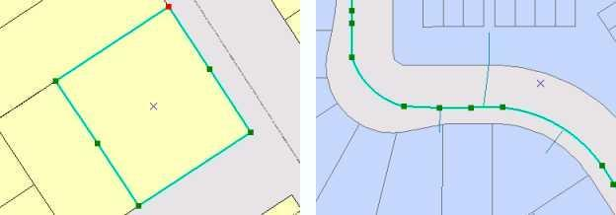
Vector
Vector data formats use “vertices” (plural of “vertex”) and “segments” to create points, lines, and polygons to represent objects.
Points are only vertices with no segments since they only show location.
Lines are made up of at least two vertices and a segment connecting the vertices.
Polygons are made up of at least three vertices and segments connecting them to create an enclosed area.
This is important because it is the vertices that include the coordinate positions that make the feature georeferenced.
Fig. 4.16. Vertex are points and segments are the lines that connect them. Together they are used as “connect the dots” to create lines and polygons. (resources.esri.com)

Slide 27
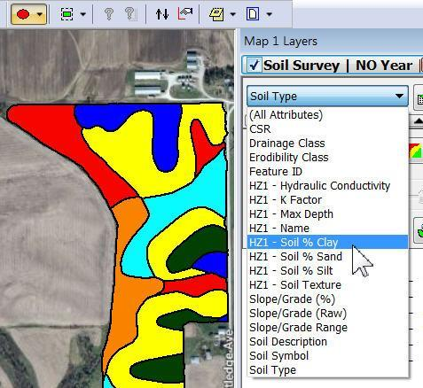
Vector
A digital soil type map, such as shown in Fig. 4.17, contains many polygons, each representing a specified soil type. Many GIS will have a default or proprietary file format for the data layer. Each will have their own structure for how the map and attribute data is stored within the file.
Fig. 4.17. This soil type map is an example of a vector data layer made up of polygons. An advantage of a vector data layer is that each feature in the data layer has an unlimited number of attributes and attribute values that can be stored in the table (Source: www.agleader.com).

Slide 28
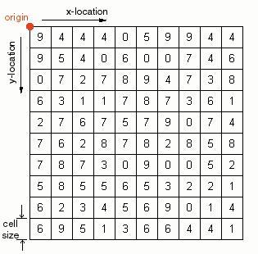
Raster
Raster data format stores data in a grid, a series of rows and columns that form grid cells (also known as pixels) (Fig. 4.18). Each grid cell represents a specific area in the real world. Rasters are sometimes referred to as a “surface” because most rasters represent a surface area with grid cells. Each pixel has locational data and has ONE attribute value. This is much different than vector which can store many attribute values for a feature.
Fig. 4.18. A raster is made up of pixels, each pixel has one value which is symbolized by a color. Instead of an attribute table, one data value is stored in the grid cell (Source: courses.washington.edu).

Slide 29
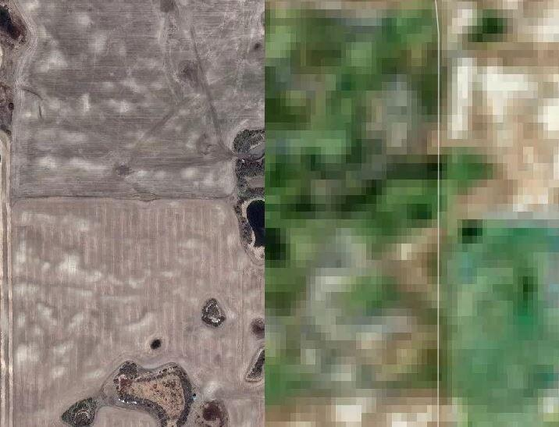
Raster Image
Raster can be broadly categorized into two types: raster image and raster grid. Raster images (Fig. 4.19) are georeferenced digital photographs. The main characteristic of a raster image is that the one attribute associated with each pixel is a color value.
Fig. 4.19. An image raster is made up of pixels, each pixel has one value which is related to a color. Putting all of the pixels together creates the image. When viewed closely, you can see the individual pixels. The image raster to the left shows features of an agricultural field. The image to the right shows the individual grids at an unappropriately close zoom level, making it difficult to see the image (Source: Google Earth).

Slide 30
Raster Image
There are various systems that provide a specific color with a number value. For example a 256 color grayscale uses numbers from 0 to 255 to indicate ranges of color from white (0) to black (255).
A value within a pixel of 124 would make that pixel display as a shade of gray. Individually, pixels of black, white or gray don’t look like much, but when looking at several thousand pixels together they create an image.

Slide 31
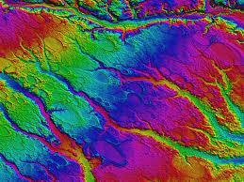
Raster Grid
Raster grids have only one value per pixel, like a raster image. But unlike a raster image, that value is an attribute value and not just a color. The attribute value is typically a continuous value that represents elevation (Fig. 4.20), yield, nutrients, or distance to a specific objects
Fig. 4.20. A grid raster is made up of grid cells. Each grid cell has one value related to the data being mapped. The raster to the left is a digital elevation model so each grid cell contains an elevation value (File:Rex, NC LiDAR DEM of Carolina bays.jpg).

Slide 32
Raster Grid
As an example, we will use a raster elevation data layer. Each pixel represents a specific area and the value within a pixel represents the elevation of that area. If the pixel value is 124.763, that is the elevation for the area represented by the pixel.
Raster images are usually created using a camera or sensor to capture light reflectance. Raster grids are usually created using GIS analysis. As an example, interpolation is an analysis tool that uses a vector point data layer to create a raster grid surface. There will be several examples of tools that create raster grids in a following section.

Slide 33
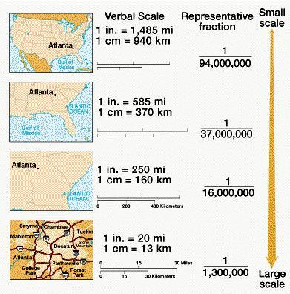
Scale
Fig. 4.21. These three examples of scale show the same stream. The far left is considered small scale (1/100000). The far right graphic shows only area C but in larger scale (1/25000) or in other words larger detail. (Source: mygeoskills.wordpress.com).

Slide 34
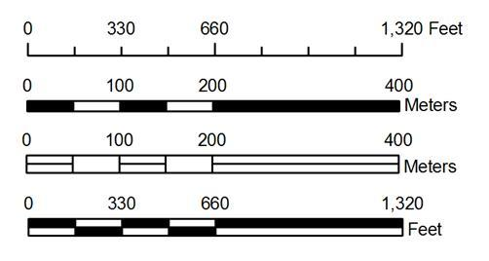
Scale
Fig. 4.22. These are two examples of a scale bar. The top one shows the scale at 1:62500 and a converted scale of 1 inch to 1 mile. The converted scale is easier for people to use to convert a map measurement (inches) to real world measure (miles). (Source: forestry.sfasu.edu).

Slide 35
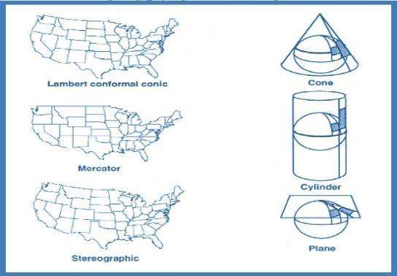
Projection
Projection is the process of transforming a spherical earth unto a flat surface map. A flat map of a sphere will always contain distortions. Either the direction, shape of an object, or a calculated area of an object will be incorrect.
Fig. 4.23. Trying to project a round sphere onto a flat surface is difficult and will always result in some type of error. Geographers have developed several ways of doing this including a conical or cylindrical. There will always be some type of distortion. (Source: healthcybermap.org).

Slide 36
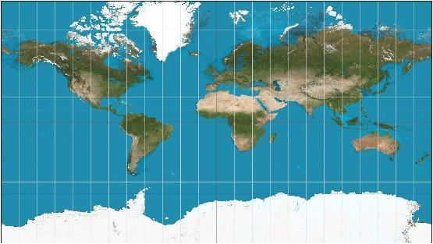
Projection
Fig. 4.24. The view of the globe on the left shows a more realistic view of North America. Greenland and Canada do not look as large as the map shown on the right. The further north a polygon feature is, the more it will be distorted to look larger (Globe: CC0 Public Domain, Mercator: Creative Commons Attribution-Share Alike 3.0).

Slide 37
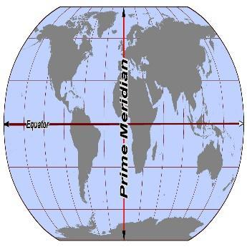
Coordinates
Fig. 4.25. The sphere represents the globe with two reference lines: the equator dividing the north hemisphere and south hemisphere; and the Prime Meridian (PM) dividing the east hemisphere from the west hemisphere. These reference lines represent the starting point for latitude (equator) and longitude (PM) Any coordinate north of the equator has a positive value; anything south of the equator has a negative value. Anything east of the PM has a positive value; anything west of the PM has a negative value. (Wikimedia Commons)

Slide 38
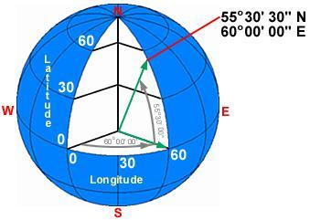
Coordinates
Fig. 4.26. To calculate a latitude, the angle between the line from the equator to the center of earth and the line from the location to the center of the earth needs to be determined. Latitude and longitude are basically the angle from the center of the earth. The example point location is a 60 degree angle east of the PM. The latitude is 53 degrees, 30 minutes, and 30 seconds north of the equator. Using minutes and seconds allow a more specific location. (Source: www.geo.hunter.cuny.edu )

Slide 39
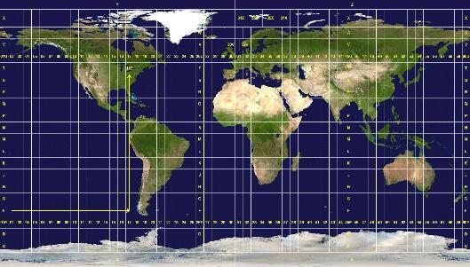
Coordinates
There are other coordinate systems such as the UTM (Universal Transverse Mercator) which is based on a grid system placed over the flattened map of the world. Each grid having its own set of coordinates (Fig. 4.27).
Fig. 4.27.
Fig. 4.27. This world map of UTM grids show how the earth is divided into columns and rows. Each grid serves as its own coordinate system. Northings and Eastings are calculated for each grid (Source: Wikimedia Commons).

Slide 40
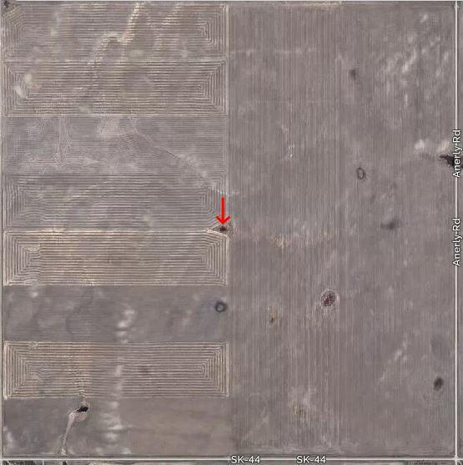
Coordinates
Universal Transverse Mer-cator coordinates are known as “Northings” and “Eastings” and are actually linear measures (meters) from each grid’s starting reference line. Coordinates in linear measure are much easier to follow for navi-gation and to calculate distance of area (Fig. 4.28).
The location of the arrow shown in this field is provided using three different formats of coordinates. (GCS = Lat, Long / UTM = Easting, Northing) GCS (Decimal Degrees) = 52.074310° lat., -108.318007 ° long.GCS (Degrees, Minutes, Seconds (DMS) 52° 4’ 27.5160”N lat., 108° 19’ 4.8252”W long. UTM = 6 837 798.89, 5 772 697.61 (Source: Google Earth)

Slide 41
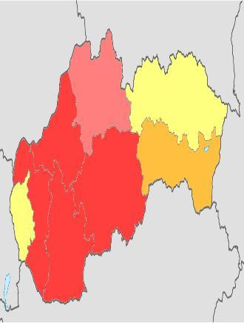
Fig. 4.29. This graphic demonstrates a vector polygon map with a low thematic resolution. Polygons could be assigned additional attributes to differentiate them in more detail (Source: Wikimedia Commons)

Slide 42
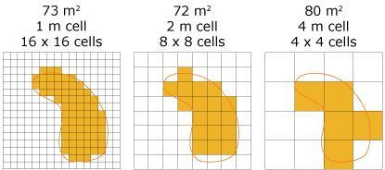
Fig. 4.30. This graphic demonstrates the effect of different pixel resolution on how an object is displayed in a raster. The smaller the pixel size, the more detail the feature has (Source: webhelp.esri.com).

Slide 43
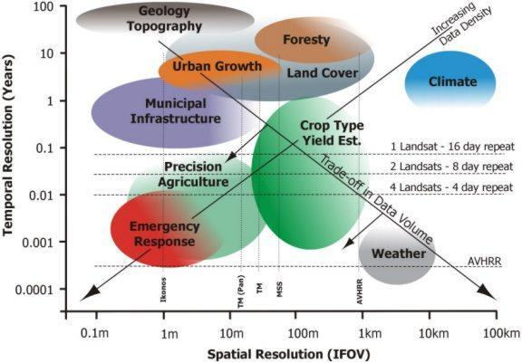
Fig. 4.31.
This graphic shows a comparison of spatial resolution and temporal resolution and the impact it has on different field of study within remote sensing. The Y axis showing temporal analysis indicates the interval of data collection (Source: geog.ucsb.edu).

Slide 44
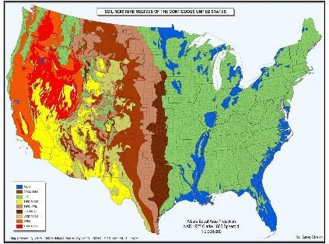
Fig. 4.32. This is a thematic map of the United States in which each province is given a different color. In GIS this is called “symbology” and it helps the user to visualize the data. (Source; Wikipedia)

Slide 45
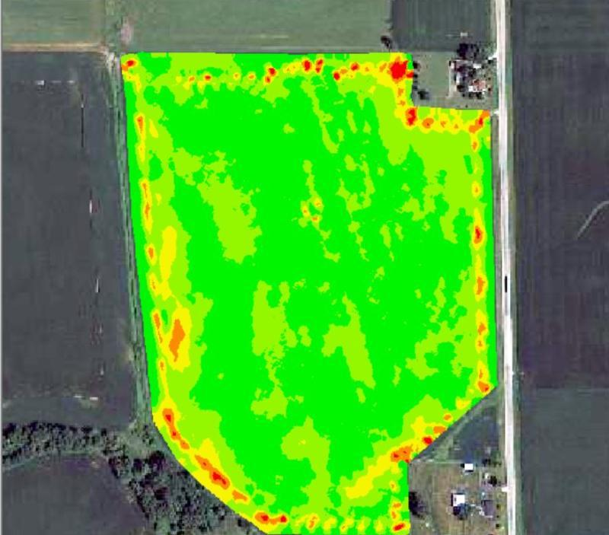
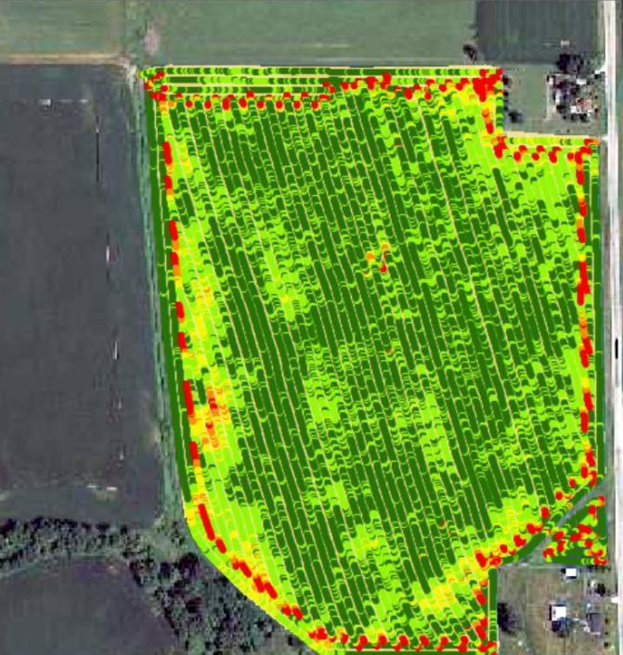
Fig. 4.33. These two maps are two different visualization of the SAME yield data layer. The yield values have been categorized in two different ways, resulting in two different maps (Source: Brase, Kirkwood Community College; ArcGIS).

Slide 46
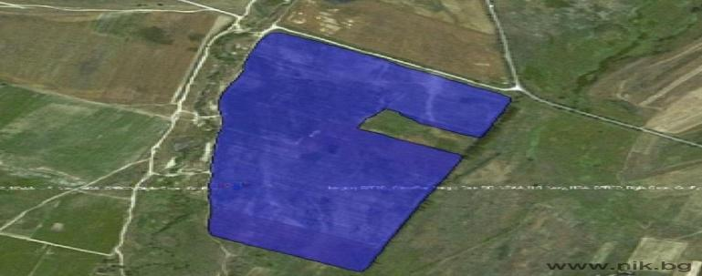
Fig. 4.34. The blue polygon (vector) represents a field boundary being compared to the raster image for accuracy. Any accuracies can be corrected by editing the vertexes(Source: ESRI ArcGIS).

Slide 47
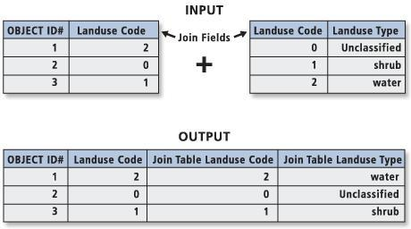
Fig. 4.35. The top left table is aspatial with no location data. The top right table is spatial with location data. After joining, the data in the aspatial table is now included in the spatial table. Joining requires a column in each table with matching data. Those two columns are highlighted in the graphic (Source: resources.esri.com).

Slide 48
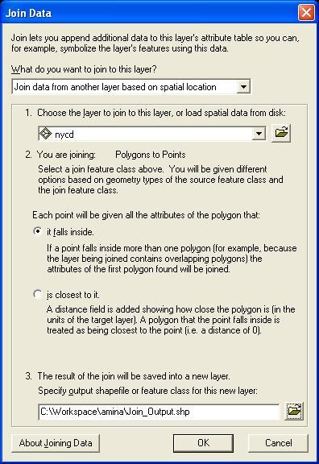
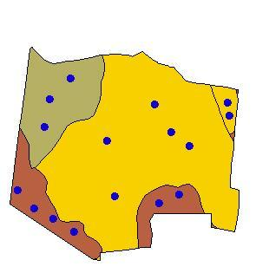
Fig. 4.36. In this example of a spatial join the attributes of the polygon (soil type data) to each point (soil sample points) that is within the respective polygon. This is known as a Polygon to Point spatial join (Source: http://geography.vt.edu/).

Slide 49
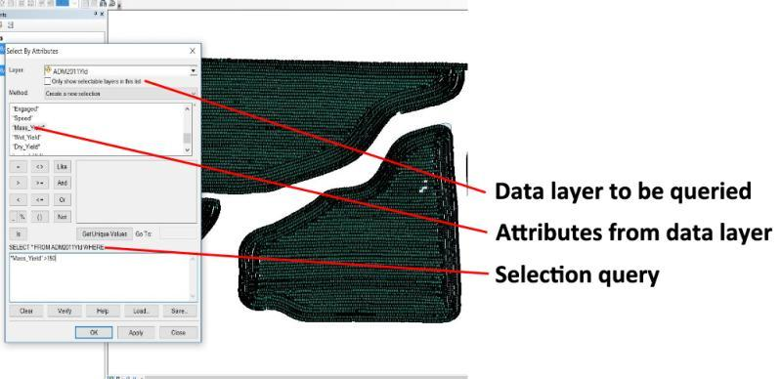
Fig. 4.37. A Select by Attribute tool allows a user to identify any attribute to query and then set the criteria for selection (Source: ESRI ArcGIS).

Slide 50
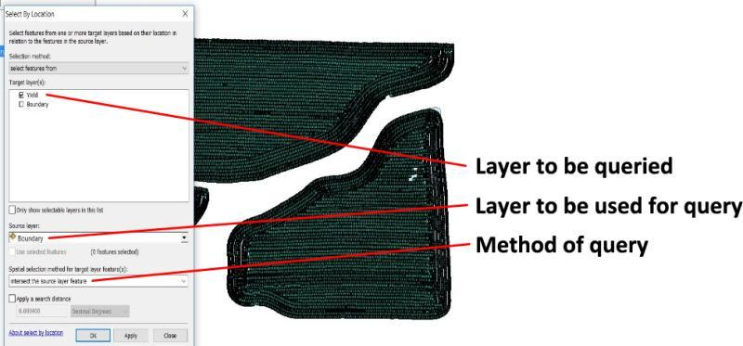
Fig. 4.38. The Select by Location tool in ArcGIS allows you to identify the features that you want to query based on adjacency or distance to other features. Adjacency refers to proximity of objects or raster grid cells next to each other. (Source: ESRI ArcGIS )

Slide 51
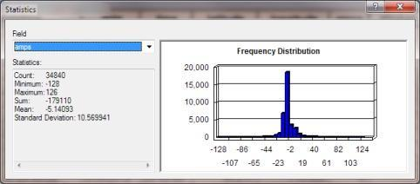
Fig. 4.39. A statistical summary can be displayed for any attribute or queried data set, which can be useful for interpreting data. (Source: ArcGIS)

Slide 52
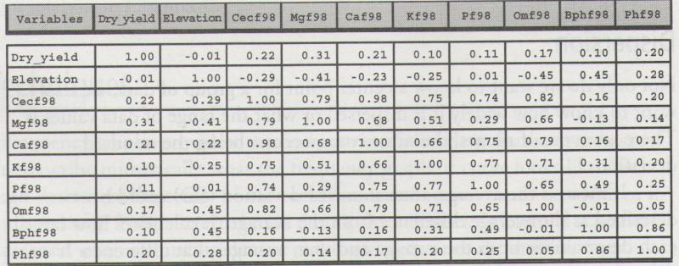
Fig. 4.40. This is an example of a correlation matrix using a joined yield and soil nutrient table. This takes each attribute within a data layer’s table and calculates a correlation value. (Source: ArcGIS)

Slide 53
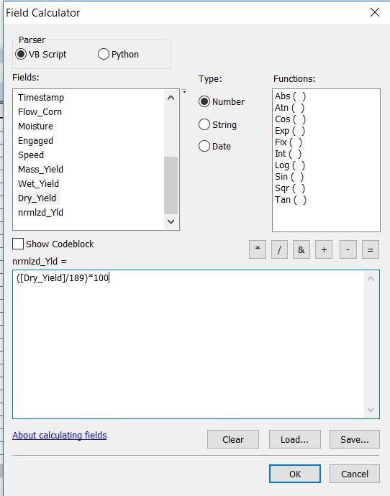
Fig. 4.41. Attribute fields are listed in the “Fields” window; mathematical functions available for calculations; and operations available are buttons. The formula is built within the bottom window. Advanced scripts can also be used that allow for great flexibility. (Source: ArcGIS)

Slide 54
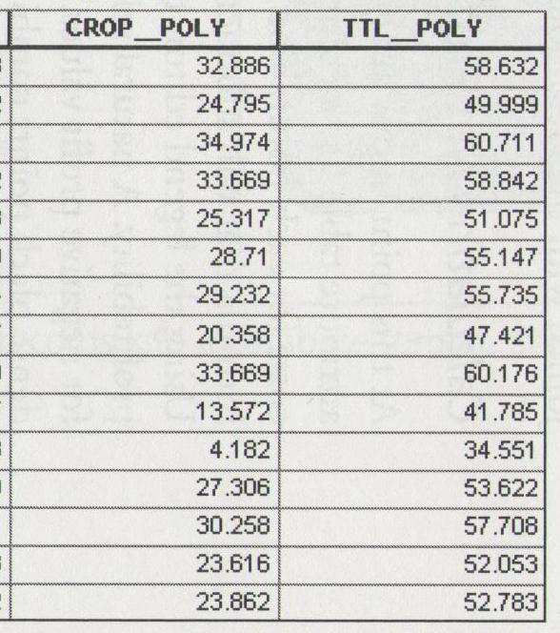
Fig. 4.42. This is an example of two new attributes that were calculated using field calculator. Attributes of costs, and area were used to determine per unit costs and total costs. With this tool a grower can do numerous financial and production calculations. (Source: ArcGIS)

Slide 55
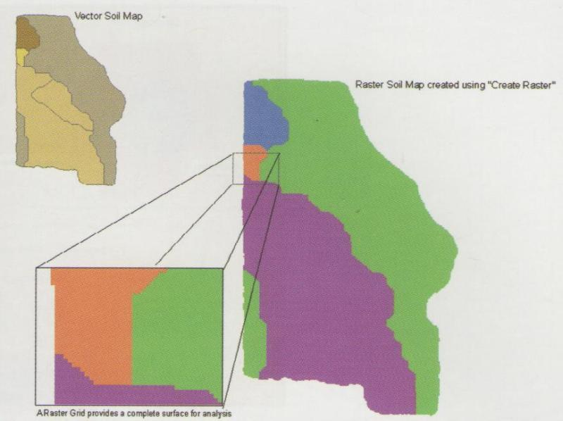
Fig. 4.43. The map in the upper left is a vector soil type data layer. There are 6 different polygons, each representing a different soil type. Each of the polygons have multiple attributes in its table. After the Convert to Grid tool is used, the raster grid looks similar to the original vector layer. In the closeup, the individual grid cells can be seen (Source: ArcGIS).

Slide 56
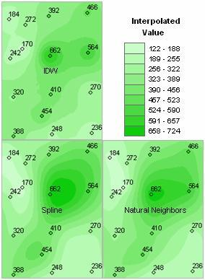
Fig. 4.44. The input for interpolation is vector point data. These points could be soil sample points with nutrient test results, elevation points, yield points, or pest counts. Point data will always have gaps and irregular spaces. Interpolation creates a regular set of grid cells which can be analyzed (Source: resources.esri.com).

Slide 57
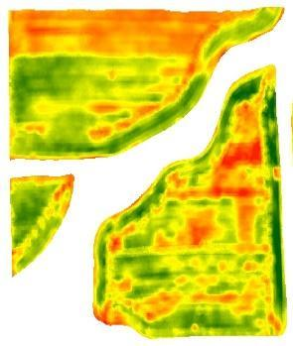
Fig. 4.45. Interpolated nutrient and yield maps are common in precision agriculture. They allow for raster analysis techniques and visualization of patterns better than point data. They also have the effect of smoothing the data (Source: ESRI ArcGIS).

Slide 58
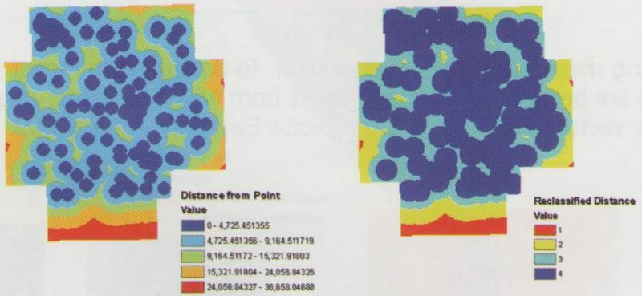
Fig. 4.46. Reclassification is different than Classification. The map on the left has been classified; that is all the data values have been placed into categories and symbolized with a color. The map on the right has been reclassified; the values have been categorized and symbolized, but also changed to integer type of data. Integer data is needed for some further analysis tools. (Source: ArcGIS)

Slide 59
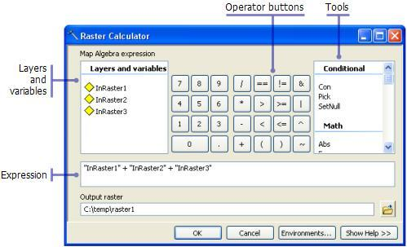
Fig. 4.47. The raster calculator looks similar to the field calculator, however it lists all raster data layers that are available for calculations instead of a vector layer’s attributes. Within the expression area, an infinite number of formulas can be written to analyze and interpret data. (Source: ArcGIS)

Slide 60
Fig. 4.48. After standardizing yield values for different crops or different years and interpolating the yield points, raster calculator can be used to find percent of yield change for each grid cell over time. (Source: ArcGIS)

Slide 61
Fig. 4.49. Many devices that deal with color images use either RGB (red, green, blue) or CYM (Cyan, Yellow, Magenta) systems. These base colors can be mixed to create many other colors. GIS uses RGB system as channels to display color images (Source: TeXample.net).

Slide 62
Fig. 4.50. This is the tool used to assign bands from an image to channels in a GIS. This combination would be known as a 412: Band 4 (NIR) in the red channel; Band 1 (Blue) in the green channel; and Band 2 (Green) in the blue channel. This would create a false color image (Source: ArcGIS).

Slide 63
Fig. 4.51. This graph compares the spectral signature of 5 different types of trees compared to a row crop plant. Light reflects differently off of each object and a sensor would capture this reflectance. Notice the high reflectance rate for infrared and the difference in its reflectance for the different objects. This is why infrared is used to identify objects in imagery (Source: Wikimedia Commons).

Slide 64
Fig. 4.52. Even more useful is the use of infrared sensors for identifying plant health and vigor. Notice the differences in reflectance values for infrared and red (Source: micasense.com).

Slide 65
Fig. 4.53. Similar to the field and raster calculators, band math calculators will have options for functions, operators, and most importantly bands. Multispectral imagery comes as a composite image with 4 or more bands (example graphic has 6 bands) which are used to create formulas and indexes (Source: ENVI).

Slide 66
Fig. 4.54. This is an example of an NDVI. Vigorous and healthy plants with NDVI values of +1 are symbolized as dark green; low vigor, unhealthy plants with NDVI values closer to -1 are symbolized as dark red (Source: ESRI ArcGIS).

Slide 67
Fig. 4.55. The green areas of this map are those areas that have been consistent in yield values (could be high or low). The red areas have shown a lot of difference in yield from year to year. This was created by subtracting yields between four different years and then adding the absolute value of those three layers together (Source: ArcGIS).

Slide 68
Fig. 4.56. The green areas of this map are those areas that have a high average yield. The red areas are those areas that have a low average yield. (Source: Brase, ArcGIS)

Slide 69
Fig. 4.57. Combining the average yield and stability map creates a map that shows stable and consistently high yielding areas. This can be interpreted as areas that have higher potential yield and product applied at a higher rate. (Sorce: Brase ArcGIS)

Slide 70
Fig. 4.58. Shown here is a yield map of three areas of a field on which a product was applied at three different rates (14 oz, 10.5 oz, 0 oz). All of the yield points for each of the application rates were queried and selected for analysis. A test of significance was used to determine if there were differences between the three areas (Source: ArcGIS).

Slide 71
Fig. 4.59. Several methods exist to create zones, which are homogenous areas. The green areas in this map have been identified as being more similar for specified factors than the yellow or red areas. Therefore similar and unique management decisions can be made for those areas (Source: ArcGIS).

Slide 72
Fig. 4.60. This generic zonal statistics graph shows the averages for seven different zones. If each zone represents a homogenous area, then an average for that area can show differences for decision making. This does not show significant differences, but it can determine where differences may exist (Source: ArcGIS).

Slide 73
Summary
Geographic Information System is a comprehensive geospatial tool that works with other geospatial and precision farming tools to collect, store, organize, edit, analyze, and interpret spatial data. With proper usage a user can create map products that can help a precision farming grower make a decision.

Slide 74
Study Questions
Describe in your own words the characteristics of the two components of a GIS: Map and Attribute Table.
Several examples of GIS are provided within this chapter. Find and research two GIS not listed and describe their characteristics and functions.
In mapping a fenceline around a field, it is most appropriately done as a line feature. Discuss if you agree or disagree with this statement and provide justification for your position.
An example of an attribute data is zip code such as 93210. What type of data is this? Explain your answer.
Using a paper map, determine the GCS and UTM coordinates of your current position. Confirm with GPS or your instructor.
Though the chapter lists several examples of agricultural data layers, there are many other specific examples. List 5 other specific data layers that could be collected for an agricultural field.
Explain the difference between the GIS tools’ “field calculator” and “raster calculator”.
A grower wants to know economic justification for using a new soil amendment product. What data would be needed and how could a GIS be used to determine this?
Research examples of FMIS that provide: a) sales support; b) communication; and c) quality assurance. Give a brief description of each.

