Slide 1
Satellite-based
Positioning Systems for
Precision Agriculture
Chapter 3

Slide 2
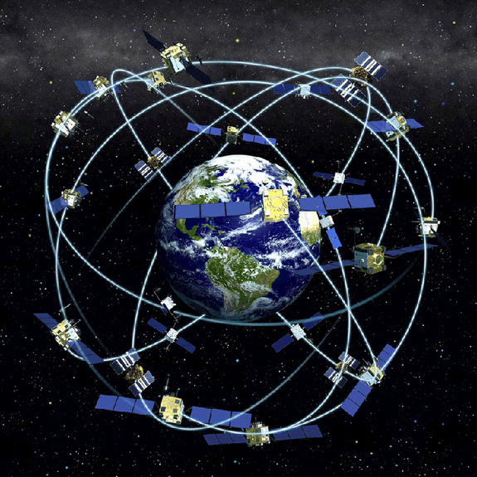
The History of GPS
Feasibility studies begun in 1960’s.
Pentagon appropriates funding in 1973.
First satellite launched in 1978.
1990’s Used in Persian Gulf War
System declared fully operational in April, 1995.
Department of Defense (DoD)

Slide 3
Terms
Global Navigation Satellite Systems (GNSS)
  collective group of satellite-based positioning systems.
Global Positioning System (GPS)
  GPS is a Part of GNSS
GLONASS (Globalnaya Navigazionnaya Sputnikovaya Sistema)
  maintained by Russia.
Dilution of Precision (DOP):
  The configuration of the satellites at any point in time is quantified by the
Horizontal (HDOP), Vertical (VDOP), and Time (TDOP) dilutions

Slide 4
Three Segments of the GPS
Space Segment
User Segment
Control Segment
Ground
Antennas
Master Station
Monitor Stations

Slide 5
Four Basic Functions of GPS
Position and coordinates.
The distance and direction between any two waypoints,
or a position and a waypoint.
Travel progress reports.
Accurate time measurement.

Slide 6
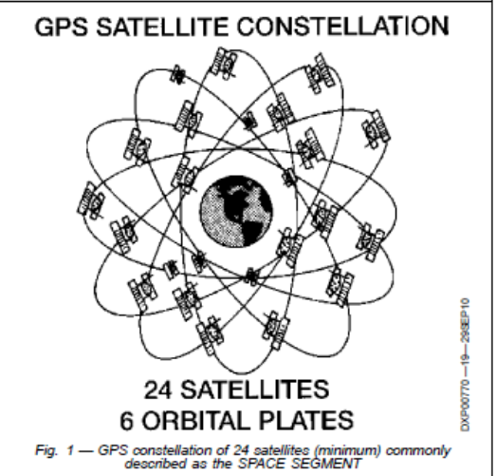
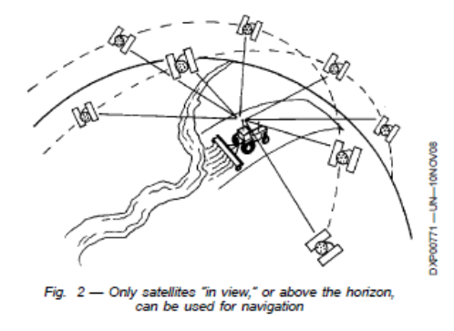
NAVSTAR, Space Segment
24+ Birds
24 Active 4 Spare
  Consistently repaired/replaced.
6 paths or plates
12 hr orbit
2 or 3 atomic or nuclear clocks,
  2/2 cesium rubidium; now 3 rubidium

Slide 7
Control Sector
Several Monitoring Stations
1 Master Control
  Colorado Springs Co.
MC, computes clock errors
tracks orbits.
Sends corrective info back
to satelite.

Slide 8
User Segment
Military.
Search and rescue.
Disaster relief.
Surveying.
Marine, aeronautical and terrestrial navigation.
Remote controlled vehicle and robot guidance.
Satellite positioning and tracking.
Shipping.
Geographic Information Systems (GIS).
Recreation.

Slide 9
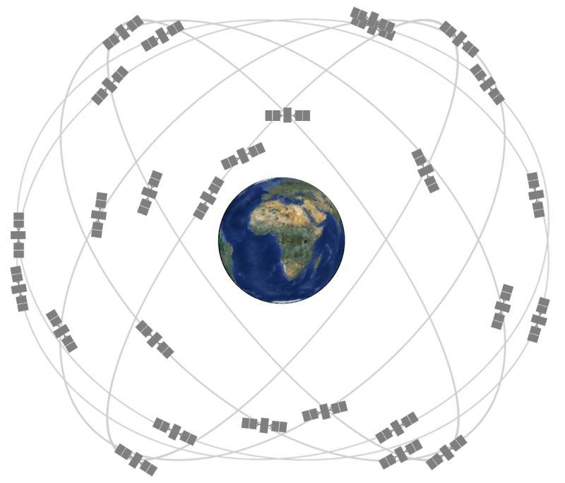
Satellite Ranging
Most GNSS satellite systems consist of multiple satellites flying in middle earth orbit planes, which places them just over 20,000 km above the earth surface. GPS, as an example, was originally comprised of 24 core satellites in six different orbital planes. In 2011, the constellation was modified to be comprised of 27 core satellites (Fig. 3.1).
Fig. 3.1.
Location of GPS satellite orbital planes.

Slide 10
Satellite Ranging.
Each satellite transmits
  Position
  Timing

Slide 11
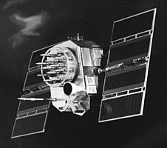
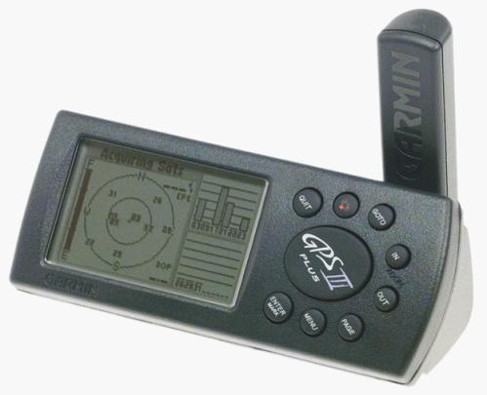
Position is Based on Time
Signal leaves satellite at time “T”
T
Signal is picked up by the receiver at time “T + 3”
T + 3
Distance between satellite and receiver = “3 times the speed of light”

Slide 12
Pseudo Random Noise Code
Time Difference
Satellite PRN
Receiver PRN

Slide 13
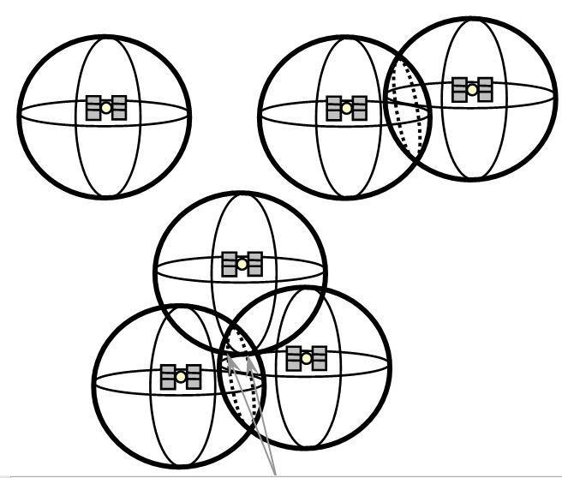
A GNSS receiver uses the distance measurements between itself and multiple satellites to calculate its location and elevation using a mathematical technique called triangulation
Fig. 3.2.
Illustration of triangulation position determination using one satellite (left), two satellites (center) and 3 satellites (right).

Slide 14
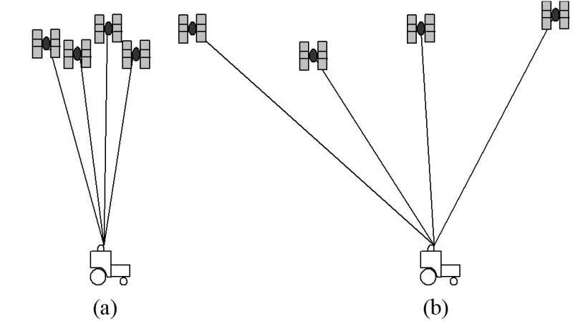
Satellite Configuration
The accuracy of a triangulation computation can be greatly affected by the relative positions of the satellites being used. If all the satellites happen to be clumped close together at one location (Fig.a), the triangulation computation will not be as accurate as if the satellites are spread or distributed evenly above the horizon (Fig.b).
Fig. 3.3.
Satellite configurations showing poor (a) and good (b) DOP.

Slide 15
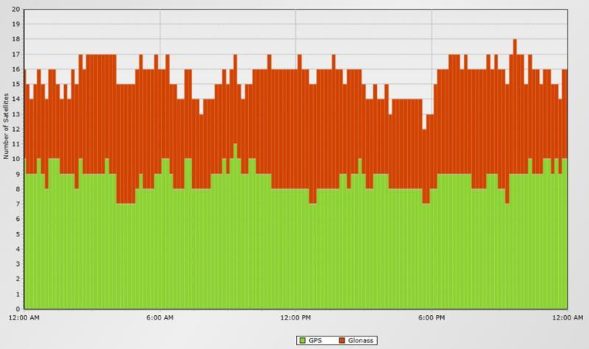
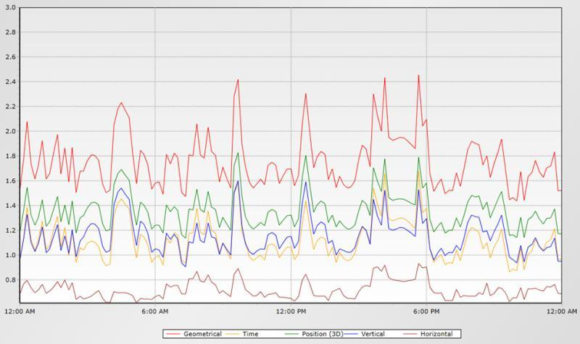
http://gnssmissionplanning.com/App/Settings
DOP can be predicted with orbital models. Some users needing utmost precision will plan to do field work during the times of the day when the satellites will be in the best configuration.
Fig. 3.4.
Example output from an online GNSS planning software showing the expected number of satellites available (left) and various measures of DOP (right) for a 24-hour period in a given location for a receiver that would be utilizing both GPS and GLONASS satellites

Slide 16
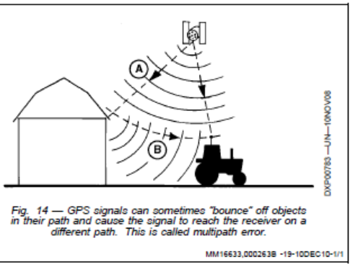
Accuracy and Factors Affecting it
Satellite Clocks
Satellite Orbit
Earths Atmosphere
Multi-Path Errors
GPS Receiver

Slide 17
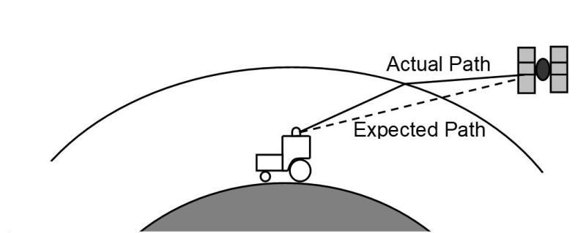
Atmospheric Interference
As radio waves enter the earth’s atmosphere, they can be bent or refracted much the same way light is refracted when it passes through a water surface (Fig. 3.5).
Fig. 3.5.
Illustration of atmospheric effects on radio signals.

Slide 18
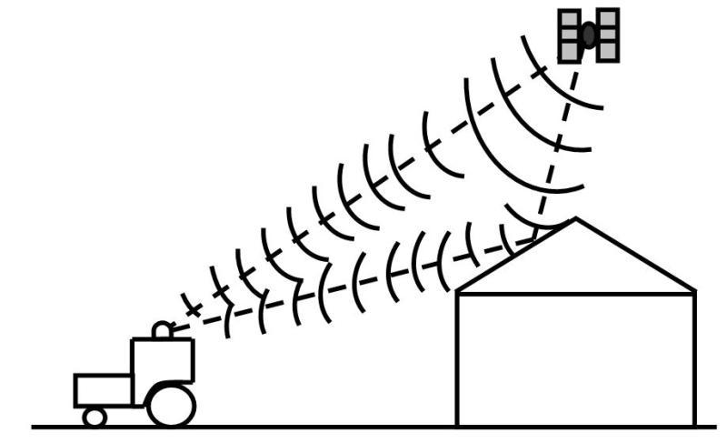
Multipath errors
GNSS transmission could come straight to the receiver and also bounce off of a building causing the same signal to arrive at the receiver a short time after the initial receipt (Fig. 3.6). Multipath errors can cause significant problems with GNSS receivers especially when operating around objects that reflect radio waves such as metal buildings and bodies of water.
Fig. 3.6.
Illustration of multipath errors in GNSS transmissions.

Slide 19
DGPS
Differential Correction.
1 or more stationary GPS
receivers located at
surveyed positions.
Typical Error GPS DGPS
Clock 3-8ft <1ft
Orbit 3-8 <1
Lanoshpere 6.5-16 1.4
Tropo 1.6-3.3 .7
Multipath 1.6-5 1.6-5
Reciver Noise 1-3 1-3

Slide 20
Sources of Real-Time DGPS
Nationwide Differential DGPS, (U.S. Coast Guard Beacon System)
Local Base Station, User Supplied
Satelitte-based differential Corrections (WAAS, Starfire®, OminiSTAR®, ect.

Slide 21
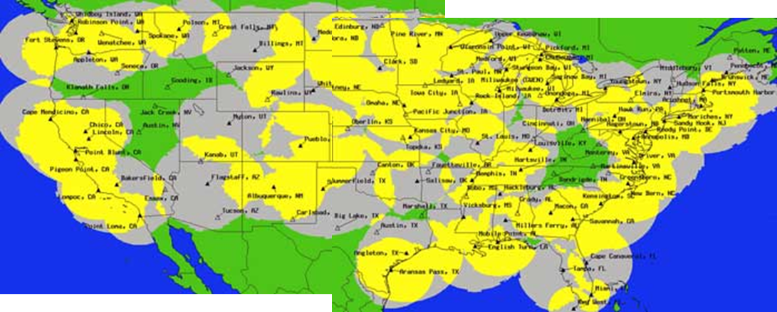
USCG Radio Beacon
285kHz-325 kHz

Slide 22
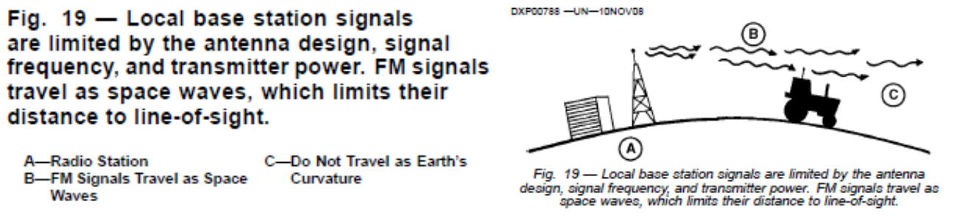
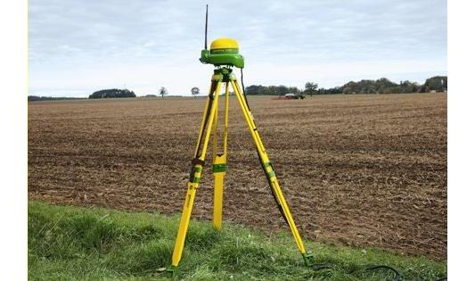
Local base Station
900 MHz-2.4GHz, Am or Fm Style (50-60 miles)
RTK-
Real Time Kinematic
Centimeter Accuracy
http://www.precisepath.com/​

Slide 23
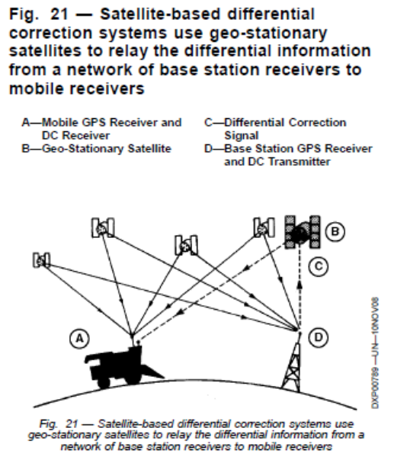
Satellite-Based DGPS
WAAS, Starfire®, OminiSTAR®
Geo-Stationary Satellites
Orbits keeps it over the same
point on the ground.
Orbits the same speed as
Earths Rotation
Commonly used for TV
broadcast.

Slide 24
WAAS
Wide Area Augmentation System (WAAS) is an air navigation aid developed by the Federal Aviation Administration (prime contractor Raytheon Company) to augment the Global Positioning System (GPS),
WAAS uses a network of ground-based reference stations, in North America and Hawaii, to measure small variations in the GPS satellites' signals in the western hemisphere.
The WAAS specification requires it to provide a position accuracy of 7.6 metres (25 ft) or better (for both lateral and vertical measurements), at least 95% of the time.^{[2]} Actual performance measurements of the system at specific locations have shown it typically provides better than 1.0 metre (3 ft 3 in) laterally and 1.5 metres (4 ft 11 in) vertically throughout most of the contiguous United States and large parts of Canada and Alaska.^{[3]} With these results, WAAS is capable of achieving the required Category I precision approach accuracy of 16 metres (52 ft) laterally and 4.0 metres (13.1 ft) vertically.^{[4]}

Slide 25
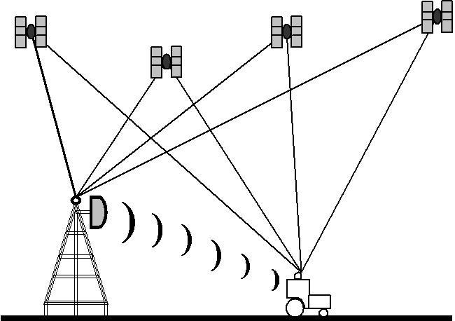
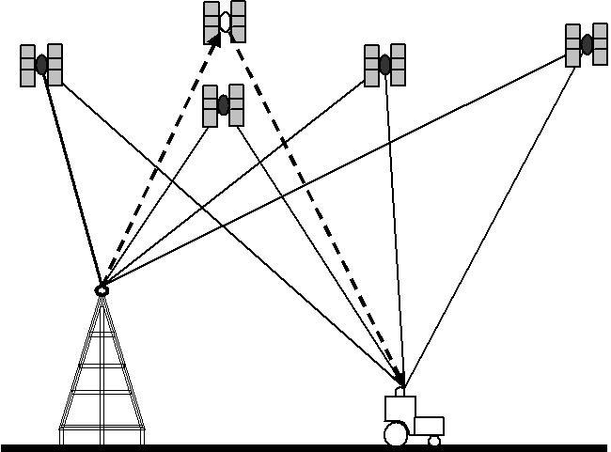
Fig. 3.7.
Illustrations of local area (left) and wide area (right) DGNSS systems.

Slide 26
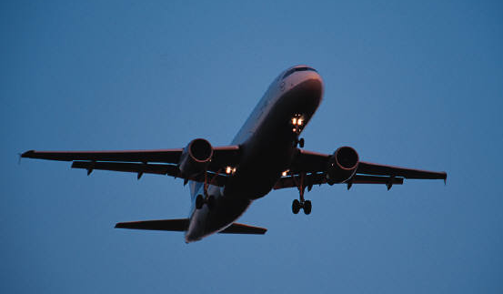
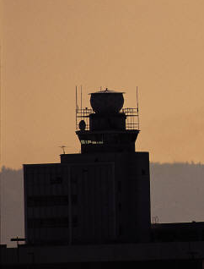
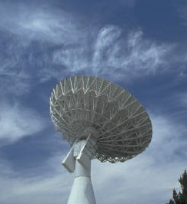
Wide Area Augmentation System
Geostationary WAAS satellites
GPS Constellation
WAAS Control Station (East Coast)
WAAS Control Station (West Coast)
Local Area System (LAAS)

Slide 27
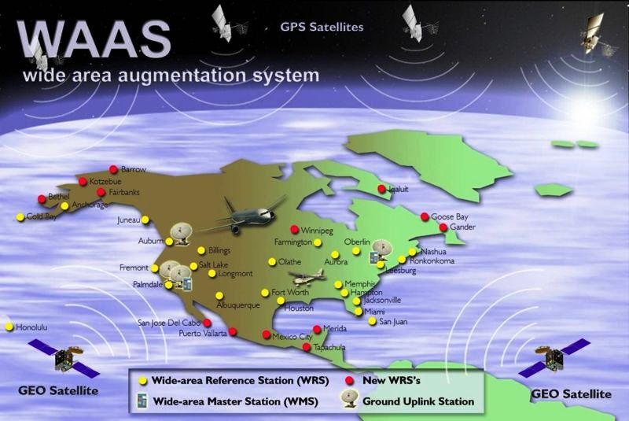
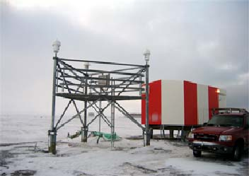
WAAS Reference Station
Barrow Alaska

Slide 28
How good is WAAS?
With Selective Availability set to zero, and under ideal conditions, a GPS receiver without WAAS can achieve fifteen meter accuracy most of the time.*
+-15 meters
+ -
3 meters
Under ideal conditions a WAAS equipped GPS receiver can achieve three meter accuracy 95% of the time.*
* Precision depends on good satellite geometry, open sky view, and no user induced errors.

Slide 29
Others
StarFire – John Deere (approx $800 annual)
Omni-Star- American Mobile Sat Corp. (
GLONASS- Russia’s Global Nav
GALILEO- European Space Agency

Slide 30
Love this Pic

Slide 32
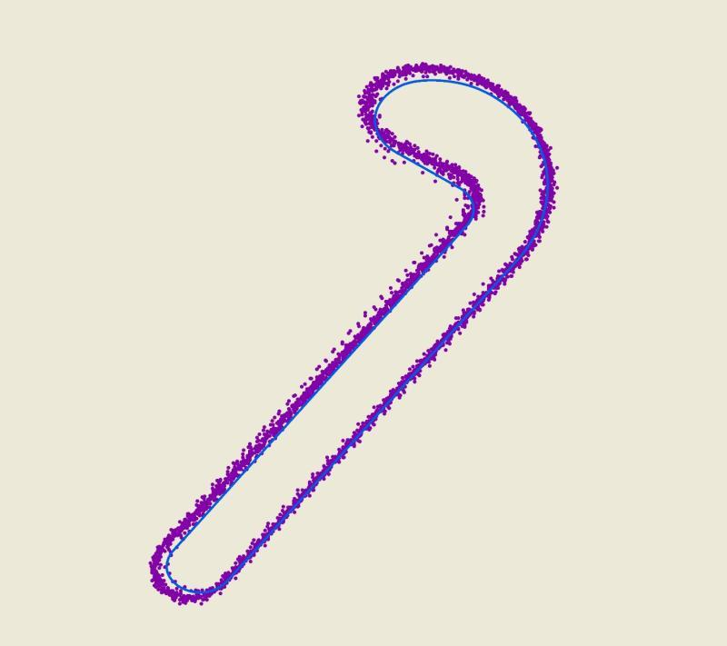
Fig. 3.8.
Example of dynamic GNSS performance from a receiver traveling clockwise on a serpentine track that shows incorrect indication of overshoot on corners.

Slide 33
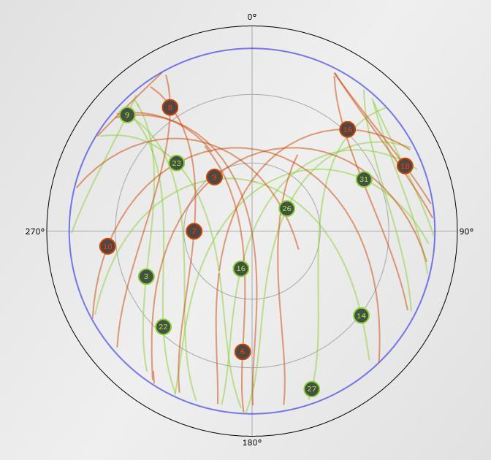
Fig. 3.9.
Plot of satellite paths on a particular day as viewed vertically from a point on the northern hemisphere of the earth.

Slide 34
Video
Video 3.1.
What is GNSS? http://bit.ly/what-is-GNSS
Video 3.2.
How accurate are GNSS receivers? http://bit.ly/accuracy-GNSS-receivers
Video 3.3.
What is differential correction? http://bit.ly/differential-correction
Video 3.4.
What accuracy do I need? http://bit.ly/what-accuraccy-do-I-need

Slide 35
Questions
What is the minimum number of satellite signals needed for a GNSS receiver to compute a three-dimensional position? Explain.
Use internet resources to explore the status of the GPS constellation and report the total number of satellites currently functional in the constellation, how many have L2C capabilities, and how many broadcast the L5 codes.
Use internet resources to explore the CORS stations in your state. Print a state map showing all of the locations. For the one closest to your location, find out where it is and when it was established.
A farmer wants to purchase an RTK GNSS system for a farm. The base station antenna will be placed on the top of a centrally located grain bins. If the accuracy of the RTK GNSS system is 1.5 cm + 4 ppm, what is the accuracy at a field located 35 km away?
For a particular date and location, use a constellation modeling tool to plot the availability of GPS and GNSS satellites and the DOP values. Are there particular times of the day that would be really good or potentially bad for GNSS work? Explain how absolute and relative accuracy of GNSS receivers would affect their use in machine guidance applications.
Why would an accuracy test for a GNSS receiver that lasted for one hour not be a good indication of the performance of the receiver?
A farmer has a field that is bordered on one side by a large manufacturing facility that is in a three-story metal-clad building. Why might their GNSS equipment perform poorly near that edge of the field?
A GPS satellite is at an altitude of 20,100 km directly above a receiver. Calculate how many wavelengths of the L1 and L2 GPS frequencies there would be between the satellite and the receiver.
A farmer in Canada is getting ready to plant a field that is perfectly square and nearly completely flat with a GNSS–based autosteer system. Which direction (N–S or E–W) should they plant the field to get the best guidance accuracy? Explain your reasoning.

