Slide 1
Nicole Remondet

Slide 2
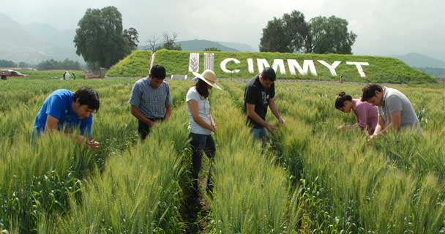
Outline of presentation
What is CIMMYT?
History of CIMMYT, Introduction to Norman Borlaug!
Dr. Borlaug’s contributions
CIMMYT Today
Importance
CIMMYT Technologies
Conclusion
Works Cited

Slide 3
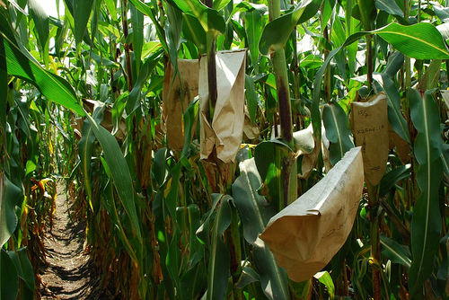
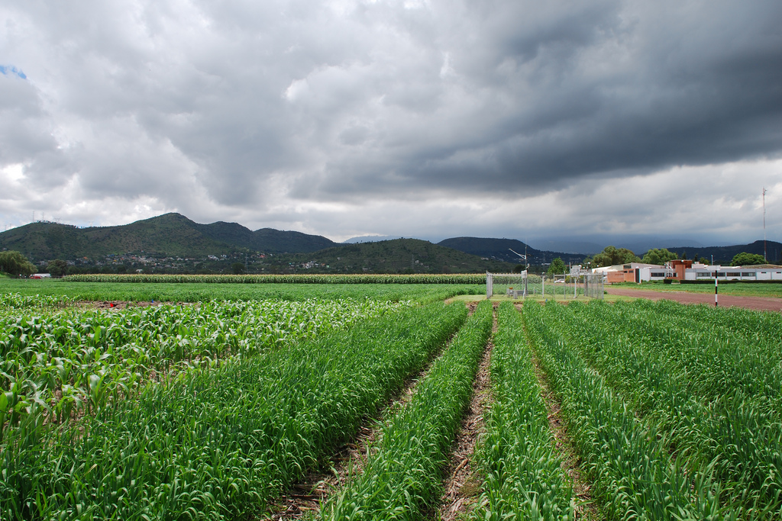
What is CIMMYT?
CIMMYT which is a Spanish acronym for Centro Internacianal de Mejoramiento de Maiz y Trigo in English it is the “International Maize and Wheat Improvement Center”
CIMMYT is a non profit research and training institution

Slide 4
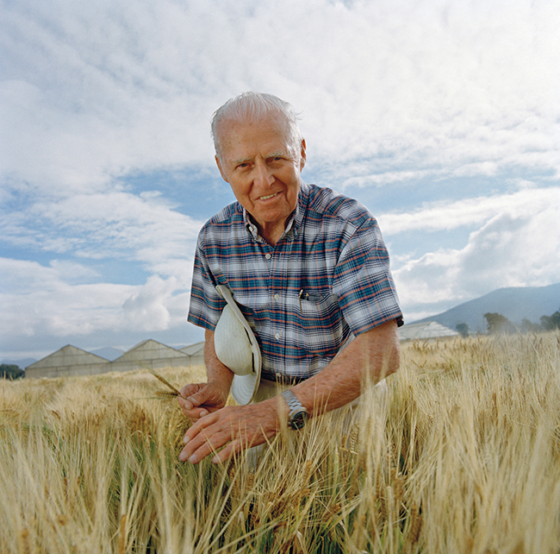
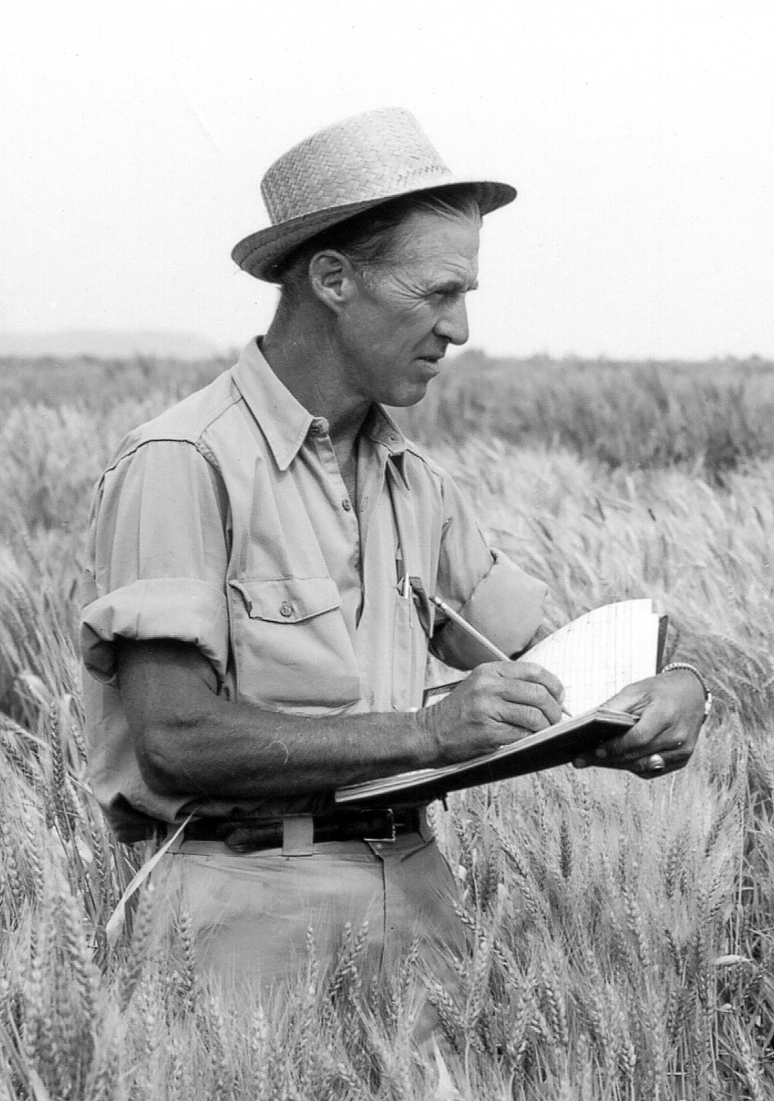
History of CIMMYT, Norman Borlaug!!

Slide 5
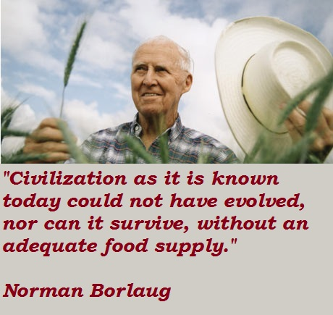
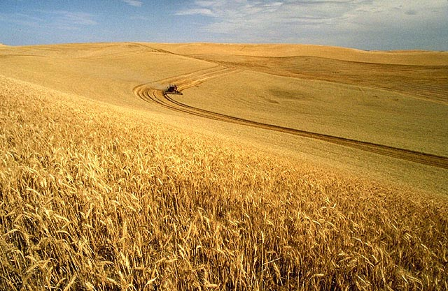
More on Norman Borlaug

Slide 6
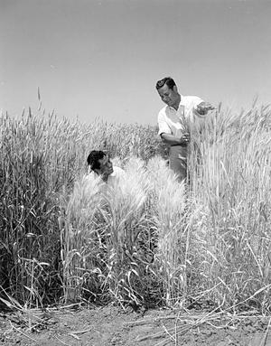
More Norman Borlaug
The other two main changes that Norman Borlaug made to wheat is, increasing the disease resistance through multiline varieties and by introducing dwarfing characteristics.

Slide 7
CIMMYT Today
Video: https://www.youtube.com/watch?v=HQ92CeKH__4
Today CIMMYT is a large organization that has many areas of focus, here are some of the main areas :
Maize Research
Wheat Research
Conservation Agriculture
Germplasm and Seed
Socioeconomics
Publications
Training

Slide 8
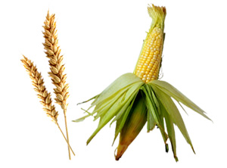
Maize Research and Wheat Research

Slide 9
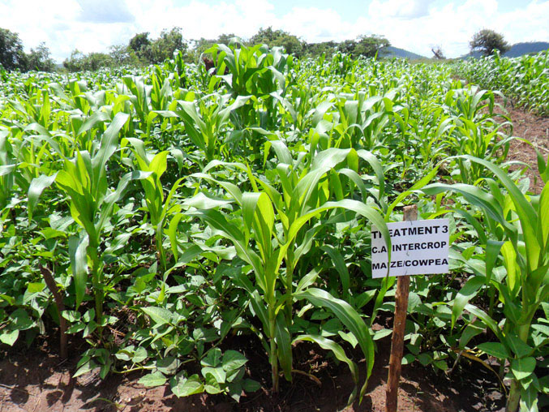
Conservation Agriculture

Slide 10
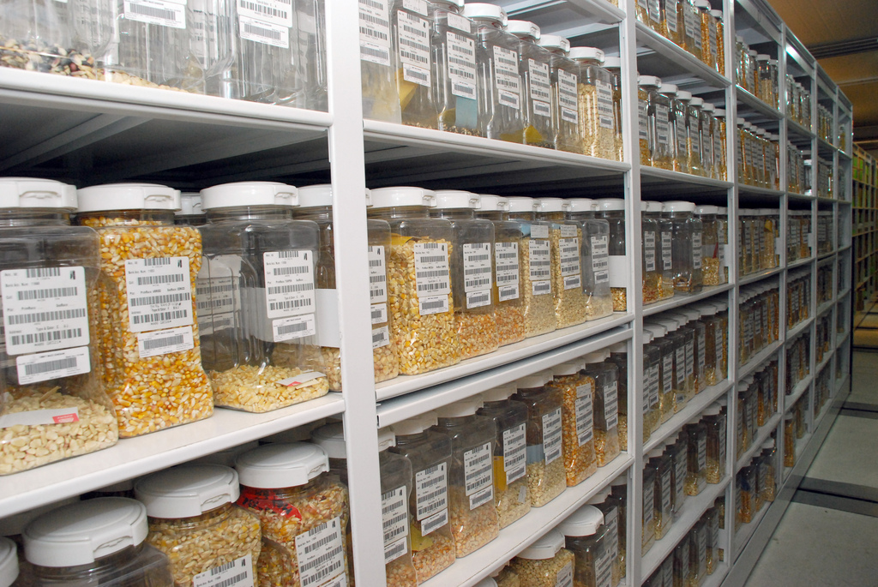
Germplasm and Seed

Slide 11
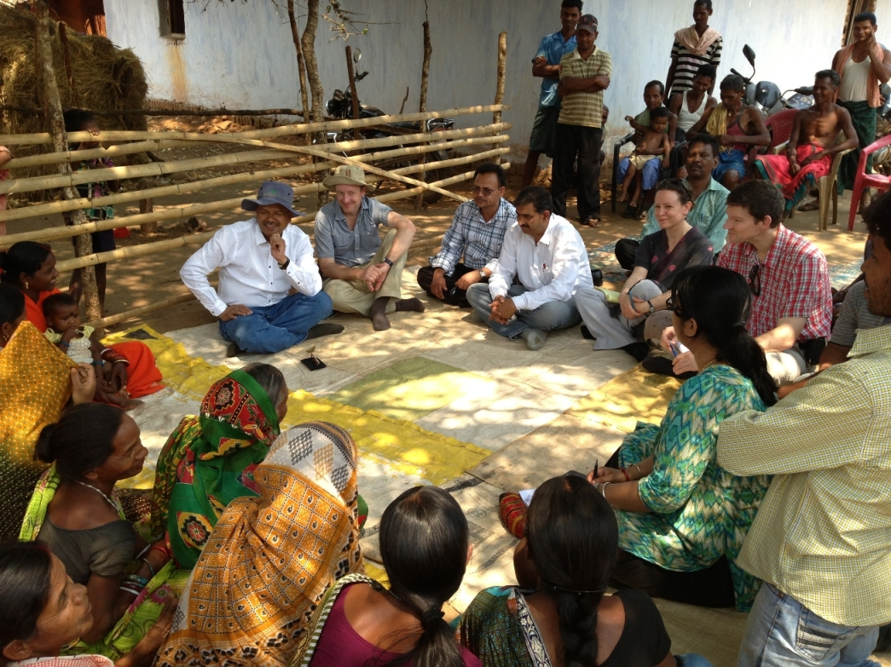
Socioeconomics

Slide 12
Publications
CIMMYT researchers are committed to share their knowledge with colleagues around the world through articles in peer-reviewed scientific journals, monographs, manuals, papers, and public lectures. Assuring Open Access to CIMMYT’s wealth of knowledge is critical to achieve their mission.

Slide 13
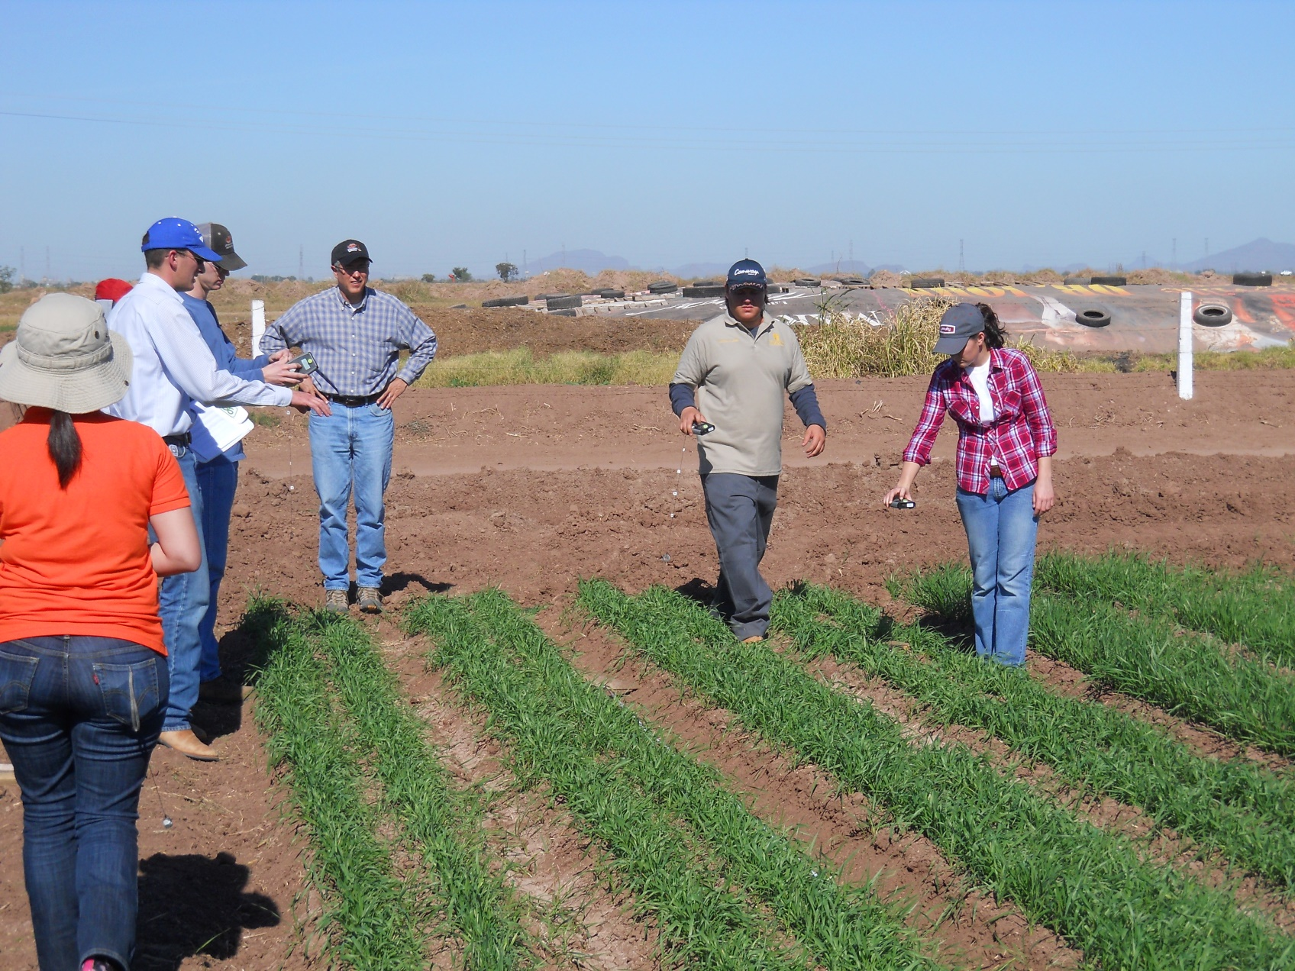
Training

Slide 14
Why is this Important?
one in nine
one in eight
the Earth only has 57 million square miles of land
there are only 12 million square miles (7.68 billion acres) of arable land
So there are a lot of people are not a lot of land to grow their food for them! CIMMYT is trying to feed more people sustainably.

Slide 15
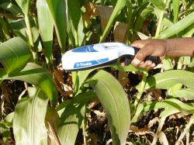
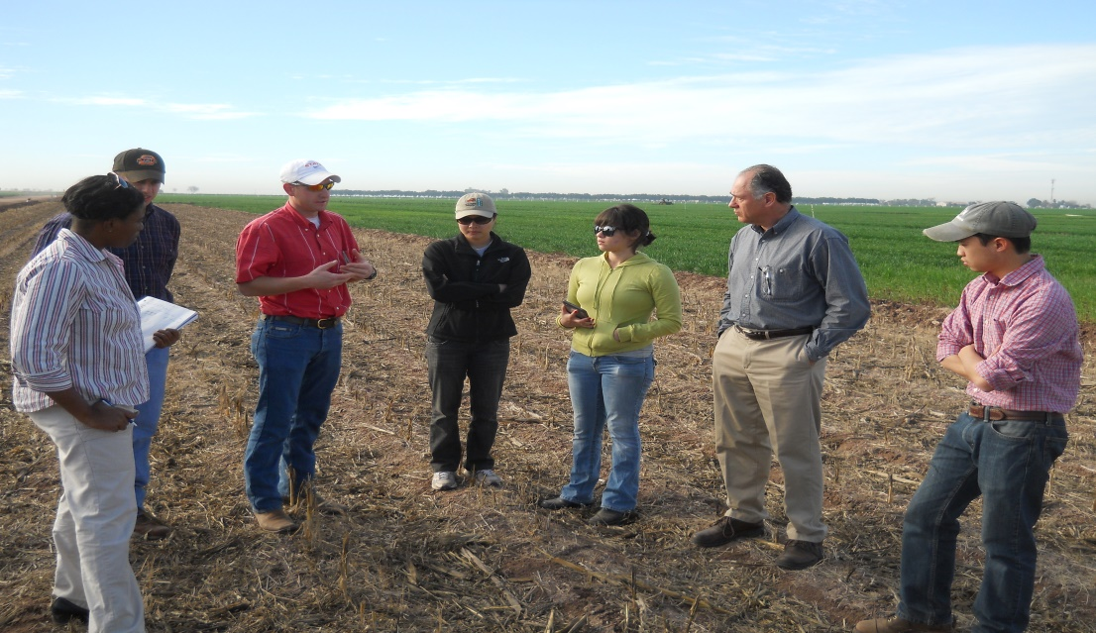
CIMMYT using Technologies
There are lot of examples of CIMMYT using technologies from OSU!
CIMMYT has been one of the key players in vetting and testing the GreenSeeker sensors.

Slide 16
CIMMYT is an organization that is dedicated to sustaining our world food supply.
It is important to take action to maintain our future food supply to prevent rampant hunger.

Slide 17
Questions?

Slide 18
Works Cited
http://en.wikipedia.org/wiki/International_Maize_and_Wheat_Improvement_Center
http://www.cimmyt.org/en/who-we-are/our-history
http://en.wikipedia.org/wiki/Norman_Borlaug#Wheat_research_in_Mexico
http://www.cimmyt.org/en/what-we-do/maize-research
http://www.cgiar.org/who-we-are/
http://www.cimmyt.org/en/what-we-do/conservation-agriculture
http://www.cimmyt.org/en/what-we-do/germplasm-and-seed
http://www.cimmyt.org/en/what-we-do/socioeconomics
http://www.cimmyt.org/en/what-we-do/research-publications
http://www.cimmyt.org/en/what-we-do/training
http://www.worldhunger.org/articles/Learn/world%20hunger%20facts%202002.htm
http://one-simple-idea.com/Environment1.htm
http://blog.cimmyt.org/oklahoma-state-university-students-help-cimmyt-researchers-in-obregon/

Slide 19
Images works cited
https://www.google.com/search?q=cimmyt&biw=1708&bih=763&source=lnms&tbm=isch&sa=X&ei=__82VeeLCMPXsAWTroHgCg&sqi=2&ved=0CAgQ_AUoAw&dpr=0.8#imgrc=_SHNlTE9Ntg2UM%253A%3BqpWepVTSymOrgM%3Bhttp%253A%252F%252Fcsisa.org%252Fwp-content%252Fuploads%252Fsites%252F2%252FCIMMYT_150px.png%3Bhttp%253A%252F%252Fcsisa.org%252F%3B621%3B150
https://www.google.com/search?q=cimmyt&biw=1708&bih=763&source=lnms&tbm=isch&sa=X&ei=__82VeeLCMPXsAWTroHgCg&sqi=2&ved=0CAgQ_AUoAw&dpr=0.8#imgrc=s6AMBdeQtk_feM%253A%3ByUc_F31UGnGQdM%3Bhttp%253A%252F%252Fwww.pymempresario.com%252Fwp-content%252Fuploads%252F2015%252F04%252F3Ciimyt.jpg%3Bhttp%253A%252F%252Fwww.pymempresario.com%252Fmicroempresas%252Fsagarpa-y-cimmyt-firman-acuerdo-de-colaboracion%252F%3B608%3B320
https://www.google.com/search?q=cimmyt&biw=1708&bih=763&source=lnms&tbm=isch&sa=X&ei=__82VeeLCMPXsAWTroHgCg&sqi=2&ved=0CAgQ_AUoAw&dpr=0.8#imgrc=DWR5RRNIEa53xM%253A%3BHlnJH013_LdnhM%3Bhttps%253A%252F%252Fc2.staticflickr.com%252F8%252F7001%252F6443995461_0498e25062.jpg%3Bhttps%253A%252F%252Fwww.flickr.com%252Fphotos%252Fcimmyt%252F6443995461%252F%3B500%3B334
https://www.google.com/search?q=cimmyt&biw=1708&bih=763&source=lnms&tbm=isch&sa=X&ei=__82VeeLCMPXsAWTroHgCg&sqi=2&ved=0CAgQ_AUoAw&dpr=0.8#imgrc=P7Hcj_k-hTeeNM%253A%3Blqh05GZa8fV04M%3Bhttps%253A%252F%252Fc1.staticflickr.com%252F7%252F6091%252F6277931459_fd2ca71e7e_b.jpg%3Bhttps%253A%252F%252Fwww.flickr.com%252Fphotos%252Fcimmyt%252F6277931459%252F%3B1024%3B683
https://www.google.com/search?q=cimmyt&biw=1708&bih=763&source=lnms&tbm=isch&sa=X&ei=__82VeeLCMPXsAWTroHgCg&sqi=2&ved=0CAgQ_AUoAw&dpr=0.8#tbm=isch&q=cimmyt+norman+borlaug&imgrc=lfCHvHytETJ-0M%253A%3B7Y_oWobsV8rV8M%3Bhttp%253A%252F%252Fblog.cimmyt.org%252Fwp-content%252Fuploads%252Fsites%252F11%252F2014%252F01%252Fborlaug.jpg%3Bhttp%253A%252F%252Fblog.cimmyt.org%252Fborlaug-100-cimmyt-and-norman-borlaug%252F%3B1520%3B2162
https://www.google.com/search?q=cimmyt&biw=1708&bih=763&source=lnms&tbm=isch&sa=X&ei=__82VeeLCMPXsAWTroHgCg&sqi=2&ved=0CAgQ_AUoAw&dpr=0.8#tbm=isch&q=norman+borlaug+double+wheat+season&imgrc=6XKvya6VQeGozM%253A%3B81qu7bohV8-xWM%3Bhttps%253A%252F%252Fthequietbranches.files.wordpress.com%252F2015%252F03%252Fnorman-borlaugs-quotes-1.jpg%3Bhttp%253A%252F%252Fthequietbranches.com%252F%3B460%3B435
https://www.google.com/search?q=cimmyt&biw=1708&bih=763&source=lnms&tbm=isch&sa=X&ei=__82VeeLCMPXsAWTroHgCg&sqi=2&ved=0CAgQ_AUoAw&dpr=0.8#tbm=isch&q=wheat&imgrc=66IDR9w7kQuk1M%253A%3BIXUq_YLBBtOOmM%3Bhttp%253A%252F%252Fupload.wikimedia.org%252Fwikipedia%252Fcommons%252F3%252F3a%252FWheat_harvest.jpg%3Bhttp%253A%252F%252Fen.wikipedia.org%252Fwiki%252FWheat%3B640%3B417
https://www.google.com/search?q=cimmyt&biw=1708&bih=763&source=lnms&tbm=isch&sa=X&ei=__82VeeLCMPXsAWTroHgCg&sqi=2&ved=0CAgQ_AUoAw&dpr=0.8#tbm=isch&q=corn+and+wheat&imgrc=4gM-jdP-FvoYiM%253A%3B3ehzkjKj20ZGnM%3Bhttp%253A%252F%252Fwww.binarytribune.com%252Fwp-content%252Fuploads%252F2014%252F05%252Fwheat-corn-headed-grain.jpg%3Bhttp%253A%252F%252Fwww.binarytribune.com%252F2014%252F05%252F21%252Fgrain-trading-outlook-wheat-and-corn-stable-after-losses-soybeans-add-russia-weather-concerns%252F%3B300%3B222
https://www.google.com/search?q=cimmyt&biw=1708&bih=763&source=lnms&tbm=isch&sa=X&ei=__82VeeLCMPXsAWTroHgCg&sqi=2&ved=0CAgQ_AUoAw&dpr=0.8#tbm=isch&q=conservation+agriculture+cimmyt&imgrc=WvvrJlFWMb3QNM%253A%3BG0mmR_dR5QyuUM%3Bhttp%253A%252F%252Fblog.cimmyt.org%252Fwpcontent%252Fuploads%252Fsites%252F11%252F2012%252F09%252FZambia.jpg%3Bhttp%253A%252F%252Fblog.cimmyt.org%252Ftag%252Fconservation-agriculture-ca%252F%3B677%3B508
https://www.google.com/search?q=cimmyt&biw=1708&bih=763&source=lnms&tbm=isch&sa=X&ei=__82VeeLCMPXsAWTroHgCg&sqi=2&ved=0CAgQ_AUoAw&dpr=0.8#tbm=isch&q=+cimmyt+seed+bank&imgrc=F72SXshRLFRg5M%253A%3BJKhyan1DVc9_TM%3Bhttps%253A%252F%252Fc1.staticflickr.com%252F7%252F6009%252F5979294208_4dbc5f379b_b.jpg%3Bhttps%253A%252F%252Fwww.flickr.com%252Fphotos%252Fcimmyt%252F5979294208%252F%3B1024%3B685
https://www.google.com/search?q=cimmyt&biw=1708&bih=763&source=lnms&tbm=isch&sa=X&ei=__82VeeLCMPXsAWTroHgCg&sqi=2&ved=0CAgQ_AUoAw&dpr=0.8#tbm=isch&q=cimmyt+socio+economics&spell=1&imgrc=pWFnD5ztkm7N7M%253A%3BZjAI4EeNg9WriM%3Bhttp%253A%252F%252Fcsisa.cimmyt.org%252Fwp-content%252Fuploads%252Fsites%252F2%252F2013%252F08%252FWork-pic-Odisha.jpg%3Bhttp%253A%252F%252Fcsisa.org%252Fresources%252Fpolicy-and-socioeconomics-research%252F%3B1045%3B783
https://www.google.com/search?q=cimmyt&biw=1708&bih=763&source=lnms&tbm=isch&sa=X&ei=__82VeeLCMPXsAWTroHgCg&sqi=2&ved=0CAgQ_AUoAw&dpr=0.8#tbm=isch&q=cimmyt+training&imgrc=51QrqKHlx3KraM%253A%3BhfUNS2fs6PIGoM%3Bhttp%253A%252F%252Fwww.nue.okstate.edu%252FPocket_Sensor%252FDSCN0189.JPG%3Bhttp%253A%252F%252Fwww.nue.okstate.edu%252FPocket_Sensor%252FPocket_Sensor.htm%3B4000%3B3000
https://www.google.com/search?q=images&biw=1708&bih=763&source=lnms&tbm=isch&sa=X&ei=lxE3VZbeFPeasQTr1ICAAg&ved=0CAYQ_AUoAQ&dpr=0.8#tbm=isch&q=conclusion&imgrc=6tpR9U4ZL_LbxM%253A%3Bacbn6vXFrwvV4M%3Bhttp%253A%252F%252Fwww.pacificcommunityventures.org%252Fimpinv2%252F%252Fwp-content%252Fuploads%252F2013%252F11%252Fconclusion.jpg%3Bhttp%253A%252F%252Fwww.pacificcommunityventures.org%252Fimpinv2%252Fconclusion%252Fconclusion-overview%252F%3B800%3B390

